Slide 1
RISK MANAGEMENT

Slide 2
Contents
What is a Risk
Categories of Risk
Risk Management Approaches
A Framework for Dealing with Risk
Risk Identification
Risk Analysis
Risk Planning
Risk Monitoring
Applying the PERT Technique

Slide 3
What is Risk
PM-BOK defines Risk as
“An uncertain event or condition that, if it occurs has a positive or negative effect on a project’s objectives”.
Risk can also be defined as
“The chance of exposure to the adverse consequences of future events”
Notes:
a positive risk might be that your servers crashed because demand suddenly spiked for your project.

Slide 4
What is Risk
The key elements of a risk are
It relates to the future.
The future is uncertain.
Some things that seem obvious when the project is over, might not have appeared obvious during planning (e.g. technology used, project estimation).
It involves cause and effect.
A “cost over-run” might be identified as a risk, but it is only the effect, it is not obvious what causes it.
Cause can be an inaccurate estimate of effort, use of untrained staff or poor specification.

Slide 5
Activity 1
Match the following causes to their possible effects
Causes
Staff inexperience
Lack of top management commitment
New technology
Users uncertain of their requirements
Effects
Testing takes longer than planned
Planned effort and time for activities exceeded
Project scope increases
Time delays in getting changes to plan agreed

Slide 6
Risk Categories
RISKS
Project Risks
Business Risk

Slide 7
Risk Categories
Project Risks are risks that could prevent the achievement of the objectives given to the project manager and the project team.
These objectives are to complete the project
On time
Within budget
Provide required functionality
Optimum Quality.

Slide 8
Risk Categories
Business risk is when an application after successful implementation proves to be a business failure.
How?
Business risks are likely to be outside the direct responsibilities of the application implementation team.

Slide 9
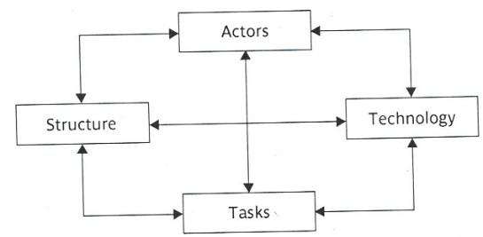
Risk Categories
A different way to categorize risks is a sociotechnical model proposed by Kalle Lyytinenand and his colleagues, presented as

Slide 10
Risk Categories
Actors
refers to all people involved in the development of the application.
Risk
A high staff turnover, leads to expertise of value to the project being lost.

Slide 11
Risk Categories
Technology
It encompasses both the technology
Used to implement the application
embedded in the delivered products.
Risk:
Relating to the appropriateness of the technology
The possible faults in it especially if it is novel.

Slide 12
Risk Categories
Structure
It describes the management structures and systems, including those affecting planning and control.
Risk
Suppose that implementation needs user participation in some tasks but responsibility for managing the users contribution might not be clearly allocated.

Slide 13
Risk Categories
Tasks
relates to the planned work.
Risk
The complexity of work might lead to delays because of the additional time required integrate the large number of components.
All boxes are interlinked. HOW?

Slide 14
Activity 2
In the case of brightmouth payroll implementation project, identify one risk for each of the four categories of sociotechnical model.

Slide 15
Risk Management Approaches
Risk management approaches can broadly be classified into reactive and proactive approaches.
Reactive Approaches take no action until an unfavorable event occurs.
Once an unfavorable event occurs these approaches try to contain the adverse effects associated with the risk and take steps to prevent future occurrence of the same risk events.
Notes:
Server hosting the project data crashes, fire fighting.

Slide 16
Risk Management Approaches
Proactive Approaches try to anticipate the possible risks that the project is susceptible to.
After identifying the possible risks, actions are taken to avoid the risks.
If a risk cannot be avoided, these approaches suggest making plan to contain the effect of risk.
Notes:
Man turnover

Slide 17
A Framework for Dealing with Risk
Planning for risk includes these steps:
Risk identification.
Risk analysis and prioritization.
Risk planning.
Risk monitoring.
Notes:
The Risk Monitoring and Control process is applied to: monitor identified risks. identify new risks. ensure the proper execution of planned risk responses. evaluate the overall effectiveness of the risk management plan in reducing risk.

Slide 18
Risk Identification
Two main approaches to identify risk are:
Use of checklists.
Brainstorming.
Checklists are lists of the risks that have been found to occur regularly in software development projects.
These checklists often suggest some potential countermeasures for each risk.
A group of representatives for a project examines a checklist for identifying risks applicable to their project.

Slide 19
Risk Identification
Barry Boehm identified a specialized list of software development risks
Personnel shortfalls
Unrealistic time and cost estimates
Developing the wrong software functions
Developing the wrong user interface
Gold plating
Late changes to requirements
Shortfalls in externally supplied components
Shortfalls in externally performed tasks
Real-time performance shortfalls
Development technically too difficult

Slide 20
Risk Identification
Brainstorming
Representatives of the main stakeholders of the project, are brought together , in order to identify the problems that might occur using their individual knowledge of different parts of the project.
This collaborative approach may generate a sense of ownership in the project.

Slide 21
Risk Analysis and Prioritization
A common problem with risk identification is that a list of risks is potentially endless.
Therefore a way is needed to prioritize the risks on the basis of their
Chances of occurrence
Damage they can cause
This can be done by estimating the risk exposure for each risk.
Risk Exposure (RE)= (potential damage) × (probability of occurrence)

Slide 22
Risk Analysis and Prioritization
Lets suppose a project depended on a data center vulnerable to fire. It might be estimated that if fire occurred a new computer configuration could be established for $500,000.
It might also be estimated that there is a 1 in 1000 chance that a fire will occur.
The risk exposure (RE) in this case would be:
500,000 *0.001 = $500
The higher the RE, the more attention or priority is given to the risk.

Slide 23
Risk Analysis and Prioritization
Another approach is to use qualitative descriptions of the possible impact and likelihood of each risk.
A probability matrix is then used to indicate the risk exposure.

Slide 24
Risk Analysis and Prioritization
Likelihood of occurrence | Range
High | Greater than 50% chances of happening
Significant | 30-50% Chances of happening
Moderate | 10-29% chances of happening
low | Less than 10% chance of happening
Impact Level | Range
High | More than 30% above budgeted expenditure
Significant | 20-29% above budgeted expenditure
Moderate | 10-19% above budgeted expenditure
low | Within 10% of budgeted expenditure

Slide 25
Probability Impact Matrix

Slide 26
Risk Planning
After the major risks are identified and Prioritized, the task is now how to deal with them.
The choices for dealing with them are:
– Risk acceptance.
– Risk avoidance.
– Risk reduction and mitigation.
– Risk transfer.

Slide 27
Risk Planning
Risk acceptance is deciding to do nothing about the risk. This means you will accept its consequences. Why?
In order to concentrate on the more likely or damaging risks.
The damage that those risks could cause would be less than the costs needed to act towards reducing their probability of occurrence.

Slide 28
Risk Planning
Risk Avoidance
Some activities are so prone to accident that it is best to avoid them altogether.
For example to avoid all the problems associated with developing software solutions from scratch, a solution could be to
Retain to existing clerical methods.
To buy an off-the-shelf solution.

Slide 29
Risk Planning
Risk Reduction and Mitigation
Risk Reduction attempts to reduce the likelihood of the risk occurring. For example consider the following risk:
Developers leaving a company in the middle of a project for a better paid job.
In order to reduce the probability of such a risk occurring:
The developers could be promised to be paid generous bonuses on successful completion of the project.

Slide 30
Risk Planning
Risk Mitigation is the action taken to ensure that the impact of the risk is reduced when it occurs.
Taking regular backups of data storage, is it a risk mitigation measure or a risk reduction measure?
Since it would reduce the impact of data corruption not its likelihood of happening, in this sense it is a data mitigation measure.

Slide 31
Risk Planning
Risk Transfer:
In this case the risk is transferred to another person or organization.
For example a software development task is outsourced for a fixed fee.

Slide 32
Risk Monitoring
Risk monitoring involves
Contingency
Deciding on risk actions
Creating and Maintaining the Risk register

Slide 33
Risk Monitoring
Contingency Plans:
Although risk reduction measures try to reduce the probability or the likelihood of risks, the risks could still happen.
These kind of risks need a contingency plan.
Contingency plan is a planned action to be carried out if a risk materializes (occurs).

Slide 34
Risk Monitoring
Consider the following risk:
Staff absence through illness.
One risk reduction measure taken:
Employers will encourage their employees to live a healthy lifestyle. Still, any of the staff members can get sick by a flu.
A contingency plan in this case can be:
To get other team members to cover on urgent tasks.

Slide 35
Risk Monitoring
Risk reduction measures usually spend some cost regardless of the risk materializing or not, while the cost for contingency measure will only be spend if the risk actually materializes.

Slide 36
Risk Monitoring
Deciding on the risk actions
For each risk number of different countermeasures can be considered.
Whatever countermeasures are adopted, they must be cost-effective.

Slide 37
Risk Monitoring
The cost effectiveness of a risk reduction action can be assessed by the risk reduction leverage (RRL).
RRL= (RE before – RE after)/cost of risk reduction.
The risk reduction action with a RRL above 1 is worthwhile.

Slide 38
Activity 3
A project is depended on a data center that is vulnerable to fire. It might be estimated that if fire occurred a new computer configuration could be established for $500,000. It might also be estimated that there is a 1% chance that a fire will occur. Installing fire alarms at a cost of $500 would reduce the chance of fire to 0.5%. Will the action of installing alarms be worthwhile.

Slide 39
Risk Monitoring
Creating and maintaining the risk register
Project managers, after identifying and examining the most threatening risks to the project, record their findings in a risk register.
After work starts on a project more risks can appear and will be added to the register.
Risk registers are reviewed and updated regularly.
Many risks threaten just one or two activities, and when the project staff have completed these, the risk can then be closed as no longer relevant.

Slide 40
Risk Monitoring (Template for a Risk Register)

Slide 41
Risk Mitigation, Monitoring and Management (RMMM) Plan
A project manager usually develop an RMMM plan for a project.
It is a document containing a risk table.
Each row of the table contains the risk, its probability and its impact on the project.
For each risk, the specific conditions required to monitor the occurrence of risk are mentioned.
For each risk, avoidance and mitigation plan is also mentioned.

Slide 42
Applying the PERT Technique
PERT stands for Program Evaluation and Review Technique.
PERT was developed to take account of the uncertainty surrounding estimates of task durations.
It is very similar to the CPM but, instead of using a single estimate of each task, PERT require three estimates

Slide 43
Applying the PERT Technique
Three estimates are
Most Likely Time (m)
Optimistic Time (a)
Pessimistic Time (b)
These estimates are then combined to form a single expected duration, t_{e} using the formula
t_{e} = a + 4m + b
6

Slide 44
Applying the PERT Technique
The calculated expected durations are then used to carry out a forward pass through a network using CPM technique.
In this case, the calculated dates are not the earliest possible dates, but the dates by which we expect to achieve those events.
Unlike CPM approach, the PERT method does not calculate the earliest date by which we could complete the project, rather it calculates the expected dates.

Slide 45
Applying the PERT Technique
A quantitative measure of the degree of uncertainty of an activity duration estimate may be obtained by calculating the standard deviation s of an activity time, using the formula
The activity standard deviation is proportional to the difference between the optimistic and pessimistic estimates and can be used as a ranking measure of the degree of uncertainty or risk for each activity.
s = b – a
6

Slide 46
Applying the PERT Technique
The main advantage of PERT technique is that it provides a method for estimating the probability of meeting or missing target dates.
This probability can be estimated both for
A single target date i.e. the project completion date
Additional intermediate target dates

Slide 47
Applying the PERT Technique
The PERT technique uses the following three-step method for calculating the probability of meeting or missing a target date
Calculate the standard deviation for project completion date.
Calculate the z value using a target date
Convert the z value to estimate the probability of missing the target date.

Slide 48
Applying the PERT Technique
Z value is calculated using the formula
T – t_{e}
s
Where T is the target date and t_{e} is the expected date.
A z value may be converted to the probability of not meeting the target date by using the following graph.

Slide 49
Applying the PERT Technique

Slide 50
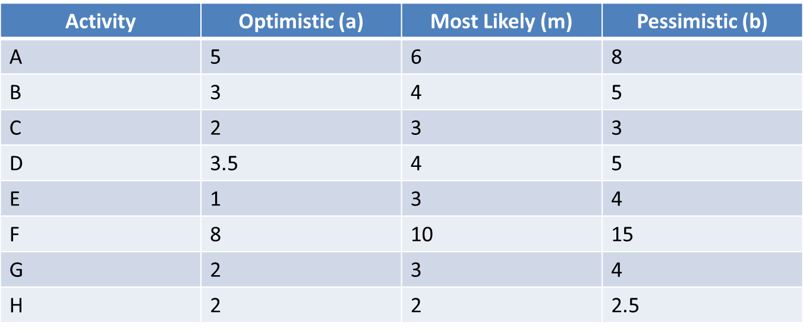
Activity 4
Calculate expected time and standard deviation for each value. Calculate overall expected completion time of project and probability of not meeting that target date.

Slide 51
Reading
[Chapter#7]“Software Project Management by Bob Hughes and Mike Cotterell, McGraw-Hill Education; 6th Edition (2009). ISBN-10: 0077122798”

