Slide 1
Sensation and Perception ENG-110

Slide 2
Stimulus
Stimulus refers to energy that produces a response in a sense organ.

Slide 3
Sensation
Sensation refers to activation/stimulation of sense organ (physical response).
OR
The process of detecting, receiving, converting and transmitting information resulting from stimulation of sensory receptors.

Slide 4
Perception
Perception refers to selection, interpretation and organization of sensory input.
OR
Basically perception involves interpretation/translation of stimulus into something meaningful (psychological response).

Slide 5
The basic function of sensation is detectionof sensory stimuli, whereas perception generally involves interpretation of the same stimuli.
Our senses tell us something is out there. Our perception tell us what that something is.

Slide 6
The human senses
Vision(sense of sight) sensitive to LIGHT ENERGY
Auditory (sense of hearing) stimulated by SOUND ENERGY
Olfaction (sense of smell) stimulates our nostrils by CHEMICAL ENERGY
Gustation (sense of taste)
Tactile (skin senses for pressure, temperature, pain) THERMAL ENERGY
Vestibular (a strong connection between sense of balance and ear) sense that is involved in body position and movement of the head.
Kinesthesia (sense of posture and movement, body, joint and muscles)
Organic (sensation from internal organs such as hunger, thirst, drowsiness

Slide 7
Bottom up processing
Perception that consists of the progression of recognizing and processing information from individual components of a stimuli and moving to the perception of the whole.
OR
Bottom-up processing, a progression from individual elements to the whole

Slide 8
Example
patterns and features of each of the separate letters.

Slide 9
Top down processing
Perception that consists of the progression of recognizing and processing information from whole to the perception of the individual elements.
OR
Top-down processing, a progression from the whole to the elements

Slide 10
It is based on experience and expectations.
Example
To perceive a word before its individual letters.
q

Slide 11
Gestalt laws of organization
A series of principles that describe how we organize bits and pieces of information into meaningful wholes.
Closure
Proximity
Similarity
Simplicity
Figure and ground
continuity

Slide 12
Closure
We perceive “complete” figures that actually have gaps in them

Slide 13
Proximity
We perceive elements that are closer together as grouped together.

Slide 14
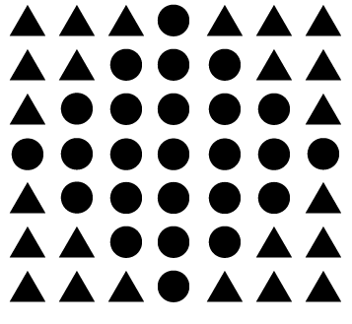
Similarity
Elements that are similar in appearance we perceive as grouped together
And we also tend to think they have the same function.
For instance, in this image, there appear to be two separate and distinct groups based on shape: the circles and the squares.

Slide 15
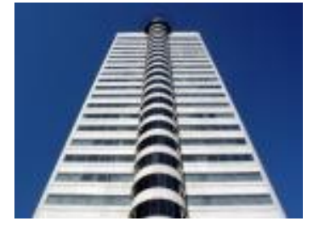
Symmetry
In organizing stimuli, we tend to favor symmetrical objects or relationships.

Slide 16
Figure and ground
Dividing visual displays into figure and ground is a fundamental way in which people organize visual perceptions.
The figure is the thing being looked at, and the ground is the background against which it stands.

Slide 17
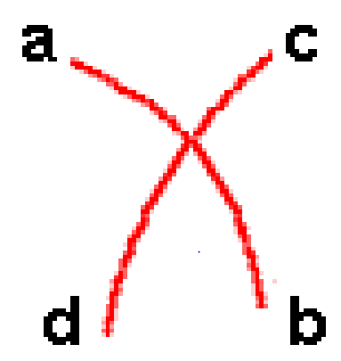
Continuity
We perceive elements in ways that produce smooth continuation

Slide 18
Perceptual constancy
The phenomenon in which physical objects are perceived as unvarying and consistent despite changes in their appearance or in the physical environment .
OR
Perceptual constancy leads us to view objects as having an unvarying size, shape, color, and brightness, even if the image on our retina varies.

Slide 19
Size constancy
Refers to our ability to see objects as maintaining the same size even when our distance from them makes things appear larger or smaller.
Example
As we walk away from radio, the song appears to get softer. We understand/perceive it as being just as loud as before.

Slide 20
Shape constancy
Refers to our ability to see objects as maintaining the same shape even when we see them from different angles.

Slide 21
Example
Everybody has seen a plate shaped in the form of a circle. When we see that same plate from an angle, however, it looks more like an ellipse. Shape constancy allows us to perceive that plate as still being a circle even though the angle from which we view it appears to distort the shape.

Slide 22
Brightness constancy
Refers to our ability to recognize that color remains the same regardless of how it looks under different level of light.
Example
That deep blue shirt you wore to the beach suddenly looks black when you walk indoors.

