Slide 1
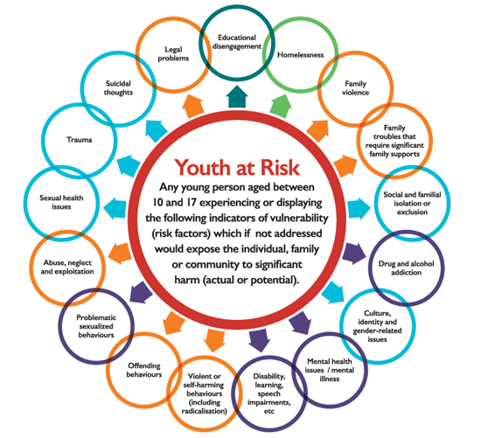
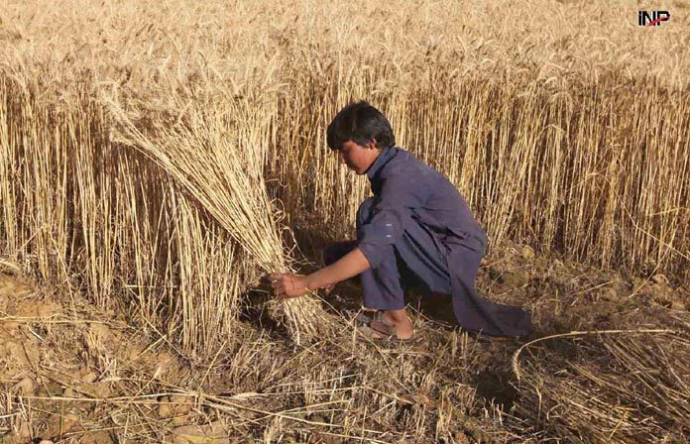
Youth Participation
and Issues

Slide 2
Three Lens Approach to Youth Participation
Working for youth as beneficiaries
Engaging youth as partners
Supporting youth as leaders
Thematic Areas
Governance & accountability
Livelihoods
Health and rights
Key Operational Areas
Organizational development
Policy & Planning
Implementation
Monitoring & Evaluation
Setting Quality Standards

Slide 3
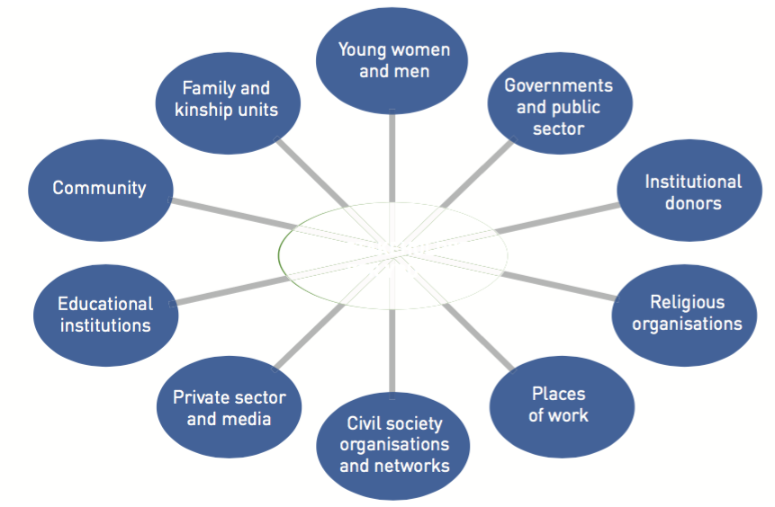
Key Stakeholders for Youth Participation

Slide 5
OBSTACLES TO YOUTH PARTICIPATION
Poor Education & Training
Weak Infrastructure
Inequality and exclusion
Neglected in development planning
Non-representation of Youth in politics
Lack of Social Protection, Education & Health

Slide 6
Needs for Rural Youth Participation
Poverty alleviation
Involvement in decision-making
Generate employment opportunities
Educational interventions
Targeting urban-migration
Improving training opportunities
Targeting gender discrimination
Access to information sources

