Slide 1
PULMONARY TUBERCULOSIS

Slide 2
Tuberculosis, MTB is a common infectious disease caused by various strains of mycobacteria, usually Mycobacterium tuberculosis.
Tuberculosis typically attacks the lungs, but can also affect other parts of the body.

Slide 3
General Considerations
spread through the air when people who have an active TB infection with cough, sneeze, or transmit respiratory fluids through the air.
Most infections are asymptomatic and latent, but about one in ten latent infections eventually progresses to active disease which, if left untreated, kills more than 50% of those so infected.

Slide 4
Etiology
main cause of TB is Mycobacterium tuberculosis, a small, aerobic, non-motile bacillus.
The high lipid content of this pathogen accounts for many of its unique clinical characteristics.
It divides every 16 to 20 hours, which is an extremely slow rate compared with other bacteria, which usually divide in less than an hour.

Slide 5
MTB can withstand weak disinfectants and survive in a dry state for weeks.
the bacterium can grow only within the cells of a host organism.
M. tuberculosis can be cultured in the laboratory.

Slide 6
Scanning electron micrograph of Mycobacterium tuberculosis

Slide 7
Risk factors
HIV infection
Over-crowding
Malnutrition
Poverty
I/V Drug abusers
Contact with T.B patient
Smoking
Silicosis
DM and Alcholism

Slide 8
Transmission
People with active pulmonary TB cough, sneeze, speak, sing, or spit, they expel infectious droplets 0.5 to 5.0 µm in diameter.
A single sneeze can release up to 40,000 droplets.
Each one of these droplets may transmit the disease.
infectious dose of tuberculosis is very low (the inhalation of fewer than 10 bacteria may cause an infection).
A person with active but untreated tuberculosis may infect 10–15 (or more) other people per year.

Slide 9
The probability of transmission from one person to another depends upon several factors,
including
the number of infectious droplets expelled by the carrier,
the effectiveness of ventilation,
the duration of exposure,
the virulence of the M. tuberculosis strain,
the level of immunity in the uninfected person.

Slide 10
Tuberculosis is transmitted by airborne droplet nuclei(containing tubercle bacilli )

Slide 11
Many droplet nuclei are capable of floating in the immediate environment for several hours
Large particles may be inhaled by a person
breathing the same air and impact on the
trachea or wall of the upper airway

Slide 12
During the course of TB, there are three basic pathologic changes
Including infiltration, hyperplasia, ulceration
or calcification
These changes happen in different stage of
tuberculosis
When host defense is destroyed and there is
much more bacterias, caseating ulceration
will exist
Otherwise, when host defense is predominant
and there is less bacteria,perhaps hyperplasia
and calcification will happen

Slide 13
The result of the tuberculosis after infection
Absorption
Fibrosis
Calcification
Deterioration: enlargement of infected aeras and appear newer infiltrated regions or spreading.

Slide 14
There are five common clinical patterns of tuberculosis
1. Primary pulmonary tuberculosis (Primary Complex and
Bronchial Lymphnode-Tuberculosis)
2. Milliary Tuberculosis (acute, subacute and
chronic hematogenous pulmonary tuberculosis)
3. secondary pulmonary tuberculosis
Infiltrative pulmonary tuberculosis
Chronic fibrocavenous pulmonary tuberculosis
4.Tuberculous pleuritis
5.Extrapulmonary tuberculosis

Slide 15
Clinical Manifestations
cases of pulmonary tuberculosis
with fever, intermittent with evening rise ,
weight loss,
anorexia,
Fatigue, night sweats & wasting.
Respiratory symptoms:
cough & sputum , chest pain , haemotysis

Slide 16
Diagnosis

Slide 17
Laboratory and physical examinations
Chest radiography
Sputum examination
Tuberculin testing
PCR test to detect TB
TB antibody testing
bronchoscopy

Slide 18
Radiology
Chest radiography is the most important method to detect TB
TB’s characteristics of a chest radiograph favor the diagnosis of tuberculosis

Slide 19
(1) shadows mainly in the upper zone
(2) patchy or nodular shadows
(3) the presence of a cavity or cavities, although these, of
course, can also occur in lung abscess, carcinoma, etc
the presence of calcification. although a carcinoma
or pneumonia may occur in an areas of the lung where there is calcification due to tuberculosis
(5) bilateral shadows, especially if these are in the
upper zones

Slide 20
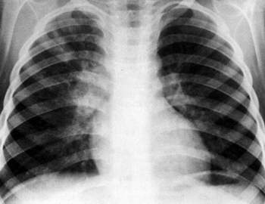
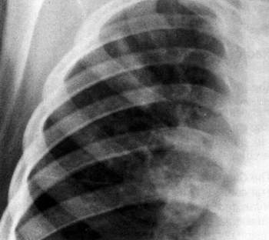
Primary complex

Slide 21
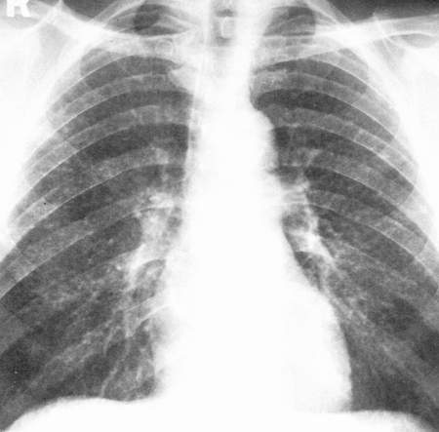
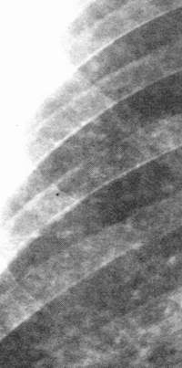
Milliary Tuberculosis
acute milliary tuberculosis

Slide 22
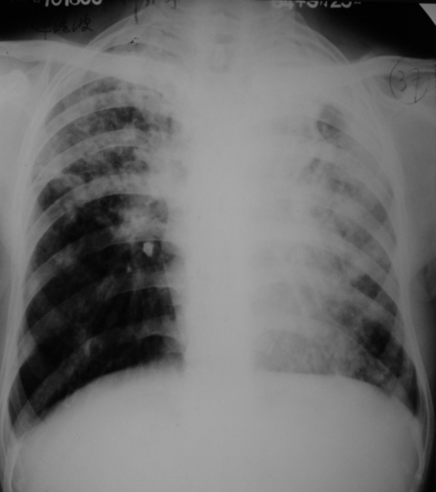
secondary pulmonary tuberculosis
infiltrate

Slide 23
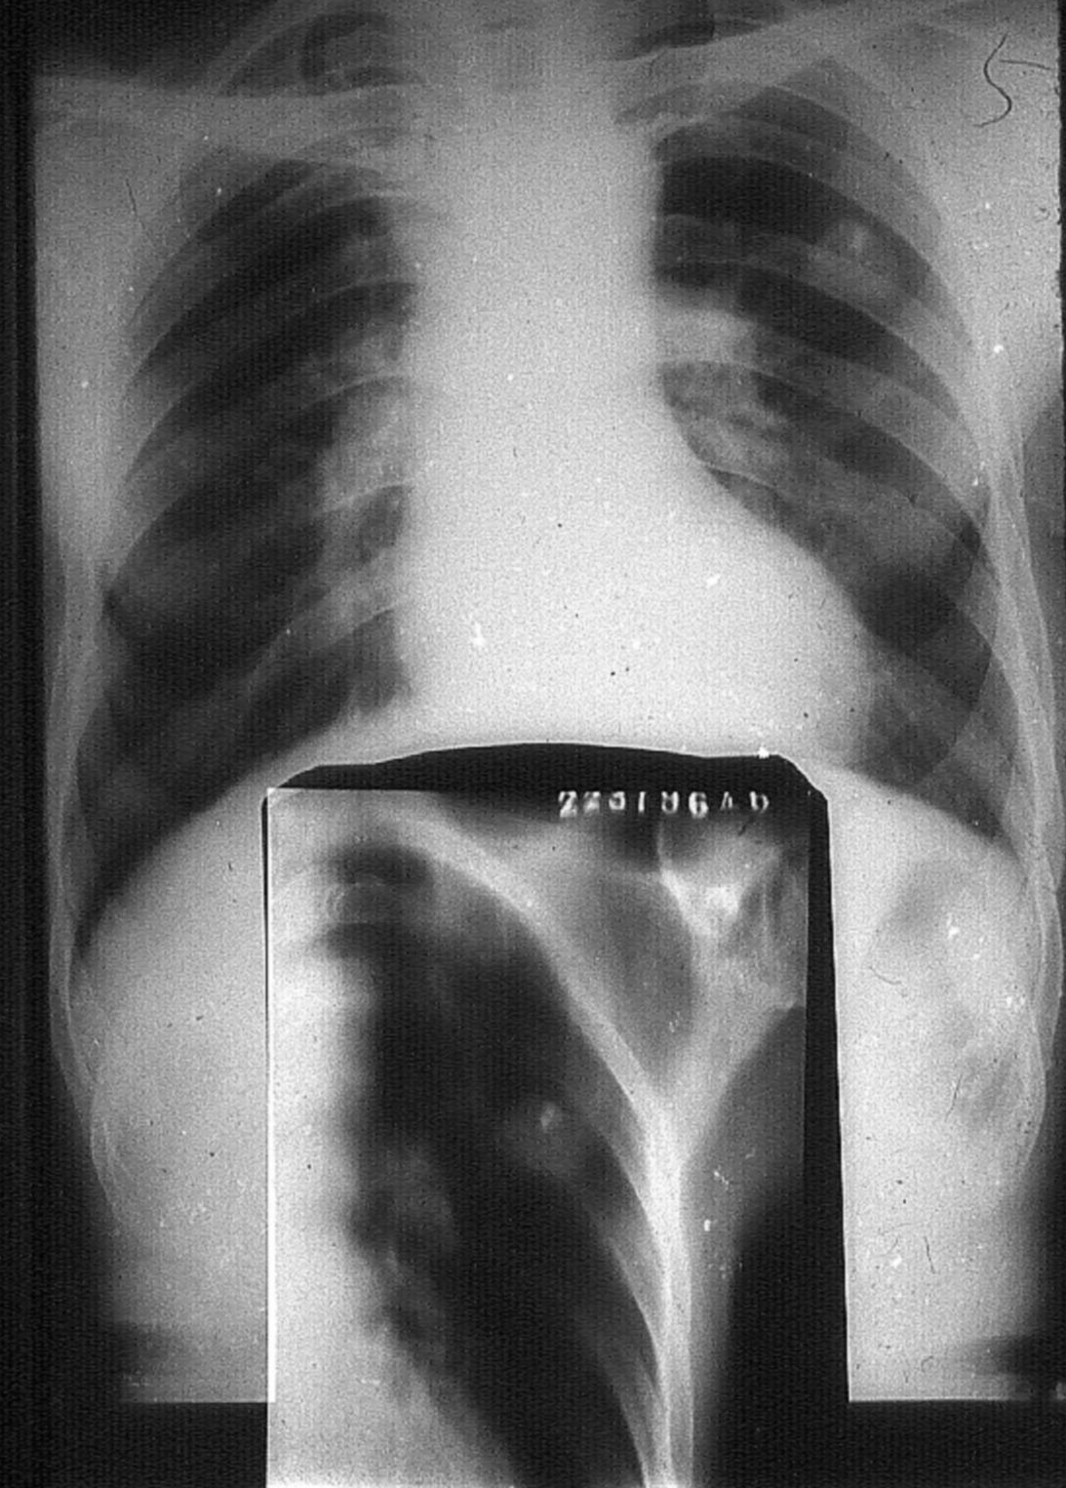
Tuberculoma

Slide 24
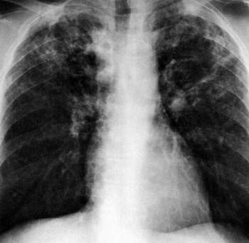
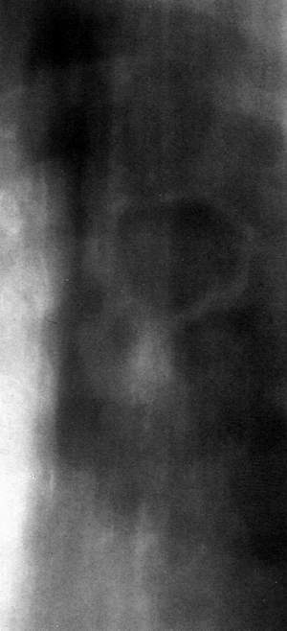
Chronic fibro-cavitary pulmonary tuberculosis
cavity

Slide 25
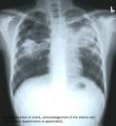

Slide 26
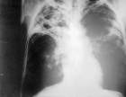

Slide 27
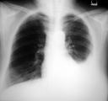
Tuberculous effusion

Slide 28
Sputum examination
There are direct smear and culture.
Direct smear examination is only positive when large numbers of bacilli begin to be excreted

Slide 29
Sputum examination
A negative smear by no means excludes tuberculosis
A negative smear in the presence of extensive disease and cavitation makes the diagnosis less likely.
Particularly if the negatives are frequently repeated

Slide 30
Tuberculin testing
A positive tuberculin test although it is of
great use in children, but it has limited diagnostic significance in older age groups

Slide 31
• A reaction of less than 5 mm is considered
negative
• 5-9 mm is considered positive (+)
• 10-19 mm is considered positive (++)
• more than 20 mm is considered positive
(+++)
A positive tuberculin skin test indicates
tuberculous infection.

Slide 32
PCR test to detect TB

Slide 33
Bronchoscopy examination

Slide 34
White blood count and ESR
The white blood count is usually normal.
In practice the white blood count is only
useful in a minority of cases, When the
patient is less ill and the radiological
shadowing less extensive the count is
often normal or high normal
ESR is often elevated

Slide 35
Diagnosis
According to the history, clinical signs, chest X-ray , we can diagnose TB ,
A patient with tuberculous pulmonary disease
will come to the physician for one of three
reasons:
(1) Suggestive symptoms
(2) A positive finding on routine tuberculin
testing
(3) A suspicious routine x-ray chest.

Slide 36
Differential Diagnosis 1 2 3 4
Bronchiectasis
may confused with chronic fibrocavenous pulmonary tuberculosis. They also have chronic cough, sputum production and hemoptysis. Usually we can use chest x-ray examination and CT scan to distinguish them.

Slide 37
Differential Diagnosis 1 2 3 4
Cavitary lung abscess
often involves the dorsal segments of the lower lobes and posterior segments of the upper lobes.

Slide 38
Differential Diagnosis 1 2 3 4
Acute bacterial pneumonias
may resemble tuberculosis in all particulars except for the sputum examination and response to
antimicrobial drugs.

Slide 39
Differential Diagnosis 1 2 3 4
Neoplasm
may resemble tuberculosis. As in an isolated coin lesion. An obstructing and inconspicuous endobronchial tumor causing distal cbronic inflammation or a caviting neoplastic mass. ( An irregular cavity wall suggests necorotic neoplasm. )

Slide 40
complications
Pneumothorax
Bronchiectasis
Empyema
Extrapulmonary expansion
Hemoptysis
Chronic pulmonary heart disease

Slide 41
Therapy
Chemotherapy
Support therapy
Surgical therapy

Slide 42
Treatment
The principles of anti-tuberculous chemotherapy involve
earlier,
combination,
appropriate ,
regularly and durations.

Slide 43
medicines used to treat tuberculosis are classified as
first-line and second-line agents
First-line essential anti=tuberculous agents are the most effective and are necessary components of any short-course therapeutic regimen

Slide 44
First-line medicines include
Isoniazid, rifampin, ethambutal
pyraziniamide, streptomycine
Second-line medicines include
para-amino-salicylic acid, kanamycin,
amikacin and ects.
Newer antituberculous drugs include
rifapentine, rifabutin , quinolones

Slide 45
Isoniazid (INH) first-line drug
Isoniazid is a principal agent used to treat
tuberculosis
It is universally accepted for initial treatment
Now considered the best antituberculous drug
It should be included in all TB treatment
regmens unless the organism is resistant

Slide 46
Dosage
Tuberculosis organization have recommended
5 mg/kg daily
Generally, a 300mg daily oral dose is adopted

Slide 47
Rifampin (RFP) first-line drug
It is also considered the most important and
potent antituberculose agent
Like isoniazid it is bactericidal and highly
effective
Unlike isoniazid, it is also effective against
most other mycobacteria as well as other
organisms

Slide 48
Dosage
Generally, 10mg/kg, 600mg daily
or twice weekly
Adverse effects
The most common adverse event
included gastrointestinal upset,
hepatitis

Slide 49
Pyrazinamide (PZA) first-line drug
Pyrazinamide is a major oral agent used
against mycobacteria
It is an important bactericidal drug used
in short-course therapy for tuberculosis

Slide 50
Advantage
It is well absorbed after oral administration
The drug is used to kill intracellular tubercle
bacillus
It is distributed throghout the body,
excellent in CSF
Dosage
15 to 30 mg/Kg

Slide 51
Streptomycin (SM) first-line drug
It is frequently used in developing
country for its lower cost
It is administered only parenterally,
intramuscular or intravenous

Slide 52
Dosage
The usual adult dose is 0.5-1.0 g ( 10 to 15 mg/kg)
daily or five times weekly

Slide 53
Ethambutal 1st-line drug
It is used most often to protect against the
emergency of drug resistance
Oral administration
The dosage is usually 25 mg/Kg
It will distributes throughout the body except
CSF
Retrobulbar optic neuritis is the most serious
adverse effect

Slide 54
Treatment regimen
Initial treatment is with 4 drugs for 2 months ….. Including combination of
Isoniazed ( 5 mg / kg body weight )
Rifampicin ( 10 mg / kg body weight )
ethambutol ( 15 mg / kg body weight )
pyrazenamide ( 25 mg / kg body weight )

Slide 55
Treatment regimen
Further 7 months treatment is with 3 drugs regimen
Isoniazed ( 5 mg / kg body weight )
Rifampicin ( 10 mg / kg body weight )
ethambutol ( 15 mg / kg body weight )

Slide 56
surgery
Surgical Intervention
cavity,
Tuberculoma,
empyema,
severe hemoptysis,

Slide 57
Prevention
Prevention of Tuberculosis :Vaccination
BCG Vaccination can obtain immunity acquired for tubercle bacillus.
it is one of the most important tuberculosis prevention
Vaccination target: infants children and youngster of tuberculin negative (vaccination is of course of no use in tuberculin-positive persons)

Slide 58
Prevention
Identifying patients earlier
Prompt Treatment and management of patients
Prevention with combination of medicines
Education of patient

