Slide 2
Presentation topic
Nature save products for control of weeds

Slide 3
Overview
Natural weed control has become a hot topic in recent years as more people are realizing that chemical weed poisons can harm more than weeds.
Weeds are control by naturally homemade remedies.

Slide 4
What is weed
A plant considered
undesirable
Unattractive
or troublesome especially one that grows where it is not wanted and often grows or spreads fast or takes the place of desired plants.

Slide 5
Natural save products for weed control
There are different natural save products and methods for weed control. Some followings are :
Mechanical method
Mulching
Crop Rotation
Boiling Water
Solarization
Vinegar as home weed killer
Flame and steam to kill weeds
Oil to eradicate weeds

Slide 6
MECHANICAL WEED CONTROL
The mechanical methods includes:
Tillage, hoeing, hand weeding, digging, chiseling, sickling, mowing, burning, flooding, mulching etc.

Slide 7
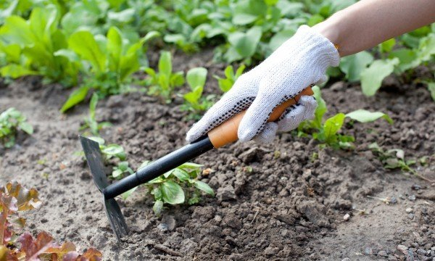
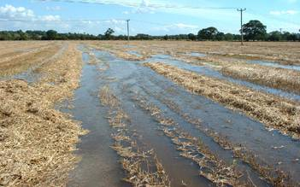
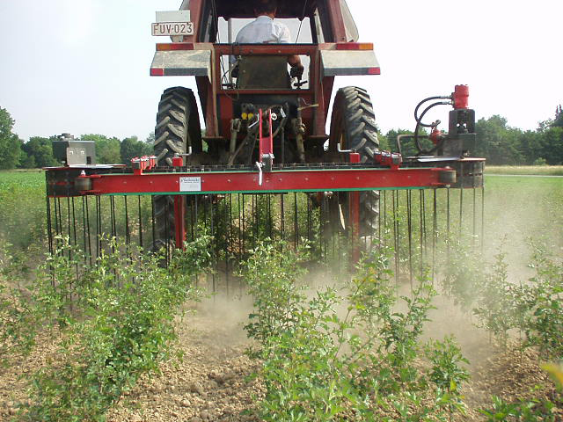
Mechanical Methods and Tools
Hand pulling of weeds
Hoeing
Digging
Flooding
Sickling
Mowing

Slide 8
Mulching
A thick layer of mulch, like the old horse manure, will help too. In between my garden plots.
Wheat straw will break down over time and add nitrogen to the soil.
Oat and barley will do the same thing.

Slide 9
continue
Newspaper is also use as a mulch for control of weds.
Wood chips, if aged, are good too.
Pine bark mulch is one of the best things to use if it is aged

Slide 10
Newspaper use as a mulch

Slide 11
Crop rotation
Weeds can be controlled by Crop rotation.
Some weed species occurring is greater if the same crop is grown year after year.
The obnoxious weeds like Cyprus rotundas can be controlled effectively by including low land rice in crop rotation.

Slide 12
Solarization
Solar radiation are also used to control weeds.
In this method field is covered with plastic sheet.
Temperature is raised by 5 – 10 ºC and then hinder the moisture evaporation and thus it stops the growth of weeds.

Slide 13
Solarization

Slide 14
Boiling water
This is more effective than many expensive chemical herbicides.
Just boil water and pour it on your weeds, but do not pour it on your plants because it will kill them too.

Slide 15
How to boil a weed
You made some tea. Grab the jug and go outside and dribble the last of the hot water on that weed.
Boil the water in Kettle and drop this water on to the patches of weeds.

Slide 16
Eradication of weeds by Boiling water

Slide 17
Vinegar as a homemade weeds killer
Vinegar is probably the most well-known way to kill weeds naturally.
Handle carefully and don't get any in your eyes.
Any acetic acid concentration over 10% will also burn skin, and be especially dangerous to eyes.

Slide 18
Homemade Vinegar weeds killer

Slide 19
How to use vinegar for weeds
Into a garden sprayer, pour 1 liter of vinegar.
Add a short squirt (about ½-1 teaspoon) of natural liquid soap to help the vinegar stick to the plants.
Add 5 drops of an herbicidal oil such as citrus, clove oil.
Put on lid and shake well, then apply to weeds.

Slide 20
Flame and Steam to Kill Weeds
Small weeds or a row of weeds on the edge of your garden, can be killed with a quick pass of a propane flame, or steam gun.
The heat boils the water in the plants' cells which causes them to burst and die.

Slide 21
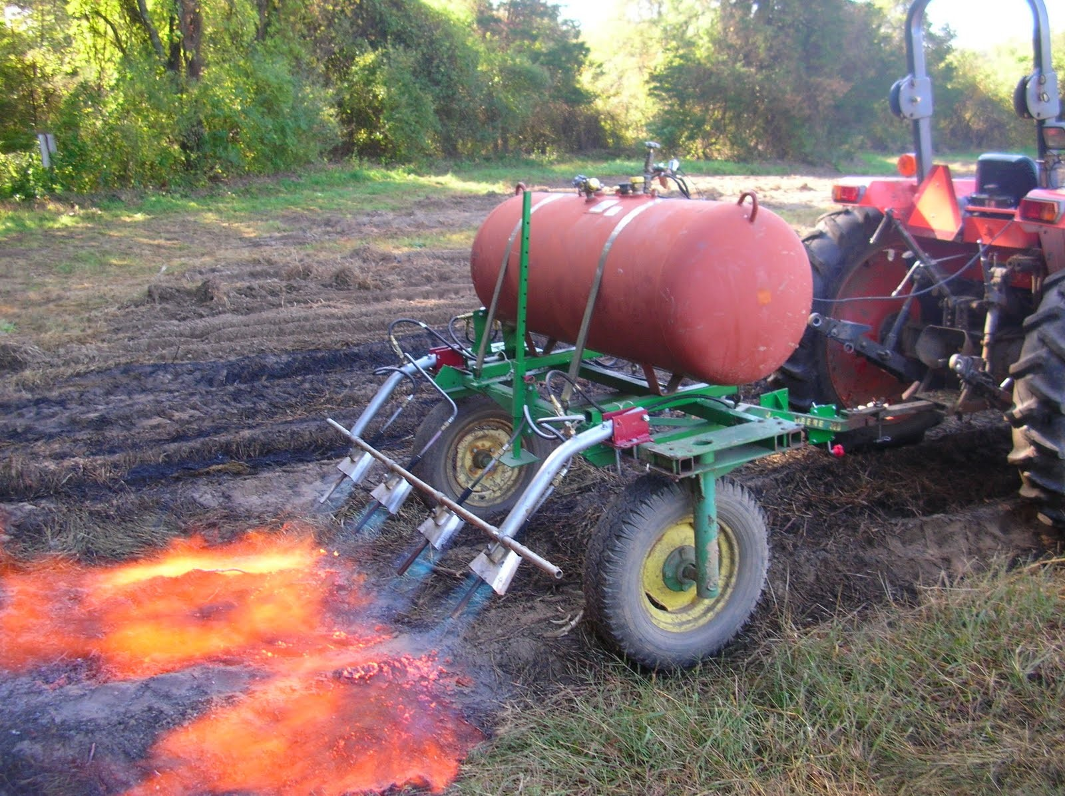
Flame is use to eradicate weeds

Slide 22
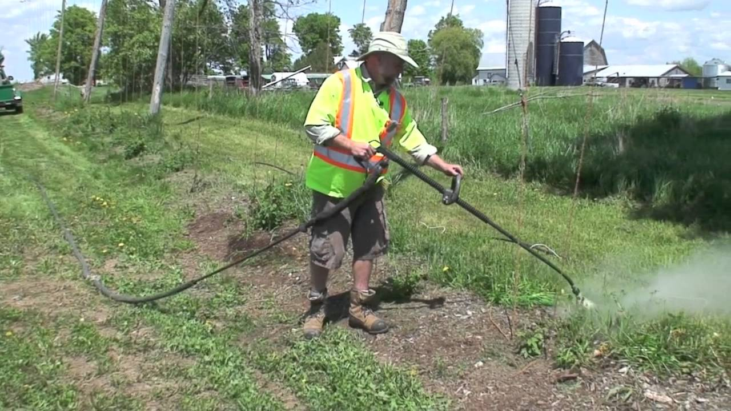
Steam is use to kill the weeds

Slide 23
Oil to kill the weeds
Oil suffocates plants so it makes a great herbicide.
Cheap vegetable oils, such as canola and sunflower are biodegradable and will be broken down by soil bacteria.

Slide 24
continue
Many herbal and plant oils contain natural pesticide and herbicide properties.
They can be mixed with other substances such as vinegar and soap to safely eliminate weeds.
These oils are citrus oil extract, neem oil, castor oil, pine oil.

Slide 25
Oils are mixed with Vinegar and soap weed killer

Slide 26
How to kill weeds with oil
Dribble the oil you have chosen or the homemade mixture containing oil, onto the weed so that it coats and smothers it.
These weeds such as oxalis/soursobs kill by oil.

Slide 27
Corn Gluten to Stop Weed
Corn gluten is called a pre-emergence weed killer.
It's definitely the sharpest trick in the box for stopping seeds from sprouting.
It is a natural by-product of processing corn or maize into corn meal, which is used in foods like chips, animal and pet foods.

Slide 28
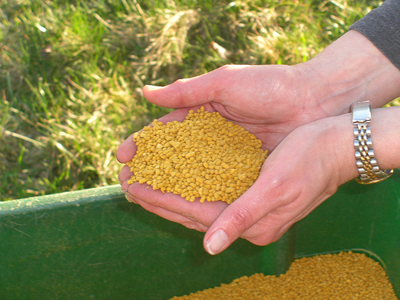
Corn Gluten To kill weeds

