Slide 1
Sociology ^{BBA} Semester: 3rd ^{Lecture No. 05 and 6} ^{Instructor: Mumtaz Hussain} University of Sargodha Sb Campus ^{Bhakkar}

Slide 2
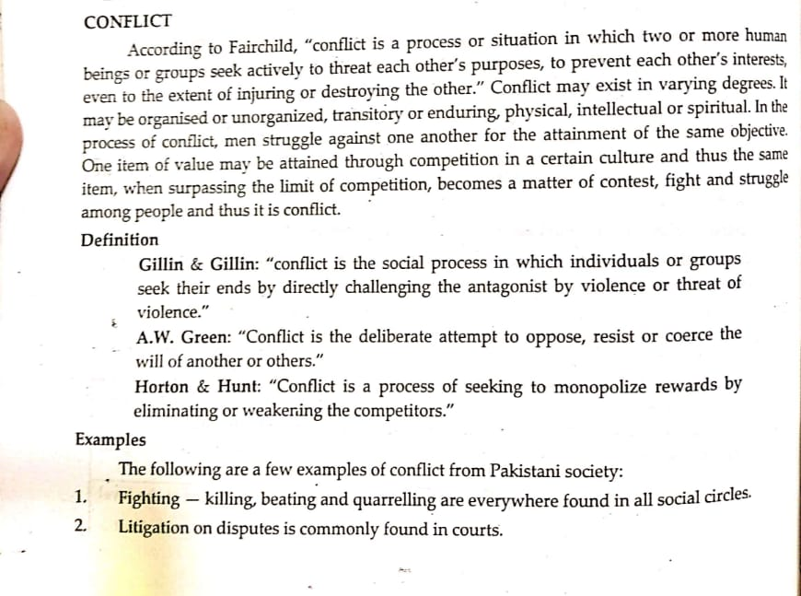
Social Processes:

Slide 3
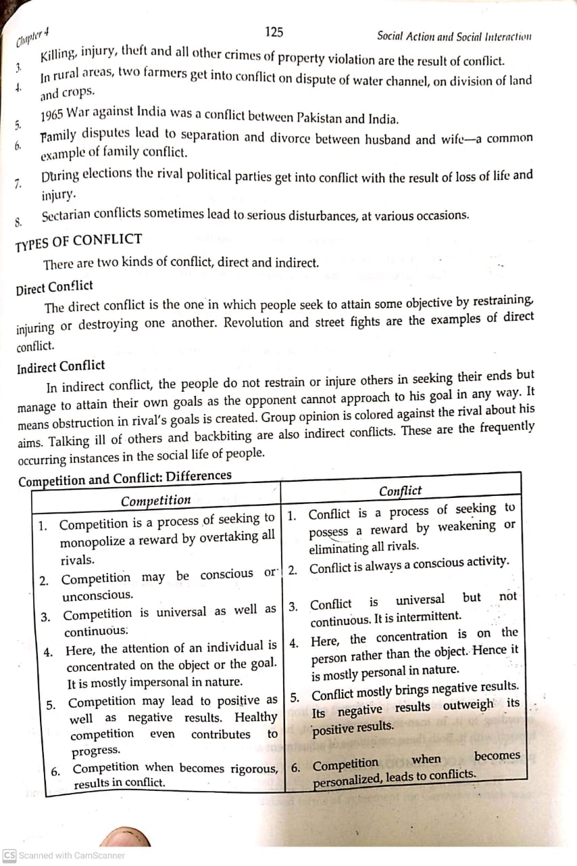
Continue….

Slide 4
Difference b/w competition and conflict

Slide 5
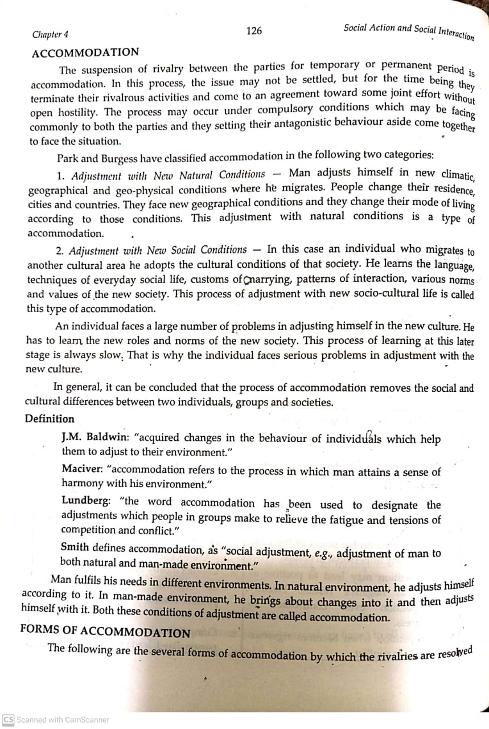
Meaning of Accomodation:

Slide 6
Definition of Accomodation:

Slide 7
Continue…

Slide 8
Continue…………..

Slide 9
Continue…

Slide 10
Continue…

Slide 11
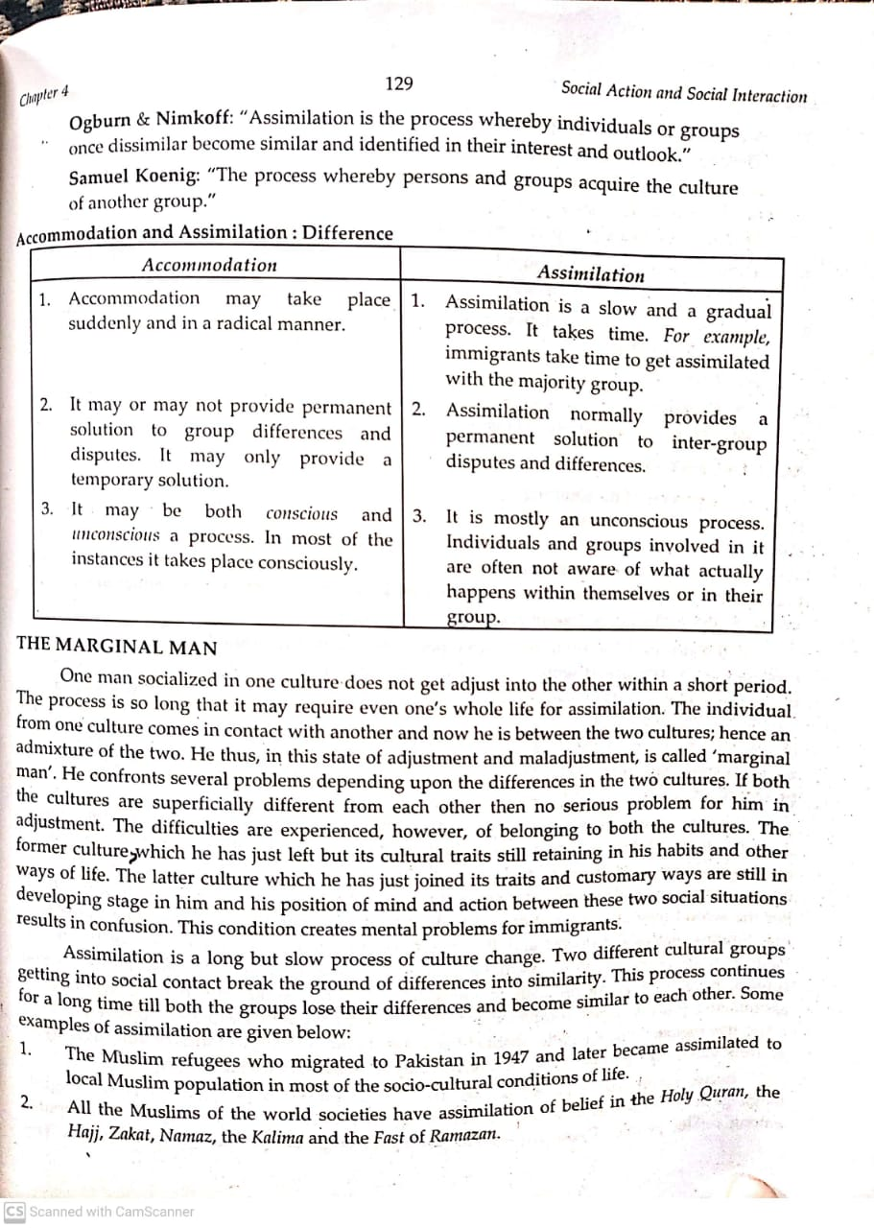

Slide 12
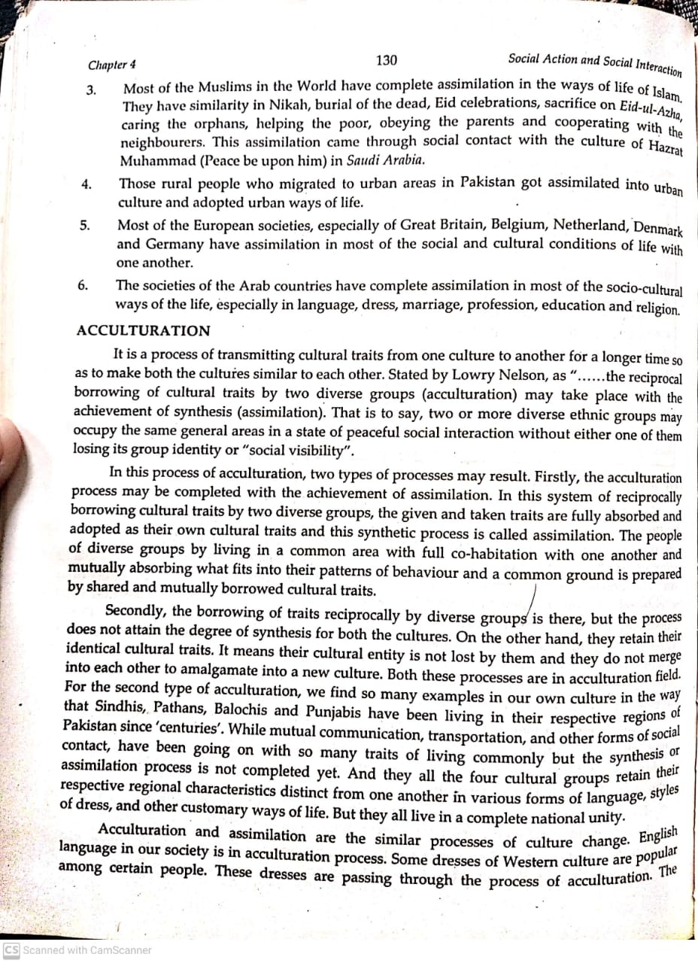

Slide 13
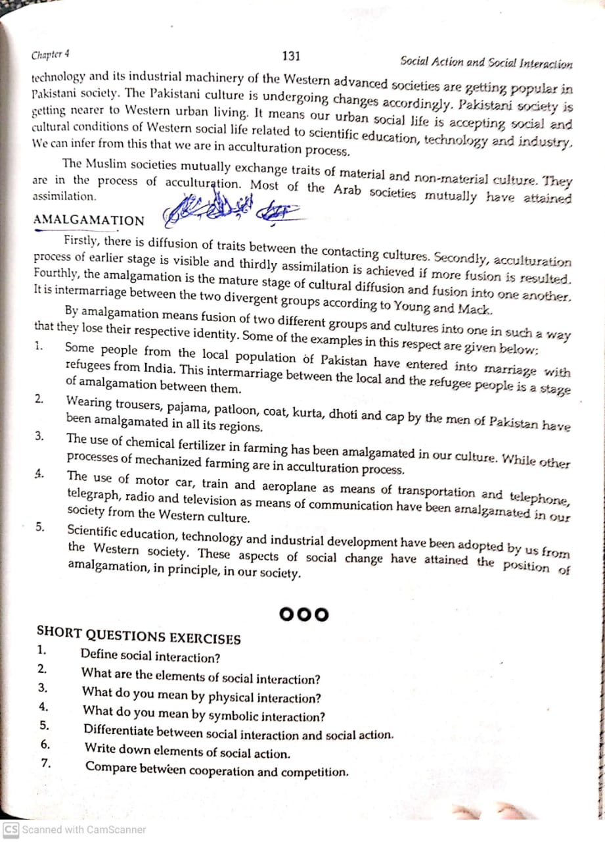

Slide 14
Thank You

