Slide 1
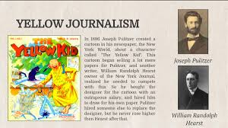
YELLOW JOURNALISM
SUNGAT BALOUCH
ROLL NO # 01
BS ‘SOCIOLOGY’ 4TH

Slide 3
Content:
1-What is Yellow journalism?
2-Sensationalism
3-Purpose of Yellow journalism
4-History of yellow journalism
“The New York World”
“ The New York Journal”
The First Famous cartoon
Nellie Bly, Stunt journalist
The Spanish-American War
5-Impact of Yellow journalism
6-Yellow journalism in Pakistan

Slide 4
1-What is Yellow journalism
Definition:
“Yellow journalism is an exaggerated, exploitative, sensational style of newspaper reporting.
It presents badly- searched news and eye catching headlined in order to sell as more information/newspapers as possible.

Slide 5
It emerged at the end of nineteenth century when rival newspaper publishes competed for sales in the coverage of events leading to and during Spanish-Americans War in 1898.

Slide 6
2-Sensationalism
Between 1895 and 1905 newspapers would do ANYTHING to sell papers.
Newspapers used readers emotions to get them to read stories. This is called sensationalism.

Slide 7
Sensational News stories
Are slanted to appear one way. They don not tell both sides, or all sides, of a story.
Focus on rich and famous people, crime and excess.
Don’t tell hard news, but focus on sensational angles of the story that are not really important.
Use quotes from unnamed people as facts.

Slide 8
3-Purpose of Yellow journalism
“Scare” headlines with excessively large type, in red and black ink.
News not characterized by in-depth research just focus on entertaining people.
Purpose is to increase sales and to change mood of people.
Published in Tabloid form
Sunday color comics

Slide 9
Continue..
Covers soft News
It does not have much credibility
Made up stories, fake interviews, misleading headlines.
Campaigns for those who suffered abuse.
Most important character of Yellow Journalism is:
“The endless drive for circulation.”

Slide 10
4-History of Yellow Journalism
In the late eighteenth century America’s
“New York World” was owned by Joseph Pulitzer and the “New York Journal” was owned by Randolph Hearst
The term Yellow Journalism was first coined during the newspaper wars between these two leading newspapers in an attempt to increase sales.

Slide 11
“The New York World” newspaper that used sensationalism exclusively and ran stories that were –Crusades(standing behind a worthy cause) and –Stunts(when the reporter takes part in making news story happen)
Pulitzer ran an editorial page, which was his favorite part of newspaper.
He was very liberal and wrote editorial on many cases and showed crime scenes, drawings and photos that were very large to get attention.

Slide 12
The New York Journal
Owned by William Rondolph Hearst, a wealthy man from california.
Spent whatever it took to have the “best paper”.
Hired the best journalists at huge salaries.
used many drawing and photos.
Reported sports events around the country.
Sent two gold expeditions to Alaska.
Sent Mark Twain as a reporter to cover Queen
Victoria’s 75th celebration.

Slide 13
Competition between Hearst and Pulitzer
When Hearst started the World, he hired Pulitzer’s entire staff away from him for higher salaries.
Pulitzer hired them back within a day.
Afterwards Hearst raised that price and had hired back all Pulitzer’s employees within 24 hours.
At the end they stayed with Hearst.

Slide 15
The First Famous cartoon
The Yellow Kid was drawn by Richard Outcault for Joseph’s World.
It was a little boy dressed in a yellow nightshirt that would comment on happenings in the city. People would buy The World just to read The Yellow Kid.
Hearst hired the Yellow Kid’s cartoon from Pulitzer.
Pulitzer hired another cartoonist to keep drawing the yellow kid for him, giving the New York two yellow kid cartoons at the same time.
The term “yellow journalism” comes from the competition of yellow kid cartoon.

Slide 17
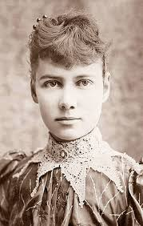
Nellie Bly, Stunt journalist
Pulitzer’s most famous reporter was a women name Elizabeth Cochran
Bly’s journalistic style was to write about the lives of ordinary people. She got her information by going undercover and pretending to be some one else.
This is called Stunt Journalism, when a reporter becomes part of the story.

Slide 18
She became a worker in a “sweet shop” and later committed herself to a mental institution for women which was said to be worst in New York.
After reading Jules Verne’s book, Around the World in Eighty Days in 1889, she attempted to break the record.
She broke the record in 72 days in 1890 in a competition held by newspaper.

Slide 19
The Spanish-American War
While not a part of decision directly, the two men are blamed by historians for drawing the United State into the War.
“Fake News” appears for the first time in America and leaves readers wondering whether journalists care more about selling copies than reporting the truth.
The rumors were; congress demanded spain to leave Cuba and they refused then U.S started war with Spain.

Slide 20
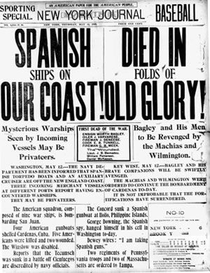

Slide 21
5-Impact of Yellow Journalism
Permanently damages Newspapers creditability for reporting accurate news.
Some good did come from the Era though many ruthless businessmen and slick politician were exposed for their injustices and rooting out corruption of power will be a trade mark of investigative journalism from now on.

Slide 22
The era of yellow journalism may be said to have ended shortly after the turn of the 20th century, with the World’s gradual retirement from the competition in sensationalism.
Some techniques of the yellow journalism period, however, became more or less permanent and widespread, such as banner headlines, coloured comics, and copious illustration.
Yellow Journalism is still present perhaps in different shade.

Slide 23
In other media, most notably television and the Internet, many of the sensationalist practices of yellow journalism became more commonplace.
Most journalists claims that yellows journalism has now been replaced with informed, intelligent and unbiased reporting.

Slide 24
6-Yellow journalism in Pakistan
SOME sections of the media in Pakistan operate in an ethics-free zone, crossing the line between fact and fiction with few compunctions, no matter how serious the possible consequences.
Indeed, they seem to have taken on some of the worst aspects of an often sensationalist social media.
A recent example is the Zainab rape-murder case where some elements have propounded theories with such certitude that these could easily be misconstrued as fact.

