Slide 1
Regulation of salt contents of shoot

Slide 2
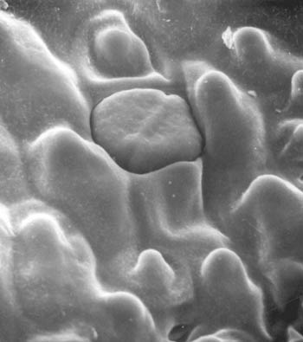
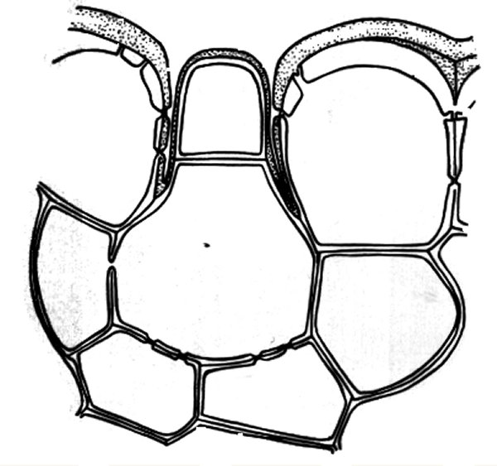
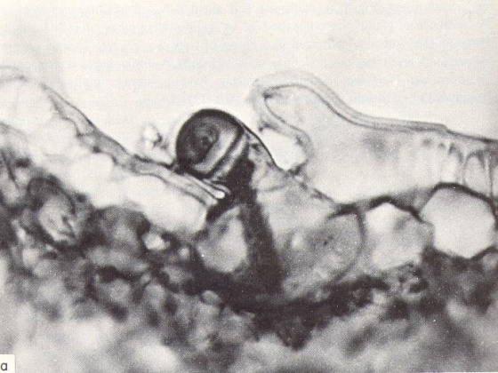
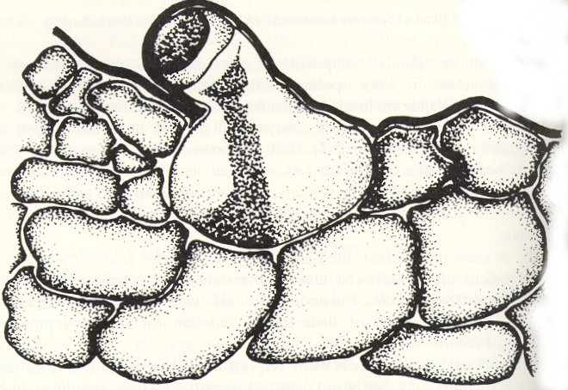
Regulation of Salt Content in Shoots
Secretion of salts
Salt exported via active
transport mechanism
Excretion includes Na+ and Cl- as well as inorganic ions
Leaf surface containing salt gland of Salt cedar (Tamarix ramiosissima)
Photograph and schematic diagram of salt gland of Aeluropus litoralis
Two celled salt gland of Spartina

Slide 3
Regulation of Salt Content in Shoots
Salt leaching
Not well understood, but results from transport of salts to the near epidermis of leaves; precipitation leaches salts
Salt-saturated leaf fall
Leaves shed after accumulation of salts
Occurs in Hydrocotyle bonariensis and others

Slide 4
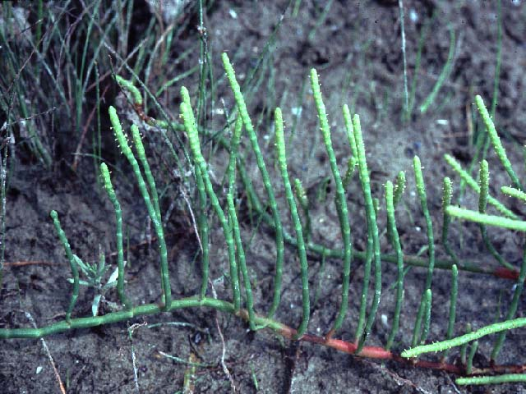
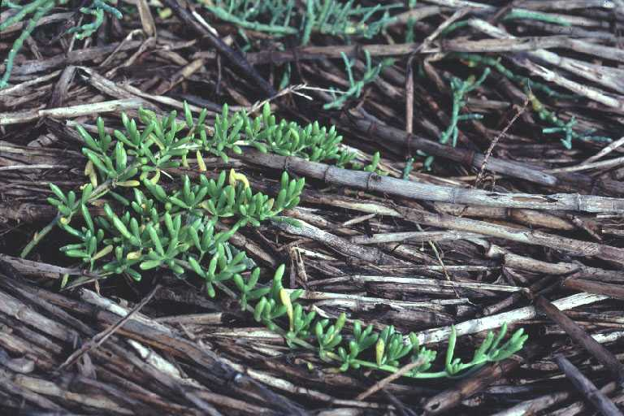
Responses to Increased Salts
Succulence Plant organs are thickened due to increased cellular water content
Increased growth Reduces cellular solute concentrations

Slide 5
Seed Dispersal in Halophytes
Most seeds of halophytes are buoyant
Examples are glasswort (Salicornia sp.), coconut (Cocos nucifera), sea rocket (Cakile sp.), and suaeda (Suaeda maritima)
Marine angiosperm seeds are not buoyant
Examples are Thalassia and Halophila

Slide 6
Germination in Halophytes
Germination inhibited by high salt concentrations
Chlorides are very toxic to germinating plants
Optimum germination is in freshwater
Germination response in salt water not necessarily correlated to later growth of a plant species under saline conditions
Higher temperatures slow germination in salt water

Slide 7
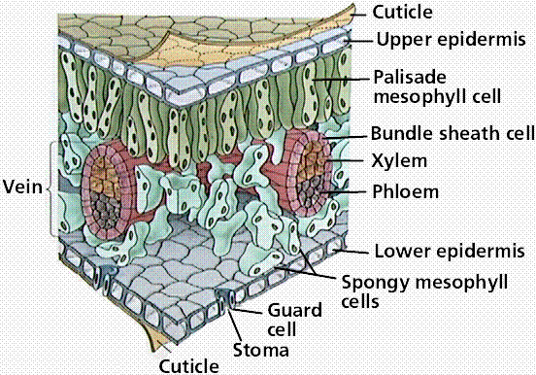
Physiological Response in Halophytes
Switch from Carbon-3 photosynthesis to CAM (crassulacean acid metabolism)
Stomates closed during
the day
CO2 fixation during
the night
Sugars accumulate in cells
Decrease osmotic pressure with organic ions (proteins)

