Slide 1
Political Systems (Developing )

Slide 2
What is System
A regularly interacting or interdependent group of units forming an integrated whole
every system is delineated by its spatial and temporal boundaries;
surrounded and influenced by its environment;
described by its structure and purpose;
and expressed in its functioning

Slide 3
CHARACTERISTICS OF SYSTEM
Interdependence and Integration
Environment
Structure
Purpose and function

Slide 4
VARIETY OF SYSTEMS
Economic System
Social System
Cultural System
Political System

Slide 5
POLITICAL SYSTEM
According to the Oxford Dictionary of Sociology
political system in any persistent pattern of human relationship that involves power, rule and authority.
It is a collectivity of political institutions (e.g., government);
associations (e.g., political parties);
and organizations performing roles based on a set of norms and goals

Slide 6
ASIA
The largest and most populous continent
located on Eastern and Northern Hemisphere
Asia & Europe are not geographically separated
Commonly accepted boundary between two is Ural mountain range and Ural River
Together Asia and Europe landmass is called Eurasia

Slide 7
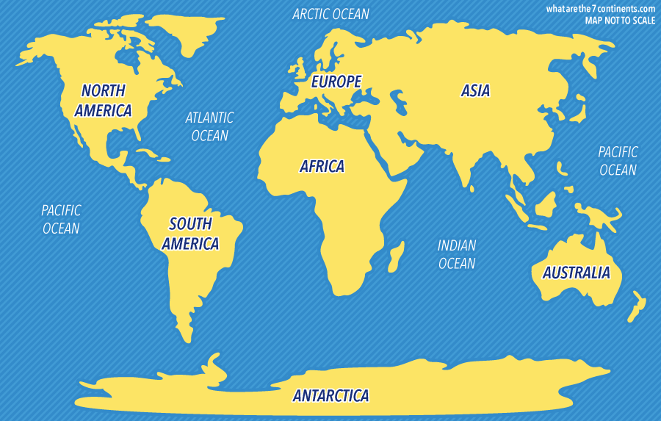

Slide 9
South Asia

Slide 10
South Asian Countries
Country | Area (km2) | Population (Million) | Capital
3Afghanistan | 6,52,864 | 32.01 | Kabul
4.Bangladesh | 1,47,570 | 159.86 | Dhaka
7.Bhutan | 38,394 | 0.78 | Thimphu
1.India | 32,87,263 | 1276.2 | New Delhi
8.Maldives | 298 | 0.38 | Mali
5.Nepal | 1,47,181 | 28.4 | Katmandu
2.Pakistan | 8,81,913 | 190.4 | Islamabad
6.Sri Lanka | 65,610 | 21.7 | Colombo
South Asian Countries : Area, Population and Capitals

Slide 11
South Asia Countries
Muslim States | Hindu States | Buddhist States
Pakistan | India | Sri Lanka
Afghanistan | Nepal | Bhutan
Bangladesh
Maldives

Slide 12
Colonialism, Nationalism, and Independence in South Asia
The policy or practice of acquiring full or partial political control over another country, occupying it with settlers, and exploiting it economically one nation assumes control over the other.
India, Pakistan, Sri Lanka
Syria, Lebanon
Laos, Cambodia

Slide 13
Nationalism
Nationalism is an ideology that gives a nation a sense of unity by imposing on them the same set of identities (for instance linguistic, historical, cultural). Especially peculiar to nationalism is defining the nation against an Other inside or outside of the state borders.
Hindu Nationalism
Muslim Nationalism
Ceylon nationalist movement

Slide 14
Nation
What is “nation”?
Benedict Anderson came up with perhaps the most famous definition; he sees it as an imagined community, because the overwhelming majority of its members never personally met each other. This community is envisioned as both limited (by its borders) and sovereign (it has the ability to self-govern). Border control is one mechanism of maintaining national identity by “protecting” the nation from dissolution in other cultures.

Slide 15
Colonialism
Pakistan | India | Bangladesh | Afghanistan | S.Lanka | Nepal | Bhutan | Maldives
1947 |  | 1971 | 1919 | 1948 | 1923 | 1949 | 1965
1757 Battle of Plassey |  | Taka Afghani S.Lankan Rupee N.rupee B. ngultrum Maldivian rufiyaa
1764 Battle of Buxer
1857 Independence War
1858 end of East India Company and British rule
1947 withdrawal of Britain

Slide 16
Political Systems of South Asia
India and Pakistan are federal republics
Afghanistan and Bangladesh practice unitary style
Sri Lanka is a unitary semi presidential democracy
Maldives unicameral people’s majlis
Nepal is federal democratic republic

Slide 19
Basic Information
Islamic Republic of Pakistan
Capital City: Islamabad
Neighbors: India, Afghanistan, Iran and China
Language: Urdu (National) English (official)
Divided into 4 provinces: Sindh, Punjab, KP, and Balochistan
The President is elected for a 5 year term by the electoral college
Bicameral Parliament

Slide 20
Senate: 104
National Assembly:342
President: Dr Arif Alvi
Prime Minister: Imran Khan
Chairman Sentae:Muhammad Sadiq Sanjrani
Deputy Chairman Senate: Saleem mandviwalla
Speaker NA:Asad Qaisar
Deputy Speaker NA:Muhammad Qasim Khan Suri

Slide 21
National Assembly
 | Punjab | Sindh | KP |  | Balochistan |  | FATA |  | ICT |  | Total
General | 148 | 61 | 35 |  | 14 |  | 12 |  | 2 |  | 272
Women | 35 | 14 | 8 |  | 3 |  | 0 |  | 0 |  | 60
Non-Muslims | -- | -- |  | -- |  | -- |  | -- |  | -- | 10
Total | 183 | 75 |  | 43 |  | 17 |  | 12 |  | 2 | 342

Slide 22
Senate
Provinces | General | Technocrats / Ulema | Women | Non-Muslims | Total
Sindh | 14 | 4 | 4 | 1 | 23
Punjab | 14 | 4 | 4 | 1 | 23
Balochistan | 14 | 4 | 4 | 1 | 23
KP | 14 | 4 | 4 | 1 | 23
ICT | 2 | 1 | 1 | - | 4
FATA | 8 | - | - | - | 8
TOTAL | 66 | 17 | 17 | 4 | 104

