Slide 1
Sulus (Thuluth)Style Calligraphy
Thuluth (Arabic: ثُلُث‎, Persian: ثلث‎ sols, Turkish: Sülüs, from thuluth "one-third") is a script variety of Islamic calligraphy invented by Ibn Muqlah Shirazi.
Thuluth script was first formulated in the 7th century at the time of the Umayyad caliphate, but it did not progress entirely until the late 9th century.
The straight angular forms of Kufic were replaced in the new script by curved and oblique lines.Though rarely utilized for writing the Holy Qur’an, Thuluth has enjoyed great popularity as an ornamental script for calligraphic inscriptions, titles, headings, and colophons.It is still the most crucial of all the ornamental scripts.Thuluth is known for its elaborate graphics and stunning plasticity.
A simple Islamic prayer in the Thuluth script. Translation: the grasping of God brings the knowledge of His comfort.

Slide 2
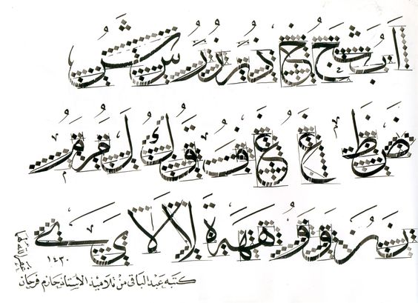

Slide 3
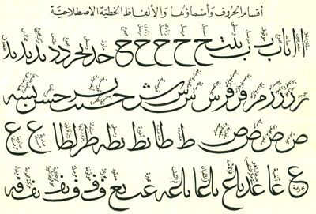

Slide 4
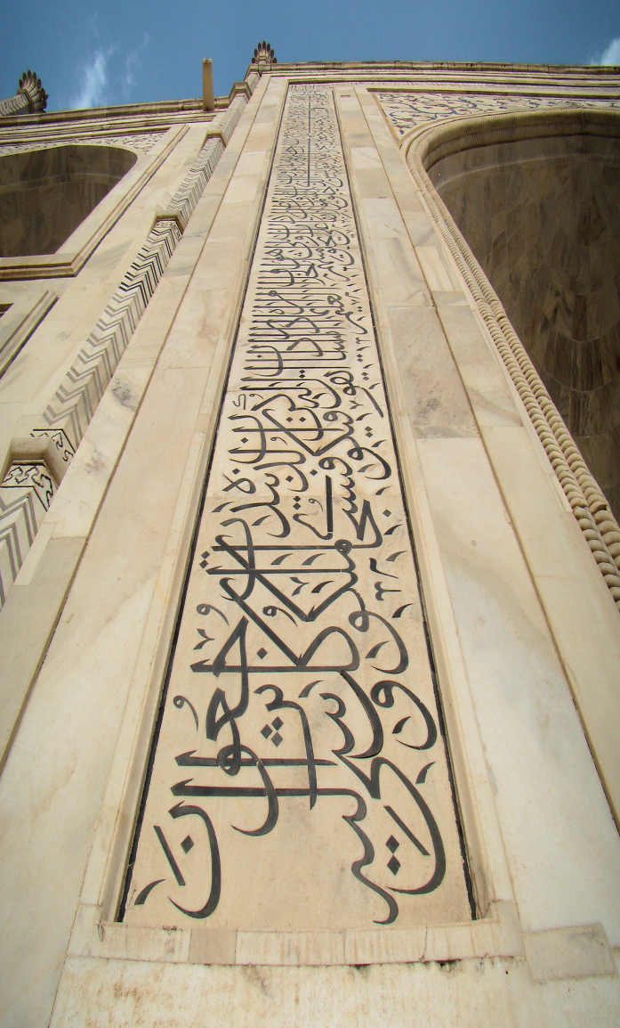
The flag of Saudi Arabia, also in Thuluth.
Taj Mahal, monumental calligraphy by Abd ul-Haq 1609
Indian thuluth

Slide 5
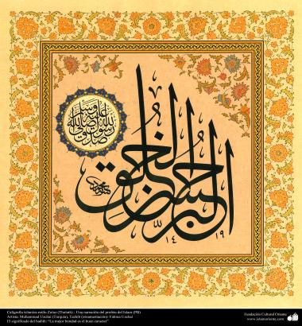
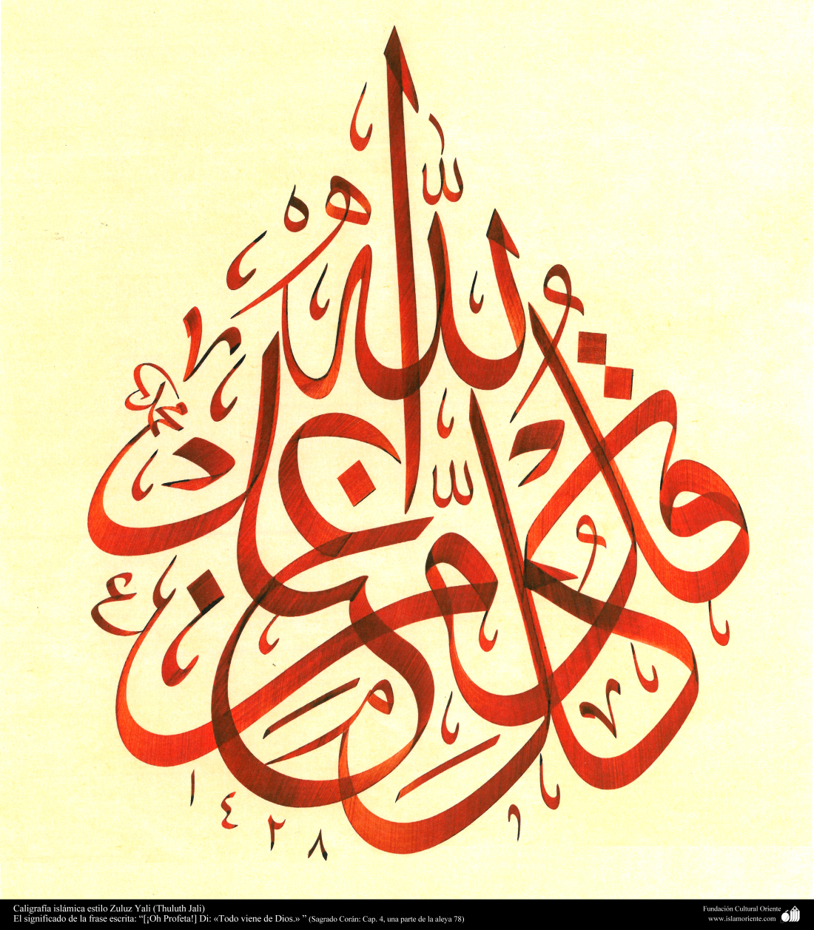
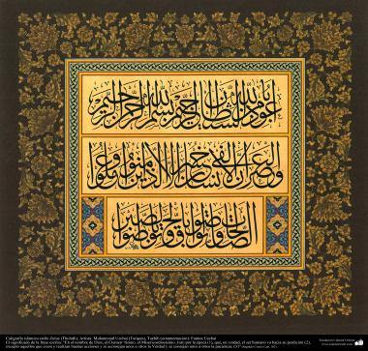

Slide 6
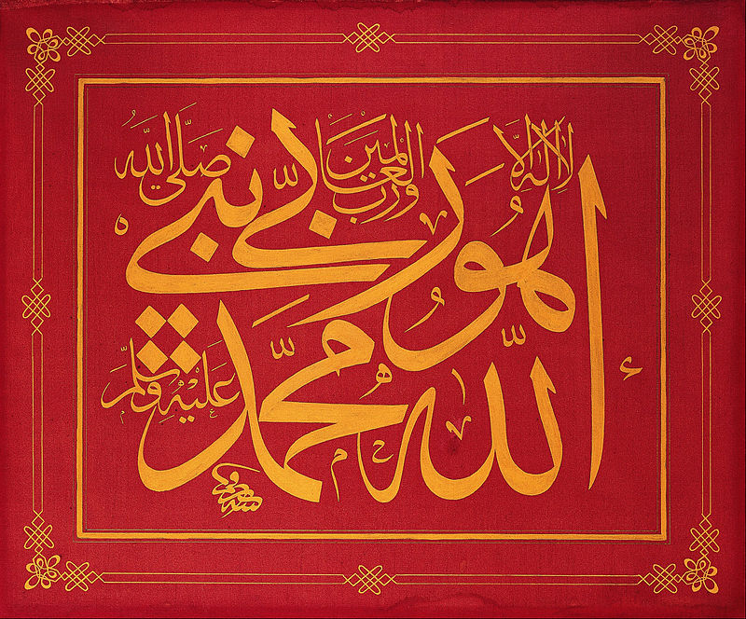
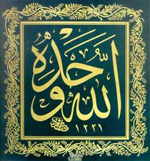
Mustafa Râkim Calligrapher
Calligraphic panel written by Mustafa Rakim, late 18th - early 19th century
Levha -Allâhu Vahdehû Mustafa Rakim

Slide 7
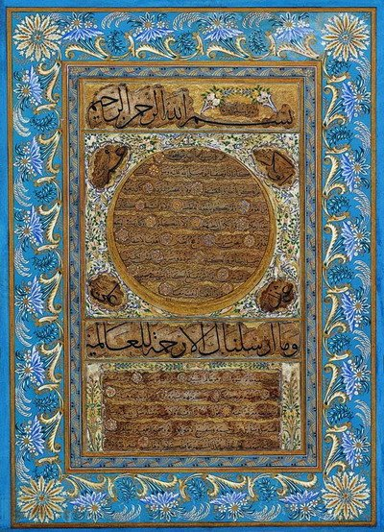
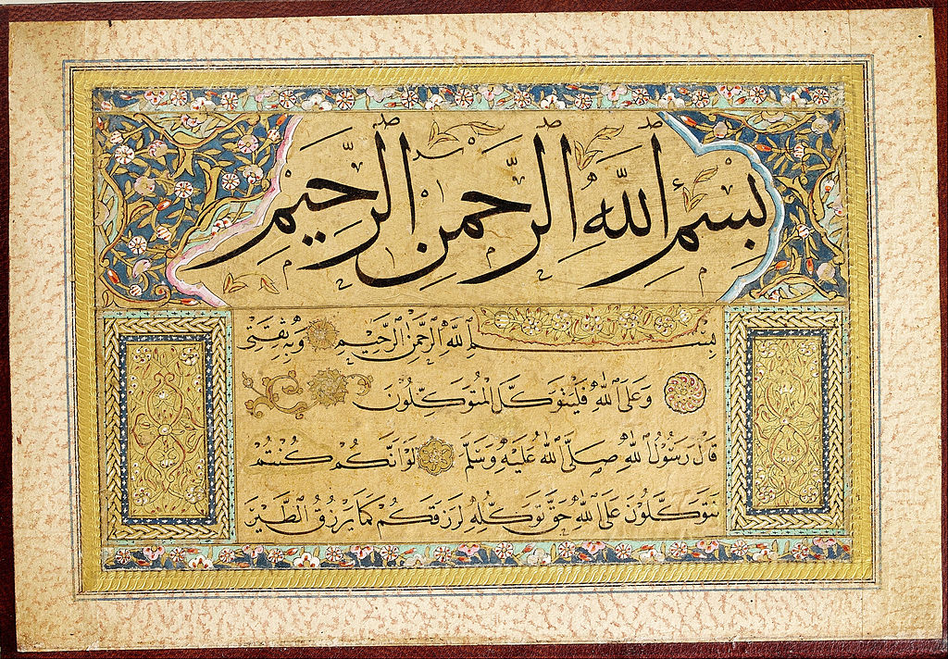
Hâfiz Osman Calligraphy
A hilye by Hâfiz Osman.
Murakka (calligraphic album) Hafiz Osman

