Slide 1
THE HEMATOPOIETIC & LYMPHOID SYSTEMS
Prof.Dr. Abdul Haseeb Khan
Chairman Pathology Department

Slide 2
CELLS AND ORGANS
CELLS
Red blood cells
Granulocytes
Platelets
Lymphocytes
Mononuclear cells
Coagulation system
ORGANS.
Lymph nodes
Bone marrow
Spleen
Liver
Tonsils
Thymus
GIT

Slide 3
HAEMOPOIETIC SYSTEM

Slide 4
HEMOPOIESIS
MULTIPOTENT MARROW STEM CELL
COMMITTED STEM CELLS
Pronormoblast Myeloblast Monoblast Megakaryoblast
Basophilic Lymphoblasts
Normoblast Promyelocyte
Polychromatic Promonocyte
Normoblast Myelocyte Prolymphocyte
Orthochromatic
Normoblast Metamyelocyte Promegakaryocyte
Reticulocyte Band cell
____________________________________________________________________
Erythrocyte Neutrophil Monocyte Platelets
Lymphocytes

Slide 5
DISEASES
RED CELL DISORDERS
Anemia
Polycythemia
WHITE CELL DISORDERS
Types of diseases
Non neoplastic
Neoplastic
Cells
Lymphoid
Myeloid
BLEEDING DISORDERS
Platelet diseases
Coagulation disorders

Slide 6
RED CELL DISORDERS (Anemias)
CLASSIFICATION OF ANEMIAS
ETIOLOGICAL CLASSIFICATION
Blood loss
Acute
Chronic
Hemolytic
Intrinsic defect – membrane, enzyme, Hb.
Extrinsic defect – antibody (iso, auto), mechanical
Impaired red cell production
Aplastic
B12 & folic acid deficiency
Iron deficiency
Maturation defects – MDS, Myelophthisic
Chronic diseases

Slide 7
MORPHOLOGICAL CLASSIFICATION OF ANEMIA
Parameters: MCV, MCH, MCHC, RDW,
Microcytic: iron deficiency, thalassemia, hemoglobinopathy
Macrocytic: folic acid B12 deficiency, hemolysis
Normocytic: Aplastic anemia
Poikilocytic: DIC, (microangiopathic) etc…

Slide 8
RED CELL INDICES

Slide 9
IRON DEFICIENCY ANEMIA
When to think of iron deficiency anemia:
MCV – low
MCH – low
MCHC – Low
Clean hypochromia & microcytosis

Slide 10
IRON DEFICIENCY ANEMIA
Frequency:
Developed countries 10% of population
Developing countries 25% to 50% of population.
Iron distribution:
Total body iron 2 to 6 grams
Hb iron 60% to 80% (1.5 to 3.0 Grams).
Tissue iron 1.2 to 2.0 grams
Storage iron: ferritin and hemosiderin
Essential tissue iron: catalase, cytochrome, myoglobin
Plasma iron/transport iron: 3 to 4 mg
Causes
Decreased intake
Increased iron loss
Increase requirement

Slide 11
IRON STATUS ASSESSMENT
Serum iron: 70 to 140 µg/dl
TIBC: 250 to 400 µg/dl
Serum ferritin: 12—25 mg/dl
Assessment of bone marrow iron stores

Slide 12
IRON ABSORPTION

Slide 13
CLINICAL FEATURES
General sign and symptoms of anemia
Koilonychia – spoon shaped, thin brittle nails
Atrophic glossitis
Leukoplakia of tongue
Angular stomatitis
Dry brittle hair

Slide 14
BLOOD PICTURE

Slide 15
LAB. DIAGNOSIS
Hb
RBC Morphology
MCV
PCV
MCH
MCHC
Serum iron
TIBC
Serum Ferritin
Bone marrow – Micronormoblast

Slide 16
PROBLEMS OF IRON METABOLISM
Seen in:
Chronic microbial infections e.g. osteomyelitis
Chronic immune disorders e.g. RA
Neoplasms: lymphoma, CA lungs and breast.
Sideroblastic anemias: both cong. & secondary.

Slide 17
APLASTIC ANEMIA
Pancytopenia
Marrow failure
Causes:
Idiopathic – autoreactive T Cells
Secondary – drugs, Chemicals, infections (viral Hepatitis), radiations.
genetic factors
Chloremphenicol – direct toxic effect & sensitivity

Slide 18
PARAMETERS
Hb → low
TLC → low
Neutrophils → low
Platelets → low
PCV → low
MCV → Normal
MCH → Normal
MCHC → Normal
Fall in PCV is parallel to fall in Hb
RBC morphology – normochromic & normocytic

Slide 19
BONE MARROW
Aspiration biopsy – variable trilineage suppression
Trephine biopsy

Slide 20
TREATMENT TARGETS
Supportive
For restoration of marrow – anti lymphocyte globulin
Hemopoietic growth factors – G – CSF, GM – CSF
Marrow transplantation – BMT, PBSC.

Slide 21
MEGALOBLASTIC ANEMIA
Parameters:
Hb → Low
RBC → Very Low
PCV/HCT → Low
MCV → High to very high
MCH → Raised
MCHC → Raised
RDW → High

Slide 22
CAUSES OF MEGALOBLASTIC ANEMIA
Folate Deficiency
Decreased in take/nutritional
Impaired absorption – coeliac disease & tropical sprue
Increased demand – pregnancy/infancy/myeloproliferation
Antifolate drugs – anticonvulsants, methotrexate
B12/Cobalamin Deficiency – anemia/demyelination
Decreased in take /nutritional
Impaired absorption
a) Gastric causes – pernicious anemia (IF), Gastrectomy
b) intestinal causes – coeliac disease, tropical sprue,
fish tape worm

Slide 23
PATHOGENESIS
Lack of B12 & folic acid → DNA synthesis
Cells accumulate in pre-mitotic phase
Cytoplasm goes on maturing
Resulting either into release of macrocytes
Or leading to intramedullary death of cells
Also called as Ineffective erythropoiesis
Macrocytes have got short life span

Slide 24
MORPHOLOGY

Slide 25
DIAGNOSIS
Blood parameter
Bone marrow findings
Serum levels of folic acid and B12

Slide 26
HEMOLYTIC ANEMIAS
Parameters
General
Red cell Morphology – NN, macrocytic
Erythroid hyperplasia in BM
Increased reticulocytes in blood
Intravascular hemolysis
Hemoglobinemia
Hemoglobin uria
Hemosiderinuria
Unconjugated hyperbilirubinemia
ATN
Decreased haptoglobin
Extravascular hemolysis
Jaundice
Gallstones
decreased haptoglobin
Heamosiderosis

Slide 27
CLASSIFICATION OF H.A
Intrinsic Defects – mainly hereditary except PNH
Membrane defects – spherocytosis
Enzyme defects – G6PD, PK deficiency
HB defects – thalassemia, hemoglobinopathies
Extrinsic Defects
Antibody mediated – isoantibodies transfusion reactions
Erythroblastosis fetalis
auto antibodies
warm and cold antibodies
drug associated antibodies
Mechanical trauma – cardiac, malaria,
microangiopathic

Slide 28
HEREDITARY SPHEROCYTOSIS
PARAMETERS
MCV, MCH, MCHC → Normal
Hb → Low
Retic → Increased
E/V Hemolysis → Positive
Spleen → Enlarged
Jaundice → Unconjugated bil. ↑
DEFECTS:
In cell membrane → Spheroidal Cells
→ Less Deformable
→ Vulnerable to Spl. Seq.
Mode of transmission- autosomal dominant

Slide 29
MEMBRANE DEFECTS
Defects are in.
Spectrin
Actin
Ankyrin
Band 3 and 4.1
Membrane Protein – Glycophorin

Slide 30
SPHEROCYTES

Slide 31
COMPLICATIONS
Hemolytic crises
Aplastic crises
Gall stones
Leg Ulceration

Slide 32
LAB FEATURES
Low Hb.
Raised unconj. Bilirubin
Spherocytosis
Normal MCV, MCH, MCHC.
Increased osmotic Fragility

Slide 33
HEMOGLOBIN DEFECTS – Hb S
PARAMETERS:
Hb → 6-9 g/dl
RBC Morphology → Sickle cells
MCV,MCH. → Normal
Reticulocytes → Increased
Positive sickle test

Slide 34
COMMON HEMOGLOBINOPATHIES
Hb S - α2 β2 – 6 glu → val.
Hb C - α2 β2 – 6 glu → lys.
Hb E - α2 β2 – 26 glu → lys.
Hb D (pb) - α2 β2 – 121 glu → gln.
COMBINATIONS.
S+A – not sickle.
S+C – Sickle.
S+F – not sickle.

Slide 35
PATHOPHYSIOLOGY OF SICKLE CELL ANEMIA

Slide 36
SICKLE CELL ANEMIA-BLOOD PICTURE

Slide 37
CLINICAL FEATURES
1/3 hemolysis in circulation (Intravascular)
2/3 hemolysis in spleen (extravascular)
1. Splenomegaly.
2. Autosplenectomy.
3. Crises
Vaso-occlusive crisis,
Aplastic crisis,
Hemolytic crisis.
4. Bacterial infections.
5. Hand-foot syndrome.
6. Splenic sequestration.
7. Cholelithiasis.
8. Hemosiderosis.
9. Necrotic marrow → fat emboli.
10. CNS stroke.

Slide 38
DIAGNOSIS
Hb → 6-9 g/dl.
RBC Morphology – sickle cells.
MCV, MCH → Normal.
Target Cells - Howell Jolly bodies.
Retics are increased.
Osmotic fragility is decreased.
Serum haptoglobin & heamopexin are reduced.
Positive sickle test.
Positive Hb solubility test.

Slide 39
Hb. Electrophoresis.
H1 Barts F
J KN D, A2, A
A, F S
GLPQ C
S, D
A2 C Ph. 6.0
Ph. 8.6

Slide 40
THALASSEMIA

Slide 41
THALASSEMIA
Parameters – β – Thalassemia minor to major
Hb → Low
MCV,MCH → Low
Target cells → +++
Normoblast → Present in blood
Hb A2 → Increased
Hb F → Increased
Hb A → Reduced

Slide 42
THALASSEMIA Classification

Slide 43
GENETIC MUTATIONS IN β THALASSEMIA
Β globin gene = chromosome no. 11
α globin gene = chromosome no. 16

Slide 44
PATHOGENESIS OF Β THALASSEMIA MAJOR

Slide 45
RBC MORPHOLOGY IN β THALASSEMIA

Slide 46
RBC MORPHOLOGY IN β THALASSEMIA

Slide 47
HAIR ON END APPEARANCE IN Β THALASSEMIA

Slide 48
DIAGNOSIS OF β THALASSEMIA
Hb
RBC parameters
RBC Morphology
Hb pattern – Hb A, Hb A2, Hb F
Biochemical estimation of Hb F
Biochemical estimation of Hb A2
Hb electrophoresis
Serium iron
Serium ferritin
Prenatal diagnosis – DNA analysis on amniotic fluid or chorionic villus biopsy.

Slide 49
TREATMENT STRATEGIES
Blood transfusions
Iron chelation therapy
Bone marrow transplantation.
Splenectomy
Bone marrow – erythroid hyperplasia

Slide 50
IMMUNOHEMOLYTIC ANEMIA

Slide 51
IMMUNOHEMOLYTIC ANEMIA
Autoimmune acquired hemolytic anemia
Hemolytic disease of newborn
Incompatible blood transfusion
Drug induced immunohemolytic anemia

Slide 52
AUTOIMMUNE HEMOLYTIC ANEMIAS

Slide 53
AUTOIMMUNE HEMOLYTIC ANEMIA (AIHA)
Parameters:
Hb → Low
MCV → Normal or raised
MCHC, MCH → Normal
Retic → Increased
Macrocytosis → Present
Polychromasia → Present
Coomb’s test – direct & indirect

Slide 54
IMMUNOLOGY OF AIHA
Antibodies/proteins on red cells
IgG+C → 40%
IgG alone → 35%
Complement Alone → 10%
IgA or IgM → Rare
DIRECT COOMB’S TEST

Slide 55
SEROLOGY OF AIHA (Ab in Serum)
 | Warm AIHA | Cold AIHA | PCH
Immnoglobulin | IgG | IgM | IgG
Ab Specificity | Anti Rh-e | Anti I,i | Anti P
Antibody Origin | Polyclonal – K, λ | Monoclonal - K | Polyclonal
Ab behaviour | Incomplete | Complete | Incomplete
I/V Hemolysis | Rare | Minor | Major
Proteins on RBCs | IgG, IgG+C, C | C 100% | C 100%

Slide 56
OTHER ANEMIAS
Myelophthisic anemia
Hemolysis due to mechanical trauma
Micorangiopathic hemolytic anemia
Cardiac anemia
PNH
G6PD deficiency
Anemia of chronic diseases

Slide 57
MYELOPHTHISIC ANEMIA
Marrow infiltrations –
Tumours,
TB,
Lipid storage disease
Myelofibrosis
Leukoerythroblastic picture.

Slide 58
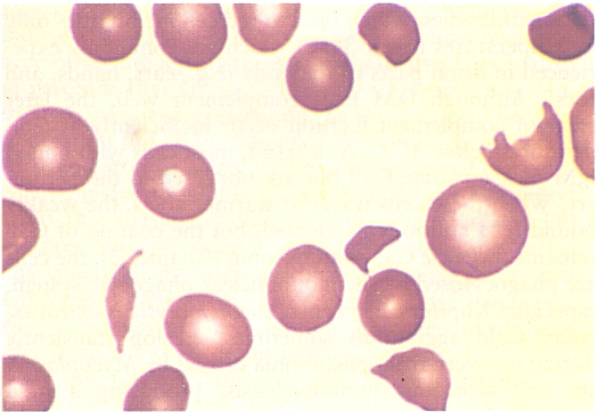
HEMOLYSIS DUE TO MECHANICAL TRAUMA
Micorangiopathic hemolytic anemia - DIC
Cardiac anemia

Slide 59
PNH
Acquired Membrane defect due to myeloid stem cells
Membrane protein PIG is deficient
Cells more sensitive to complement
Sensitivity is more during night due acidosis
Defect is transferred by X chromesomes

Slide 60
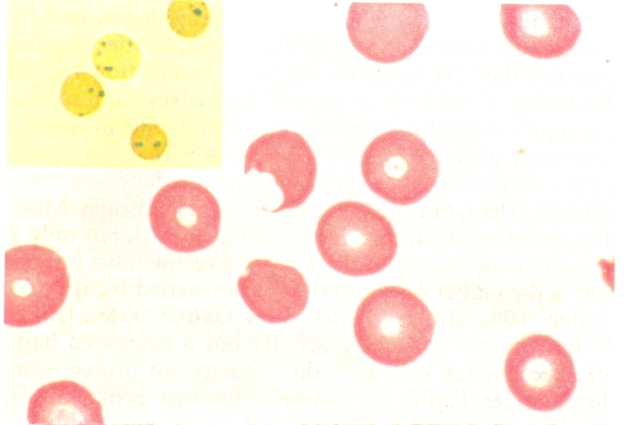
G6PD DEFICIENCY
X chromosome
Drugs – antimalarials, Aspirin, sulphomamide
Lead to hemolysis of red cells due to more oxidants – oxidized glutathione –GSH
Denatured Hb gives rise to heinz bodies

Slide 61
ANEMIA OF CHRONIC DISEASES
Chronic infections – Osteomyelitis, SBE, Lung abscess,
Immune disorders – RA, Regional enteritis
Neoplasm – Hodgkin, CA lungs, Brest

