Slide 1
INFORMATION SOCIETY

Slide 2
WHAT IS INFORMATION SOCIETY?
An “Information Society” is a society where the creations, distribution, use, integration & manipulation of information is a significant economic, political & cultural activity.

Slide 3
THE DEVELOPMENT OF THE INFORMATION SOCIETY
This concept originally born in Japan in 1960’s & then spread around the world.
Japanese economist Fritz Machlup was one of the first few people who developed this concept.
The aim of the “Information Society” is to gain competitive advantage internationally, through using Information Technology in a creative & productive way.

Slide 4
THE DEVELOPMENT OF THE INFORMATION SOCIETY
Humanity has progressed from agricultural revolution to the industrial revolution and is now moving to an information revolution.
It allows computers to being networked over global telecoms highways

Slide 5
THE DEVELOPMENT OF THE INFORMATION SOCIETY
The invention of printing was the first big breakthrough in IT
It helped literacy and education to grow up.

Slide 6
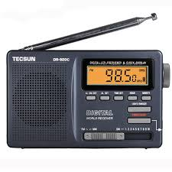
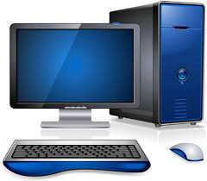
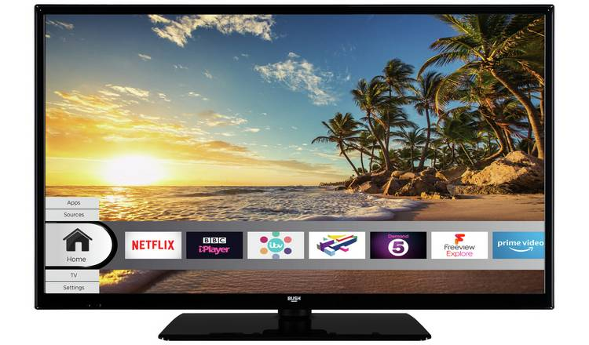
THE DEVELOPMENT OF THE INFORMATION SOCIETY
Other break-through in IT

Slide 7
CHARACTERISTICS OF INFORMATION SOCIETY
Information Empowerment
Information Consciousness
Use of information as economic resource
Development of an Information sector & emergence of Information Industry.

Slide 8
INFORMATION SOCIETY - AT PRESENT
The Internet & the computer networks have made the whole world a family.
No need to meet the buyer & seller in the business activities.
Less use of books & the literal resources.
Mental power is more important than the physical power.
Organizations make predictions without making any huge effort.

