Slide 1
Attachment Theory (Bowlby and Ainsworth)
To: Dr Sadia Malik
From: Anam Yousaf
PhD scholar
Dptt. Of Psychology
University of Sargodha

Slide 2
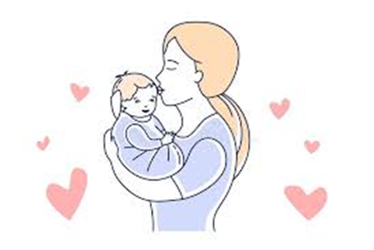
Attachment theory
According to Bowlby “attachment is a lasting psychological connectedness between human beings”
It is basically a deep and enduring emotional bond between two people in which each seeks closeness and feels more secure when in the presence of the attachment figure. This relation can be between parents and children, between romantic partners.
It is not a general theory of relationships but attempts to address specific aspects of it. i.e how human beings respond in relationships when hurt, separated from loved one’s, or perceive a threat or under stress.
Address questions:
Reason why children behave the way they do
Factors affecting their ability to FORM meaningful and satisfying relations with others, specially their parents
Factors contributing to experience of anxiety, avoidance and fulfillment in terms of relations

Slide 3
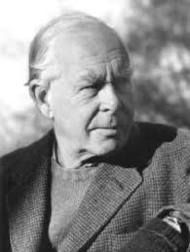
John Bowlby (1907-1990) British developmental psychologist and psychiatrist
Belonged to upper class family 4th in 6 siblings
Father: leading surgeon
cared by nanny and nursemaids: badly ignored by both parents as they had no time for family.
At 7 he was sent to boarding school (I will not sent even my dog at 7 in boarding)
Graduated in Psy. from Uni. Of Cambridge (4th oldest survining uni. in the world) in 1928
volunteer work for 1 year at school for maladjusted children while reconsidering his career goals.
His interaction with 2 children set his professional life on course.
1st. isolated, remote, affectionless teenager who was expelled from his previous school for theft and had nostable mother figure.
2nd. a very anxious boy of 7 or 8 years who was known as his shadow as he follow bowlby wherever he go (Ainsworth, 1974).

Slide 4
Got medical degree in 1933.
Started training in psychiatry and till 1940 worked in London child guidance clinic, school for maladjusted children.
He was persuaded by this experience of the effects of early family relationships on personality development, behavioral problems, Bowlby decided to embark on a career as a child psychiatrist.
based on case notes from the London Child Guidance Clinic, many of the clinic patients were affectionless and prone to stealing. Through detailed examination of 44 cases, Bowlby was able to link their symptoms to histories of maternal deprivation and separation.
Why did he select the theme of separation anxiety?
At age 4 her nanny(minnie) left her family who was primary caregiver and it was as tragic as the loss of a mother

Slide 5
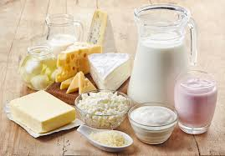
Results
-ve effects of maternal deprivation (a situation in which mother was non-responsive or absent during first 2 years of child's life)
According to Bowlby, Children are born with innate derive to form attachment with primary caregivers.
E.g. When frightened they seek proximity to their mother for comfort and care.These results were groundbreaking bcaz firstly its was considered that goal of attachment is satisfaction of needs specially food.
To bowlby attachment is primarily determined by nurturance and responsiveness and not by food and other materialistic need.

Slide 6
4 phases of development of attachment
Pre attachment (new born to 6 weeks)
Attachment in making (6 weeks to 6-8 months)
Clear cut attachment (6-8 months to 18 months)
Formation of reciprocal relations (18 months to years)

Slide 7
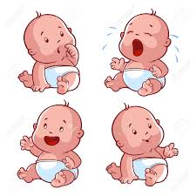
Pre attachment (new born to 6 weeks)
Child learn how to act in order to get attention of adults. (Crying, smiling, eye contact)
Child do not show particular attachment with caregiver even mother.

Slide 8
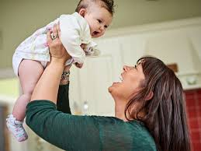
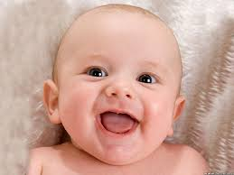
Attachment in making (6 weeks to 6-8 months)
They distinguish between familiar and unfamiliar faces
Develop sense of trust because they can depend on mothers in times of needs
Respond positively to primary caregiver, mother.
Does not get upset when she is gone.

Slide 9
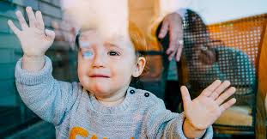
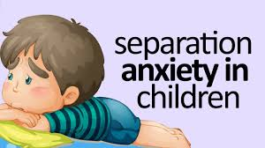
Clear cut attachmnet (6-8 months to 18 months)
Show attachment and preference for 1 specific person (mother) and experience separation anxiety when mother leaves
Protest in absence of mother and in presence of stranger

Slide 10
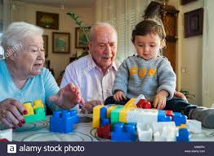
Formation of reciprocal relations (18 to years)
Form emotional bond with caregivers other than mother (father, grandparents, siblings)
Can understand when mother is leaving and when will she get back
He developed a sense of security that although mother is not here physically but she is always there for him.

Slide 11
IWM and attachment theory
Bowlby implemented this model in his theory and explained how infants act in accordance with theses mental representations
According to Bowlby, an internal working model is a cognitive framework comprising mental representations for understanding the world, self and others, and is based on the relationship with a primary caregiver specially mother. It becomes a prototype for all future social relationships and allows individuals to predict, control and manipulate interactions with others. According to Bowlby (1969), the primary caregiver acts as a prototype for future relationships via the internal working model.
This IWM guides future beh. For example, a mother rejecting the child's need for care conveys that close relationships should be avoided in general, resulting in maladaptive attachment styles.
Notes:
Prototype: best example or representation of concept . Protype of a step mother

Slide 12
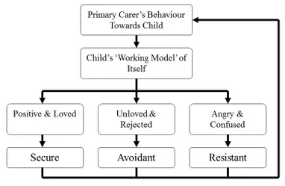

Slide 14
Ainsworth (1913-1999)
She was an Ameriacan developmental psychologist
Tested attachemnet theory in 1960’s by using “STRANGE SITUATION protocol”
Where infants are placed in an unfamiliar situation and separated from primary caregiver. Children b/w 12 to 18 months briefly left alone and reunited with mother.
On the basis of children responses, she gave 3 styles of attachment

Slide 15
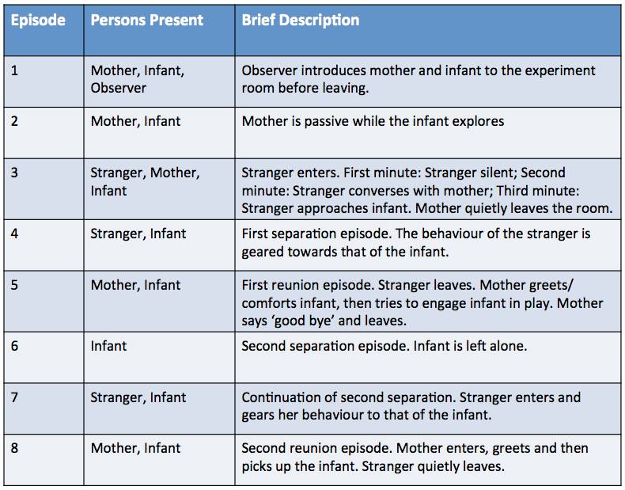

Slide 16
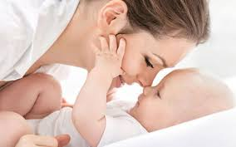
Secure attachment: 70%
Mother’s behavior is consistent and sensitive to the needs of children. child will develop secure attachment bcaz he knows mother is available specially in times of need. Although he becomes distressed when alone but he is confident that mother will return. Children with SA are happy, confident and explore the surrounding.
As an adult: it is quite normal and healthy to feel sad when your loved one leave and feel good in his/her presence
are able to form close bonds with others and are comfortable with interdependent relationships

Slide 17
Anxious resistant
Mother’s behavior is NOT consistent. At time she becomes responsive and at times neglect her child.
Children deveop ARA- and show a mixture of anger and helplessness toward mother.
Result: child feel passive, insecure and learn that he can not depend on mother.
Child show: intense distress when alone, Afraid of stranger , Upset at mother for leaving the room, Uncomfortable in going far from mother
want close relationships, but they suspect that other people do not truly care about them.

Slide 18
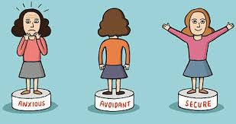
Avoidant attachment
Show minimal or no stress upon separation from mother. Play normally with stranger. Ignore the mother upon reuniting or actively avoid the mother. Both mother and stranger comfort the child equally.

Slide 19
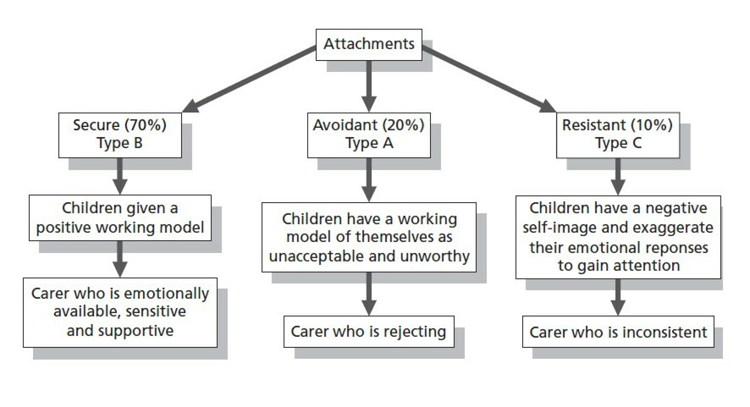

Slide 20
Conclusion
Children style of attachment depends on the caregiving he received from mother
-ve effects:
Causing Decline in intelligence
Depression
Aggression
Delinquency (tendency to commit crime)
Anti social PD
PTSD
Affectionless psychopathy (no concern for feelings of otters)
+ve relations= psychological wellbeing, sense of security, child will explore the world confidently. High level of self-confidance, self esteem, healthy, happy and lasting relation.

Slide 21
Application of this theory
Schools: need to understand those who are underachiever, procrastinate, delinquent, social competence
Organization with SA: score high on affective and normative commitment. emotional intelligence, enjoy work, job satisfaction, normal worn-out
Insecure: burnout, stress, neuroticism, fear of rejection,
Marital relations: secure: healthy relations, more trust, marital satisfaction, good coping skills, appreciation, gratitude, forgiveness, happy, friendly, and trusting, emotional stability
Insecure: conflicts, abuse, distressed relation, jealousy, emotional highs and lows, extreme sexual attraction, short length of relation
Parents: secure with authoritative and permissive
Insecure with authoritarian and neglectful

Slide 22
Applications (cont..)
Cognitive: better language skills, cognitive advantage, IQ, learning skills
Social: social competence, +ve peer interaction, social support, relations
Physical: promote good health, behavioral inhibition, stress reactivity, low level of cortisol, less drug use, less risky sexual behavior, and more exercise
Psychological: ego resiliency, substance abuse, anxiety, depression, positive and negative affect

Slide 23
Criticism on this theory by Field (1996)
The first limitation is that model attachment is based on behaviors that occur during momentary separations (stressful situations) rather than during nonstressful situations.
the list of attachment behaviors is limited to those that occur with the primary attachment figure, typically the mother. However, other attachments are not necessarily characterized by those same behaviors.
includes only blatant behaviors, but there may be physiological changes during separations and reunions.

Slide 24
Focusing only on infancy and early childhood period. It does not consider attachments that occur during adolescence (the first love), during adulthood (spouses and lovers), and during later life (the strong attachments noted between friends in retirement)

Slide 25
To conclude
Attachment theory underlines that attachment is a lifespan phenomenon existing “from the cradle to the grave” (Bowlby, 1973, 1976,1980). Bowlby (1988) argued that an infant’s relation with a caregiver is internalized as a working model and therefore generalized to new relationships.
Remember the parenting goal
https://www.youtube.com/watch?v=gIjyEHaD6BU
The Strange Situation｜Mary Ainsworth - YouTube

Slide 26
Ainsworth MD, Bell SM. Attachment, exploration, and separation: Illustrated by the behavior of one-year-olds in a strange situation. Child Dev. 1970;41(1):49-67. doi:10.2307/1127388
Bowlby J (1995) [1950]. Maternal Care and Mental Health. Bulletin of the World Health Organization. The master work series. 3 (2nd ed.). Northvale, NJ; London: Jason Aronson. pp. 355–533.
Bowlby J (1976) [1965]. Fry M (abridged &) (ed.). Child Care and the Growth of Love (Report, World Health Organisation, 1953 (above)). Pelican books. Ainsworth MD (2 add. ch.) (2nd ed.). London: Penguin Books. ISBN 978-0-14-013458-2.
Bowlby J (1999) [1969]. Attachment. Attachment and Loss (vol. 1) (2nd ed.). New York: Basic Books. ISBN 0-465-00543-8.
Bowlby J (1973). Separation: Anxiety & Anger. Attachment and Loss (vol. 2); (International psycho-analytical library no.95). London: Hogarth Press.
Bowlby J (1980). Loss: Sadness & Depression. Attachment and Loss (vol. 3); (International psycho-analytical library no.109). London: Hogarth Press.
Bowlby J (1988). A Secure Base: Parent-Child Attachment and Healthy Human Development. Tavistock professional book. London: Routledge.
Field, T. (1996). Attachment and separation in young children. Annual Review of Psychology, 47, 541-562.
Guglielmi D, Simbula S, Schaufeli W, Depolo M. Self-efficacy and workaholism as initiators of the job demands-resources model. Career Dev Int. 2012;17:375–89. doi: 10.1108/13620431211255842.
Lorente L, Salanova M, Martinez I, Schaufeli W. Extension of the job demands-resources model in the prediction of burnout and engagement among teachers over time. Psicothema. 2008:345–60.
Pines AM. Adult attachment styles and their relationship to burnout: a preliminary, cross-cultural investigation. Work & Stress. 2004;18:66–80. doi: 10.1080/02678370310001645025.
Shore J, Shore A. Modern attachment theory: the central role of affect regulation in development and treatment. Clin Soc Work J. 2007;36:9–20. doi: 10.1007/s10615-007-0111-7.

Slide 27
Attachment styles (18 itms, secure, insecure) Gratitude (5 ITEMS) Positive and negative affect (PANAS, 20 items) Ego resiliency scale (R) 10 items
Positive affect
Attachment styles
Ego resiliency
2. Gratitude
Negative affect

