Slide 1
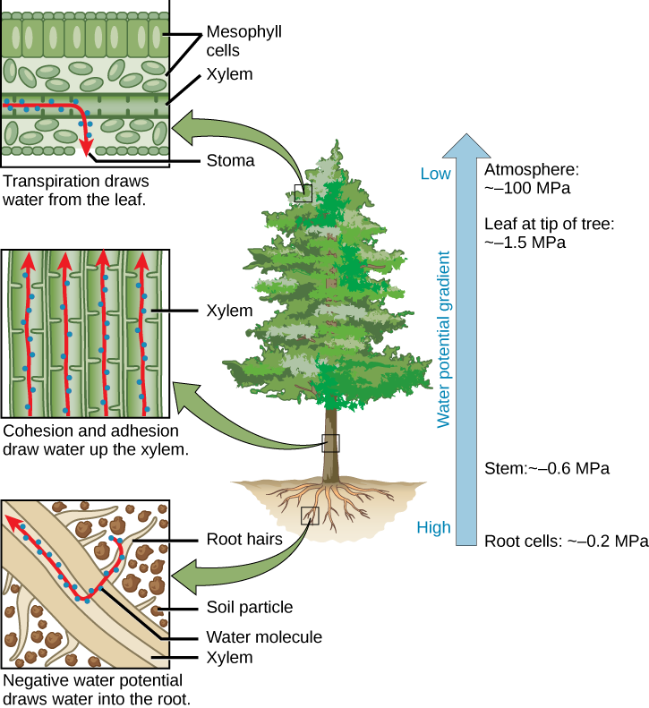
DEFINITION The difference between free energy of water in that system and the free energy of pure water at atmospheric pressure and defined temperature.
FACTORS
Two main factors that determine the water potential of plant cells are as follows:
Solute potential
Pressure potential
UNIT OF MEASUREMENT
Unit used for measuring water potential is termed as psi, ψ. The formula of water potential measurement is as follows:
Ψ = ΨS + ΨP

Slide 2
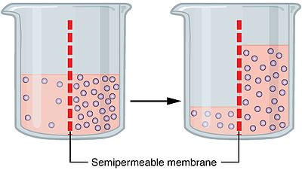
OSMOSIS Osmosis is movement of water from a higher potential to a lower potential through semipermeable membrane.
PRESSURE POTENTIAL
The hydrostatic pressure to which the liquid phase water is subjected is known as pressure potential. It can also be known as wall pressure or turgor pressure.
Water potential= pressure potential + solute potential
ROLE OF PRESSURE POTENTIAL
Turgidity, Flow of material and water, Cell enlargement, Turgor movement

Slide 3
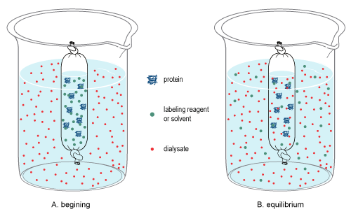
OSMOTIC POTENTIAL
To prevent the inward flow of pure solvent across the semi permeable membrane by applying minimum pressure. This minimum pressure is called as osmotic pressure.
POTENTIAL OSMOTIC PRESSURE
The maximum potential developed when the pure solvent is separated by solution through a semi permeable membrane.
IMPORTANCE OF OSMOSIS
purification of water, transport of water, Reabsorption of water, regulates the cell volume

Slide 4
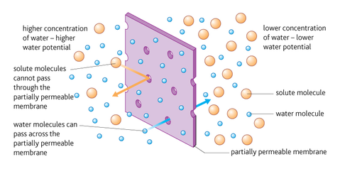
MEASUREMENT OF WATER POTENTIAL There are two ways to measure the potential pressure gauge vapor pressure The pressure gauge (tensiometer) works in the wet range-a special pressure gauge that delays the boiling point (UMS) from 0 to about -0.2 MPa. The vapor pressure method operates in the dry range-about -0.1 MPa to -300 MPa (0.1 MPa 99.93% relative humidity; -300 MPa 11%).

Slide 5
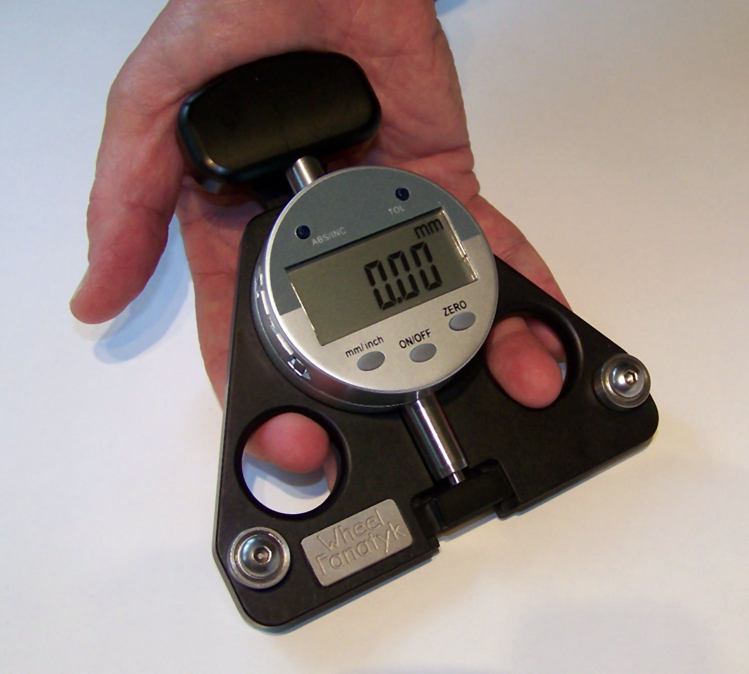
VAPOUR PRESSURE METHOD
WP4C Dew Point Hygrometer is a vapour pressure device. A tiny mirror in the chamber is cooled to form dew. At the dew point, WP4C measures the mirror and the sample temperature to the nearest 0.001. C to determine the relative humidity of the vapour above the sample.
ADVANTAGES
accuracy of 1% to -5 to -300 Mpa, easy to use, analyzed in five to ten minutes.
LIMITATION
Restrictions on the temperature measurement resolution. At high water potential content, the difference in temperature between the coils and subject flow in the sample chamber becomes smaller.

Slide 6
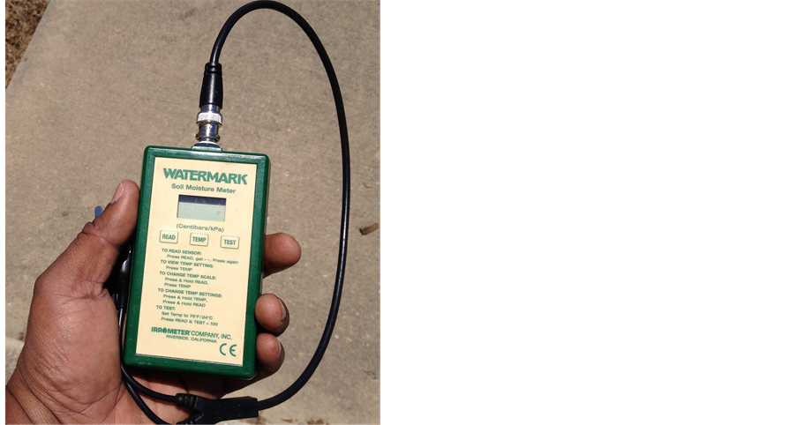
MATRIC POTENTIAL SENSOR
Matrix potential sensors use a porous material with a known moisture function. As all energy systems tend to balance, the porous material will reach a potential water balance with the surrounding soil.
LIMITED RANGE
All the senses that a matrix can have are limited by irrigation conductivity: as the soil dries, the balance of the porous material takes longer. The change also becomes negligible and really difficult to measure. At the wet end, the area of the sensor is limited by air pollution of the porous material used.

Slide 7
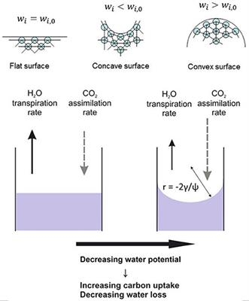
CONCLUSION
Water potential plays an important role in water flow theory, similar to temperature theory associated with heat flow, or voltage in the context of electric circulation theory. Water flows in response to liquid gradient. When the water potential is the same over the wall, the water does not flow, although the amount of water on either side of the wall may be different.

