Slide 1
Orthopedic Injuries

Slide 2
Basic Emergency Medical Care
Primary survey
Secondary survey
This consists of obtaining a History and Screening the torso and extremities for obvious deformities, open wounds, and adequate circulation.
Traumatic orthopedic injuries include establishing the degree of injury, evaluating neurovascular function, determining appropriate management for optimal outcomes, and providing correct splinting for immediate protection.

Slide 3
Fundamentals of Skeletal Fractures
Macrotrauma :
Fractures of the human skeletal system result when a bone is cracked or broken as a result of a single large force applied all at once or
Microtrauma :
Many small forces that accrue over a long period.

Slide 4
Skeletal fractures are often classified based on anatomical location of pathology and structures involved and are typically referred to as the distal segment relative to a proximal segment.

Slide 5
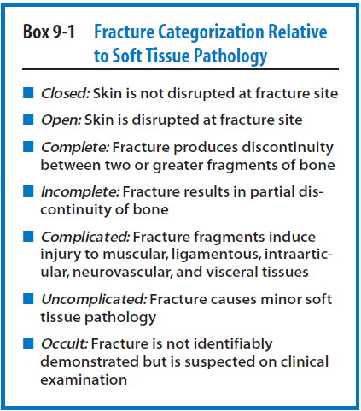

Slide 6
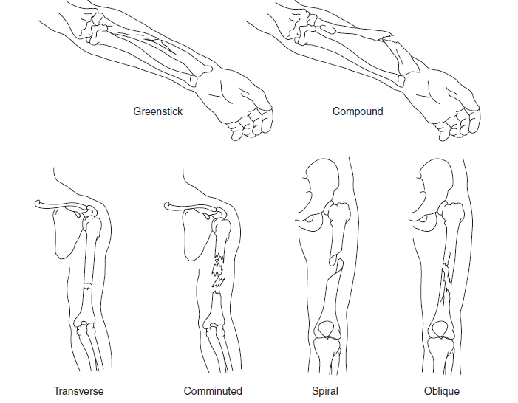

Slide 7
Greenstick fracture
A fracture in a young, soft bone in which the bone bends and breaks. Greenstick fractures usually occur most often during infancy and childhood when bones are soft.
The name is by analogy with green (i.e., fresh) wood which similarly breaks on the outside when bent.

Slide 8
Alignment :
The longitudinal position of a bone or limb
It refers to the association of long-bone fragment axes to one another and is measured in degrees of angulation from the distal fragment in relation to the proximal fragment.
Apposition :
The relationship of fracture fragments to one another
It is referred to as the contact of skeletal fracture fragments and may be expressed as a partial, bayonet or distraction.
Bayonet apposition presents as displaced fragments overlapping one another
Distraction occurs as fragments are displaced along a longitudinal axis.

Slide 9
Management
Bilateral Assessment of the Extremities.
Thorough observation of the skin at the injury site
Palpation of potentially fractured bone typically elicits point tenderness, significant pain, and crepitus.
Joints proximal and distal to a fractured site should be consistently evaluated for associated injury.

Slide 10
Soft tissue wounds and exposed bone should be thoroughly irrigated with sterile saline solution to remove debris
Should be immediately dressed with ample sterile materials to decrease the risk of infection and osteomyelitis.
Open fractures increase the incidence of infection and are deemed true traumatic orthopedic emergencies

Slide 11
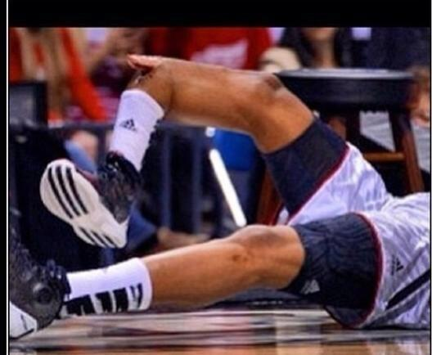
Open fracture
Increases the incidence of infection
Any bleeding in or around the area should be considered as open type. Vascular compromise sec to profuse bleeding
Absent pulse
health of that limb and overall life threatening situation

Slide 12
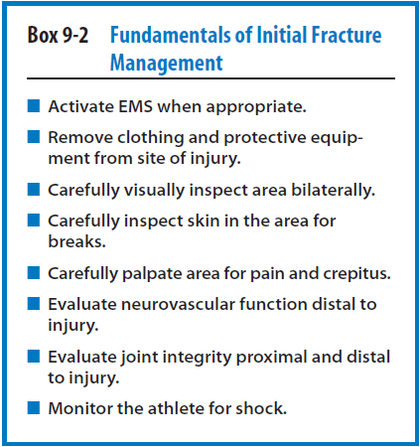

Slide 13
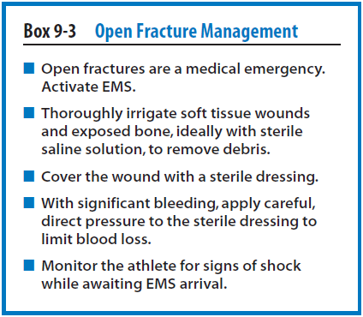

Slide 15
Acute compartment syndrome
It may potentially arise subsequent to any skeletal fracture but is most often encountered in the forearm and lower leg.
The defining clinical symptom of acute compartment syndrome includes pain out of context to what is expected with contraction or lengthening of injured compartment musculature.

Slide 16
There is little area to accommodate edema in these anatomical locations.
Abrupt increases in compartmental pressure as a result of excessive swelling cause diminished or absent pulses because of constricted blood vessels.
The alteration of correct sensation may also be present as a consequence of nerve impingement.

Slide 17
If inappropriately managed,this condition may prove limb threatening because the gradual onset of increased vascular pressure leads to an ischemic condition throughout the injured area
Gentle Traction along the longitudinal axis of the bone while moving fractured ends into correct anatomical position will usually result in reestablishment of pulses and sensation and may lead to a reduction in pain.

Slide 18
On site # alignment
Occasional practice
Competency of person
Degree of displacement / angulation
Associated Neurovascular pathology
With intact pulse it is recommended to splint the angulated part in same position.
In other situation it is better to Realign.
Gentle longitudinal traction:
Realign & establishment of pulse,
Pain regression
Opioid analgesics made process easy ☺

Slide 19
In a situation of inability to stop blood from the site of injury even after application of direct pressure on the site ….What will you do??

Slide 20
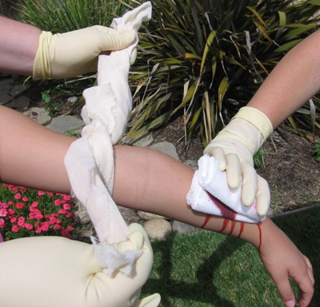
Direct Capillary
Pressure
Tourniquet

Slide 21
Complications of tourniquet application
Tourniquet pain - Characterized by hyperemia, hyperthermia and pain following reperfusion
Post-tourniquet syndrome - Manifesting as pain, numbness, paresis, stiffness and pallor
Skin changes - Blistering, ischemic necrosis
Compartment syndrome

Slide 22
Splinting Techniques
Proper immobilization of the injury tends to diminish irritation and pain and consequently limits edema or effusion.
Reduces the danger of magnified fragment displacement.
Lacerations, abrasions, and avulsions should be suitably cleansed and dressed with sterile supplies prior to application of a splint.

Slide 23
Basic Classes of Splints
Rigid
Soft
Formable
Vacuum
Traction splints

Slide 24
Rigid Splints
which are constructed of stiff and sturdy materials, are most appropriately used for protecting and immobilizing misaligned skeletal fractures or gross joint instability.

Slide 26
Soft Splints
It use air pressure or bulky padding for immobilization and protection purposes of skeletal fractures and pathological joint instability.

Slide 27
Varied forms of soft devices include pillow and air splints.
A Pillow Splint is a comfortable piece of equipment commonly used with foot and ankle complex injuries that applies mild and steady pressure on the affected anatomy. A pillow splint is wrapped around the foot and ankle complex and secured with tape or bandage.

Slide 28
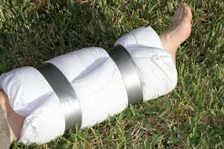

Slide 29
Air splints are structured in a similar way to a fashioned cylinder and permit contouring specific to the injured anatomy.
Air splints provide the advantage of supplemental compression that may be beneficial in limiting excessive hemorrhages.

Slide 30
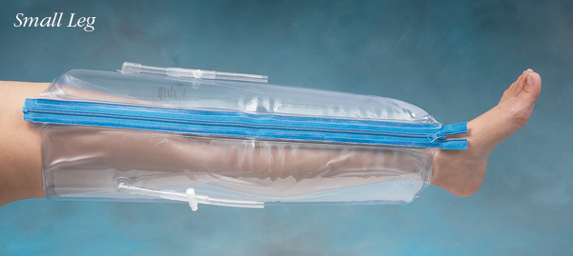

Slide 31
Air splints are not to be used with humeral or femoral fractures because of their inability to adequately limit proximal joint excursion.

Slide 32
Formable Splint
It is somewhat of a fusion device consisting of a semi-rigid shell and soft inner lining.
The formable splint’s soft inner lining is usually composed of foam and serves to support the injured area.

Slide 33
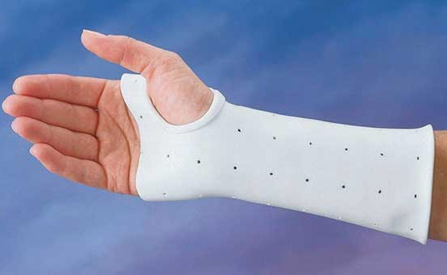
Formable Splint

Slide 34
Vacuum splints are constructed of fabric or vinyl material containing micro Styrofoam beads.
Fixed and secured to the injured area by straps.
Traction splints
They are often used to treat long-bone fractures, especially of the lower extremity.
Limit spasm of surrounding musculature.

Slide 35
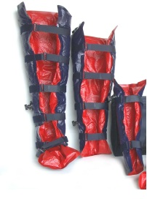
Vaccum splint

Slide 36
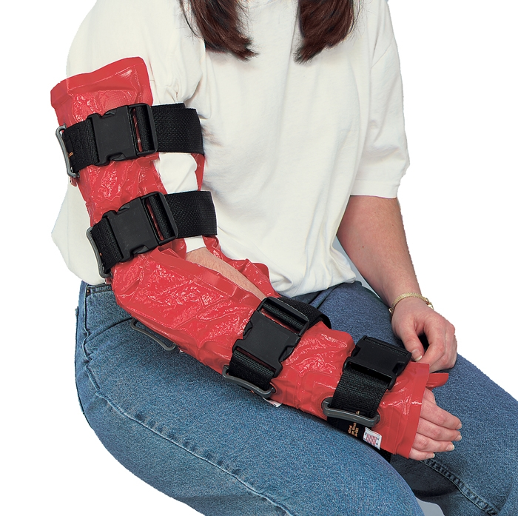

Slide 37
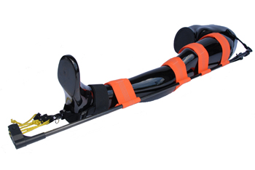
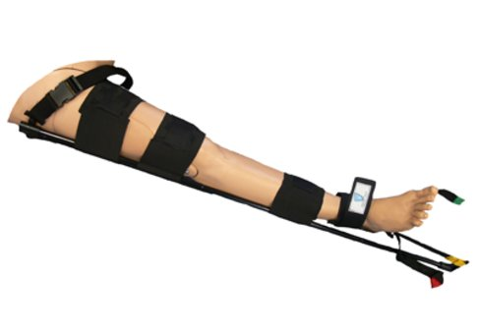
Traction splint

Slide 38
Traction splints are used cautiously with upper extremity long-bone fractures because of the potential for susceptible pathology of respective neurovascular structures.
Immobilize joints both proximal and distal to a fracture site.

Slide 39
Splints should be adequately padded to protect the skin and soft tissues prior to their application.
Elastic wraps are typically used in splint application.

Slide 40
Fractures and Dislocations of Upper Extremity

Slide 41
Fractures of the Hand and Wrist
Most commonly fractured sites of human Skeletal.
Only open fractures and dislocations are considered true orthopedic traumatic emergencies.
Splinting the injured hand and wrist complex in a position of function and immediately transporting the athlete to the nearest hospital.

Slide 42
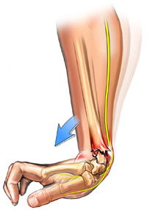
Fractures of the Forearm
The most common type of distal radial fracture is the Colles’ fracture.
Falling on an outstretched arm with the wrist in extension.
Mechanism of injury > fractured fragments dorsally.
Median nerve Palsy
An additional traumatic distal radial fracture is known as the Smith’s fracture.

Slide 43
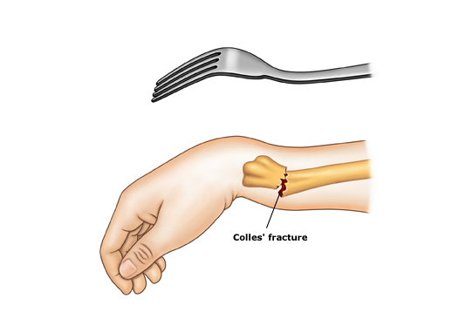
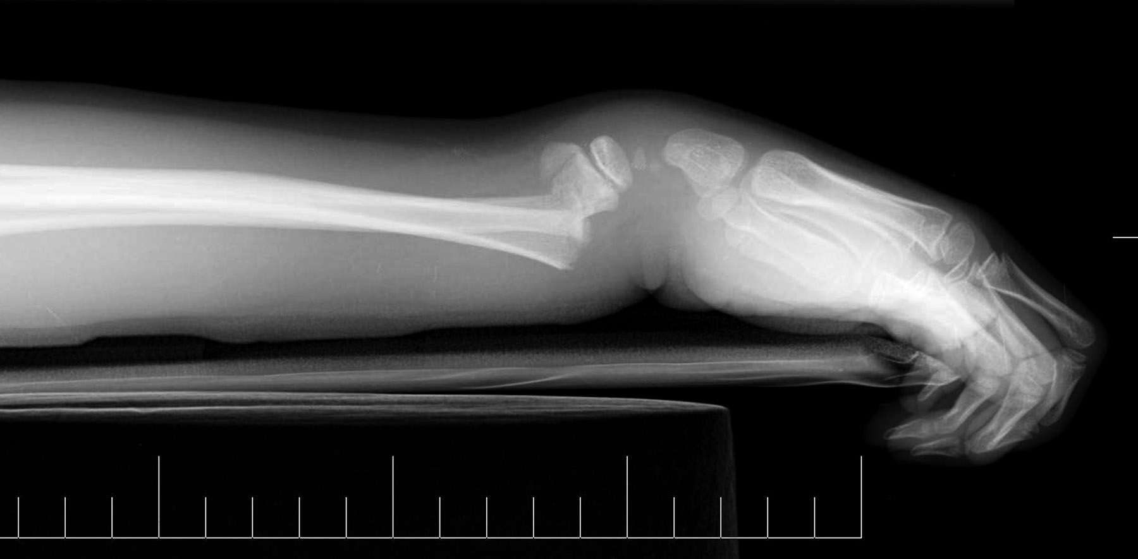
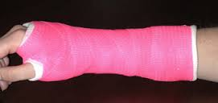

Slide 44
volar displacement of distal fragments following injury.
falling on an outstretched arm with the wrist in flexion.
Reverse Colles fracture
requires urgent referral to Orthopedic Surgeon.
Activation of EMS
Monitor neurovascular function

Slide 45
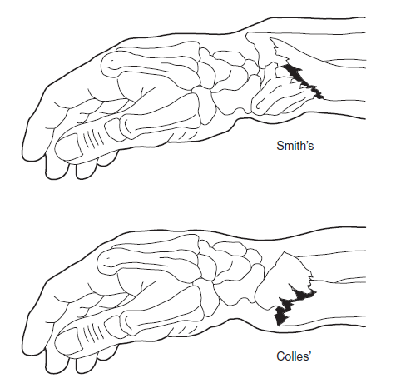

Slide 46
acute compartment syndrome and shock
Radial and ulnar shaft fractures are most often the result of a significant direct force.
Radial shaft fractures are more prevalent at the middle and distal third because of the decreased cross-sectional area of the musculature.
Rigid splint

Slide 47
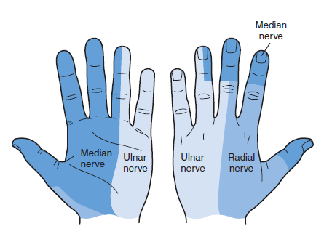
Most important is assessing sensorimotor distribution of the radial, median, and ulnar nerves along the forearm and hand

Slide 48
Fractures of the Elbow
Blunt trauma or falling on an outstretched arm.
Uncommon
Sensorimotor distribution of the median nerve.
Monitoring the Brachial Artery
Volkman’s ischemic contracture

Slide 49
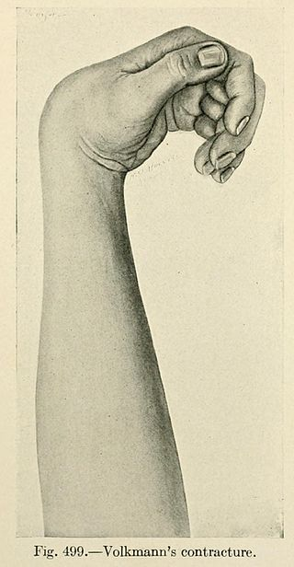
A permanent flexion contracture of the hand at the wrist, resulting in a claw-like deformity of the hand and fingers. Passive extension of fingers is restricted and painful. It is excruciatingly painful and disabling.

Slide 50
Comfortable compressive dressing and immobilization of the elbow with a rigid long-arm splint in the position of presentation.

Slide 51
If the lateral condyle is affected, splint the forearm in supination with the wrist in extension so as to alleviate tension on the wrist extensor musculature.
If the medial condyle is fractured, the wrist should be splinted in pronation and flexion so as to ease tension on the wrist common flexor tendon.

Slide 52
Olecranon if suspected of fracture
Fracture of the olecranon is recognized as an intra articular lesion and calls for realignment to ensure favorable outcomes.
Displaced olecranon fractures routinely rupture the triceps aponeurosis and subject the ulnar nerve to compromise.

Slide 53
with a rigid splint
If non-displaced then a long-arm splint with the elbow joint flexed to 70 degrees and the wrist joint in neutral.
Complications that may arise from improper care include cubitus valgus or varus deformity, malunion, arthritis, and ulnar nerve palsy.

Slide 54
Fractures of the radial head and neck are commonly related to avulsion of the humeral lateral epicondyle or capitellar injury.
Assess integrity of the distal radioulnar joint subsequent to radial head and neck fractures.
Violent mechanisms of injury to the radial head and neck may occasionally result in an Essex-Lopresti fracture.

Slide 55
Essex-Lopresti fracture
A fracture of the radial head with dislocation of the distal radioulnar joint and disruption of the interosseous membrane.

Slide 56
Rupture of the interosseous membrane.
Substantial morbidity may result from negligible treatment of an Essex-Lopresti fracture.
Potential onset of acute compartment syndrome secondary to skeletal fracture

Slide 57
Fractures of the Humerus and Shoulder
Proximal humeral fractures typically occur in the athletic population as the result of trauma, most likely secondary to falling on an outstretched arm.
Direct blow to the lateral aspect of the bone.
Athlete to hold the involved arm in an adducted position.

Slide 58
Pain, edema, and focal tenderness over the proximal humerus.
the brachial plexus, axillary nerve, and vascular structures in danger of compromise.
Typically GHJ fracture-dislocations cause the anatomical area to be more susceptible to related rotator cuff lesions and brachial plexus and axillary neurovascular pathology.

Slide 59
Appropriate arm sling and swathe.
The careful application of ice for pain and spasm control.
Potential complications resulting from inappropriate treatment include malunion healing, myositis ossificans, secondary GHJ stiffness, and arthritis.

Slide 60
Myositis ossificans
The formation of bone tissue inside muscle tissue after a traumatic injury to the area. ​
This injury usually is the result of an acute deep-muscle bruise or repeated muscular trauma to the same spot, and rarely is caused by a bad muscle strain.

Slide 61
Greater and lesser tuberosities include nonunion healing of the respective osseous structures and tenosynovitis of rotator cuff musculotendinous tissues.
Avascular necrosis (AVN) may also result from inadequate management of these conditions.

Slide 62
A direct force to the humerus, such as a violent blow, frequently results in a transverse fracture of the bone.
Indirect force > spiral fracture.
Humeral shaft fractures, especially the radial nerve, is essential.
Fractures to the middle and distal third of the humerus carry the potential for radial palsy, which is exemplified by wrist-drop or an inability to actively extend the wrist of the injured arm.

Slide 63
The presence of displacement and the degree of angulation or accompanying neurovascular pathology.
a rigid long-arm splint
Failure to appropriately manage humeral shaft pathology may lead to nonunion or delayed union healing and radial nerve palsy.

Slide 64
Scapular Fractures
Extreme forces eliciting scapular fracture may be associated with life-threatening thoracic injuries.
elevation, immobilizing the affected extremity in a sling and swathe, and carefully applying ice for pain control.

Slide 65
Clavicle
From a direct force to the bone or are secondary to a traumatic force imparted onto the lateral aspect of the shoulder complex.
Exacerbation into an open fracture.
GHJ horizontal adduction.
Fractures to the intermediate and lateral thirds of the clavicle are most prevalent

Slide 66
A sling and swathe, careful application of ice for pain control, and urgent referral to an orthopedic specialist for consultation.
Traditionally, figure-eight bandages.
The most severe yet least common type of clavicular fracture occurs at the medial third.Circumstances pneumothorax or hemothorax may result and lesions to the brachial plexus or subclavian vasculature.

Slide 67
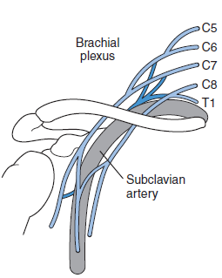
Examination of pulmonary and neurovascular functions during routine management of clavicular fractures.

Slide 68
Fractures of the Thorax
Sternum
A blunt force directed to the anterior thorax.
Extreme trunk hyperflexion injuries may also generate fractures of the sternum.
Tenderness and occasional crepitus may be present with palpation of the fractured bone.

Slide 69
Palpitations may be noted secondary to dysrhythmia, which is an additional sign of cardiac pathology.
To facilitate respiration and periodic evaluation of vital signs.
Pneumothorax, hemothorax, cardiopulmonary contusion, and neurovascular compromise

Slide 70
Increase respiratory restriction and exacerbate an underlying pulmonary injury.

Slide 71
Fractures of the Lower Extremity
Pelvis
Symptoms specific to pelvic fractures include extreme pain and tenderness throughout the injured area and hematuria indicating internal hemorrhage.

Slide 72
Other clinical indications include Destot sign, indicated by formation of a hematoma above the inguinal region.
Roux sign indicates bilateral distance discrepancies between the greater trochanter and anterior superior iliac spines,
signifying an acetabular fracture..

Slide 73
EMS
vital signs
Complications
Intra pelvic compartment syndrome, digestive and reproductive systems dysfunctions, and internal infections subsequent to disruption of urinary and bowel structures.

Slide 74
Femur
The femur is known to be the largest and strongest bone in the body. This bone also possesses a rich vascular supply.
Type I (spiral or transverse, which represents the most common) Type II (comminuted)
Type III (open)

Slide 75
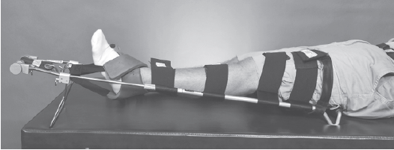
Tachycardia and hypotension may result from extensive blood loss and are indicative of hypovolemic shock.
Rigid splint
Successful realignment of femoral fractures often requires intravenous opioid analgesic administration for pain control.

Slide 76
Patella
Both indirect and direct mechanisms of injury.
Violent quadriceps contraction.
Displaced transverse fracture to the patella and render the knee joint void of the quadriceps extensor mechanism.

Slide 77
Actively extend the knee joint or perform a straight leg raise against gravity.
Open patellar fractures should be splinted with a knee joint immobilizer after the wound is appropriately cleaned and dressed for transport to a hospital by EMS.

Slide 78
Tibia and Fibula
The tibia remains the most frequently fractured long bone in the human skeletal system and is often associated with open fractures.
Direct trauma and indirect torsional forces.
Transverse or comminuted displaced open fracture with associated fibular fracture.

Slide 79
Spiral or oblique fractures
Displaced fragments or coupled soft tissue pathology.
Interosseous membrane.
Tibial and fibular fractures often present with extreme pain and edema of the lower leg and an obvious anatomical deformity.

Slide 80
Dorsal pedal and posterior tibial pulses and capillary refill are necessary to recognize the onset of acute compartment syndrome.
Exaggerated pain, pallor, paresthesia, or paralysis.
A rigid or vacuum splint.

Slide 81
Fractures of the Foot and Ankle
Foot
Lisfranc fracture.
Fracture of Base of the third metatarsal.
Substantial torsional stress, and physical examination reveals significant swelling and pain at the tarsometatarsal joint.

Slide 82
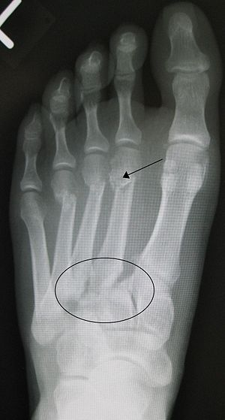

Slide 83
Include immobilizing the foot in a posterior ankle splint or walking boot and advising the use of crutches for non weight-bearing ambulation.
Include post-traumatic arthritis and reflex sympathetic dystrophy.

Slide 84
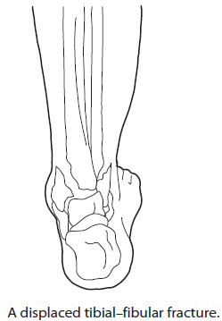
Ankle

Slide 85
The distal tibia and fibula and the talus and calcaneus.
The most common mechanism of injury is hyperinversion of the joint.

Slide 86
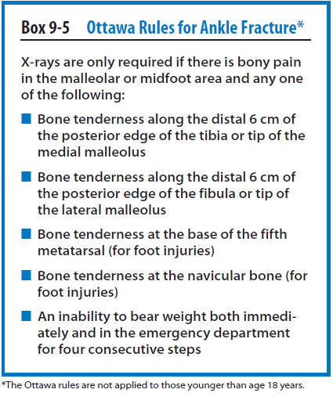

Slide 87
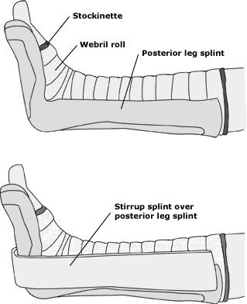
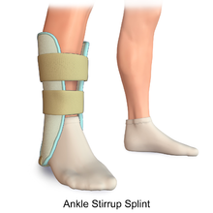
Posterior ankle splint, sugar tong/short-leg stirrup splint, or walking boot.

Slide 88
Fundamentals of Joint Dislocations
Early reduction following joint dislocation is less difficult than prolonged reduction.
In most cases only dislocations of the patella, shoulder, fingers, or toes should be reduced on the field if required immediately.
Reductions of the elbow, hip, or knee joints are regarded as difficult.

Slide 89
Dislocations of the Hand
Dislocations at the hand, especially of the digits, are common in sports activities.
Mechanisms of injury may present as either significant or marginal trauma and usually consist of axial loading, compression, hyperextension, and valgus or varus forces on the respective joint.

Slide 90
Firm traction along the longitudinal axis of the joint and gentle movement so as to return the joint to normal anatomical alignment.
Applying ice and splinting in a position of function such as buddy taping.

Slide 91
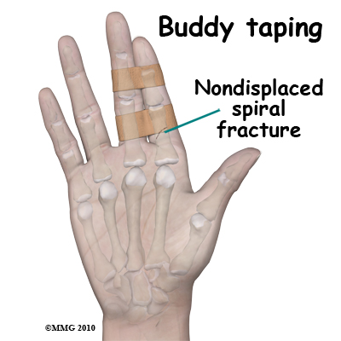

Slide 92
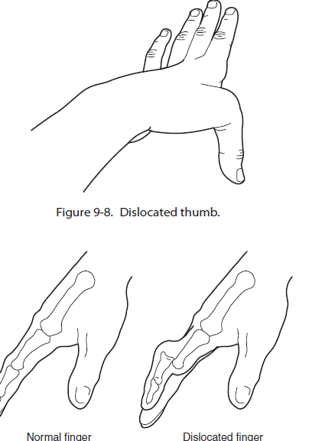

Slide 93
Dislocations of the Elbow
The elbow joint is susceptible to anterior and posterior dislocation.
With anterior dislocations, a significant force is typically directed to the posterior aspect of a flexed elbow.
Anteriorly respective to the humerus. In the more common posterior dislocation, the mechanism of injury is often described as a fall on an outstretched arm.

Slide 94
a rigid, air, or vacuum splint.
Complications resulting from inadequate management include brachial artery occlusion, medial or ulnar nerve pathology, and myositis ossificans and arthritis.
If a spontaneous reduction of a dislocation is suspected, the athletic trainer should evaluate stability of the elbow complex and appropriately splint the area.

Slide 95
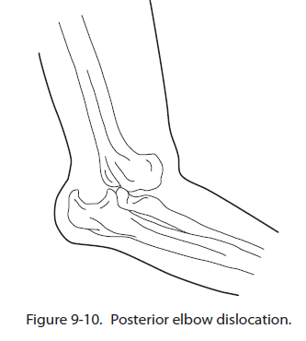

Slide 96
Dislocations of the Shoulder
Anterior and Posterior.
Inferior dislocations are typically associated with concomitant fracture and significant neurovascular compromise, although such injuries are rare.

Slide 97
Anterior dislocation is that of a direct extreme external rotation and abduction force applied to the GHJ.
Posterior dislocations of the GHJ occur as the result of a significant direct force that drives the humeral head posteriorly, thereby disrupting its integrity with the glenoid.

Slide 98
This usually consists of an exaggerated protrusion of the humeral head and hollow area inferior to the acromion.

Slide 99
The self-reduction technique, the gravity (modified Stimson’s) method, and traction/external rotation procedure.
Self reduction calls for the athlete with a GHJ dislocation to interlock his or her fingers and grasp the flexed knee of the unaffected side.
The athlete then gradually leans backward , inducing slight traction to the GHJ, which ideally yields relocation.

Slide 100
The gravity (modified Stimson’s) method requires the athlete to lay prone with the injured extremity draped over an examination table or similar surface.
The athletic trainer then grasps the wrist of the affected extremity and applies a minimal amount of gravity-assisted traction.
The gravity assisted traction aims to gradually stretch the surrounding musculature in spasm, thereby facilitating relocation of the GHJ

Slide 101
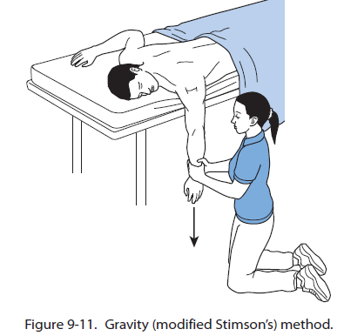
An arm sling

Slide 102
The traction/external rotation procedure begins with the injured athlete in a supine position followed by the athletic trainer inducing mild and continual traction along the humeral axis of the affected extremity.
Returned to 0 degrees of abduction and internally rotated until the hand comes into contact with the torso, all while maintaining steady traction.

Slide 103
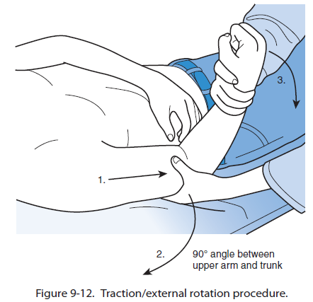

Slide 104
The athletic trainer then slowly and passively guides the GHJ to approximately 90 degrees of abduction while maintaining the mild traction.
If reduction in this position proves unsuccessful, the clinician may attempt to gradually increase GHJ abduction to 120 degrees while steadily maintaining traction and GHJ external rotation.

Slide 105
Returned to 0 degrees of abduction and internally rotated until the hand comes into contact with the torso, all while maintaining steady traction.
An arm sling.

Slide 106
Dislocations of the Thorax
The sternoclavicular joint (SCJ).
blow to the anterior aspect of the shoulder complex transmitting force to the SCJ.
Posterior SCJ dislocations are prevalent.
These include pneumothorax, lesions to the superior vena cava and trachea, and occlusion of the subclavian vasculature.

Slide 107
Other symptoms that may be indicative of additional pathology include dyspnea, dysphagia, and paresthesia.
Injured athlete may remain seated upright with the affected arm placed in a sling.

Slide 108
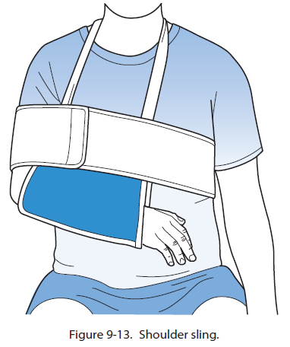

Slide 109
Dislocations of the Hip
As anterior, posterior, or central.
Less common anterior hip joint dislocations most often result from a substantial force imparted on an abducted leg, which levers the femoral head anteriorly from the acetabulum.

Slide 110
Forceful direct blow to the posterior aspect of the joint.
Protrusion of the femoral head from the acetabulum.

Slide 112
Significant force transmitted along the femoral shaft while both knee and hip joints are in a flexed position.
termed central, is best
The central hip dislocation typically ensues following application of a significant direct force to the lateral aspect of the joint.

Slide 113
Symptoms of paresis may further indicate associated pathology to the femoral nerve. Pallor and diminished distal pulses should raise suspicion of femoral artery compromise.
Complications of hip joint dislocations include osteoarthritis, femoral neurovascular compromise specific to anterior dislocation,
chronic hip joint instability, AVN of the femoral head, and sciatic nerve pathology subsequent to posterior dislocation.

Slide 116
Dislocations of the Knee
Tibiofemoral Joint
Complete displacement of the tibia from the femur with rupture of three or more articulating ligaments.
usually ruptures both cruciate ligaments and at least one collateral ligament.
anterior, posterior, medial, lateral, and rotational.

Slide 117
Posterolateral being most common.
Finally, knee joint dislocations can also be expressed as open or closed and either reducible or irreducible.
Monitoring of distal pulses and sensory distribution.
The popliteal artery and peroneal nerve
a rigid splint.

Slide 118
To be stabilized in a knee joint immobilizer set to 30 degrees of flexion.
Patellofemoral Joint
Dislocations of the patella most often occur when a partially flexed knee is exposed to simultaneous valgus and extensor forces.

Slide 119
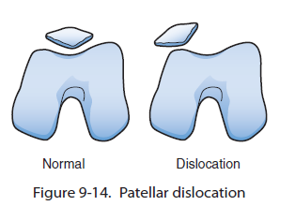
The athletic trainer then fully extends the knee gently while applying firm pressure directed medially to the lateral border of the patella.
immobilization of the knee joint in full extension with a brace.

Slide 120
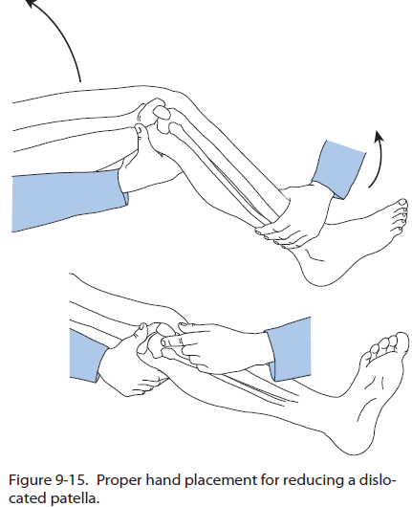

Slide 121
Dislocations of the Ankle
The ankle and include posterior, anterior, lateral, and superior.
Posterior dislocations represent the most prevalent type encountered and are subsequent to a force that displaces the talus posteriorly relative to the tibia

Slide 122
Anterior dislocations are commonly the product of an anteriorly directed force on the posterior aspect of the ankle while the foot is suspended in the open kinetic chain.

Slide 123
Lateral dislocations are associated with hyper inversion, hyper eversion, or excessive rotatory excursion of the ankle joint and are typically accompanied by malleolar and distal fibular fractures.
Superior joint dislocations are most often the product of the talus displacing superiorly within the ankle mortise and usually are encountered subsequent to violent falls from a considerable height.

