Slide 1
Rural Sociology ^{BS Sociology} Semester: 7th ^{Lecture No. 07} ^{Instructor: Mumtaz Hussain} University of Sargodha Sb Campus ^{Bhakkar}

Slide 2
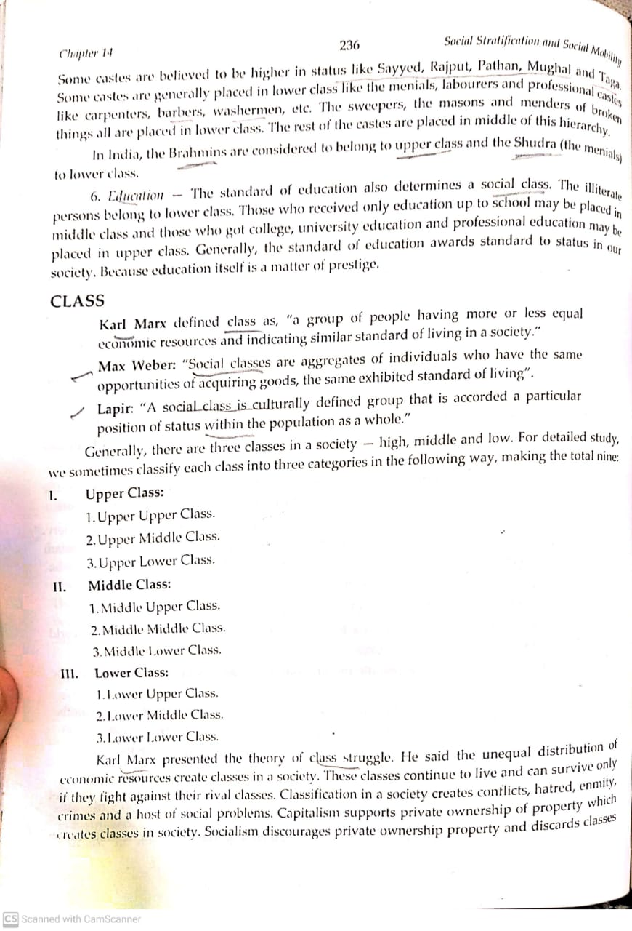
Class:

Slide 3
Continue..

Slide 4
Continue..

Slide 6
Continue..

Slide 9
Biradari
Biradari defined as “brotherhood” originated by the Persian word Baradar meaning “brother”. Among South Asian Muslims especially in Pakistan and India, a number of social classes are segregated on the basis of biradari. According to the author Anatol Lieven, in Pakistani society biradari plays the role of most important force, stronger and significant than religion, ethnic or any ideological causes. Political alliances and parties in Pakistan are normally based on biradari system not ideologies.
In Punjabi cultural scenario, biradari/qaum/zat is considered to be most important and strongest tie that is favored most of the time while making political alliances and loyalty of people within the same caste group.

Slide 10
Biradari
In the social system of Pakistan's Punjab province, the main characteristic is biradarism. Biradari system plays its role on both local and national level politics. Biradari vote for the same biradari that shows more significance determinant than party loyalty. The first trend is the caste, a major determinant of voting behavior .
Biradari system played an important role in different times in Pakistan during local body elections. Most important and functional biradaris’ in politics of Punjab are Gujjars, Jatts, Syeds, Araiens, Bloachs and Rajputs. District administration is normally selected from the key biradari of respective district. Rajputs are in northern Punjab, Jatts and Araiens are in central Punjab, Balochs in southern Punjab leading the political activities. The stratification of biradris into different areas of Punjab affects outcomes of overall Pakistan’s political system.
Biradari is defined as “an association, attachment, emotional linkage and sharing common characteristics by an individual being a part of a particular group descended of the same ancestor”.

Slide 12
Thank You

