Slide 1
Rural Sociology ^{BBA} Semester: 3rd ^{Lecture No. 19} ^{Instructor: Mumtaz Hussain} University of Sargodha Sb Campus ^{Bhakkar}

Slide 2
SOCIAL INSTITUTIONS

Slide 3
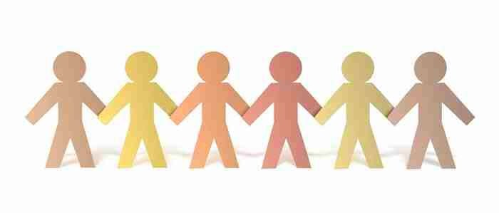
.
In sociology, social institutions, such as economy and government, are the 'bike parts' and the overall society is the 'bicycle.' Social institutions are established sets of norms and subsystems that support each society's survival.

Slide 4
WHAT IS A SOCIAL INSTITUTION?
Social institution is a group of social positions, connected by social relations, performing a social role.
Any institution in a society that works to socialize the groups of people in it.
Ex. universities, governments, families,
And any people or groups that you have social interactions with.
It is a major sphere of social life organized to meet some human need.

Slide 9
CHARACTERISTICS AND FUNCTIONS OF AN INSTITUTION
Palispis (1996) pointed out the following characteristics and functions.
Institutions are purposive. Each of them has the satisfaction of social needs as its own goal or objective.
Relatively permanent in their content. The pattern roles and relations that people enact in a particular culture become traditional enduring. Although institutions are subject to change, the change is relatively slow.

Slide 10
.
Institutions are structured. The components tend to band together, reinforce one another. This is because social roles and social relations are in themselves structured combinations of behavior patterns.
Institutions are a unified structure. They function as a unit.
Institutions are necessarily value-laden. Their repeated uniformities, patters and trends become codes of conduct. Most of these codes subconsciously exert social pressures. However, others are in form of rules and laws.

Slide 11
FUNCTIONS:
Institutions simplify social behavior for the individual person. The social institutions provide every child with all the needed social and cultural mechanisms through which he can grow socially.
Institutions provide ready-made forms of social relations and social roles for the individual. The principal roles are not invented by the individuals, they are provided by the institutions.

Slide 12
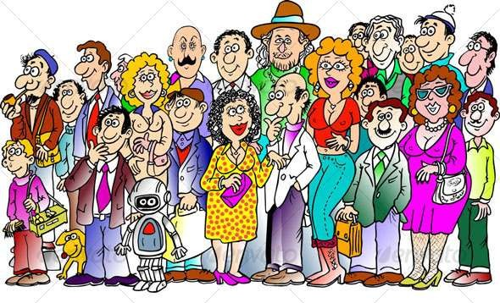
Institutions also act as agencies of coordination and stability for total culture. The ways of thinking and behaving that are
institutionalized “make sense” to people.
Institutions tend to control behavior. They contain the systematic expectations of the society.

Slide 13
.
Social Institutions can take many forms, depending on a social context.
It may be a family, business, educational, or political institution.

