Slide 1
content
What is RNA virus?
Discovery and History
Examples of RNA virus
Dissemination of RNA virus
Mechanism of RNA virus

Slide 2
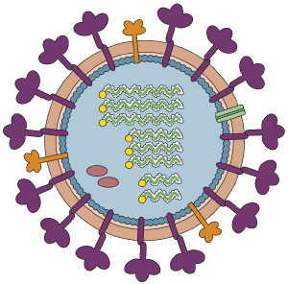
RNA Virus
RNA virus is a virus that has RNA as genetic material .The nucleic acid is usually single stranded RNA but may be double stranded RNA.

Slide 3
Introduction .
RNA virus were discovered about the same time as a series of momentous events in molecular biology.
About 50 years before the development of electron microscope the existence of viruses was demonstrate as a large group of a cellular disease causing agents composed of nucleic acid encapsulated in a protein coat by L.pasteur and A.Mayer .

Slide 4
Discovery
In 1884 the French microbiologist Charles Chamberland invented a filter known today as the Chamberland filter or Chamberland Pasteur filter that has pores smaller than bacteria .Thus he could pass a solution containing bacteria through the filter and completely remove them from the solution.
In the early 1890’s The Russian biologist Dmitri Ivanovsky used this filter to study what became known as the tobacoo mosaic virus. His experiment showed that extracts from the crushed leaves of infected tobacco plants remain infectious after filtration.

Slide 5
In 1935,
American biochemist and virologist Wendell Meredith Stanley examined the tobacco mosaic virus and found it to be mostly made from protein .
A short time later this virus was separated into protein and RNA parts.

Slide 6
Types of RNA Virus
Orthomyxovirus
Hepatitis C virus
SARS
Influenza virus
Retro virus
Corona virus
Tobacco Mosaic virus.

Slide 7
Dessimination of RNA virus
A desseminated infection is one in which a localized infection spreads from one area of the body to other organs systems while there are systematic infections that can affect the entire body at once.
How viruses are transferred Viruses can be transmitted in variety of ways such as through:
Saliva
Touch
Sexual contact
Sharing contaminated needles
Insect

Slide 8
Process of Rna dessiminition
Rna dessiminate through following processes:
Pathogenesis
Pathogenesis is the process by which an infection leads to disease. Pathogenic mechanisms of viral disease include .
(1) implantation of virus at the portal of entry
(2) local replication
(3) spread to target organs (disease sites)
(4) spread to sites of shedding of virus into the environment.

Slide 9
Cellular Pathogenesis
Direct cell damage and death from viral infection may result from
(1) diversion of the cell's energy,
(2) shutoff of cell macromolecular synthesis,
(3) competition of viral mRNA for cellular ribosomes,
(4) competition of viral promoters and transcriptional enhancers for cellular transcriptional factors such as RNA polymerases, and inhibition of the interferon defense mechanisms. Indirect cell damage can result from integration of the viral genome, induction of mutations in the host genome, inflammation, and the host immune response.

Slide 10
Key stages of RNA virus Dessiminition
Implantation
Replication and local spread
Dessiminition from portal of entry
Incubation period
Multiplication in target organs
Shedding

Slide 11
Implantation
RNA virus implant onto living cells mainly via the respiratory, gastrointestinal, skin-penetrating, and genital routes although other routes can be used.

Slide 12
Local Replication and Local Spread
Most virus types spread among cells extracellularly, but some may also spread intracellularly. Establishment of local infection may lead to localized disease and localized shedding of virus

Slide 13
Dissemination from the Portal of Entry:
The most common route of systemic spread from the portal of entry is the circulation, which the virus reaches via the lymphatics. Virus may enter the target organs from the capillaries by
(1) multiplying in endothelial cells or fixed macrophages
(2) diffusing through gaps
(3) being carried in a migrating leukocyte.
Neural: Dissemination via nerves usually occurs with rabies virus.

Slide 14
Incubation Period
The incubation period is the time between exposure to virus and onset of disease. During this usually asymptomatic period, implantation, local multiplication, and spread (for disseminated infections) occur.
Multiplication in Target Organs
Depending on the balance between virus and host defenses, virus multiplication in the target organ may be sufficient to cause disease and death.
Shedding of Virus
Although the respiratory tract, alimentary tract, urogenital tract and blood are the most frequent sites of shedding, diverse viruses may be shed at virtually every site

Slide 15
Examples of RNA virus
Rabies
It is acute viral disease of CNS .The causative agent of rabies is rebiews virus (RV) a negative stranded RNA virus of the rhabdovirus family . Mode of transmission
Animaql bite ,licks
Dessiminition:
Is an acute infection of CNS .Following inoculation .Virus replicates in striated or connective tissue at site of inoculation and enters peripheral nerves through neuromuscular junction.
It then spread to CNS.

Slide 16
dessimination of rabbies

Slide 17
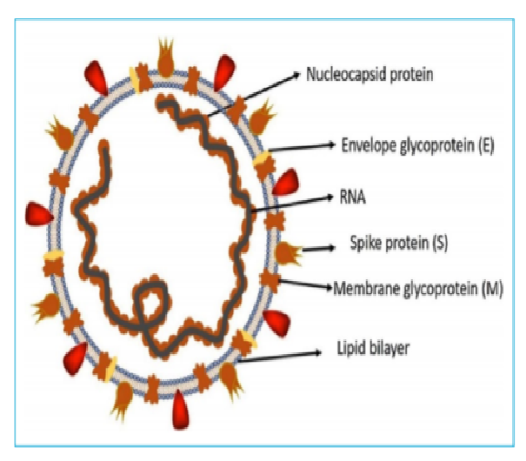
Corona Virus
COVID-19 is an infectious disease caused by the recently found
virus known as SARS-CoV-2 (or coronavirus).
Before the outbreak originated in Wuhan, China
on December 2019, there was no information
about this virus.It is RNA virus.

Slide 18
Mechanism of Transmission of COVID-19
A highly transmittable and pathogenic viral infection
Mainly transmitted through contact with respiratory droplets Primarily people can catch coronavirus disease 19 (COVID-19) from others who are infected.
A single cough can circulate up to 3,000 droplets. These droplets can land on other people, and covering surfaces around them, however, several smaller particles will stay within the air.
That is why to stay more than 1 meter (3 feet) away from a person who is sick.
Transmit through respiratory secretions, direct contact with infected people, contaminated surfaces with these droplets

Slide 19
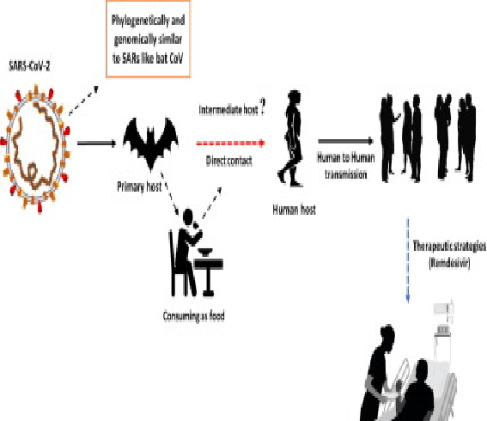
Transmission of COVID-19

Slide 20
Replication
Infection begins when the virus enters the host cell, the virus spike protein attaches to its complementary host cell receptor.
After attachment, a proteolytic enzyme of the host cell cleaves and activates the receptor-attached spike macromolecule .
Coronavirus RNA consists of 5' methylated head and a 3' polyadenylated tail, through which the RNA attaches to the free ribosomes of the host cell. This lead to the process of translation and formation of a long polypeptide chain.

Slide 21
Thank you

