Slide 1
Subject: Population Studies
Class: MSc 4th
Lecture: 5th week
Topic: Life Tables

Slide 2
Question
The following data represent the age distribution and number of survivors.
Age x | lx | Age x | lx | Age x | lx
0 | 100000 | 30 | 98981 | 65 | 90159
1 | 99562 | 35 | 98743 | 70 | 85201
5 | 99484 | 40 | 98386 | 75 | 77504
10 | 99440 | 45 | 97817 | 80 | 65457
15 | 99387 | 50 | 96923 | 85 | 48163
20 | 99277 | 55 | 95510
25 | 99148 | 60 | 93393

Slide 3
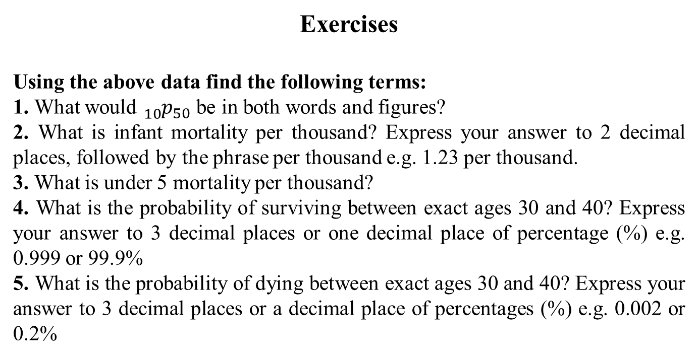
Exercises
Using the above data find the following terms:
1. What would ${}_{10}^{}{p_{50}}$ be in both words and figures?
2. What is infant mortality per thousand? Express your answer to 2 decimal places, followed by the phrase per thousand e.g. 1.23 per thousand.
3. What is under 5 mortality per thousand?
4. What is the probability of surviving between exact ages 30 and 40? Express your answer to 3 decimal places or one decimal place of percentage (%) e.g. 0.999 or 99.9%
5. What is the probability of dying between exact ages 30 and 40? Express your answer to 3 decimal places or a decimal place of percentages (%) e.g. 0.002 or 0.2%

Slide 4
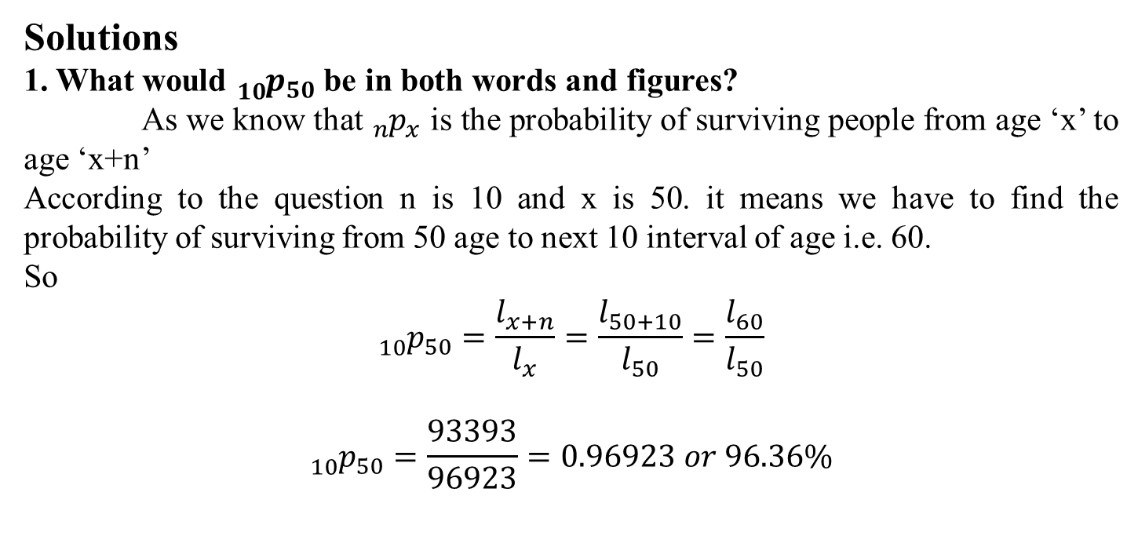
Solutions
1. What would ${}_{10}^{}{p_{50}}$ be in both words and figures?
As we know that ${}_{n}^{}{p_{x}}$ is the probability of surviving people from age ‘x’ to age ‘x+n’
According to the question n is 10 and x is 50. it means we have to find the probability of surviving from 50 age to next 10 interval of age i.e. 60.
So
$${}_{10}^{}{p_{50}}=\frac{l_{x+n}}{l_{x}}=\frac{l_{50+10}}{l_{50}}=\frac{l_{60}}{l_{50}}$$
$${}_{10}^{}{p_{50}}=\frac{93393}{96923}=0.96923 or 96.36\%$$

Slide 5
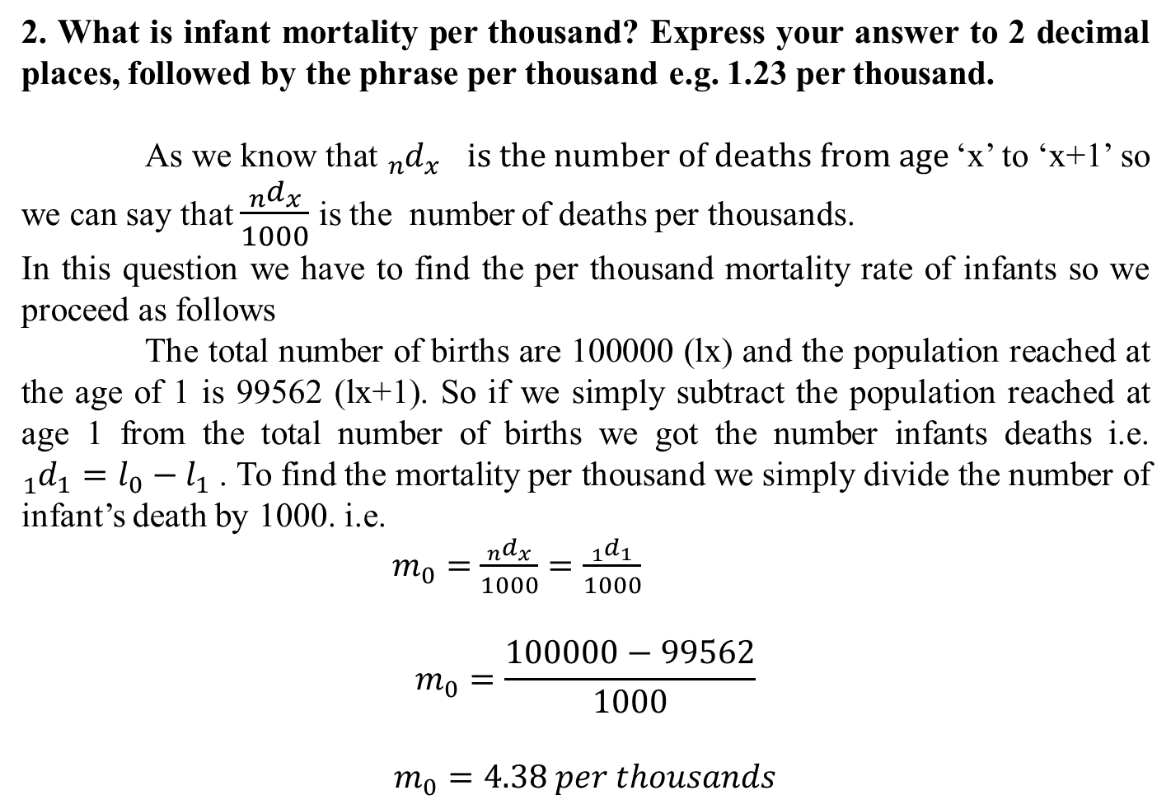
2. What is infant mortality per thousand? Express your answer to 2 decimal places, followed by the phrase per thousand e.g. 1.23 per thousand.
As we know that ${}_{n}^{}{d_{x} }$ $is the number of deaths from age$‘x’ to ‘x+1’ so we can say that $\frac{{}_{n}^{}{d_{x}}}{1000}$ is the number of deaths per thousands.
In this question we have to find the per thousand mortality rate of infants so we proceed as follows
The total number of births are 100000 (lx) and the population reached at the age of 1 is 99562 (lx+1). So if we simply subtract the population reached at age 1 from the total number of births we got the number infants deaths i.e. ${}_{1}^{}{d_{1}=l_{0}−l_{1} }$. To find the mortality per thousand we simply divide the number of infant’s death by 1000. i.e.
$m_{0}=$ $\frac{{}_{n}^{}{d_{x}}}{1000}=\frac{{}_{1}^{}{d_{1}}}{1000}$
$$m_{0}=\frac{100000−99562}{1000}$$
$$m_{0}=4.38 per thousands$$

Slide 6
Task
Perform the remaining parts of the above question.
Assignment: (8 Marks)
What is fertility? Explain all the following measures. Give at least one numerical example for each measure.
Crude Birth Rate
General Fertility Rate
Age specific Fertility Rate
Total Fertility Rate
Gross Reproduction Rate
Net Reproduction Rate
Child Women Ratio

