Slide 1
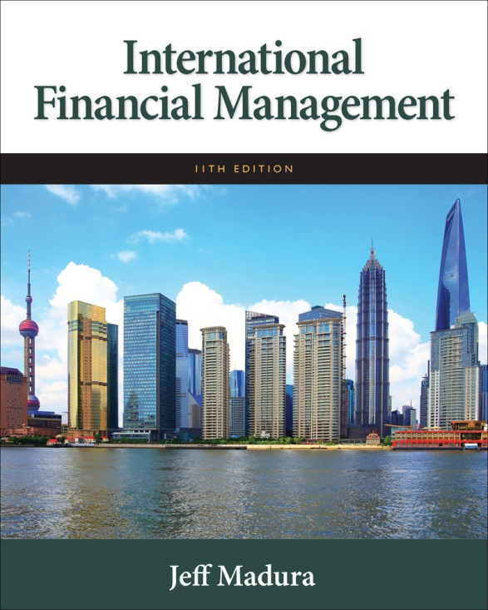

Slide 2
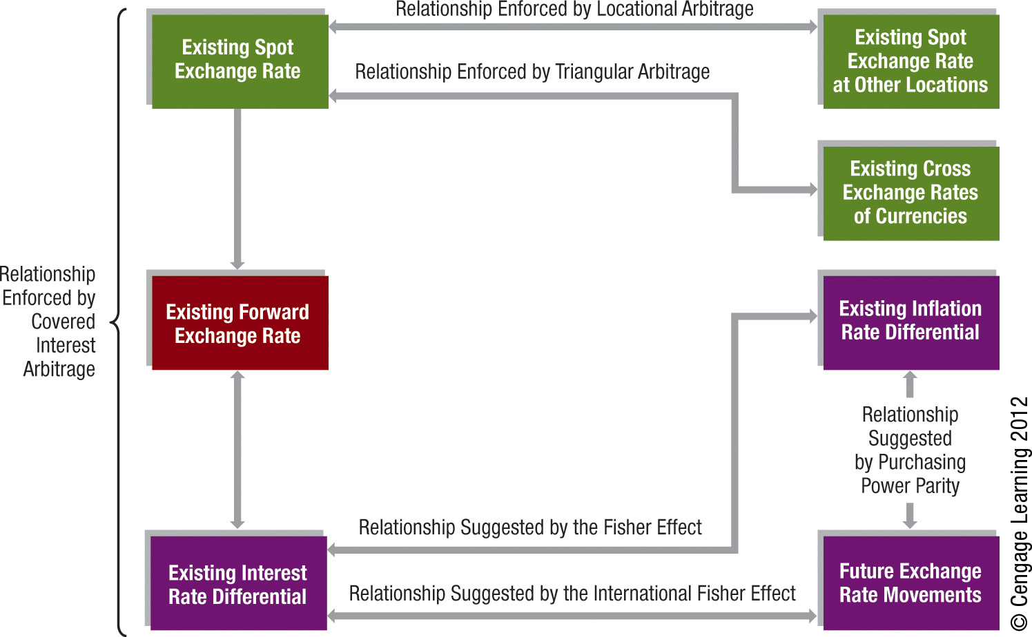
Part 2 Exchange Rate Behavior

Slide 3
6
Government Influence on Exchange Rates
Chapter Objectives
Describe the exchange rate system used by various governments
Describe the development and implications of a single European currency
Explain how governments can use direct intervention to influence exchange rates
Explain how government intervention in the foreign exchange market can affect economic conditions
3

Slide 4
Exchange Rate Systems
Exchange rate systems can be classified according to the degree of government control and fall into the following categories:
Fixed
Freely floating
Managed float
Pegged

Slide 5
Fixed Exchange Rate System
Exchange rates are either held constant or allowed to fluctuate only within very narrow boundaries.
Central bank can reset a fixed exchange rate by devaluing or reducing the value of the currency against other currencies.
Central bank can also revalue or increase the value of its currency against other currencies.

Slide 6
Fixed Exchange Rate System
Examples:
Bretton Woods Agreement 1944 – 1971 - Each currency was valued in terms of gold.
Smithsonian Agreement 1971 – 1973 - called for a devaluation of the U.S. dollar by about 8 percent against other currencies.
Advantages of fixed exchange rate system
Insulate country from risk of currency appreciation.
Allow firms to engage in direct foreign investment without currency risk.
Disadvantages of fixed exchange rate system
Risk that government will alter value of currency.
Country and MNC may be more vulnerable to economic conditions in other countries.

Slide 7
Freely Floating Exchange Rate System
Exchange rates are determined by market forces without government intervention.
Advantages of freely floating system:
Country is more insulated from inflation of other countries.
Country is more insulated from unemployment of other countries.
Does not require central bank to maintain exchange rates within specified boundaries.
Disadvantages of freely floating system:
Can adversely affect a country that has high unemployment.
Can adversely affect a country with high inflation.

Slide 8
Managed Float Exchange Rate System
Governments sometimes intervene to prevent their currencies from moving too far in a certain direction.
Critics suggest that managed float allows a government to manipulate exchange rates to benefit its own country at the expense of others.
Currencies of most large developed countries are allowed to float, although they may be periodically managed by their respective central banks.

Slide 9
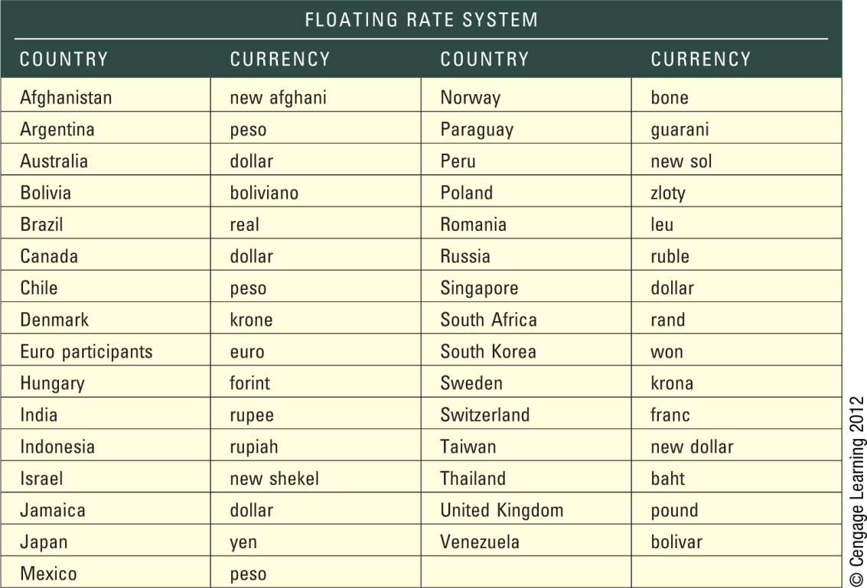
Exhibit 6.1 Exchange Rate Arrangements

Slide 10
Pegged Exchange Rate System
Home currency value is pegged to one foreign currency or to an index of currencies.
May attract foreign investment because exchange rate is expected to remain stable.
Weak economic or political conditions can cause firms and investors to question whether the peg will be broken.

Slide 11
Pegged Exchange Rate Systems
Examples:
Europe’s Snake Arrangement 1972 – 1979
European Monetary System (EMS) 1979 – 1992
Mexico’s Pegged System 1994
China’s Pegged Exchange Rate 1996 – 2005
Venezuela’s Pegged Exchange Rate 2010

Slide 12
Pegged Exchange Rate Systems (Cont.)
Currency Boards Used to Peg Currency Values - a system for pegging the value of the local currency to some other specified currency. The board must maintain currency reserves for all the currency that it has printed.
Interest Rates of Pegged Currencies - Interest rate will move in tandem with the interest rate of the currency to which it is tied.
Exchange Rate Risk of a Pegged Currency – (Exhibit 6.2) provides examples of countries that have pegged the exchange rate of their currency to a specific currency. Currencies are commonly pegged to the U.S. dollar or to the euro.

Slide 13
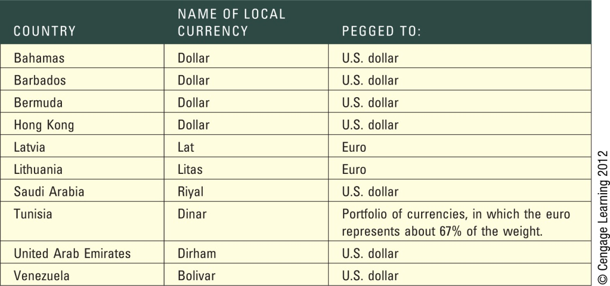
Exhibit 6.2 Pegged Exchange Rates

Slide 14
Dollarization
Replacement of a foreign currency with U.S. dollars.
This process is a step beyond a currency board because it forces the local currency to be replaced by the U.S. dollar. Although dollarization and a currency board both attempt to peg the local currency’s value, the currency board does not replace the local currency with dollars.

Slide 15
A Single European Currency
Monetary Policy in the Eurozone
European Central Bank - based in Frankfurt and is responsible for setting monetary policy for all participating European countries
Objective is to control inflation in the participating countries and to stabilize (within reasonable boundaries) the value of the euro with respect to other major currencies.
Impact on Firms in the Eurozone - Prices of products are now more comparable among European countries.
Impact on Financial Flows in the Eurozone - Bond investors who reside in the eurozone can now invest in bonds issued by governments and corporations in these countries without concern about exchange rate risk, as long as the bonds are denominated in euros.

Slide 16
A Single European Currency
Exposure of Countries within the Eurozone
A single European monetary policy prevents any individual European country from solving local economic problems with its own unique monetary policy.
Any given monetary policy used in the eurozone during a particular period may enhance conditions in some countries and adversely affect others.
Impact of Crises within the Eurozone - may affect the economic conditions of the other participating countries because they all rely on the same currency and same monetary policy.

Slide 17
Reasons for Government Intervention
Smooth exchange rate movements
If a central bank is concerned that its economy will be affected by abrupt movements in its home currency’s value, it may attempt to smooth the currency movements over time.
Establish implicit exchange rate boundaries
Some central banks attempt to maintain their home currency rates within some unofficial, or implicit, boundaries.
Respond to temporary disturbances
A central bank may intervene to insulate a currency’s value from a temporary disturbance.

Slide 18
Direct Intervention
To force the dollar to depreciate, the Fed can intervene directly by exchanging dollars that it holds as reserves for other foreign currencies in the foreign exchange market.
By “flooding the market with dollars” in this manner, the Fed puts downward pressure on the dollar.
If the Fed desires to strengthen the dollar, it can exchange foreign currencies for dollars in the foreign exchange market, thereby putting upward pressure on the dollar.

Slide 19
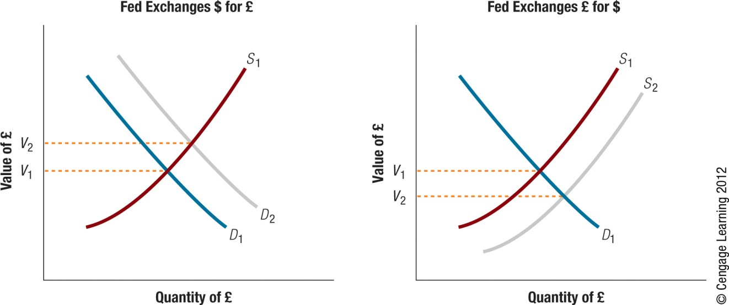
Exhibit 6.3 Effects of Direct Central Bank Intervention in the Foreign Exchange Market

Slide 20
Direct Intervention
Reliance on reserves
The potential effectiveness of a central bank’s direct intervention is the amount of reserves it can use.
Nonsterilized versus sterilized intervention (See Exhibit 6.4)
When the Fed intervenes in the foreign exchange market without adjusting for the change in the money supply, it is engaging in a nonsterilized intervention.
In a sterilized intervention, the Fed intervenes in the foreign exchange market and simultaneously engages in offsetting transactions in the Treasury securities markets.
Speculating on direct intervention
Some traders in the foreign exchange market attempt to determine when Federal Reserve intervention is occurring and the extent of the intervention in order to capitalize on the anticipated results of the intervention effort.

Slide 21
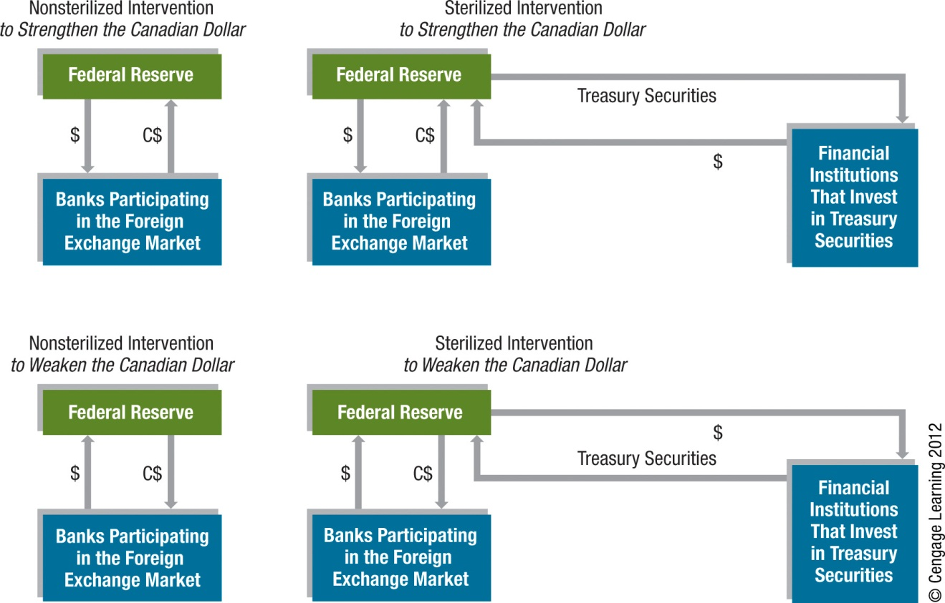
Exhibit 6.4 Forms of Central Bank Intervention in the Foreign Exchange Market

Slide 22
Indirect Intervention
The Fed can affect the dollar’s value indirectly by influencing the factors that determine it.

Slide 23
Indirect Intervention
Government Control of Interest Rates by increasing or reducing interest rates
Foreign Exchange Controls such as restrictions on the exchange of the currency
Intervention Warnings intended to warn speculators. The announcements could discourage additional speculation and might even encourage some speculators to unwind (liquidate) their existing positions in the currency.

Slide 24
Intervention as a Policy Tool
A weak home currency can stimulate foreign demand for products. (See Exhibit 6.5)
A strong home currency can encourage consumers and corporations of that country to buy goods from other countries. (See Exhibit 6.6)

Slide 25
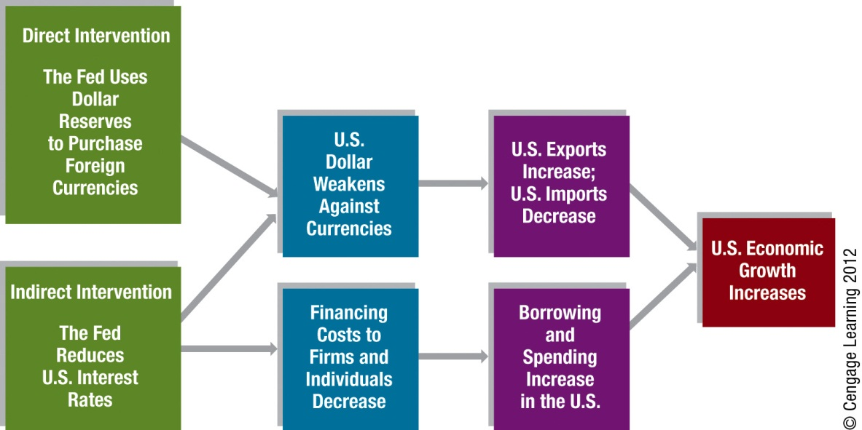
Exhibit 6.5 How Central Bank Intervention Can Stimulate the U.S. Economy

Slide 26
Exhibit 6.6 How Central Bank Intervention Can Reduce Inflation

Slide 27
SUMMARY
Exchange rate systems can be classified as fixed rate, freely floating, managed float, and pegged. In a fixed exchange rate system, exchange rates are either held constant or allowed to fluctuate only within very narrow boundaries. In a freely floating exchange rate system, exchange rate values are determined by market forces without intervention. In a managed float system, exchange rates are not restricted by boundaries but are subject to government intervention. In a pegged exchange rate system, a currency’s value is pegged to a foreign currency or a unit of account and moves in line with that currency (or unit of account) against other currencies.

Slide 28
SUMMARY (Cont.)
Numerous European countries use the euro as their home currency. The single currency allows international trade by firms within the eurozone without foreign exchange expenses and without concerns about future exchange rate movements. However, countries that participate in the euro do not have complete control of their monetary policy because one monetary policy is applied to all countries in the eurozone. In addition, some countries might be more susceptible to a crisis in another country in the eurozone as a result of being in the eurozone.

Slide 29
SUMMARY (Cont.)
Governments can use direct intervention by purchasing or selling currencies in the foreign exchange market, thereby affecting demand and supply conditions and, in turn, affecting the equilibrium values of the currencies. When a government purchases a currency in the foreign exchange market, it puts upward pressure on the currency’s equilibrium value. When a government sells a currency in the foreign exchange market, it puts downward pressure on the currency’s equilibrium value. Governments can use indirect intervention by influencing the economic factors that affect equilibrium exchange rates.

Slide 30
SUMMARY (Cont.)
When government intervention is used to weaken the U.S. dollar, the weak dollar can stimulate the U.S. economy by reducing the U.S. demand for imports and increasing the foreign demand for U.S. exports. Thus, the weak dollar tends to reduce U.S. unemployment, but it can increase U.S. inflation. When government intervention is used to strengthen the U.S. dollar, the strong dollar can increase the U.S. demand for imports, thereby intensifying foreign competition. The strong dollar can reduce U.S. inflation but may cause a higher level of U.S. unemployment.

