Slide 1
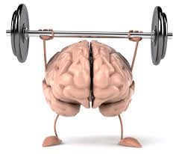
WHAT IS BRAIN?
COLLECTION OF INFORMATION
PROCESSING & CONTROL SYSTEMS
IT WORKS BY ELECTRICAL AND
CHEMICAL SIGNALLING

Slide 2
Function of brain
The scientific study of the brain and nervous system is called neuroscience or neurobiology.
The brain performs an incredible number of tasks including the following:
It controls body temperature, blood pressure, heart rate and breathing.
It accepts a flood of information about the world around you from your various senses (seeing, hearing, smelling, tastingand touching).
It handles your physical movement when walking, talking, standing or sitting.
It lets you think, dream, reason and experience emotions.
All of these tasks are coordinated, controlled and regulated by an organ that is about the size of a small head of cauliflower.
Your brain, spinal cord and peripheral nerves make up a complex, integrated information-processing and control system known as your central nervous system.

Slide 3
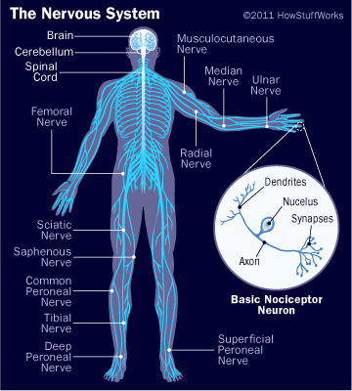

Slide 5
Human information processing model
we store memories:
first in the sensory stage;
then in short-term memory;
and ultimately, for some memories, in long-term memory.
the different stages of human memory function as a sort of filter protect us from the flood of information that we're confronted with on a daily basis.

Slide 7
Sensory memory
The creation of a memory begins with its perception: The registration of information during perception occurs in the brief sensory stage that usually lasts only a fraction of a second. It's your sensory memory that allows a perception such as a visual pattern, a sound, or a touch to linger for a brief moment after the stimulation is over.

Slide 8
Capacity large
Durability 1-3 sec
Contents resembles the sensation from original stimuli

Slide 9
Perception
The meaning we attach to the raw information through our senses. This meaning is constructed based on both object reality + our existing knowledge
Interpretation of sensory information.

Slide 10
Short term memory
After that first flicker, the sensation
is stored in short-term memory.
limited capacity.
it can hold about seven items for no more than 20 or 30 seconds at a time.
You may be able to increase this capacity somewhat by using various memory strategies. For example, a ten-digit number such as 8005840392 may be too much for your short-term memory to hold. But divided into chunks, as in a telephone number, 800-584-0392 may actually stay in your short-term memory long enough for you to dial the telephone. Likewise, by repeating the number to yourself, you can keep resetting the short-term memory clock.

Slide 12
Long term memory
Important information is gradually transferred from short-term memory into long-term memory. The more the information is repeated or used, the more likely it is to eventually end up in long-term memory, or to be "retained." Unlike sensory and short-term memory, which are limited and decay rapidly, long-term memory can store unlimited amounts of information indefinitely.

Slide 13
Long-term memory refers to the continuing storage of information. In Freudian psychology, long-term memory would be call the preconscious and unconscious. This information is largely outside of our awareness, but can be called into working memory to be used when needed. Some of this information is fairly easy to recall, while other memories are much more difficult to access.

Slide 14
Types of Long-Term Memory
Declarative (explicit) memory
Procedural (implicit) memory.
Declarative includes all of the memories that are available in consciousness.
Declarative
episodic memory semantic memory
(specific events) (knowledge about the world).
Procedural memory involves memories of body movement and how to use objects in the environment.

