Slide 1
Plant reproduction:
Definition:
The process by which plants generate new individuals, or offspring.
It is an inherent characteristic of all living organism to continue or maintain their races by the mechanism of reproduction.
Types:
Asexual reproduction.
Sexual reproduction.

Slide 2
Asexual reproduction:
Definition:
Asexual reproduction produces new individuals without the fusion of gametes, genetically identical to the parent plants.
Types:
Binary fission.
Budding.
Spore formation.
Fragmentation.
Vegetative reproduction.

Slide 3
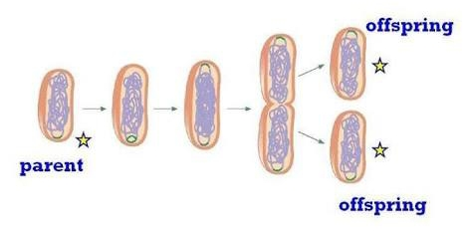
1. Binary fission:
Definition:
A single parent cell divides into two daughter cells.
e.g. bacteria.

Slide 4
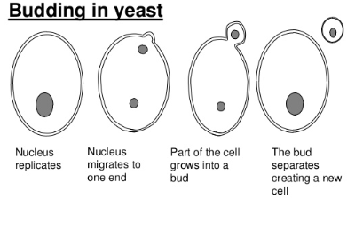
2. Budding:
Definition:
parent cell produces bud, it gets detached and develops into new individual.
e.g. yeast.

Slide 5
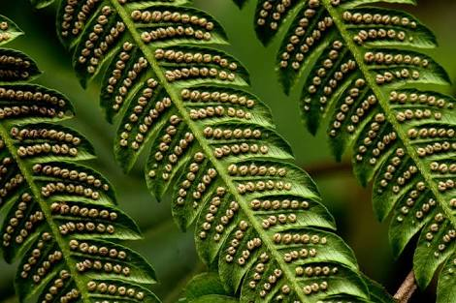
3. Spore formation:
Definition:
Reproduces by forming spores. Under favourable conditions spores develop into new individuals.
e.g. ferns, fungi, bacteria.

Slide 6
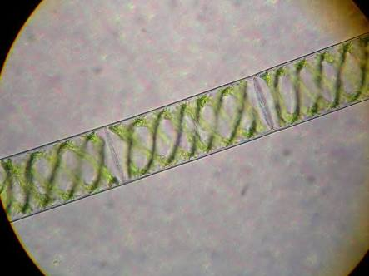
4. Fragmentation:
Definition:
Organism with filamentous body, break into two or more fragments. Each fragment grows into a new individual.
e.g. spirogyra.

Slide 7
5. Vegetative reproduction:
Definition:
Organisms produce new individuals by a vegetative part of the plant.
e.g. potato, onion.

Slide 8
Types of vegetative reproduction:
Artificial vegetative propagation:
Cutting.
Layering.
Grafting.
Tissue culture (micro propagation).
2. natural vegetative reproduction:
Rhizomes.
Tubers.
Runners (stolon).
Plantlets.

Slide 9
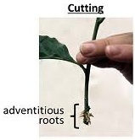
1. Cutting:
Definition:
A part of stem is cut and the cut end grows into a new plant when placed in moist soil.
e.g. rose, lemon.

Slide 10
cont.….
Plants such as money plant are propagated through stem cuttings where a portion of the stem containing nodes and internodes is placed in moist soil and allowed to root.
In some species, stems can start producing a root even when placed only in water.

Slide 11
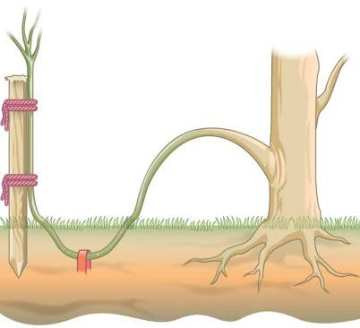
2. layering:
Definition:
The stem of a plant is bent down until it touches the soil. The stem is then cut once it develops roots and grows into a new plant.
e.g. lemon, rose.

Slide 12
Cont.….
Layering is a method in which a stem attached to the plant is bent and covered with soil. Young stems that can be bent easily without any injury are the preferred plant for this method.
In some plants, a modified form of layering known as air layering is employed.
A portion of bark or outermost covering of the stem is removed and covered with moss, which is the taped. Some gardeners also apply rooting hormone.
After some time, roots will appear; this portion of plant can be placed in separate pot.

Slide 13
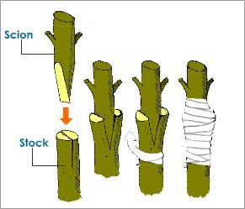
3. Grafting:
Definition:
The stem of a plant is cut and then fitted on another strong plant and covered with grafting wax.
e.g. oranges, ornamental plants.

Slide 14
Cont.…
Grafting has long been used to produce varieties of roses, citrus species, and other plants.
Two plants species are used:
Part of the stem of desirable plant is grafted onto a rooted plant called stock.
The part that is grafted or attached is called scion.
Both are cut at oblique angle, placed in close contact with each other, and are held together.

Slide 15
Cont.…
Matching up these two surfaces as closely as possible is extremely important because these will be holding the plant together.
After a period of time, the scion starts producing shoots, eventually bearing flowers and fruits.
Grafting is widely used in viticulture.

Slide 16
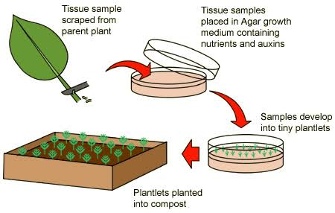
4. Tissue culture:
Definition:
A collection of techniques used to maintain or grow plant cells, tissues or organs under sterile conditions on a nutrient culture medium of known composition.

Slide 17
Cont.…
Micro propagation (also called plant tissue culture) is a method of propagating a large number of plants from a single plant in a short time under laboratory conditions.
This method allows propagation of rare, endangered species that may be difficult to grow under natural conditions, are economically important.
To start plant tissue culture, a part of the plant such as a stem, leaf, embryo, anther, or seed can be used.

Slide 18
Cont.…
The plant material is thoroughly sterilized using a combination of chemical treatments standardized for that species.
Under sterile conditions, the plant material is placed on a plant tissue culture medium that contains all the minerals, vitamins, and hormones required by the plant.
The plant part give rise to an undifferentiated mass, known as a callus.
The grown plantlets are first grown under greenhouse conditions.

Slide 19
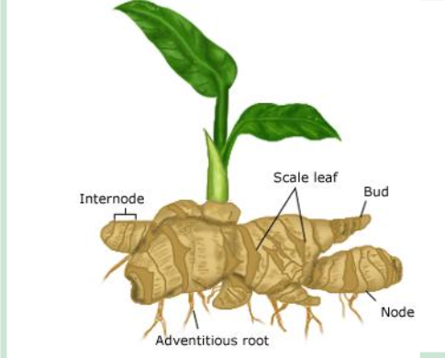
Natural methods: 1. rhizomes:
One type of asexual reproduction in plants is by rhizomes which are underground horizontal stem of the plant.

Slide 20
Cont.…
The rhizomes consist of many key parts to their structure including nodes, internodes, scale leaves, axillary buds as well as adventitious roots, which provide it support.
The asexual reproduction of rhizomes is very unique. It occurs when the scale leaves are seen rising from the nodal points of the plant and eventually the axillary buds develop and grows into branches that spread out of the ground and creates leaves.

Slide 21
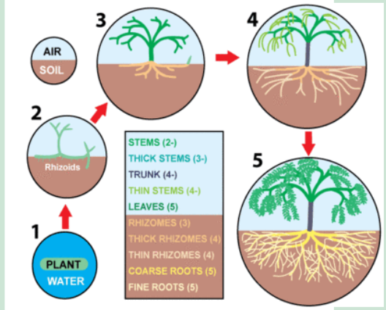
Cont.…
The rhizomes continue to grow underground and strengthen the root of the newly created individual.

Slide 22
2. Tubers:
They are a plant structure which saves energy for the parent plant. due to energy stored in tubers, often people would eat them, to obtain more energy and strength.
Two types of tubers:
Stem tubers.
Root tubers.
Stem tubers:
Stem tubers form from underground rhizomes. E.g. potato.

Slide 23
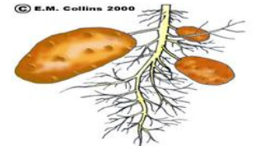
Cont.…
Root tubers:
Root tubers develop when sections of the roots swell and bud.
example: A new potato can be grown on its own when stem branches grow and reach into the ground, swelling up with starch containing cells.

Slide 24
3. Runners (stolon):
Definition:
A shoot that grows along the ground and produces roots at its nodes.
e.g. strawberries, spider plants.
The mother parent of a strawberry plant for example runs along the surface and eventually, produces new individuals from tip of its node.
As the new plant is slowly developing, the stem of the plant continue to take the advantage of the rich soil and grow, while roots begin to get stronger and support newly create clone of plant.

Slide 25
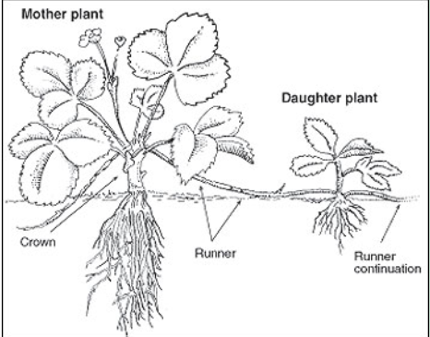
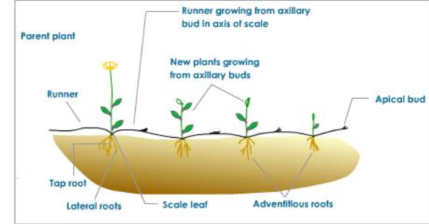

Slide 26
4. plantlets:
A simple yet effective way that plants such as duckweed use the method of plantlets.
Plantlets are formed when there are miniature plants established on the margin of the leaves.
Eventually these leaves break off, fall to the ground and continue growing on their own.
The growing success occurs due to sunlight, rich soil and water, and eventually the newly created individual resembles the appearance of the mother parent.

Slide 27
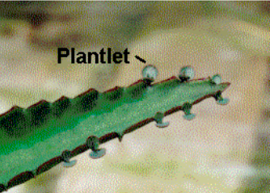
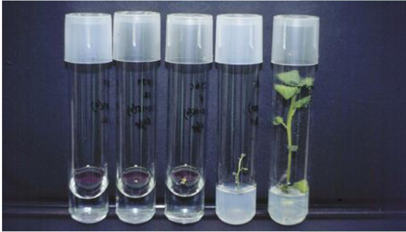

Slide 28
Sexual reproduction:
Definition:
Sexual reproduction produces off spring by the fusion of gametes, resulting in offspring genetically different from the parents.
Flowers are reproductive parts of a plant.
The stamens are male reproductive part .
The pistil is the female reproductive part.

Slide 29
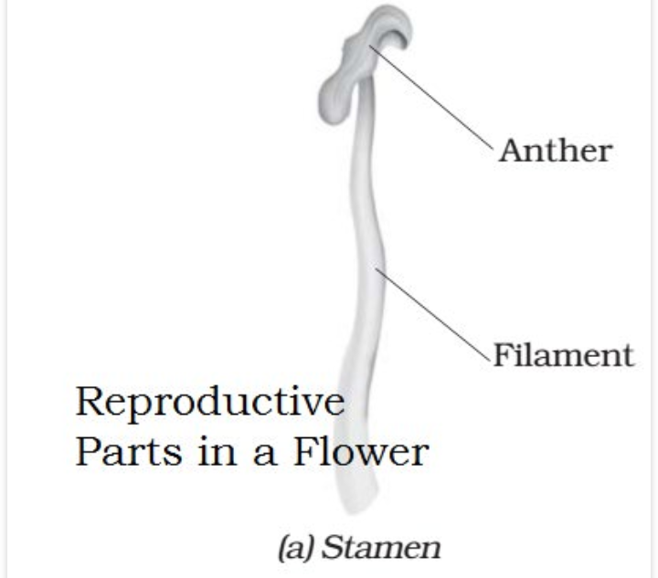
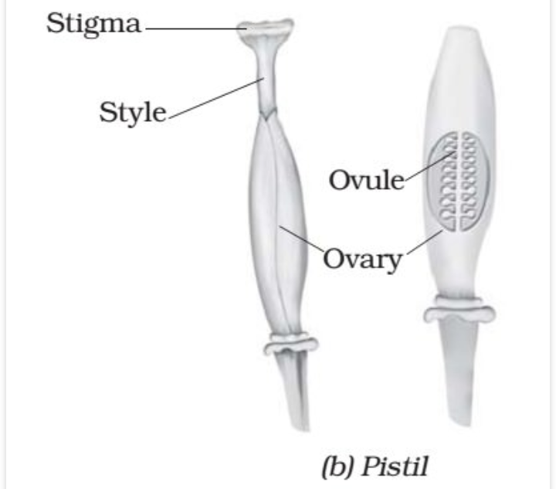

Slide 30
Cont.…
Unisexual flowers:
The flowers which contain either only the pistil or only the stamens.
e.g. corn, cucumber.
Bisexual flowers:
The flowers which contain both stamens and pistil.
e.g. rose, mustard.
Both the male and the female unisexual flowers may be present in the same plant or in different plants.

Slide 31
Cont.…
Anthers contains pollen grains which produce male gametes.
A pistil consists of stigma, style and ovary.
The ovary contains one or more ovules.
The female gamete or the egg is formed in an ovule.
In sexual reproduction a male and a female gamete fuse to form zygote.

Slide 32
Pollination:
Generally pollen grains have a tough protective coat which prevents them from drying up. Since pollen grains are light, they can be carried by wind or water. Insects visit flowers and carry away pollen on their bodies.
Some of the pollen lands on the stigma of a flower of the same kind. The transfer of pollen from the anther to the stigma of a flower is called pollination.

Slide 33
self pollination vs. cross pollination:
Self pollination
Cross pollination
Pollen grains are transferred to the stigma of the same flower.
Occurs in bisexual plants having anther and stigma maturing at same time.
E.g. wheat, peas.
pollen grains are carried to stigma of another flower.
Occurs in bisexual flowers having anther and stigma maturing at different times.
E.g. tomato, lady finger.

Slide 34
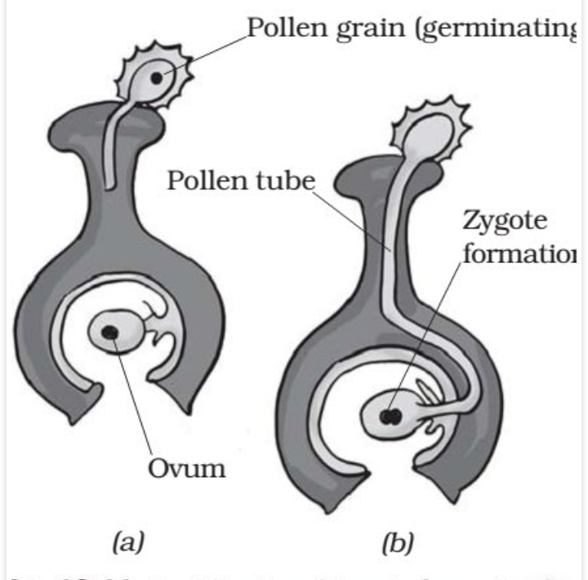
Fertilization:
The cell which results
after fusion of the gametes
is called zygote.
The process of fusion of
male and female gametes
(to form zygote) is called
fertilization.
The zygote develops into
an embryo.

Slide 35
Fruits and seed formation:
After fertilization, the ovary grows into a fruit and other parts of the flower fall off. The fruit is the ripened ovary.
The seeds develop from the ovules. The seed contains the embryo enclosed in a protective seed coat. Some fruits are fleshy such as mango, apple and orange. Some fruits are hard like almonds and walnuts.

Slide 36
Seed dispersal:
Some seed are dispersed by animals, especially spiny seeds with hooks which get attached to the bodies of animals and are carried t distant places.
e.g. urena.
Some are dispersed when the fruits burst with sudden jerks. The seeds are scattered far from the parent plant.
e.g. castor.

