Slide 1
Chapter 9: Project Human Resource Management
Information Technology Project Management, Sixth Edition
Note: See the text itself for full citations.

Slide 2
The Importance of Human Resource Management
Many corporate executives have said, “People are our most important asset”
People determine the success and failure of organizations and projects
It is important to understand global IT workforce issues

Slide 3
What is Project HR Management?
Includes all processes required to make the most effective use of the people involved with a project
Includes all project stakeholders: sponsors, team members, support staff, customers

Slide 4
Processes of HR management
Developing the human resource plan: identifying and documenting project roles, responsibilities, and reporting relationships
Acquiring the project team: getting the needed personnel assigned to and working on the project
Developing the project team: building individual and group skills to enhance project performance
Managing the project team: tracking team member performance, motivating team members, providing timely feedback, resolving issues and conflicts, and coordinating changes to help enhance project performance

Slide 5
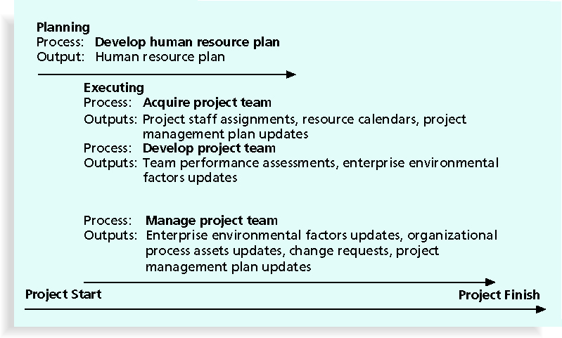
Figure 9-1. Project Human Resource Management Summary

Slide 6
Developing the HR Plan
Involves identifying and documenting project roles, responsibilities, and reporting relationships
Contents include:
Organizational charts
Work definition and assignment
Staffing management plan
Resource histograms

Slide 7
Project organizational chart
Project manager should first decide what types of people and skills the project needs
IT project has a diverse group of people
It is difficult to manage such diversity
Project manager should create an organizational chart that organizes people in the project according to their roles, responsibilities, and skills

Slide 8
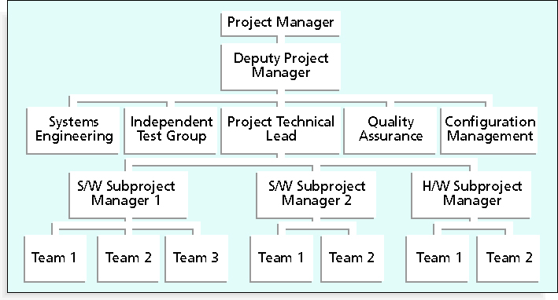
Figure 9-3. Sample Organizational Chart for a Large IT Project

Slide 9
Work definition and assignment
Finalizing the project requirements (project scope)
Defining how the work will be accomplished (technical approach)
Breaking down the work into manageable elements (WBS)
Assigning work responsibilities, assign work to people/units (OBS)
Organization Breakdown Structure (OBS): is a specific type of organizational chart that shows which organizational units are responsible for which work items

Slide 10
Staffing Management Plans and Resource Histograms
A staffing management plan describes when and how people will be added to and taken off the project team
Number of people from each type needed every month
How those people would be acquired, trained, and rewarded
A resource histogram is a column chart that shows the number of resources assigned to a project over time

Slide 11
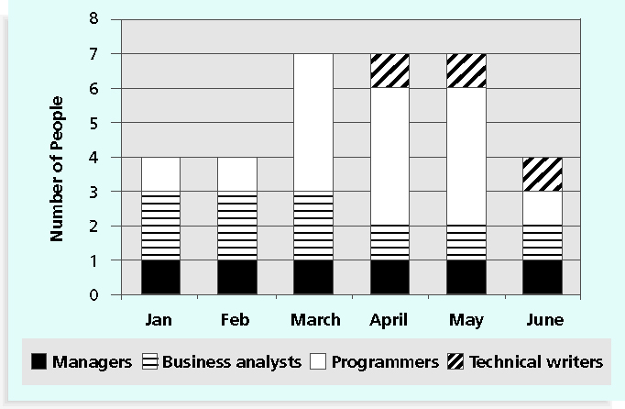
Figure 9-7. Sample Resource Histogram

Slide 12
Acquiring the Project Team
Acquiring qualified people for teams is crucial
The project manager who is the smartest person on the team has done a poor job of recruiting!
It’s important to assign the appropriate type and number of people to work on projects at the appropriate times
Acquiring project team includes
Resource assignment
Resource loading
Resource leveling

Slide 13
Resource Assignment
Assigning particular personnel to their projects
Good hiring procedures are important, as are incentives for recruiting
Some companies give their employees one dollar for every hour a new person they helped hire works
Some organizations allow people to work from home as an incentive
Enrollment in U.S. computer science and engineering programs has dropped almost in half since 2000, and one-third of U.S. workers will be over the age of 50 by 2010
CIO’s researchers suggest that organizations rethink hiring practices and incentives to hire IT talent

Slide 14
Best Practice
Best practices can be applied to include the best places for people to work
For example, Fortune Magazine lists the “100 Best Companies to Work For” in the United States every year, with Google taking the honors in 2007 and 2008
Working Mothers Magazine lists the best companies in the U.S. for women based on benefits for working families
The Timesonline (www.timesonline.co.uk) provides the Sunday Times list of the 100 Best Companies to Work For, a key benchmark against which UK companies can judge their Best Practice performance as employers

Slide 15
Resource Loading
Resource loading refers to the amount of individual resources an existing schedule requires during specific time periods
Helps project managers develop a general understanding of the demands a project will make on the organization’s resources and individual people’s schedules
Overallocation means that more resources than are available are assigned to perform work at a given time

Slide 16
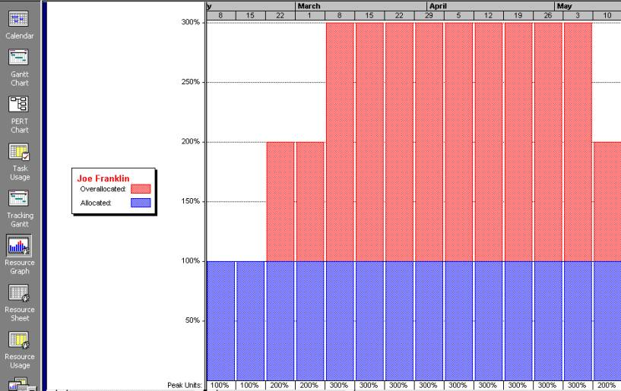
Figure 9-8. Sample Histogram Showing an Overallocated Individual

Slide 17
Resource Leveling
Resource leveling is a technique for resolving resource conflicts by delaying tasks
The main purpose of resource leveling is to create a smoother distribution of resource usage and reduce overallocation

Slide 18
Resource Leveling
Without resource leveling
With resource leveling

Slide 19
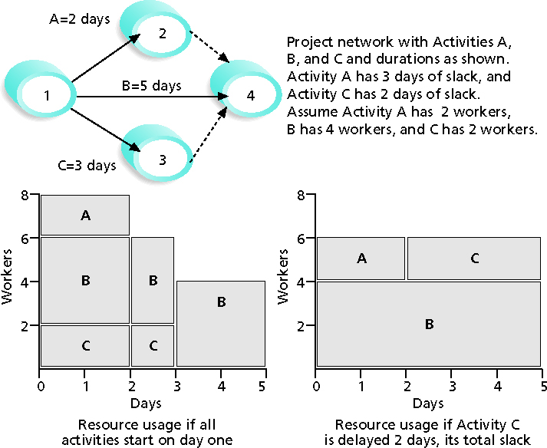
Figure 9-9. Resource Leveling Example

Slide 20
Benefits of Resource Leveling
When resources are used on a more constant basis, they require less management
It may enable project managers to use a just-in-time inventory type of policy for using subcontractors or other expensive resources
Use 4 consultants - full time – 4 months
It results in fewer problems for project personnel and accounting department
It often improves morale

Slide 21
Developing the Project Team
The main goal of team development is to help people work together more effectively to improve project performance
It takes teamwork to successfully complete most projects
Five stages to develop a team
Forming, Storming, Norming, Performing, and Adjourning
Tools and Techniques for team development
Training
Team-building activities
Reward and recognition systems

Slide 22
Team-building Stages
Forming: introduction of team members
Storming: team members have different opinions of how the team should operate
Norming: team members have agreed to a common working method
Performing: team members have emphasized on reaching project goals
Adjourning: breakup of the team after successfully reach the goals

Slide 23
Training
Training can help people understand themselves, each other, and how to work better in teams
Project manager recommend that people take specific training courses

Slide 24
Team-building activities
Physical activities
Rappelling off towers, Running and marching
Going through obstacles, Climb mountains and rocks
Psychological preference activities
Tools for determining personality preferences
Myers-bigger type indicator (MBTI)
Social style profile
DISC profiles
Project manager can benefit from these tools by adjusting their management styles for each individual

Slide 25
Social Styles Profile
People are perceived as behaving primarily in one of four zones, based on their assertiveness and responsiveness:
Drivers (strive for actions, severe, tough, pushy, practical)
Expressives (use intuition to look for fresh perspective)
Analyticals (use analysis, strong thinker)
Amiables (friendly, social)
People on opposite corners (drivers and amiables, analyticals and expressives) may have difficulties getting along

Slide 26
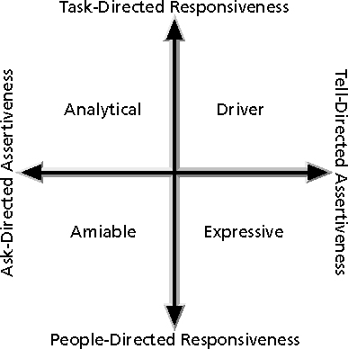
Figure 9-10. Social Styles

Slide 27
DISC Profiles
Also uses a four-dimensional model of normal behavior
Dominance
Influence
Steadiness
Compliance
People in opposite quadrants can have problems understanding each other

Slide 28
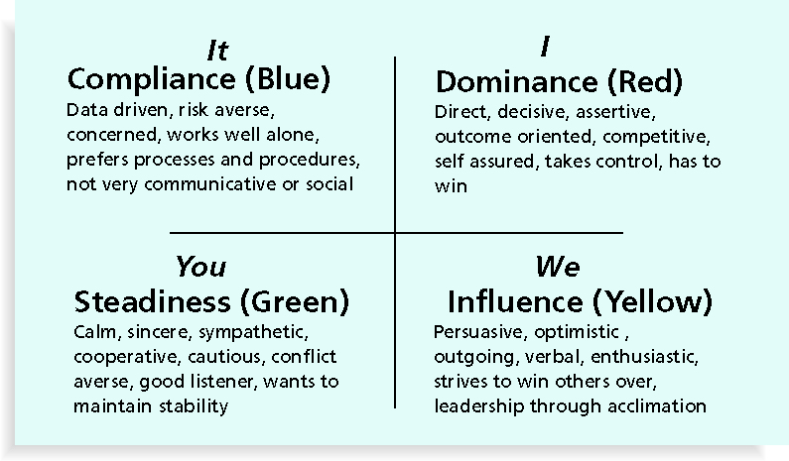
Figure 9-11. The DISC Profile

Slide 29
Managing the Project Team
Project managers must lead their teams in performing various project activities
After assessing team performance and related information, the project manager must decide:
If changes should be requested to the project
If corrective or preventive actions should be recommended
If updates are needed to the project management plan

Slide 30
Tools and Techniques for Managing Project Teams
Observation and conversation
Project performance appraisals (assessment
Conflict management
Issue logs: monitor and track issues that need to be resolved for the project team to work effectively
Interpersonal skills: leadership, communications, influencing, and decision-making skills

Slide 31
General Advice on ManagingTeams
Be patient and kind with your team
Fix the problem instead of blaming people
Establish regular, effective meetings
Allow time for teams to go through the basic team-building stages
Limit the size of work teams to three to seven members
Acknowledge individual and group accomplishments

Slide 32
General Advice on Teams (continued)
Plan some social activities to help project team members and other stakeholders get to know each other better
Stress team identity(create traditions that team members enjoy)
Support team members and encourage them to help each other

Slide 33
Five malfunctions of a Team
Absence of trust
Fear of conflict
Lack of commitment
Avoidance of accountability
Inattention to results

