Slide 1
Regression Analysis

Slide 2
Objectives
Understand the basic types of data
Conduct basic statistical analyses in Excel
Generate descriptive statistics and other analyses using the Analysis ToolPak
Use regression analysis to predict future values
Notes:
The objectives of this chapter are:
Understand the language of statistics
Understand the basic types of data
Conduct basic statistical analyses in Excel
Generate descriptive statistics and other analyses using the Analysis ToolPak
The objectives continue on the next slide.

Slide 3
Generate Descriptive Statistics and Other Analyses Using the Analysis ToolPak
Analysis ToolPak
Add-in
After installed, found on Data tab, as Data Analysis
Descriptive statistics
Notes:
The Analysis ToolPak is an add-in that enables you to access a variety of statistical analyses. Installed from the Backstage view, using Options, it appears on the Data tab as Data Analysis.
First we will look at the descriptive statistics that the Analysis ToolPak generates, as shown on the next slide.

Slide 4
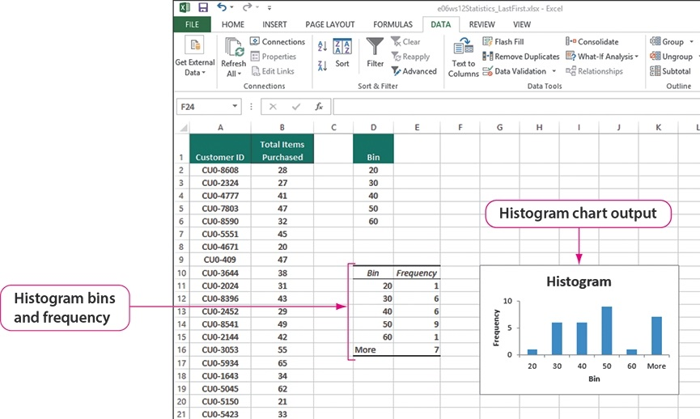
Descriptive Statistics and Other Analyses Using the Analysis ToolPak Histogram
Notes:
Using the Analysis ToolPak, you can create a histogram, which is a statistical graph that summarizes the distribution of data and how the data fits into the bins. In this example, the bins relate to the number of purchases that individual customers made over a period of time. Looking at the histogram, you can see that many people have purchased up to 50 products, but for some reason, the number drops off dramatically as you go into the 60 products bin. Notice that the More cell reports a rebound of people purchasing more than 60 products.
The next slide discusses the Analysis ToolPak moving average feature.

Slide 5
Regression Analysis
Regression analysis is a tool for building statistical models that characterize relationships among a dependent variable and one or more independent variables, all of which are numerical.
Simple linear regression involves a single independent variable.
Multiple regression involves two or more independent variables.

Slide 6
Purpose of Regression Analysis
The purpose of regression analysis is to analyze relationships among variables.
The analysis is carried out through the estimation of a relationship and the results serve the following two purposes:
Answer the question of how much y changes with changes in each of the x's (x1, x2,...,xk),
Y is the dependent variable
Forecast or predict the value of y based on the values of the X's
X is the independent variable

Slide 7
Simple Linear Regression
Finds a linear relationship between:
- one independent variable X and
- one dependent variable Y
First prepare a scatter plot to verify the data has a linear trend.
Use alternative approaches if the data is not linear.
Figure 9.1

Slide 8
Scatter Plots and Correlation
A scatter plot (or scatter diagram) is used to show the relationship between two variables
Correlation analysis is used to measure strength of the association (linear relationship) between two variables
Only concerned with strength of the relationship
No causal effect is implied

Slide 9
Scatter Plot Examples
(continued)
Strong relationships
Weak relationships
y
y
x
x
y
y
x
x

Slide 10
Examples of Approximate r Values
y
y
y
x
x
x
r = -1
r = -.6
r = 0
y
y
x
x
r = +.3
r = +1

Slide 11
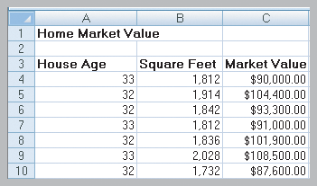
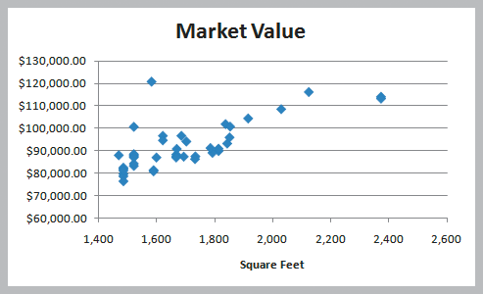
Simple Linear Regression
Example 9.1
Home Market Value Data
Size of a house is typically related to its market value.
X = square footage
Y = market value ($)
The scatter plot of the full data set (42 homes) indicates a linear trend.
Figure 9.2
Figure 9.3

Slide 12
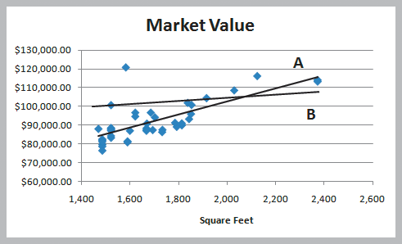
Simple Linear Regression
Finding the Best-Fitting Regression Line
Two possible lines are shown below.
Line A is clearly a better fit to the data.
We want to determine the best regression line.
Y = b₀ + b₁X
where
b₀ is the intercept
b₁ is the slope
^
Figure 9.4

Slide 13
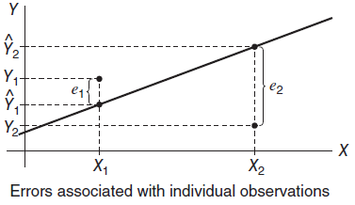
Least Squares Line
The most widely used criterion for measuring the goodness of fit of a line
The line that gives the best fit to the data is the one that minimizes this sum; it is called the least squares line or sample regression line.
The slope of a regression line represents the rate of change in y as x changes. Because y is dependent on x, the slope describes the predicted values of y given x.

Slide 14
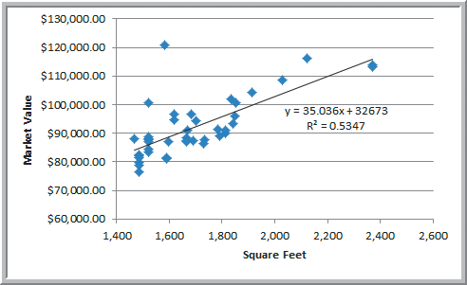
Simple Linear Regression
Using Excel to Find the Best Regression Line
Market value = 32673 + 35.036(square feet)
The regression model explains variation in market value due to size of the home.
It provides better estimates of market value than simply using the average.
Figure 9.5

Slide 15
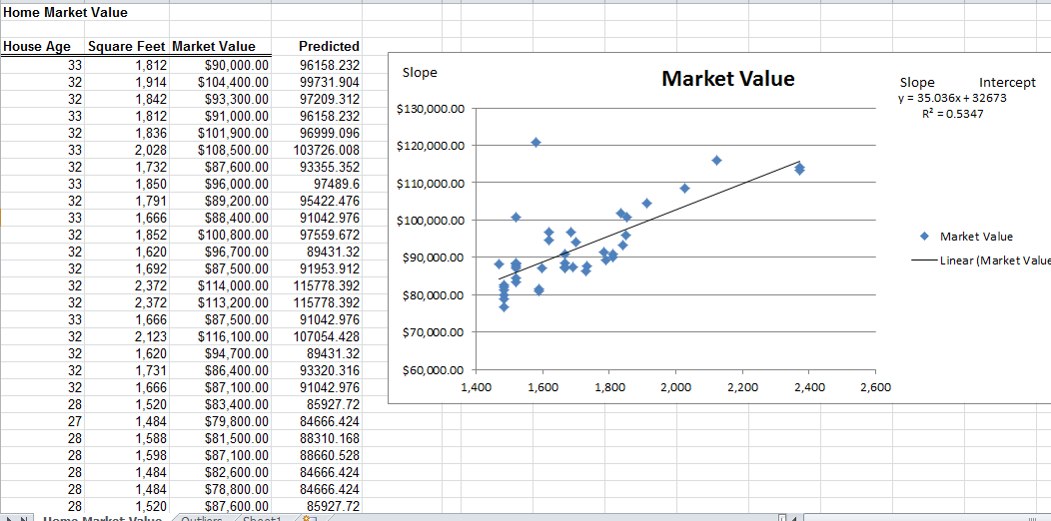

Slide 16
Linear Relations
We know from algebra lines come in the form y = mx + b, where m is the slope and b is the y-intercept.
In statistics, we use y = a + bx for the equation of a straight line. Now a is the intercept and b is the slope.
The slope (b) of the line, is the amount by which y increases when x increase by 1 unit.
This interpretation is very important.
The intercept (a), sometimes called the vertical intercept, is the height of the line when x = 0.

Slide 17
Simple Linear Regression
Using Excel Functions to Find Least-Squares Coefficients
Slope = 35.036
=SLOPE(C4:C45, B4:B45)
Intercept = 32,673
=INTERCEPT(C4:C45, B4:B45)
Estimate Y when X = 1800 square feet
Y = 32,673 + 35.036(1800) = $95,737.80
Figure 9.2

Slide 18
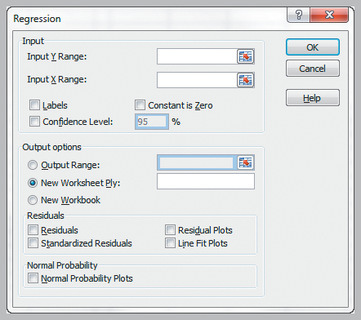
Simple Linear Regression
Excel Regression tool
Data
Data Analysis
Regression
Input Y Range
Input X Range
Labels
Excel outputs a table with many useful regression statistics.
Figure 9.7

Slide 19
Three Important Questions
To examine how useful or effective the line summarizing the relationship between x and y, we consider the following three questions.
Is a line an appropriate way to summarize the relationship between the two variables?
Are there any unusual aspects of the data set that we need to consider before proceeding to use the regression line to make predictions?
If we decide that it is reasonable to use the regression line as a basis for prediction, how accurate can we expect predictions based on the regression line to be?

Slide 20
Simple Linear Regression
Regression Statistics in Excel’s Output
Multiple R
is the correlation between actual and predicted values of the dependent variable (r varies from -1 to +1 (r is negative if slope is negative) )
R Square
the model’s accuracy in explaining the dependent variable
R² varies from 0 (no fit) to 1 (perfect fit)
Adjusted R Square
adjusts R² for sample size and number of X variables
As the sample size increases above 20 cases per variable, adjustment is less needed (and vice versa).
Standard Error
variability between observed & predicted Y variables

Slide 21
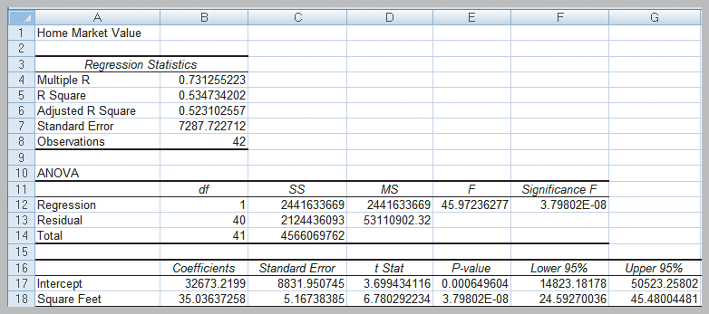
Simple Linear Regression
Example 9.4 Interpreting Regression Statistics for Simple Linear Regression (Home Market Value)
53% of the variation in home market values can be explained by home size.
The standard error of $7287 is less than standard deviation (not shown) of $10,553.
Figure 9.8

Slide 22
Multiple Linear Regression
Multiple Regression has more than one independent variable.
Simple vs. Multiple Regression
One dependent variable Y predicted from a set of independent variables (X1, X2 ….Xk)
One regression coefficient for each independent variable
R²: proportion of variation in dependent variable Y predictable by set of independent variables (X’s)
One dependent variable Y predicted from one independent variable X
One regression coefficient
r²: proportion of variation in dependent variable Y predictable from X

Slide 23
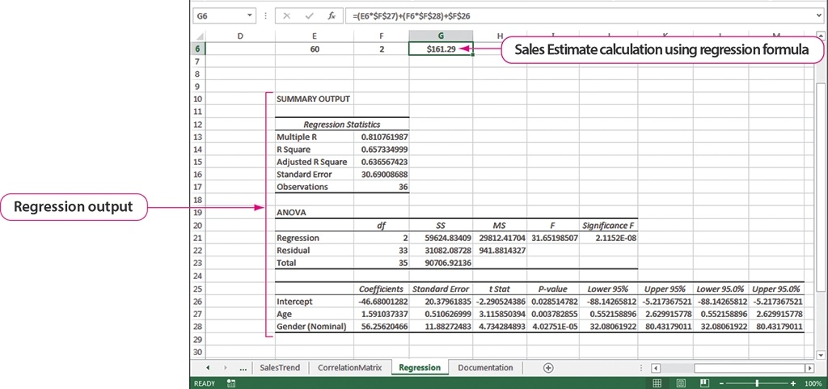
Multiple Regression Analysis to Predict Future Values
=(E3*$F$27)+(F3*$F$28)+$F$26
Age
Age coefficient
Gender
Gender coefficient
Intercept coefficient
Notes:
Regression analysis predicts future values by analyzing relationships between two or more variables, such as age and gender compared with sales, as shown here. Available in the Analysis ToolPak, the Regression feature produces three values that you can effectively use to determine the relationships. The R Square value is a conservative estimate of the independent variables’ ability to predict the value of the dependent variable. In this case, age and gender account for 65.7% of the sales revenue generated by a customer.
The Intercept coefficient, found in cell F26, is the value at which a regression line will cross the y-axis. It is used in the formula to predict the sales amount based on age and gender found in cell G6. The Gender coefficient and the Age coefficients are also used in the regression formula, shown above the figure. In this case, the prediction is that women in the 60-year-old range will spend $207.97 at the spa.

Slide 24
Multiple Regression Analysis to Predict Future Values (con’t)
=(E3*$F$27)+(F3*$F$28)+$F$26
Age
Age coefficient
Gender
Gender coefficient
Intercept coefficient
The R Square value is a conservative estimate of the independent variables’ ability to predict the value of the dependent variable. In this case, age and gender account for 65.7% of the sales revenue generated by a customer.
Notes:
Regression analysis predicts future values by analyzing relationships between two or more variables, such as age and gender compared with sales, as shown here. Available in the Analysis ToolPak, the Regression feature produces three values that you can effectively use to determine the relationships. The R Square value is a conservative estimate of the independent variables’ ability to predict the value of the dependent variable. In this case, age and gender account for 65.7% of the sales revenue generated by a customer.
The Intercept coefficient, found in cell F26, is the value at which a regression line will cross the y-axis. It is used in the formula to predict the sales amount based on age and gender found in cell G6. The Gender coefficient and the Age coefficients are also used in the regression formula, shown above the figure. In this case, the prediction is that women in the 60-year-old range will spend $207.97 at the spa.

Slide 25
Multiple Regression Analysis to Predict Future Values (con’t)
=(E3*$F$27)+(F3*$F$28)+$F$26
Age
Age coefficient
Gender
Gender coefficient
Intercept coefficient
The Intercept coefficient, found in cell F26, is the value at which a regression line will cross the y-axis. It is used in the formula to predict the sales amount based on age and gender found in cell G6. The Gender coefficient and the Age coefficients are also used in the regression formula, In this case, the prediction is that women in the 60-year-old range will spend $207.97 at the spa.
Notes:
Regression analysis predicts future values by analyzing relationships between two or more variables, such as age and gender compared with sales, as shown here. Available in the Analysis ToolPak, the Regression feature produces three values that you can effectively use to determine the relationships. The R Square value is a conservative estimate of the independent variables’ ability to predict the value of the dependent variable. In this case, age and gender account for 65.7% of the sales revenue generated by a customer.
The Intercept coefficient, found in cell F26, is the value at which a regression line will cross the y-axis. It is used in the formula to predict the sales amount based on age and gender found in cell G6. The Gender coefficient and the Age coefficients are also used in the regression formula, shown above the figure. In this case, the prediction is that women in the 60-year-old range will spend $207.97 at the spa.

Slide 26
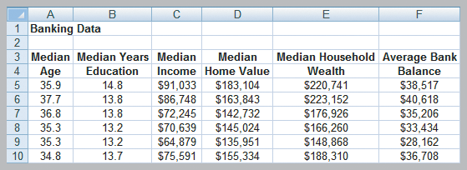
Building Good Regression Models
All of the independent variables in a linear regression model are not always significant.
We will learn how to build good regression models that include the “best” set of variables.
Banking Data includes demographic information on customers in the bank’s current market.
Y
Figure 9.16

Slide 27
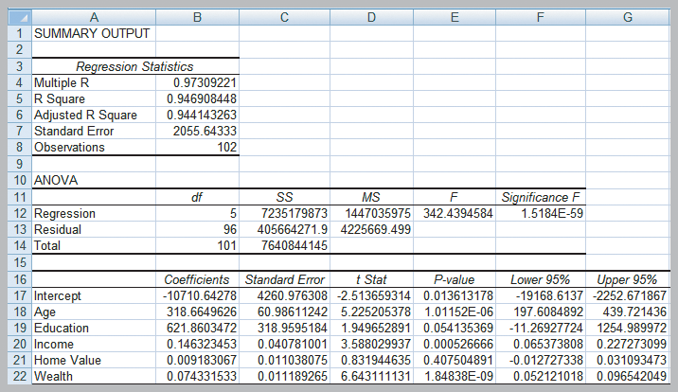
Building Good Regression Models
Predicting Average Bank Balance using Regression
Home Value and Education are not significant.
Figure 9.17

Slide 28
Building Good Regression Models
Systematic Approach to Building Good Multiple Regression Models
1. Construct a model with all available independent
variables and check for significance of each.
2. Identify the largest p-value that is greater than .05
3. Remove that variable and evaluate adjusted R².
4. Continue until all variables are significant.
→ Find the model with the highest adjusted R².
(Do not use unadjusted R² since it always
increases when variables are added.)

Slide 29
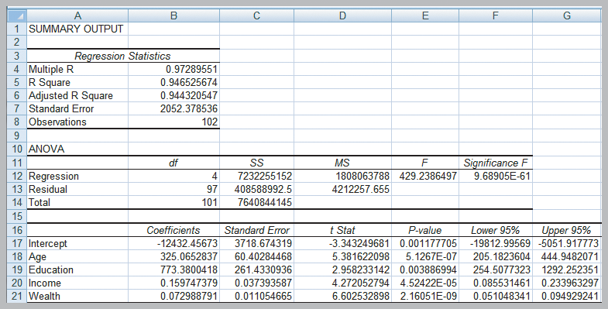
Building Good Regression Models
Identifying the Best Regression Model
Bank regression after removing Home Value
Adjusted R² improves slightly.
Figure 9.18

