Slide 1
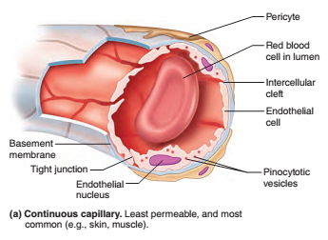
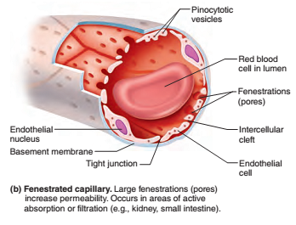
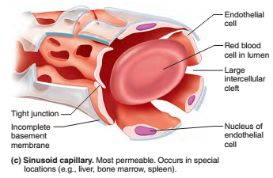
Capillaries
Structurally three types
Continuous
Fenestrated
Sinusoids
Notes:
Pericytes (previously known as Rouget cells, \ rü-ˈzhā Cells ) are multi-functional mural cells of the microcirculation that wrap around the endothelial cells that line the capillaries and venules throughout the body.

Slide 2
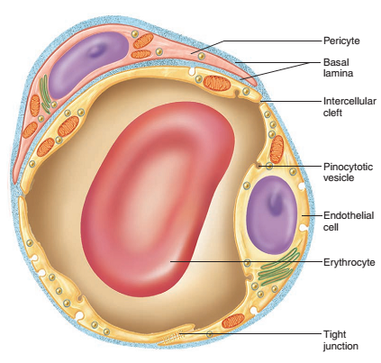
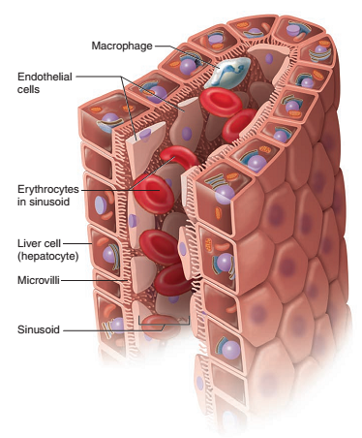
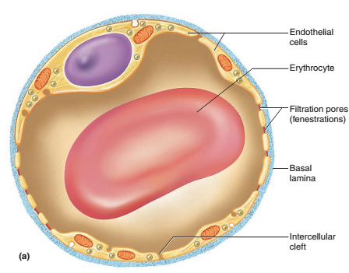
Notes:
A pinocytotic vesicle is a structure that aids in transportation as a cell's plasma membrane absorbs molecules from outside.
Sinusoids are low pressure vascular channels that receive blood from terminal branches of the hepatic artery and portal vein at the periphery of lobules and deliver it into central veins. Sinusoids are lined with endothelial cells and flanked by plates of hepatocytes.

Slide 3
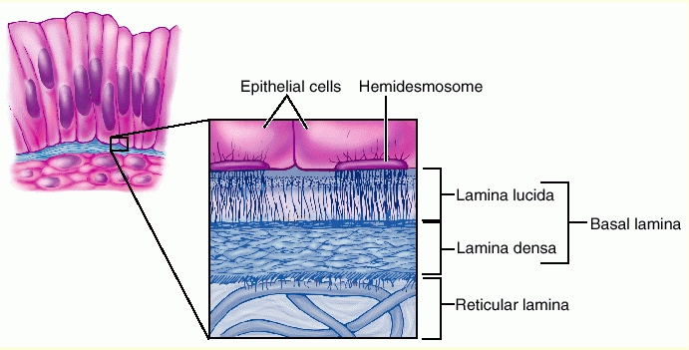
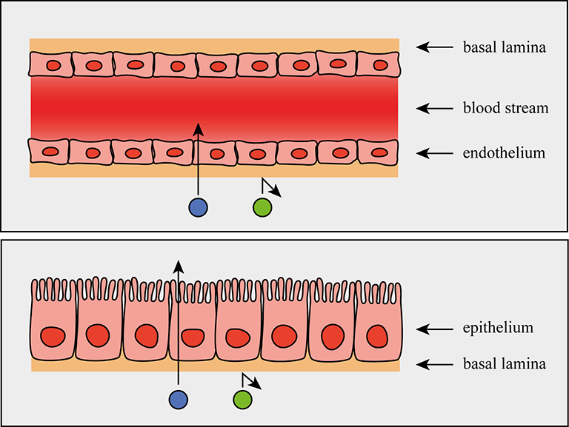
Notes:
The basal lamina is a layer of extracellular matrix secreted by the epithelial cells, on which the epithelium sits.
Hemidesmosomes (HD) are specialized junctional complexes, that contribute to the attachment of epithelial cells to the underlying basement membrane in stratified and other complex epithelia, such as the skin, the cornea, parts of the gastrointestinal and respiratory tract, and the amnion. (The amnion is a membrane that closely covers the embryo when first formed)

Slide 4
Veins
Capacitance vessels of the cardiovascular system
Relatively thin walled and flaccid, and expand easily to accommodate an increased volume of blood
They collapse when empty and thus have relatively flattened, irregular shapes in histological sections
Notes:
Capacitance vessels are considered to be the blood vessels that contain most of the blood and that can readily accommodate changes in the blood volume. They are generally considered to be veins.

Slide 5
Postcapillary venules
Smallest of the veins, 10 to 20 μm
Have a tunica interna with only a few fibroblasts around it and no muscle
Postcapillary venules are even more porous than capillaries; therefore, venules also exchange fluid with the surrounding tissues.
Most leukocytes emigrate from the bloodstream through the venule walls
Notes:
A fibroblast is a type of biological cell that synthesizes the extracellular matrix and collagen, produces the structural framework (stroma) for animal tissues, and plays a critical role in wound healing. Fibroblasts are the most common cells of connective tissue in animals.

Slide 6
Muscular venules
1mm
Receive blood from the postcapillary venules
Tunica media of one or two layers of smooth muscle, and a thin tunica externa

Slide 7
Medium veins
10 mm
veins with individual names
Tunica interna with an endothelium, basement membrane, loose connective tissue, and sometimes a thin internal elastic lamina
Tunica media is much thinner than it is in medium arteries; it exhibits bundles of smooth muscle, but not a continuous muscular layer as seen in arteries
The tunica externa is relatively thick

Slide 8
Venous sinuses
Veins with especially thin walls, large lumens, and no smooth muscle
Coronary sinus
Dural sinus
Notes:
Dural Venous Sinuses. The dural venous sinuses lie between the periosteal and meningeal layers of the dura mater. They are best thought of as collecting pools of blood, which drain the central nervous system, the face, and the scalp. All the dural venous sinuses ultimately drain into the internal jugular vein.

Slide 9
Large veins
> 10 mm
They have some smooth muscle in all three tunics
They have a relatively thin tunica media with only a moderate amount of smooth muscle
The tunica externa is the thickest layer and contains longitudinal bundles of smooth muscle
Large veins include the venae cavae, pulmonary veins, internal jugular veins, and renal veins.

Slide 10
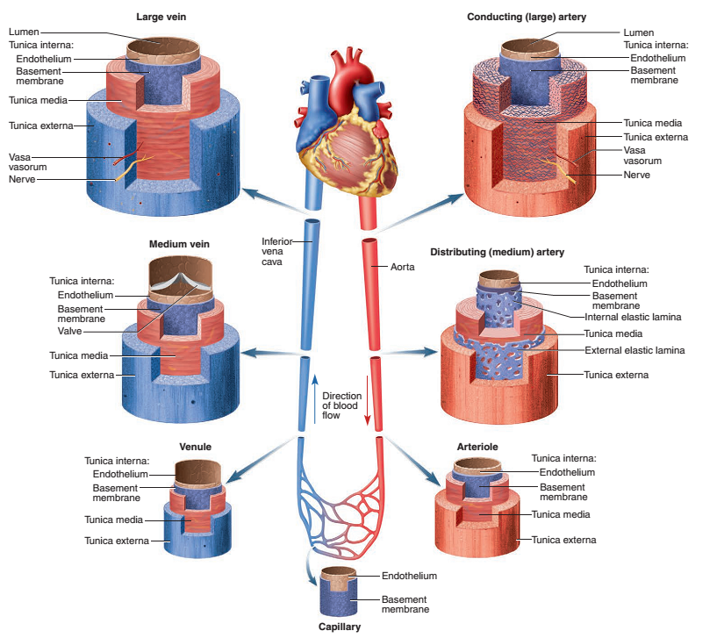

Slide 11
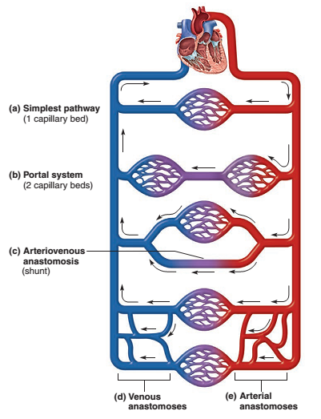
Notes:
An anastomosis (plural anastomoses) is a connection or opening between two things (especially cavities or passages) that are normally diverging or branching, such as between blood vessels, leaf veins, or streams.

Slide 12
Circulation of the blood
Describe the circulation of the blood through the lungs, naming the main vessels involved
List the arteries supplying blood to all major body structures
Describe the venous drainage involved in returning blood to the heart from the body
Describe the arrangement of blood vessels relating to the portal circulation.

Slide 13
Although circulation of blood round the body is continuous it is convenient to describe it in two parts:
Pulmonary circulation
Systemic or general circulation

Slide 14
Pulmonary Circulation
From the right ventricle of the heart to the lungs and back to the left atrium
In the lungs, carbon dioxide is excreted and oxygen is absorbed
The pulmonary artery or trunk, carrying deoxygenated blood, leaves the upper part of the right ventricle of the heart
Passes upwards and divides into left and right pulmonary arteries at the level of the 5th thoracic vertebra.

Slide 15
Pulmonary Circulation
The right pulmonary artery passes to the root of the right lung and divides into two branches, Superior Branch → Superior lobar
Lower branch divides again within lung → Middle lobar and inferior lobar
The left pulmonary artery is much more variable
Before entering to hilum → Several Superior lobar arteries
After entering → Inferior lobar arteries

Slide 16
Pulmonary Circulation
Within the lung these arteries divide and subdivide into smaller arteries, arterioles and capillaries
Capillaries surround alveoli (air sacs)
The exchange of gases takes place between capillary blood and air in the alveoli of the lungs.
In each lung the capillaries containing oxygenated blood join up and eventually form two pulmonary veins.

Slide 17
Systemic circulation to lungs
The lungs also receive a separate systemic blood supply by way of the bronchial arteries

Slide 18
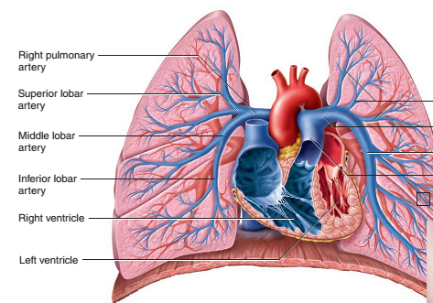
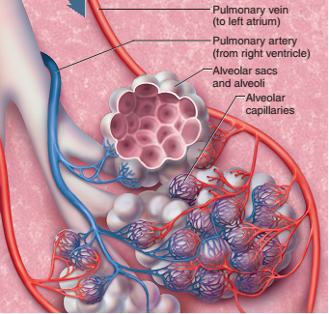

Slide 19
Systemic or general circulation
Outline only the most common circulatory pathways
There is a great deal of anatomical variation
The names of the blood vessels often describe
Location (Body region traversed (pass through)
An adjacent bone
Organ supplied
In many cases, an artery and adjacent vein have similar names

Slide 20
Systemic or general circulation
The blood pumped out from the left ventricle → carried by the branches of the aorta around the body → superior and inferior venae cavae → right atrium of the heart

Slide 21
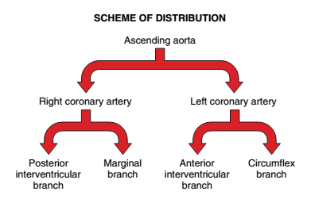
Aorta and its major branches

Slide 22
Aorta and its major branches

