Slide 1
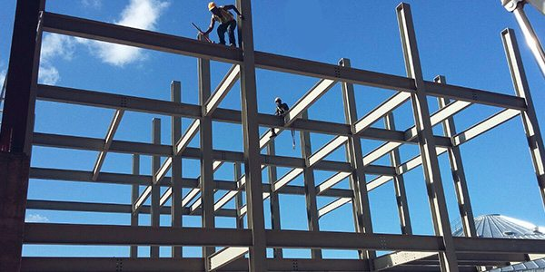
COLLEGE OF ENGINEERING AND TECHNOLOGY UNIVERSITY OF SARGODHA DESIGN OF STRUCTURES (CE-409) 01-Credit Hour
LECTURE-6
SERVICEABILITY………

Slide 2
TYPES OF CRACKS
Tensile stresses induced by loads, moments, shears and torsion cause distinctive crack patterns.
However, this section presents a few introductory comments concerning some of the several types of cracks that occur in reinforced concrete beams.
Members loaded in direct tension crack right through the entire cross section, with a crack spacing ranging form 0.75 to 2 times the minimum thickness of the member.
In the case of a very thick tension member with reinforcement in each face, small surface cracks develop in the layer containing the reinforcement as shown in figure-1. As a result, for a given total change in length, the crack width at B is greater than at A.

Slide 3
Figure-1

Slide 4
TYPES OF CRACKS……
Members subjected to bending moments develop flexural cracks as shown in figure below.
Flexural cracks are vertical cracks that extend from the tension sides of beams up to the region of their neutral axes.
These cracks may be wider up in the middle of the beam than at the bottom.
These vertical cracks extend almost to the zero-strain axis (neutral axis) of the member.

Slide 5
TYPES OF CRACKS……
In a beam with a web that is more than 3 to 4 ft high, the cracking is relatively spaced at the level of the reinforcement, with several cracks joining or disappearing above the reinforcement, as shown in figure below. Again, the crack width at B will frequently exceed that at A.

Slide 6
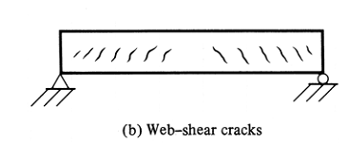
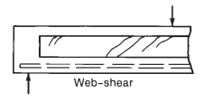
TYPES OF CRACKS……
Inclined cracks due to shear can develop in the webs of reinforced concrete beams as independent cracks or as extensions of flexural cracks.
Occasionally, inclined cracks will develop independently in a beam even though no flexural cracks are in that locality.
These cracks, which are called web-shear cracks and which are illustrated in following figure.
These cracks sometimes occur in the webs of prestressed sections, particularly those with large flanges and thin webs.
Cracks due shear have characteristic inclined shape, such cracks extend upward as high as the neutral axis and sometimes into the compression zone.

Slide 7
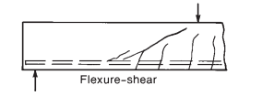
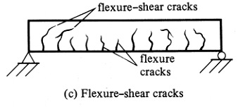
TYPES OF CRACKS……
The usual type of inclined shear cracks are the flexure-shear cracks, which are illustrated in the following figures.
They commonly develop in both prestressed and non prestressed beams.

Slide 8
TYPES OF CRACKS……
Torsion cracks are quite similar to shear cracks except that they spiral around the beam.
Should a plain concrete member be subjected to pure torsion, it will crack and fail along 45⁰ spiral lines due to the diagonal tension corresponding to the torsional stresses.
For a very effective demonstration of this type of failure, you can take a piece of chalk in your hands and twist it until it breaks.
Although torsion stresses are very similar to shear stresses, they will occur on all faces of a member.
As a result, they add to the shear stresses on ne side and subtract from them on the other.

Slide 9
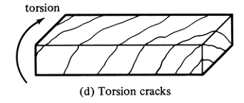
TYPES OF CRACKS……

Slide 10
TYPES OF CRACKS……
Sometimes bond stresses between the concrete and the reinforcing lead to a splitting along the bars as shown in the figure below.
Concentrated loads will sometimes cause splitting cracks or “Bursting Cracks” of the type shown in figure below.
It occurs in bearing areas and in struts of strut-and-tie models.

Slide 11
TYPES OF CRACKS……
At service loads, final cracking pattern has generally not developed completely, with the result that there are normally only a few cracks at points of maximum stress at this load level.
cracks also develop in response to imposed deformations, such as differential settlements, shrinkage and temperature differentials.
If shrinkage is restrained, as in the case o fa thin floor slab attached at each end to stiff structural members, shrinkage cracks may occur.
Generally, however, shrinkage simply increases the width of load-induced cracks.
A frequent cause of cracking in structures is restrained contraction resulting from the cooling down to ambient temperatures of very young members that expanded under the heat of hydration, which developed as the concrete was setting.

Slide 12
TYPES OF CRACKS……
This most typically occurs where a length of wall is cast on a foundation that was cast some time before.
As the wall cools, its contraction is restrained by the foundation.
A typical heat-of-hydration cracking pattern is shown in figure in next slide
such cracking can be controlled by controlling the heat rise due to the heat of hydration and the rate of cooling or both; by placing the wall in short lengths; or by reinforcement considerably in excess of normal shrinkage reinforcement.
Plastic shrinkage and slumping of concrete, which occur as newly placed concrete bleeds and the surface dries, result in settlement cracks along the reinforcement or a random cracking pattern, referred to as map cracking as shown in figure in next slides.
These types of cracks can be avoided by proper mixture design and by preventing rapid drying of the surface during the first hour or so after placing.
Map cracking can also be due to alkali-aggregate reaction.

Slide 13
TYPES OF CRACKS……

Slide 14
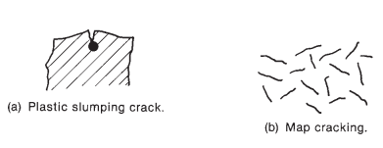
TYPES OF CRACKS……

Slide 15
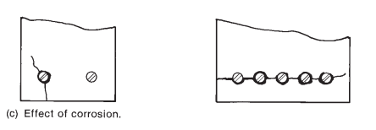
TYPES OF CRACKS……
Rust occupies two to three times the volume of the metal from which it is formed.
As a result, if rusting occurs, a bursting force is generated at the bar location, which leads to splitting cracks and an eventual loss of cover as shown in figure below.
Such cracking looks similar to bond cracking and may accompany bond cracking.

