Slide 2
Temperature Stress in Plants

Slide 3
What is Stress????
External conditions that adversely affect growth, development or productivity.
Stress trigger a wide range of plant responses
Altered gene expression
Cellular metabolism
Changes in growth rates and crop yields

Slide 4
Types of stress
Biotic- imposed by other organisms
Abiotic- arising from an excess or deficit in the physical or chemical environment
- Biotic and abiotic stresses can reduce average plant productivity by 65% to 87% depending upon the crop.

Slide 5
Plant response to abiotic stress:
Arising from an excess or deficit in the physical or chemical environment

Slide 6
Environmental conditions that can cause stress
Water-logging
Drought
High or low temperature
Excessive soil salinity
Inadequate mineral in the soil
Too much or too little light

Slide 7
Stress resistance mechanisms
Avoidance mechanism
- prevents exposure to stress
Tolerance mechanism
- permit the plant to withstand stress
Acclimation
- alter their physiology in response stress

Slide 8
Heat stress or high temperature stress
The typical stress response to stress is a decrease in the synthesis of normal proteins, accompanied by an accelerated transcription and translation of new proteins known as heat shock proteins.

Slide 9
Heat shock
May arise in leaves
- when transpiration is insufficient
- when stomata are partially or fully closed and irradiance is high
May arise in germinating seedlings
- when the soil is warmed by the sun
May arise in organs with reduced capacity for transpiration e.g. fruits

Slide 10
Effect of High Temperature on Plants

Slide 11
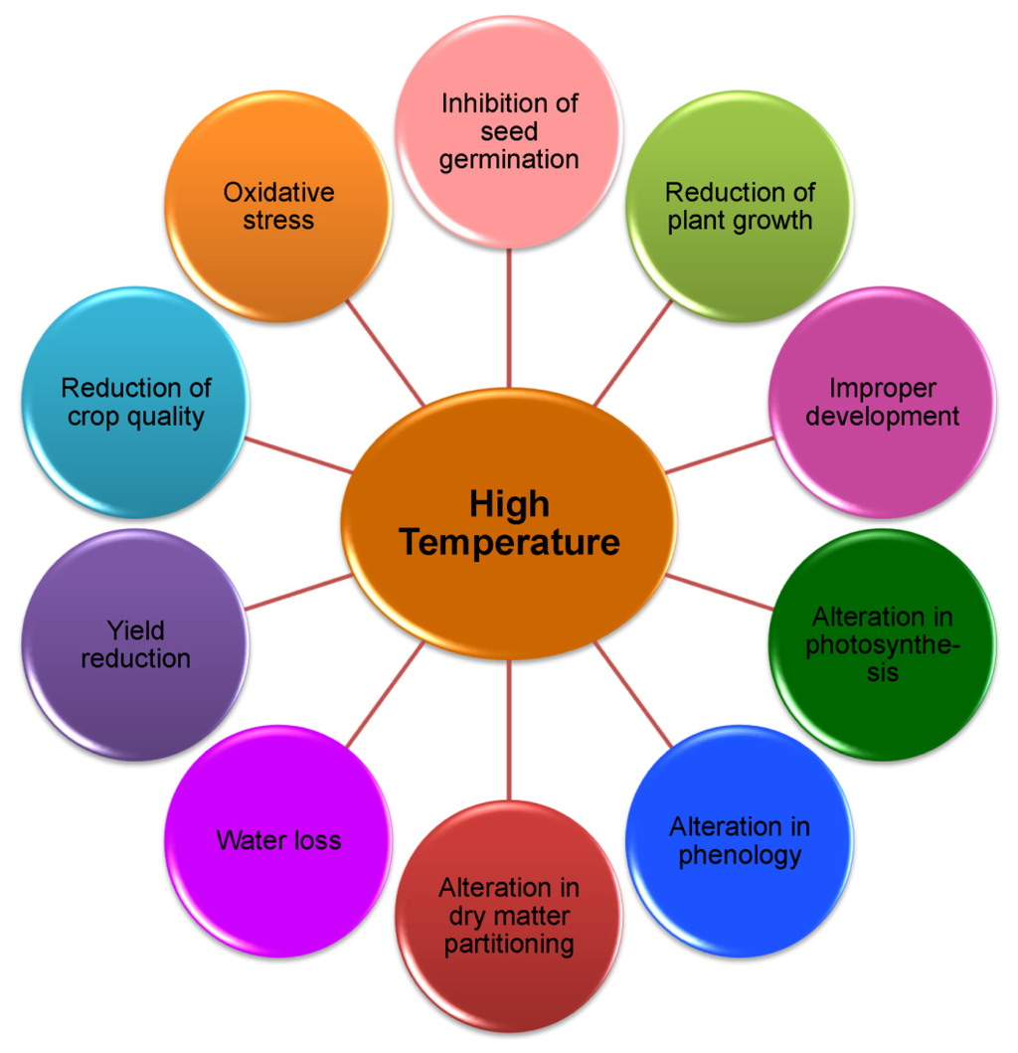

Slide 12
Effect on growth
Reduced germination percentage,
Plant emergence,
Abnormal seedlings,
Poor seedling vigor,
Reduced radicle and plumule growth of geminated seedlings

Slide 13
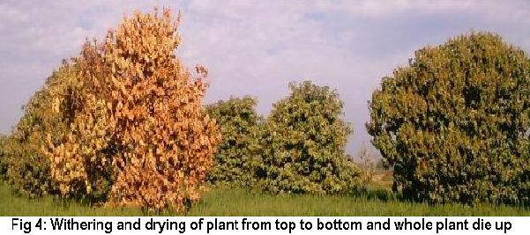
High temperature causes loss of cell water content for which the cell size and ultimately the growth is reduced.
Reduction in net assimilation rate (NAR) is also another reason for reduced relative growth rate (RGR).

Slide 14
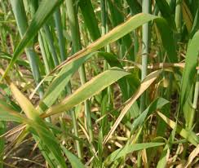
The morphological symptoms of heat stress include scorching and sunburns of leaves and twigs, branches and stems, shoot and root growth inhibition, fruit discoloration and damage.
High temperatures may alter the total phenological duration by reducing the life period.
Increases in temperatures 1–2 °C than the optimum result in shorter grain filling periods and negatively affect yield components of cereal.

Slide 15
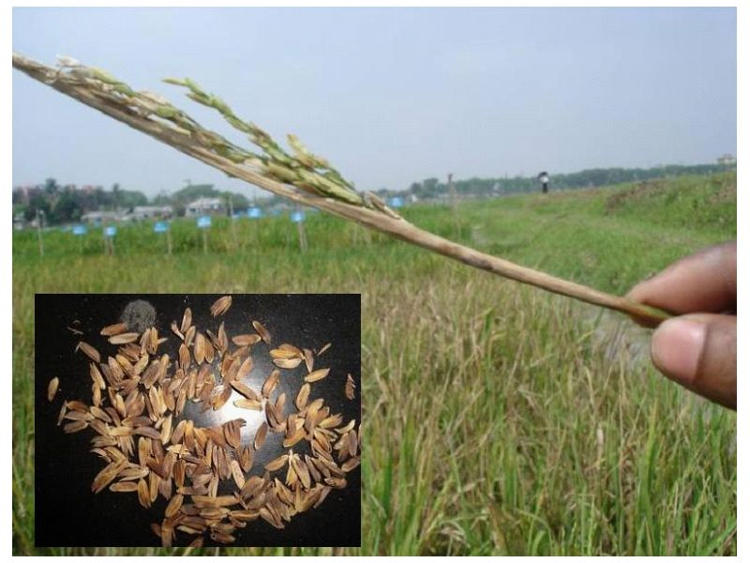
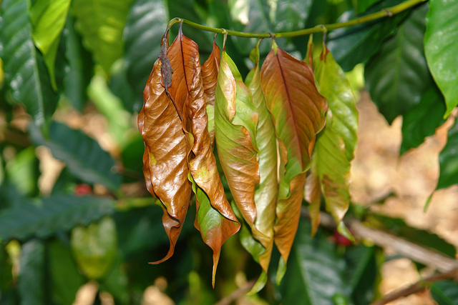

Slide 16
Effect on Photosynthesis
High temperature has a greater influence on the photosynthetic capacity of plants especially of C₃ plants than C₄ plants.
In chloroplast, carbon metabolism of the stroma and photochemical reactions in thylakoid lamellae are considered as the primary sites of injury at HTs.
Thylakoid membrane is highly susceptible to HT.
Again, the photosystem II (PSII) activity is greatly reduced or even stops under HTs.
Heat shock reduces the amount of photosynthetic pigments.

Slide 17
The ability of plant to sustain leaf gas exchange and CO₂ assimilation rates under heat stress is directly correlated with heat tolerance.
Heat markedly affects the leaf water status, leaf stomatal conductance (gs) and intercellular CO₂ concentration.
Closure of stomata under HT is another reason for impaired photosynthesis that affects the intercellular CO₂ .

Slide 18
Effect on Reproductive Development
During reproduction, a short period of heat stress can cause significant decrease in floral buds.
Heat spell at reproductive developmental stages plant may produces no flowers or flowers may not produce fruit or seed.

Slide 19
The reasons for increasing sterility under abiotic stress conditions including
The HT are impaired meiosis in both male and female organs
Impaired pollen germination and pollen tube growth
Reduced ovule viability,
Reduced number of pollen grains retained by the stigma,
Disturbed fertilization processes,
Obstacle in growth of the endosperm,
Unfertilized embryo.

Slide 20
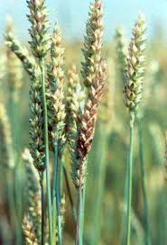
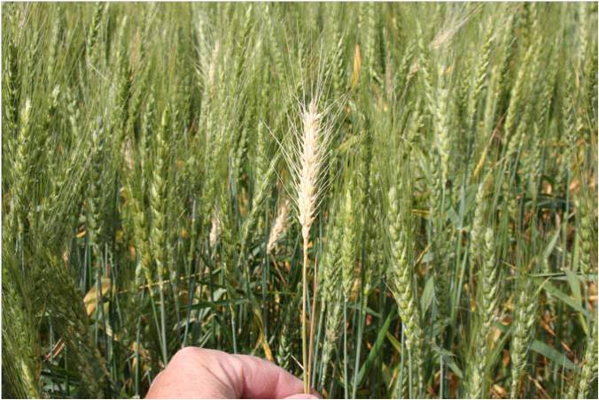

Slide 21
Effect on Yield
Higher temperatures affect the grain yield mostly through affecting phenological development processes.
Heat induced yield reduction was documented in many cultivated crops including cereals (e.g., rice, wheat, barley, sorghum, maize), pulse (e.g., chickpea, cowpea), oil yielding crops (mustard, canola) and so on.

Slide 22
Plant Adaptation to Heat Stress
Living organisms can be classified into three groups, subject to the preferred temperature of growth. There are
(a) Psychrophiles: which grow optimally at low temperature ranges between 0 and 10 °C;
(b) Mesophyles: which favor moderate temperature and grow well between 10 and 30 °C
e.g. water lily, pond weed
(c) Thermophyles: which grow well between 30 and 65 °C or even higher

Slide 23
Survival in hot, dry environments can be achieved in a variety of ways, by combinations of adaptations. Plant adaptation to heat stress includes avoidance and tolerance mechanisms which employ a number of strategies.

Slide 24
Avoidance Mechanisms
Under HT conditions, plants exhibit various mechanisms for surviving which include
Long-term evolutionary phenological and morphological adaptations and short-term avoidance or acclimation mechanisms such as changing leaf orientation, transpirational cooling, or
Alteration of membrane lipid compositions
Closure of stomata and reduced water loss, increased stomatal and trichomatous densities, and larger xylem vessels are common heat induced features in plant.

Slide 25
Plants growing in a hot climate avoid heat stress by reducing the absorption of solar radiation.
This ability is supported by the presence of small hairs (tomentose) that form a thick coat on the surface of the leaf as well as cuticles, protective waxy covering.
In such plants, leaf blades often turn away from light and orient themselves parallel to sun rays (paraheliotropism). Solar radiation may also be reduced by rolling leaf blades. Plants with small leaves are also more likely to avoid heat stress: they evacuate heat to ambient more quickly due to smaller resistance of the air boundary layer in comparison with large leaves.

Slide 26
Tolerance Mechanisms
Heat tolerance is generally defined as the ability of the plant to grow and produce economic yield under HT.
This is a highly specific trait, and closely related species, even different organs and tissues of the same plant, may vary significantly in this respect.

Slide 27
Some major tolerance mechanism, including
Ion transporters,
Late embryogenesis abundant (LEA) proteins, osmoprotectants,
Antioxidant defense, and
Factors involved in signaling cascades and transcriptional control
are essentially significant to counteract the stress effects .

Slide 28
In case of sudden heat stress, short term response, i.e., leaf orientation, transpirational cooling and changes in membrane lipid composition are more important for survival.
Different tissues in plants show variations in terms of developmental complexity, exposure and responses towards the prevailing or applied stress types.
The stress responsive mechanism is established by an initial stress signal that may be in the form of ionic and osmotic effect or changes in the membrane fluidity. This helps to reestablish homeostasis and to protect and repair damaged proteins and membranes.

Slide 29
Practices to overcome Heat Stress
Water regularly and deeply.
Mulch the soil with at least three inches of organic mulch to reduce moisture loss and help regulate soil temperature.
Soils rich in organic matter retained more water and dry out more slowly than low organic matter soils.

Slide 30
Use of Mulching and Shade Cloth to Protect Plants in Hot and Dry Weather
Mulching is very effective in retaining moisture in the soil and keeping it cool.
Covering pot plants or areas of the garden with 50 -70 per cent shade cloth is also very effective for protecting plant vegetation from heat and drying from.
On very hot days, a thick blanket of good quality mulch (3-6 inches thick; 7-10 cm) will keep the soil temperatures down by 5-10 degrees.

Slide 31
Low Temperature Stress

Slide 32
Stress
In biology the any change in environmental condition which reduce or adversely effect the growth and development of plant.e.g
Drought, heat, salt , pest and disease.

Slide 33
Chilling Temperature
Chilling temperatures are too low for normal growth but not low enough for ice to form. Typically, tropical and sub-tropical species are susceptible to chilling injury. Among
crops, maize, bean, rice, tomato, cucumber, sweet potato, and cotton are chilling sensitive.

Slide 34
Chilling injury
When plant growing relatively 25-35°C and cooled to 10-15°C chilling injury occurs. E.g
Cold shock, sudden exposure to low temperature.

Slide 35
Cont……….
In cold weather, non adapted plant show changes
Changes in consistency of membrane.
Under freezing condition, crystals are built in the intercellular.

Slide 36
Classification of plants response to Low temperature
Chilling Sensitive plants:
Seriously injured by temp. above 0°C and below 15°C.
Chilling resistant plants:
Able to tolerate low temperature stress
Seriously injured when ice form in tissues

Slide 37
Frost resistant plants:
Tolerate exposure to very low temperature
(-50°C to -100°C), even immersed in liquid N₂.

Slide 38
Symptoms of chilling injuries
i) Cellular changes:
Changes in membrane structure and composition decrease protoplasmic streaming.
electrolyte leakage and plasmolysis.

Slide 39
Chilling injuries symptoms
ii) Altered metabolism:
Increase or reduce respiration depending on severity of stress production of abnormal metabolites due to anaerobic conditions.

Slide 40
Cellular membrane changes
Plant membrane consist of lipid bilayer. In chilling sensitive plants, lipid bilayer have high percentage of saturated fatty acid chain. Membrane with composition become semi-solidify at chilling temperature.
Transition from liquid crystalline phase to solid gel state.
Increase in permeability of plasma results in leakage of organic and inorganic substances

Slide 41
Cellular membrane changes

Slide 42
Formation of crystalline deposits in root,epidermal,mesophyll and vascular cells leading to tonoplast disruption.
Tonoplast disruption is irreversible.
During hardening lipids accumulates in cytoplasm.

Slide 43
Cytological changes
Swelling of plastids membrane and mitochondrial membrane.
Swelling of chloroplast thylakoids.
Decrease in size and number of grain.
Mitochondria with reduce cristae and transparent matrix.
Swelling and disintegration of dictyosomes.

Slide 44
Common symptoms
Reduce plant growth and health.
Surface lesions on leaves and fruits.
Abnormal curling , crinkling of leaves.
Water socking of tissues.
Cracking, splitting and die back of stem.
Internal discoloration.
Failure to ripened early.
Loss of vigor.

Slide 45
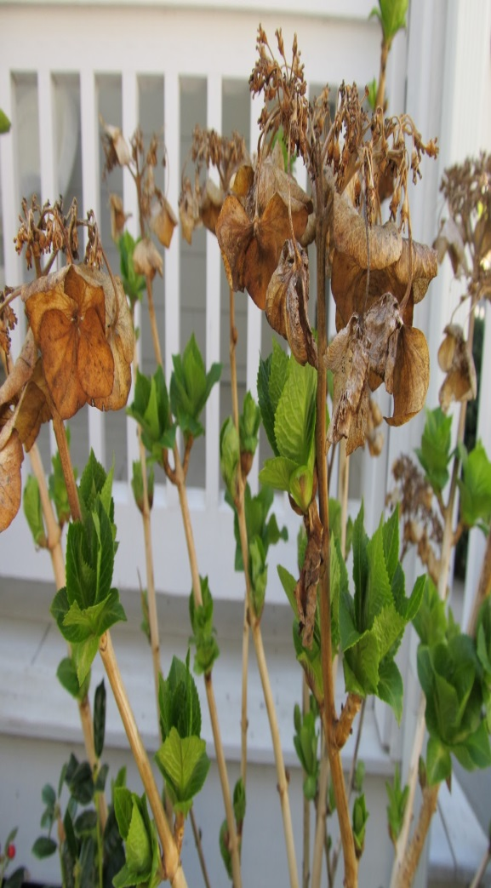
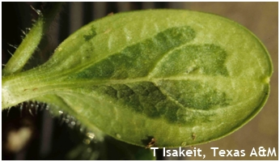
Surface Lesions
Die back of stem
Abnormal curling
Water socking

Slide 46
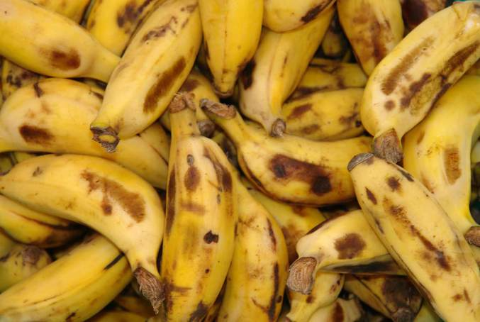
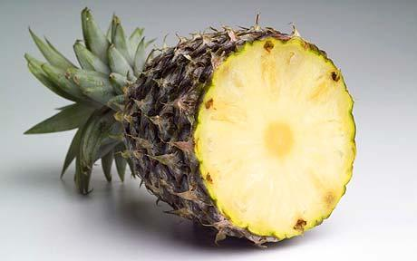
Chilling stress in fruits
Sunken pits in cucumber.
Browning of skins and degradation of pulp in banana.
Black heart of pineapple.

Slide 47
Freezing injury
Freezing injury occurs at Temperature below freezing point of water.
Freezing injury can be from two sources.
Freezing of soil water:
Water present in soil available to plant freezes at -2°C, and not available to plant.
Freezing of fluid in plants:
It make disruption of cell structure and its function.

Slide 48
Two types of freezing occur in plant cells
Vitrification:
Solidification of cellular content.
Crystallization/ ice formation:
Ice formation in intracellular or intercellular.

Slide 49
Strategies taken by plants
Stress Avoidance
Some succulents
Many annuals
Supper cooling
Stress Tolerance
Cold acclimation in plants is a complex process involving changes in the expression of numerous cold-responsive (COR) genes This results in modification of plant cell structural, biochemical, and photosynthetic properties that facilitate an increase in the plant’s freezing stress tolerance.

Slide 50
The adaptation of plant cells to low temperature is
Based on their ability to maintain saturation of fatty acid in membrane lipids, thus modifying membrane fluidity.
Chilling-resistant plants have a greater abundance of unsaturated fatty acids and it has been shown that the proportion of unsaturated fatty acids increases during acclimation to cold temperature.

Slide 51
This modification allows membranes to remain fluid by lowering the temperature. Thus, desaturation of fatty acids provides protection against damage from chilling temperatures.

Slide 52
Approaches to Combat chilling stress
i) Resistant cultivars usage (Alfalfa)
Herbs, ground shrubs, low Leaf Area ,high root/shoot ratio.
Cold adapted plants tend to be slow growing.
Store sugar in underground tissues.
Have C3 mode of p/s.

Slide 53
ii) Low temperature Hardening/Acclimation.
when plants are exposure to low temperature
Slowly and gradually for a period.
iii) Mulching , warming of plant artificially.
iv) Application of glycine betaine (GB) to plants could improve tolerance to stress caused by chilling.

