Slide 1
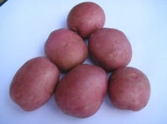
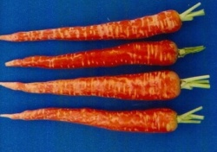
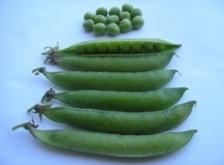
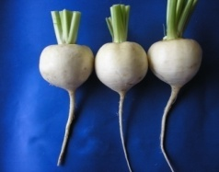
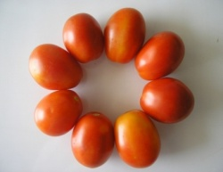
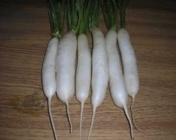
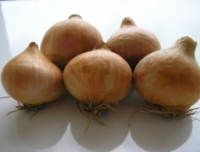
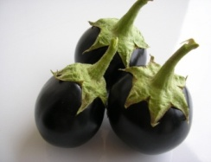
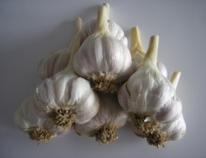
Horticulture?
HORT-201
University College of Agriculture,
University of Sargodha

Slide 2
Classification of Horticultural Crops

Slide 3
Classification of Hort. Crops
Types of classification
Horticultural
Botanical
Horticultural Classification
Logically conceived systems
description
nomenclature and
identification of plants

Slide 4
Ways and Means of Classification
Growth habit and physiological characteristics
Life span
Flowering Habits
Temp. relation
Uses
Morphology
Cultural requirements

Slide 5
A. Growth habit & physiological characteristics
Succulents:
Plants with tender and watery stem & leaves
Foliage plants (Nanthra)
Herbacious:
Herb self supporting succulent
tender stem either drooping or self supporting
Most of vegetables
Woody:
self supporting woody plants
Trees and shrubs

Slide 6
A. Growth habit & physiological characteristics
Classification of tree & shrub
Tree Shrub
Single central stem one or more stem
Taller smaller
May vary with environment and training practices.
Plants with trailing/climbing stems
woody/non-woody
Non-woody stem Vine (Cucurbits)
Woody stem Liana (Grapes)

Slide 7
Vine: A climbing plant with a non woody stem is known as vine
Liana: A climbing plant with a woody stem is known as Liana

Slide 8
A. Growth habit & physiological characteristics
Evergreen
Plants with persistent leaves
Tropical in origin
E.g., Citrus, mango, date, guava, litchi, coconut, olive, ber, banana, chiku, pineapple, fig and papaya etc.
Deciduous
Plant shedding their leaves in winter
Eg., Apple, pear, peach, plum, apricot, almond, cherry, strawberry, grapes, walnut, pistachio, pomegranate and falsa

Slide 9
B. Classification based on life span
Annuals
complete life cycle in one growing season.
many vegetables and seasonal flowers.
Biennials
complete life cycle in two growing seasons.
Ist season
vegetative with short internodes and rosettes
IInd season
bolting (sends up flowering stalk with long internodes bearing flowers and fruits)
root vegetables (Carrot, beet, radish)
leafy vegetables (Lettuce and cabbage)
& onion.
Climate is critical factor in determination of the life cycle
Most of the above vegetables are treated as annuals ?

Slide 10
B. Classification based on life span
Perennials
Grow for years and woody.
Growth
Juvenile (vegetative for several yrs.)
Mature (veg. + reproductive)
all fruit and ornamental trees and shrubs.

Slide 11
Perennials
Winter Killing
Above ground parts killed
Underground storage structures survive
Brinjal and tomato
perennial in tropical climate
annual in temperate climate

Slide 12
C. Classification based on flowering habits
Acc. to functionality of parts
Unisexual/imperfect
Having one of the male/female floral parts on the flower
Bisexual/hermaphrodite/perfect
Both male and female parts present on same flower e.g. peas.
Acc. to presence/absence of floral parts
Complete flower.
All four whorls present (Sepals, petals, stamens and pistils)
Incomplete flower.
Anyone absent.

Slide 13
C. Classification based on flowering habits
Acc. to availability of male/female parts on the plant
Monoecious:
Male and female parts on the same flower/plant.
e.g., mango, citrus, cucurbits and walnuts.
Dioecious:
only one male and female part present on one plant.
e.g., Date and papaya, spinach, asparagus, beet
Polygamous
having all male, female and hermaphrodite flowers on the same plant
Fig, mango

Slide 14
D. Classification based on temperature relations
Temp. requirements for growth and tolerance to low temperature
Acc. To growing season (Vegetables)
Summer
grown year round in entire lower sindh-frost free area
Winter
Grown in plains of Punjab
Easily cultivated in summer at high altitudes

Slide 15
D. Classification based on temperature relations
Acc. To growing season (Vegetables)
Cool season crops
Max. 80-85°F
Min. 35-40°F
Opt. 65°F
Warm season crops
Opt. above 80°F
Min. below 50°F (can’t grow)
Frost sensitive

Slide 16
D. Classification based on temperature relations
Acc. To growing season (Fruits)
Temperate:
Mostly deciduous.
Required chilling to flower
e.g., apple, pear, plum and peaches.
Sub tropical:
Can tolerate frost
e.g., citrus, guava and grapes.
Tropical:
More sensitive to low temp.
e.g., banana, papaya and mango.

Slide 17
D. Classification based on temperature relations
Acc. To growing season (Fruits)
Both tropical and sub tropical are
native to warmer climate,
frost sensitive,
needs hardening in late summer.
According to ability to withstand low winter temperature.
tender not resistant
hardy resistant

Slide 18
D. Fruit Classification based on Uses & cultural requirements
Small or Soft fruit:
Born on low growing plants like shrubs and vines
grapes, Phalsa, strawberry
Nuts
edible seeds
almond, walnut, pecans etc.
Fleshy fruit
soft flesh opposite to seed
mango

Slide 19
D. Fruit Classification based on Uses & cultural requirements
Pome/False fruits
edible part thalamus
apple, pear, quince.
Berries: In botany, a berry is a fleshy fruit without a stone produced from a single flower containing one ovary. Berries so defined include grapes, currants, and tomatoes, as well as cucumbers, eggplants (aubergines) and bananas, but exclude certain fruits commonly calledberries, such as strawberries and raspberries.
develop from ovary walls
grapes, banana, citrus, tomato.
Stone/drupe fruit
fruits have stony endocarp.
peach, plum, apricot, mango, cherry.

Slide 21
Quince

Slide 22
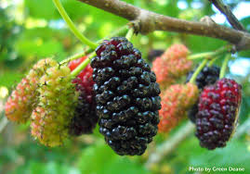
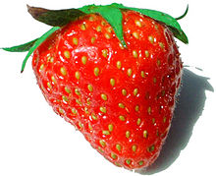
D. Fruit Classification based on Uses & cultural requirements
Multiple fruits
develop from many separate but closely clustered flowers
Pineapple, fig, mulberry
Aggregate fruits
derived from a flower with more pistils on a common receptacle
Develop from numerous ovaries of same flower
Individual fruit
drupe (blackberry)
Achene strawberry
Small one seeded indehiscent fruit developed from a single carpel

Slide 24
D. Vegetable classification based on uses & cultural requirements
Root crops
with underground edible part
carrot, radish, turnip, beet, potato.
Leafy vegetables
lettuce, cabbage, celery, spinach
Vine crops
Most of cucurbits

Slide 25
D. Vegetable classification based on uses & cultural requirements
Solanaceous fruits
Tomato, eggplant & bell pepper
Flower crops
Cauliflower & broccoli
Seed
Peas & beans

Slide 26
D. Ornamental plant classification based on uses & cultural requirements
Flowering plants
Annuals,
perennials and
bulbs with underground storage organs.
Landscape plants
Foliage plants, ground covers, lawn grasses, hedges, trees and shrubs
Indoor plants with persistent evergreen foliage

Slide 27
B. Botanical classification
Scientific plant classification based on phylogenetic (evolutionary) relationships of organisms.
Taxonomy : Greek word
Taxon group/category
Science of classification
Class. On the basis of diff. and similarities
Mid 18th Century, C. Linnaeus used
morphology of sexual/reproductive parts as basis for taxonomy b/c
these organs are less influenced by environment.

Slide 28
Botanical classification
Kingdom
Phyla or division
Class Major Taxa
Order
Family
Genus
Specie Minor Taxa
variety

Slide 29
Divisions
The plant kingdom consist of about dozen major phyla or divisions
But most advances division is known as Tracheophyta
Vascular and tracheary system is the common features of all higher plants hence the name Tracheophyta
All horticultural plants belong to this division except mushrooms

Slide 30
Class
Division tracheophyta is divided into different
classes
Filicinae Gymnospermae Angiospermae
(Fern) (Conifers) (Flowering plants

Slide 32
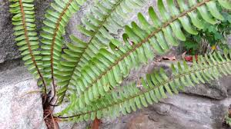
B. Botanical classification
Plant Kingdom
Includes a dozen major phyla/divisions
Tracheophyta is more developed
Have vascular/treachery system (common in all higher plants)
All hort. crops except mushrooms
Several classes
Hort. Important classes
Filicinae (ferns)
Gymnospermae (conifers)
Angiospermae (flowering plants)

Slide 33
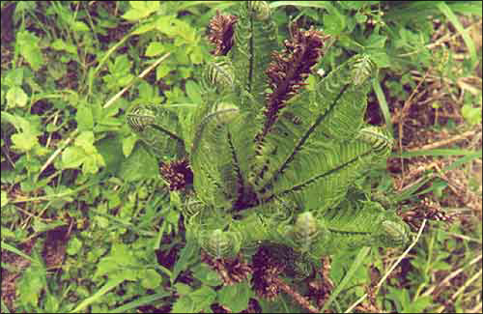
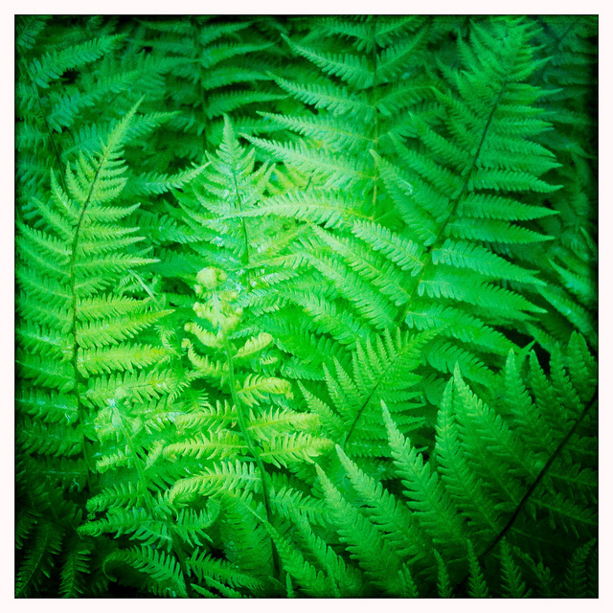
Ferns

Slide 34
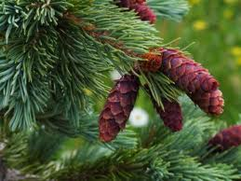
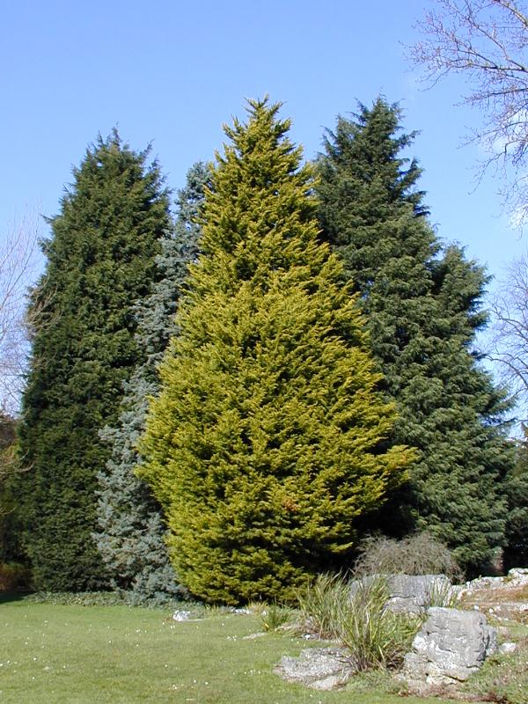
Gymnospermae (Conifers)

Slide 35
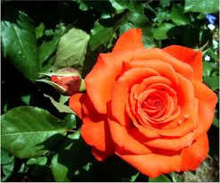
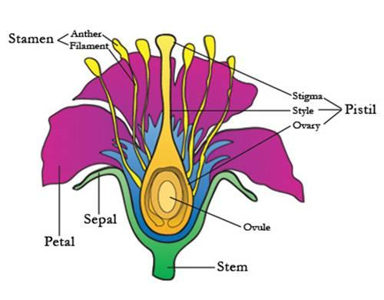
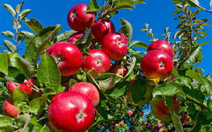

Slide 36
Class is divided into order and then order is further divided into families
Each families comprises a number of genera (genus)
With in each genus, there are various species
Each species have many varieties or strain

Slide 37
Varieties:
An identical group of individuals within species is called variety
Cultivar:
The term cultivar refers to a named group of plants within a cultivated species which maintain their identity when propagated either sexually or asexually
Clone:
A population propagated vegetatively from a single original stock
Strain or sports
Variants among clones are called strain or sports

Slide 38
Filicinae
Filicinae or fern (also called monilophytes) is any one of a group of about 12,000 species of plants.
Unlike mosses, they have xylem and phloem; making them vascular plants.
They have stems, leaves, and roots like other vascular plants.
Ferns do not have either seeds or flowers, they reproduce via spores.

Slide 39
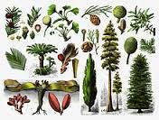
Gymnosperm | Angiosperm
Small group of about 700 spp | Largest group of higher plant
Evergreen trees | contain 250,000 Spp
Needle shape leaves | Deciduous with broad leaves
Belong to temperate zones
Seed are naked or uncovered | Seeds are covered in fruit
Seed are edible
Source of timber, wood, | Source of food, fiber and shelter
 | Moncotyledonae (Monocots) Dicotyledonae (Dicots)

Slide 40
Angiosperms
Dicotyledonae | Moncotyledonae
Two cotyledon | One cotyledon
Reticulate leaf venation | Parallel leaf venation
Vascular cambium (xylem and Phloem) | Lack of vascular cambium
200,000 spp | 50,000 spp

Slide 41
vascular cambium
The vascular cambium is a plant tissue located between the xylem and the phloem in the stem of a vascular plant.

Slide 43
B. Botanical classification
Identification and description
Based on two parts,
Generic (capital letter)
Specific (small)
Genus
group of species with common morphological, genetic and cytogenetic features.
Specie
Plants morphologically same and produce like progeny
Normally inter-breeding population.

Slide 44
B. Botanical classification
Varietal name follows the specific name.
Brassica oleraceaea botrytis (cauliflower)
Brassica oleraceaea capitata (cabbage)
Cultivar
Group of plants within cultivated specie that maintain the identity when propagated sexually or asexually.
Sexually propagated cultivar categories:
Pure line or self-pollinated
Open-pollinated (OP’s)
Hybrids

