Slide 1
Case Study
A 2-year-old unvaccinated child was seen in the emergency room because of complaints of headache, fever and altered mental status. Neck rigidity and kerning sign were positive

Slide 2
A cerebrospinal fluid(CSF) sample was obtained and sent to the laboratory for culture
The Gram stain showed many white blood cells and many gram-negative, small bacilli.
Glucose level
Protein levels

Slide 3
Haemophilus Species
“Blood-lover”
Important Haemophilius species
H. influenzae (an important pathogen)
H. ducreyi (soft chancre)
H. parainfluenzae (opportunistic pathogen)
Haemophilus species require hemoglobin for growth:
X-factor ( haemin): Heat-stable substance
V-factor (NAD): Heat- labile, a coenzyme1, NAD, found in RBCs or secreted by certain organisms

Slide 4
Haemophilus influenzae
Serological differentiation - capsular antigens: serotype a to f
Type b is most important and it is composed of polyribitol phosphate
Type-able and non type-able serotypes
Biochemical properties – catalase and oxidase positive.
Ferments glucose and galactose but not lactose and sucrose

Slide 5
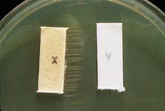
Haemophilus Species: Identification
This organism would be identified as H. influenzae because it is using both X and V factors.

Slide 6
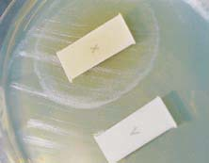
Haemophilus Species: Identification
This organism would be identified as hemophilus ducreyi because it is using X factor only.

Slide 7
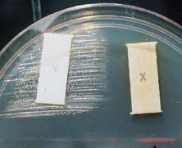
Haemophilus Species: Identification
This organism would be identified as H. parainfluenzae because it is using V factor only.

Slide 8
Transmission
Inhalation of air borne droplets
Person-to-person transmission in non-immune population
Increased disease frequency in households where there is a primary case or an asymptomatic carrier.
Close contacts should be given chemoprophylaxis.

Slide 9
VIRULENCE FACTORS
Adherence
Capsular polysaccharide
IgA Protease
Lipid A LPS

Slide 10
Pathogenesis encapsulated Hi type b
Uncommon in the URT
Common cause of disease in unvaccinated children
Produce IgA1 proteases, facilitate colonization
Invasion: Adhesion proteins → colonization of oropharynx →lipid A LPS…… → damage and impair ciliary function →across epithelial and endothelial cells → blood
LPS lipid A induces meningeal inflammation

Slide 11
Pathogenesis Non-encapsulated Hi (non-typeable)
Colonize URT in all people
10% of the flora of saliva: H. parainfluenzae
Opportunistic pathogens: Spread locally and cause acute and chronic otitis, sinusitis, bronchitis, and pneumonia

Slide 12
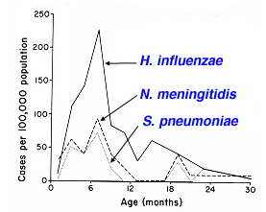
Clinical diseases (Hib infection)
Meningitis: Hi type b was the most common cause of pediatric meningitis (3 -18 m).
Age-specific incidence of bacterial meningitis caused by Haemophilus influenzae, Neisseria meningitidis and Streptococcus pneumoniae prior to 1985

Slide 13
Clinical diseases (H. influenza infection)
Pneumonia: typically occurs in infants and is accompanied by empyema and meningitis
Laryngo-tracheal infection
Cellulitis : fever, reddish-blue patches on the cheeks or periorbital area.
Septic Arthritis: the most common form of arthritis (single large joint) in children <2 yrs.
Epiglotitis : 2-4 yrs; swelling of the supra-glottic tissue, pharyngitis, fever, rapidly progress to complete obstruction of the airways, life-threatening emergency

Slide 15
Diagnosis
Clinical as well as laboratory diagnosis
Specimens:
Oral swab: avoid contamination with oral secretions
Sputum for LRT
Direct needle aspiration
Cerebrospinal fluid (CSF) and blood
Microscopy: both sensitive & specific; G(-) bacilli /cocobacilli in CSF in >80% cases before antibiotics treatment

Slide 16
Serological identification
Quellung’s reaction
Latex agglutination test
CIEP
ELISA
DNA probe

Slide 17
Diagnosis (for Hib only)
Particle agglutination test :
Detect PRP antigen, rapid and sensitive
Anti-PRP Ab-coated latex particles + specimen, if PRP present, “positive” agglutination
Culture:
Chocolate agar, colony 1-2 mm.
Blood agar: Hib grows around colonies of Staph. aureus on blood agar - Satellite phenomenon

Slide 18
Gram stain

Slide 19
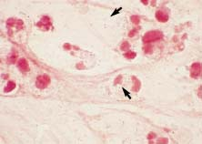
Direct smear of H. influenzae in CSF in a case of meningitis. Note the intracellular and extracellular pleomorphic gram-negative bacilli.

Slide 20
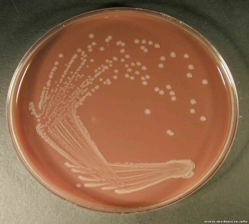
Culture
Small 1-2mm colonies on chocolate agar

Slide 22
Treatment
Prompt antimicrobial therapy for systemic Hib infections, otherwise mortality 90-100%
Serious infections: cephalosporins
Severe infections (otitis, sinusitis): augmentin
Antibiotic chemoprophylaxis (rifampin x 4days) for high risk group (children < 2ys with patients around)

Slide 23
Prevention
Polysaccharide PRP vaccine for Hib was not effective for children < 18m (the high risk population).
Hi type b conjugate vaccine
Purified capsular PRP + Carrier proteins: Diphtheria toxoid or Tetanus toxoid

Slide 24
Haemophilus ducreyi
A sexually transmitted disease; most common in Africa and Asia
Painful ulcer on genitalia (soft chancre, with regional lymphadenopathy
Differential:
Syphilis; Herpes simplex; Lymphogranuloma venereum (caused by Chlamydia trachomatis)

Slide 25
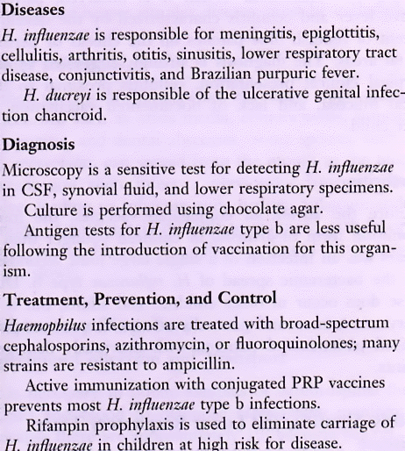
Haemophilus Infections (cont.)
NOTE:
Polysaccharide PRP is weakly immunogenic
Pediatric immunity not mature for processing polysaccharide antigens until ~18 months
Conjugated Vaccine:
PRP conjugated to protein carrier induces protective immunity (carriers may include: diphtheria toxoid, tetanus toxoid or meningococcal OMP)

Slide 26
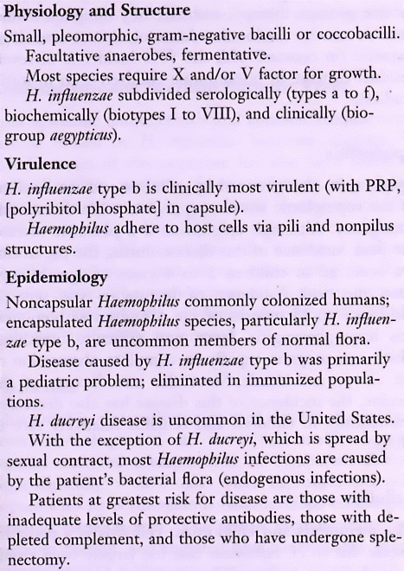
Haemophilus Infections
(see others in text)
PRP = polyribitol phosphate

