Slide 1
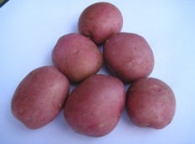
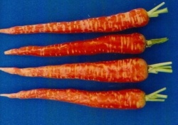
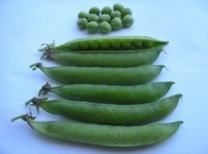
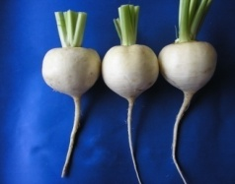
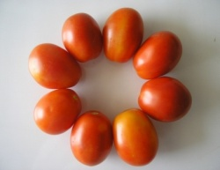
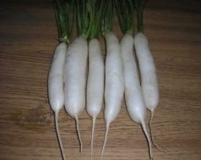
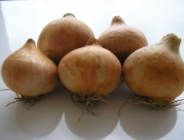
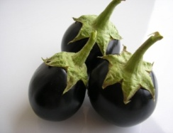
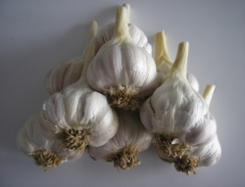
Horticulture?
HORT-201
University College of Agriculture,
University of Sargodha

Slide 2
Plant Parts and Functions
Melissa Morris
Covering:
2014A
2014B
2014C
2014D

Slide 3
Parts of The Plant
Roots
Leaves
Stem
Flower
Seed
Image found at: www.webinstituteforteachers.org

Slide 4
Roots
2 Types of Root Systems
Taproot
Fibrous System
Image found at: http://www.puc.edu

Slide 5
Roots
Taproot System
Primary roots grow down from the stem with some secondary roots forming
Image found at: http://www.arboretum.fullerton.edu

Slide 6
Roots
Fibrous Root System
Small lateral roots that spread out just below the soil surface
Image found at: www.wildmanstevebrill.com

Slide 7
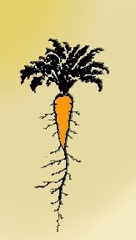
Can you identify these root types?

Slide 8
Root Functions
Roots have 4 primary functions
Absorption of water and nutrients
performed by root hairs
Transportation of water and nutrients to stem
Anchor plant to maintain stability
Store food and water

Slide 9
Parts of the Root
Epidermis
Outermost layer of cells, like the skin of the root
Cortex
Tissue inside epidermis that stores starch and other substances for the growth of the root

Slide 10
Parts of the Root
Root Cap
Provides protection for the root tip
Root Hairs
Site of absorption
Vascular Tissue
Within cortex, contains cells that transport water, nutrients, and minerals to all parts of the plant
Image found at: www.cactus-art.biz
Image found at: www.bio.psu.edu

Slide 11
Important Functions of Leaves
Photosynthesis
Process that plants use to produce their food
6CO2 + 6H2O →C6H12O6 + 6O2
Transpiration
Loss of water and exchange of carbon dioxide

Slide 12
Leaf Parts
Blade
Main body of leaf
Petiole
Attaches blade to stem
Midrib
Large central vein
Image found at: www.yourdictionary.com

Slide 13
Leaf Parts
Apex
Tip of leaf
Base
Attaches to petiole – if petiole is absent, attaches directly to stem
Margin
Edge of leaf
Epidermis
“Skin” of leaf - responsible for gas exchange
Stomata
Outside layer of leaf opening in epidermis where gas and water exchange
Mesophyll
Middle layer of leaf where photosynthesis occurs

Slide 14
Functions of the Stem
Transport water and nutrients from roots to leaves
Supports leaves, fruit, and flowers
Food storage
Image found at: www.karencarr.com

Slide 15
Parts of the Stem
Node
Areas where side branches and leaves develop
Internode
Area between nodes
Xylem
Carries nutrients up
Phloem
Carries nutrients down
Pith
Stores food
Image found at: www.ext.colostate.edu

Slide 16
Flower Function
Sexual Reproduction!!!!
Flowers are pollinated by:
Wind
Insects
Birds

Slide 17
Flower Parts
Pistil
Female part of plant
Containing:
Stigma
Style
Ovary
Image found at: www.howe.k12.ok.us

Slide 18
Flower Parts
Stamen
Male reproductive part
Contains
Anther
Filament
Image found at: www.botanyworld.com

Slide 19
Flower Parts
Petals
Highly colored part of the flower, may contain perfume and/or nectar glands
Sepals
Small green structures on the base of a flower that protect the flower bud
Image found at: http://biology.clc.uc.edu

Slide 20
Parts of the Seed
Embryo
Growing part of seed containing:
Plumule – “Shoot”
Hypocotyl – Stem
Radical – “Root”
Endosperm
Tissue that provides nutrition for the developing seed
Cotyledon
Food Storage
Seed Coat
Protective outer covering of the seed

Slide 21
Parts of the Seed
Image found at: www.puc.edu

