Slide 2
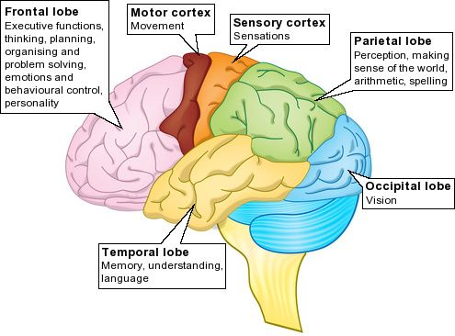
DEFINITION OF BRAIN
An organ of soft nervous tissue contained in the skull of vertebrates, functioning as the coordinating center of sensation and intellectual and nervous activity.

Slide 3
CLASSIFICATION

Slide 4
MENINGES
These are the INTEGUMENTS of CNS
Dura Mater
Latin Word of Tough Mother
Thick and dense membrane composed of dense connective tissues
Close to Skull
Support Venous Channels between two membrane
Arachnoid Mater
A transparent, web like, fluid impermeable, middle layer of meninges.
Cushioning effect to CNS
Pia Mater
Latin of Soft mother
Thin, fluid impermeable membrane with large blood Supply
Adheres to brain Surface

Slide 5
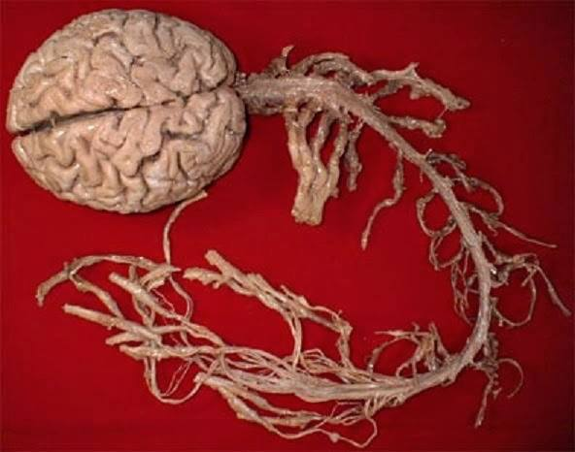
Spinal Cord
The cylindrical bundle of nerve fibres and associated tissue which is enclosed in the spine and connects nearly all parts of the body to the brain, with which it forms the central nervous system.

Slide 6
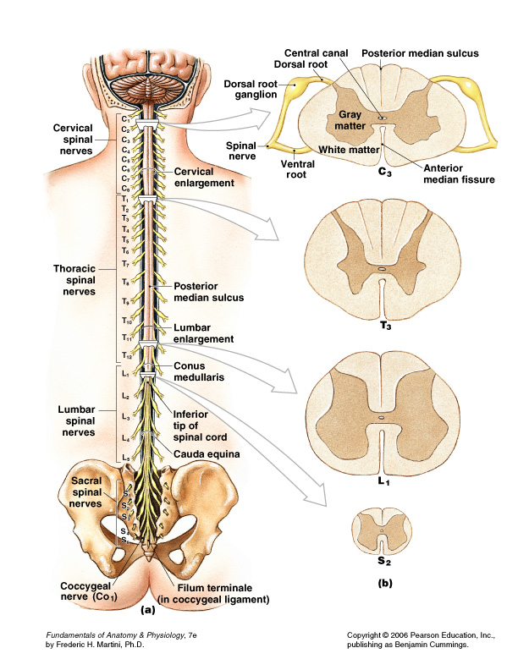
GROSS ANATOMY
3 layers of meninges:
1) Dura Mater
2) Arachnoid mater
3) Pia Mater
It is cervical enlargement of Brain stem.
CSF – subarachnoid space.
Terminates at L1/2 vertebral level (conus medullaris ). Dura extends to S2 vertebral level
Connects via filum terminale & denticulate ligaments (pia mater).
31 pairs of spinal nerves (mixed) (cauda equina).
Cervical & lumbar enlargements

Slide 7
GROSS ANATOMY………
Conus medullaris – terminal portion of the spinal cord
Filum terminale – fibrous extension of the pia mater; anchors the spinal cord to the coccyx
Denticulate ligaments – delicate shelves of pia mater; attach the spinal cord to the vertebrae
Spinal nerves – 31 pairs attach to the cord by paired roots
Cervical nerves are named for inferior vertebra
All other nerves are named for superior vertebra
Cervical and lumbar enlargements – sites where nerves serving the upper and lower limbs emerge
Cauda equina – collection of nerve roots at the inferior end of the vertebral canal.

Slide 8
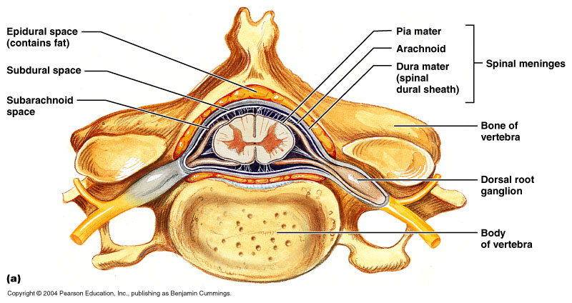
CROSS-SECTIONAL ANATOMY OF SPINAL CORD
Anterior median fissure – separates anterior funiculi
Posterior median sulcus – divides posterior funiculi

Slide 9
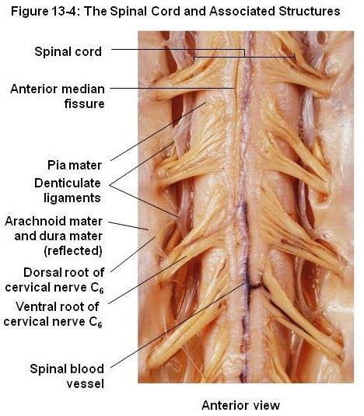
STRUCTURE OF SPINAL CORD
Paired denticulate ligaments:
extend from pia mater to dura mater
stabilize side-to-side movement
Blood vessels:
along surface of spinal pia mater
within subarachnoid space

Slide 10
ORGANIZATION OF GREY MATTER
Dorsal half – sensory roots and ganglia
Ventral half – motor roots
Dorsal and ventral roots fuse laterally to form spinal nerves
Four zones are evident within the gray matter – somatic sensory (SS), visceral sensory (VS), visceral motor (VM), and somatic motor (SM)

Slide 11
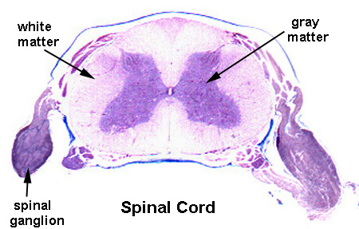
CROSS-SECTIONAL HISTOLOGY OF SPINAL CORD

Slide 12
THE 4 MAJOR PLEXUS OF VERTEBRAL RAMI

Slide 13
SPINAL NERVES

Slide 14
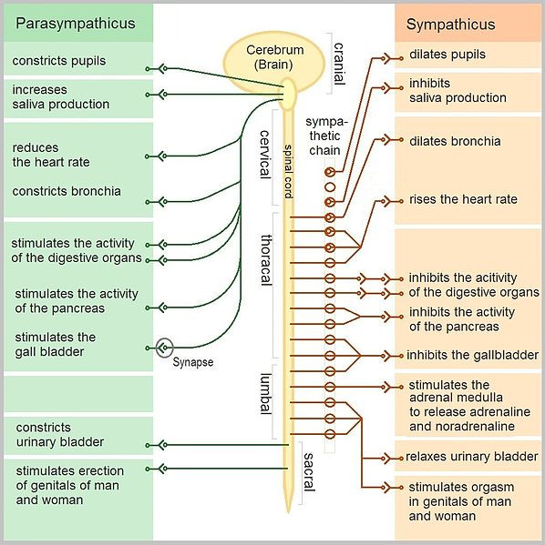

Slide 15
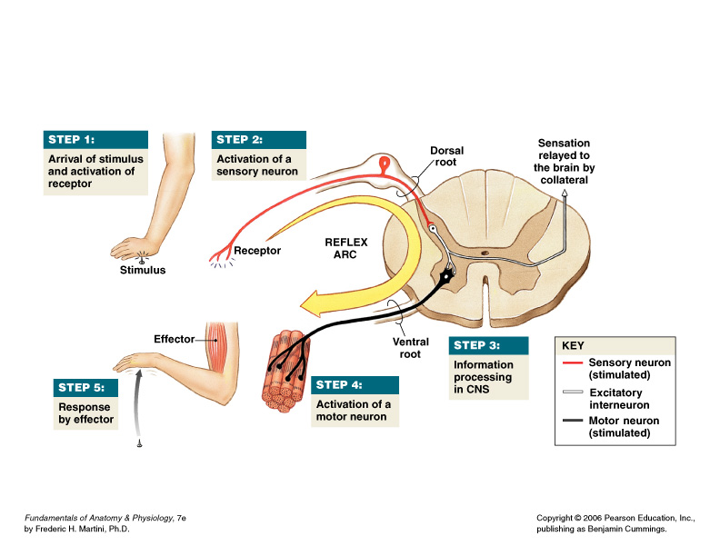
REFLEX ARC AND REFLEX ACTION
5 components of a reflex arc
Receptor
Sensory neuron
Integration center (CNS)
Motor neuron
Effector

Slide 16
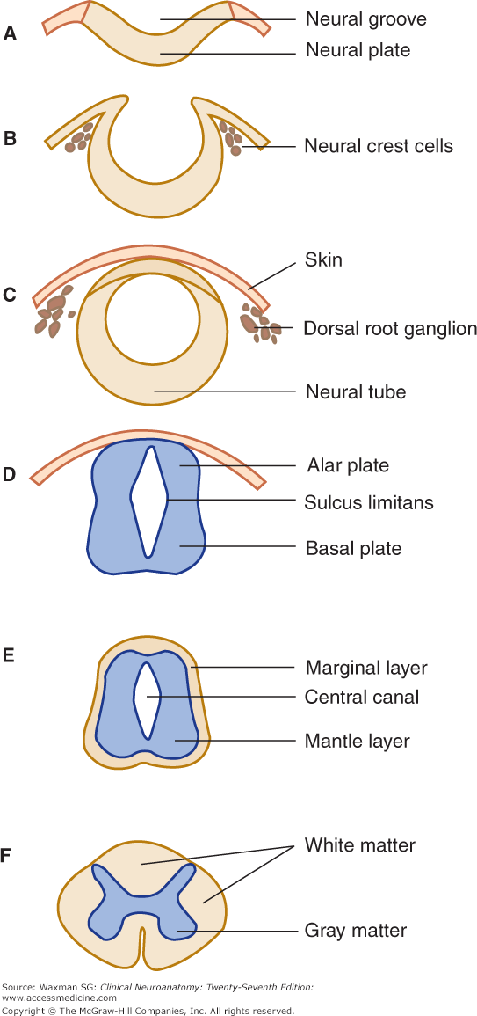
Embryology of spinal cord

Slide 17
MORBID ANATOMY OF SPINAL CORD
Viral Diseases
1. Poliomyelitis (Polio)
Poliomyelitis is the focus of an international campaign to rid the Earth of the disease
Poliomyelitis is caused by polioviruses 1, 2, and 3 (All are members of the picornavirus family.)
Route: Oro-fecal
Initial infection: Throat, intestine, blood stream and then crosses blood brain barrier.
Final Infection: Selectively destroys motor neurons in the brain and spinal cord causing paralysis, failure of normal bone development muscle dystrophy and death.

Slide 18
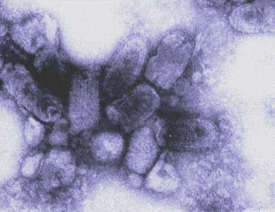
2) Rabies
Slow, progressive, disease characterized by fatal meningoencephalitis
Caused by the rhabdovirus (A RNA virus with a distinctive bullet shape)
The virus is spread to humans from wild and domestic reservoirs via bites, scratches, and sometimes inhalation of respiratory droplets
The virus initially stays at the entry site and multiplies before moving along sensory nerves to the CNS
Viral replication in the CNS is followed by migration to structures such as the eye, heart, skin, and salivary glands (which completes the cycle).
The disease progresses through identifiable stages.

Slide 19
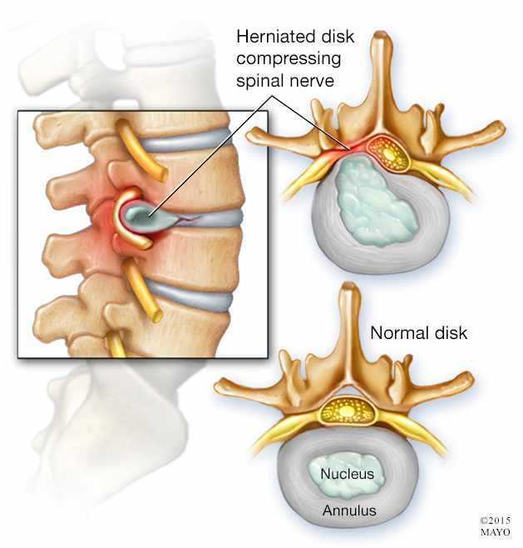
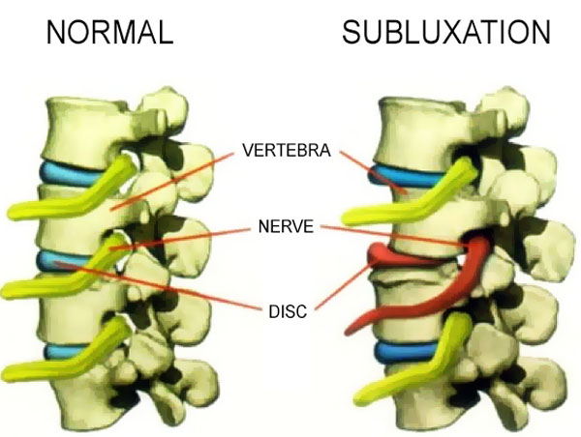
Traumatic Disorders
1) Disk hernia 2) Vertebral Subluxation

Slide 20
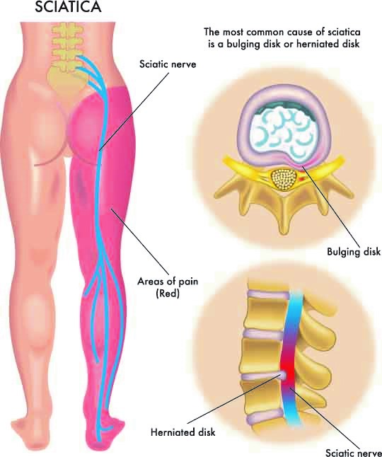
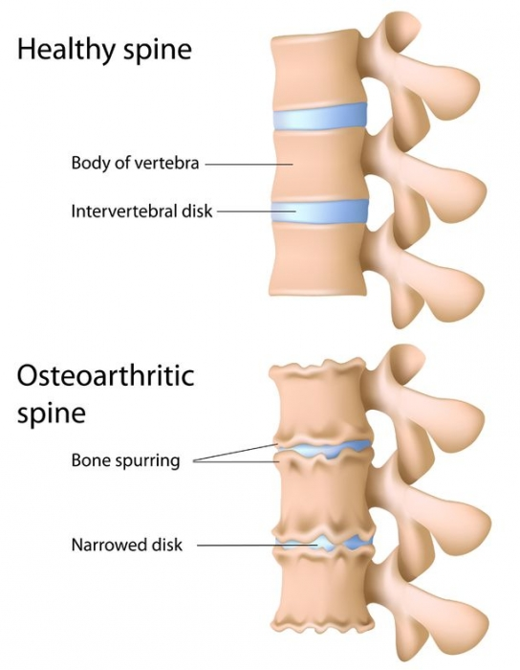
3) Sciatica 4) Spondylosis

Slide 21
bibliography
Marieb Human Anatomy and Histology
Fundamentals of Anatomy and Histology 7e by Frederic H. Martini
BD Chaurasia`s Human Anatomy
Snell`s Anatomy
General Anatomy by Laiq Hussain Siddiqui
Principles of Anatomy and Physiology 14th Edition Gerard J. Tortora
Waxmann SG: Clinical Neuroanatomy 27th Edition

