Slide 1
ANIMALS MODELS OF HYPERTENSION
SUBMITTED BY: RIZWANA KAUSAR
SUBMITTED TO:DR.HAFIZ IRFAN
SUBJECT:ADVANCE
CHEMOTHERAPY

Slide 2
CONTENTS
Introduction of disease
animals models needed
Causes
Types
Pathophysiology
Agents
Animal models
Need for animal models
Types of animal models
Measurement of BP
REFERENCE

Slide 3
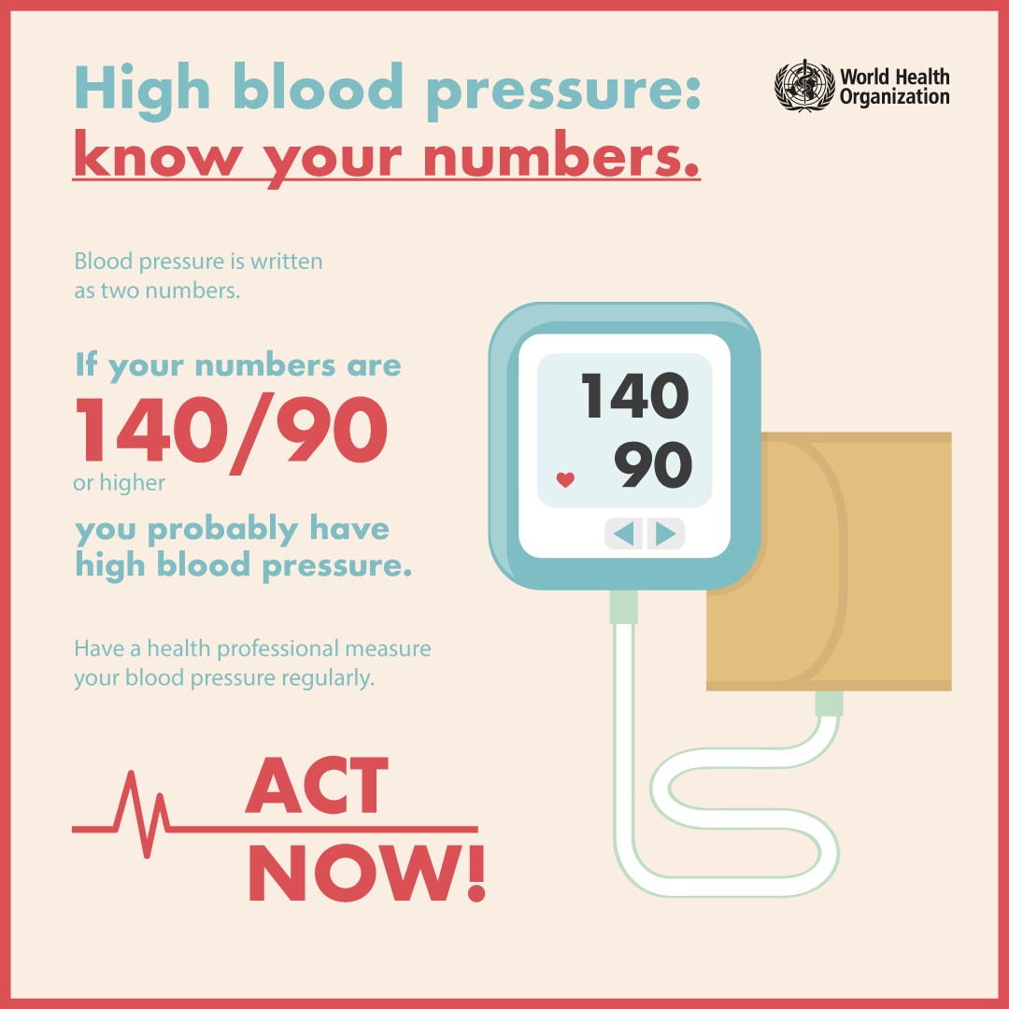
Introduction of disease
Hypertension, also known as high or raised blood pressure, is a condition in which the blood vessels have persistently raised pressure.
Hypertension is a serious medical condition and can increase the risk of heart, brain, kidney and other diseases.
There are four stages of high blood pressure or hypertension:
STAGE 1 or Prehypertension is 120/80 to 139/89.
STAGE 2 or Mild Hypertension is 140/90 to 159/99.
STAGE 3 or Moderate Hypertension is 160/100 to 179/109.
STAGE 4 or Severe Hypertension is 180/110 or higher
.

Slide 4
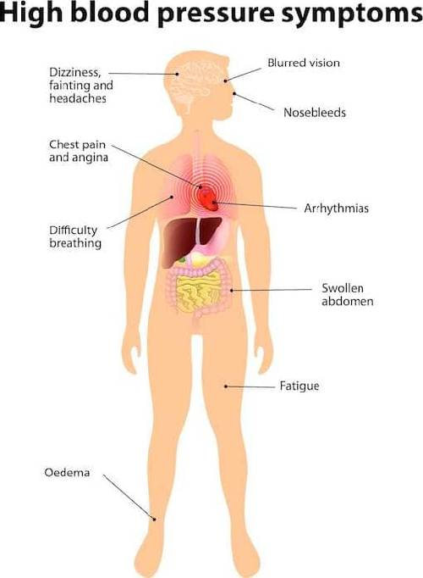
Symptoms
Symptoms of High Blood Pressure
Severe headache.
Fatigue or confusion.
Vision problems.
Chest pain.
Difficulty breathing.
Irregular heartbeat.
Blood in the urine.
Pounding in your chest, neck, or ears.

Slide 5
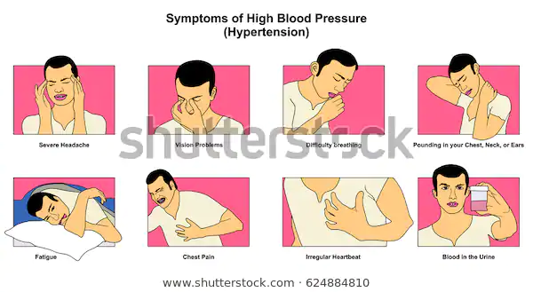

Slide 6
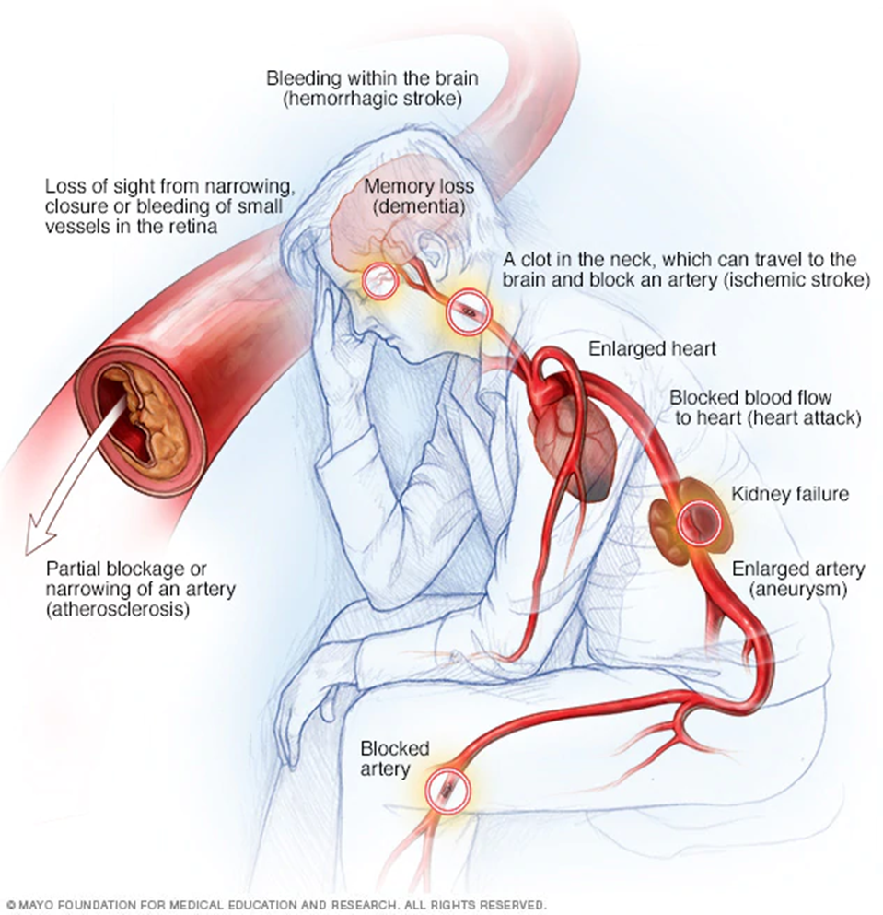

Slide 7
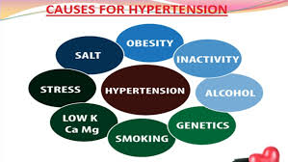
Causes
The exact causes of high blood pressure are not known, but several things may play a role, including:
Smoking
Being overweight or obese
Lack of physical activity
Too much salt in the diet
Too much alcohol consumption (more than 1 to 2 drinks per day)
Stress
Older age
Genetics
Family history of high blood pressure
Chronic kidney disease
Adrenal and thyroid disorders
Sleep apnea

Slide 8
Types of hypertension
There are two primary hypertension types. For 95 percent of people with high blood pressure, the cause of their hypertension is unknown — this is called essential, or primary, hypertension. When a cause can be found, the condition is called secondary hypertension.
Essential hypertension. Usually people with essential hypertension have no symptoms, but you may experience frequent headaches, tiredness, dizziness, or nose bleeds. Although the cause is unknown, researchers do know that obesity, smoking, alcohol, diet, and heredity all play a role in essential hypertension.
Secondary hypertensionThe most common cause of secondary hypertension is an abnormality in the arteries supplying blood to the kidneys. Drugs can cause secondary hypertension, including over-the-counter medications such as ibuprofen (Motrin, Advil, and others) and pseudoephedrine.

Slide 9
Some causes of secondary hypertension are listed below
Renal artery stenosis, Chronic renal disease, Stress, Preeclampsia,
Primary hyperaldosteronism, Hyper- or hypothyroidism
Sleep apnea, Pheochromocytoma, &Aortic coarctation
Additional Hypertension Types:
Isolated systolic:This type of hypertension is most common in people over the age of 65 and is caused by the loss of elasticity in the arteries.
Malignant Malignant hypertension occurs when your blood pressure rises extremely quickly.
Resistant Resistant hypertension may have a genetic component and is more common in people who are older, obese, female, African American, or have an underlying illness, such as diabetes or kidney disease.

Slide 12
Physiological mechanisms involved in development of essential hypertension
Cardiac output
Peripheral resistance
Renin-angiotensin-aldosterone system
Autonomic nervous system
Other factors: Bradykinin
Endothelin EDRF (endothelial derived relaxing factor) or nitric oxide ANP (atrial natriuretic peptide)

Slide 13
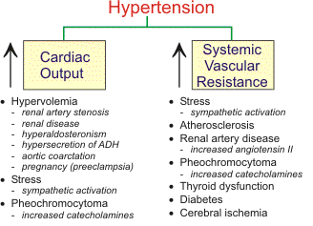
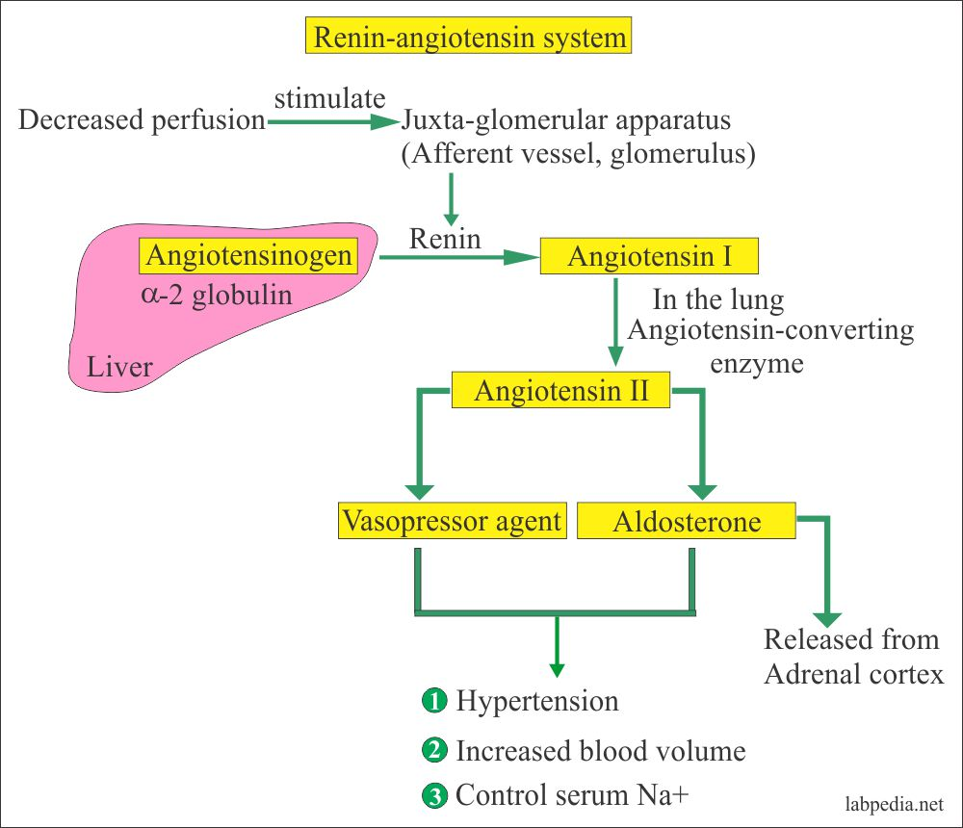
Cardiac output and peripheral resistance Renin-angiotensin system
:

Slide 14
Autonomic nervous Endothelin system

Slide 15
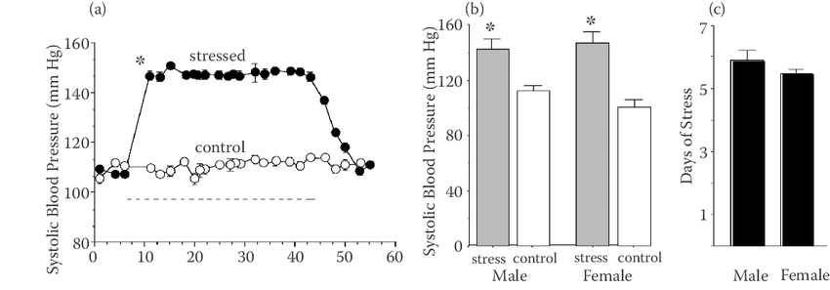
Agents use to induce hypertension
Stress: Increases in renal nerve activity mediate the marked changes in renal blood flow that have been observed during stress. -Blood pressure and circulating catecholamines were evaluated in borderline hypertensive rats (BHR) that were exposed to daily sessions of either short (20 min) or long (120min) duration air-jet stimulation.

Slide 16
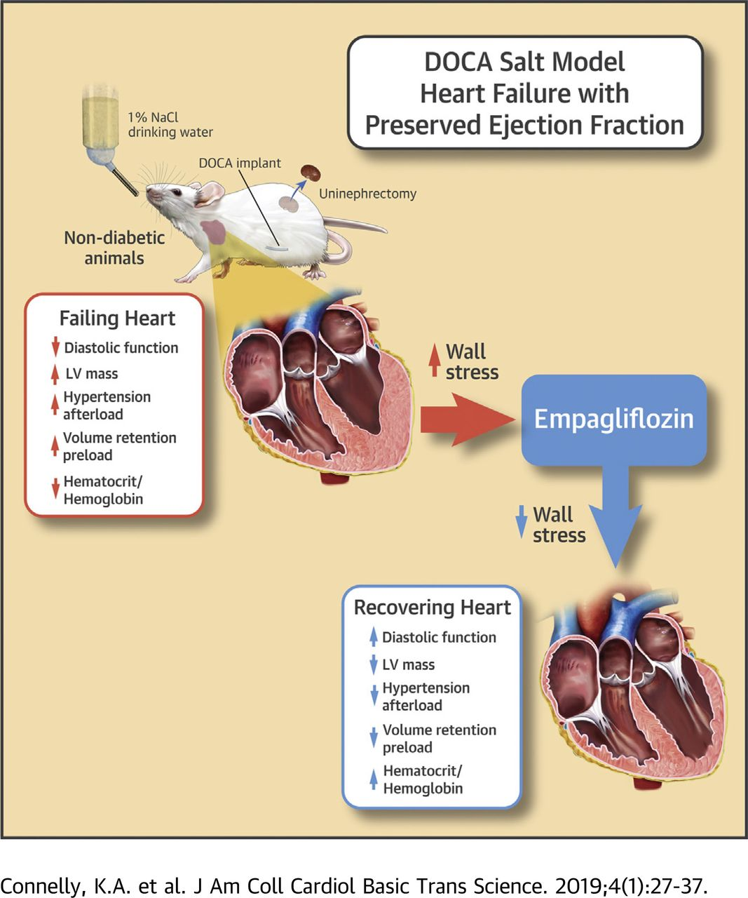
DOCA SALTS:

Slide 17
Agents….
Monocrotaline (MCT) is an 11-membered macrocyclic pyrrolizidine alkaloid (PA) that causes a pulmonary vascular syndrome in rats
characterized by proliferative pulmonary vasculitis, pulmonary hypertension.

Slide 18
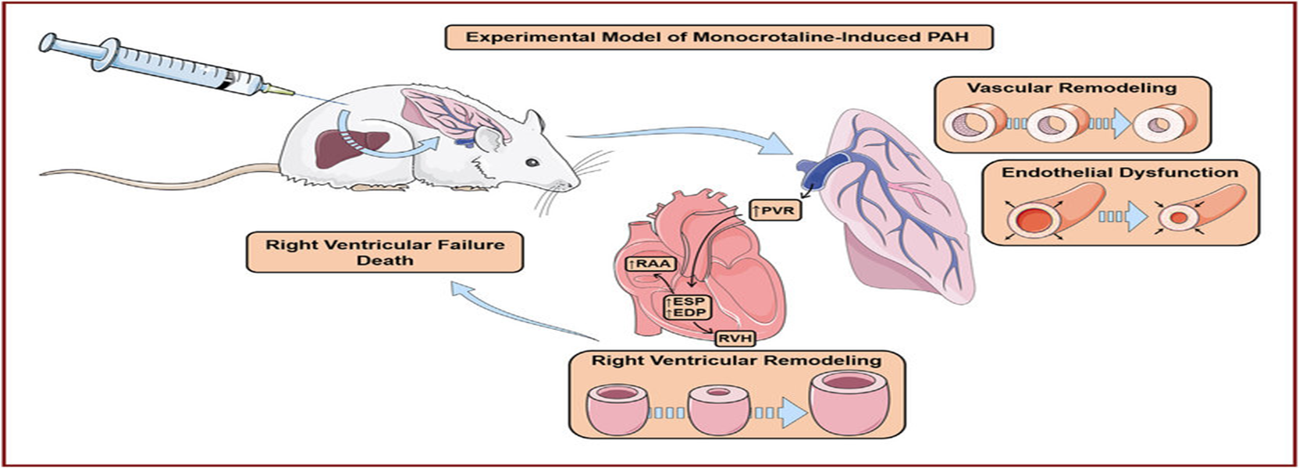

Slide 19
Agents..
Fructose:The use of 10% fructose in drinking water, which is equivalent to a diet containing 48-57% (by calories) fructose, for one week or longer appeared to be most suitable for rapid production of fructose induced hyp.

Slide 21
Intra cerebroventricular Infusion of Aldosterone Induces Hypertension in Rats
Blood pressure was significantly elevated only in those animals receiving 0.005 micro g aldosterone/h icvt and 0.5 ng aldosterone/h sc

Slide 24
Need for Animal Models and selection criteria
Similarities to Human. Moreover, many animals are suitable due to their similarity in anatomical basis and physiological functions with humans. For example, chimpanzees and mice share about 99% and 98% of DNA with humans,
These models may target specific factors implicated in the pathogenesis of human hypertension, including salt sensitivity, activation of the renin-angiotensin-aldosterone system (RAAS), and genetic factors.
Feasibility. Animal models are relatively easy to manage, as compounding effects of dietary intake and environmental factors including temperature and lighting can be controlled.
Drug Safety. Preclinical toxicity testing, pharmacodynamics, and pharmacokinetics profile of drugs may be investigated on animals before the compounds or drugs are used in humans.
The short life span, small size, and relatively low cost of the animals enable the researchers to study the natural history, genetic factors, and pathophysiological changes in hypertension
Currently, the preferred animal model is the rat. Along with rats, occasionally mice, monkeys, and pigs are also used as a model for experimental hypertension

Slide 25
Selection criteria…
An ideal animal model of hypertension should fulfill the following criteria: • It should be feasible in small animals. • It should be simple to perform and uniformly reproducible. • It should be able to predict the potential antihypertensive properties of an agent. • It should consume minimal quantities of compounds. • It should be comparable to some form of human hypertension

Slide 26
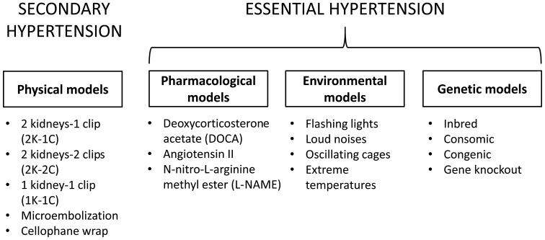

Slide 27
Types of Animals models
The various types of animal models of hypertension being used are:
1. Reno-vascular hypertension
2. Dietary hypertension
3. Endocrine hypertension
4. Neurogenic hypertension
5. Psychogenic hypertension
6. Genetic hypertension
7. Other models

Slide 28
1. Renovascular hypertension:
Experimentally, renal hypertension is produced by
renal artery constriction, which activates peripheral RAAS and sympathetic nervous system.
Renin is secreted by kidneys when sympathetic activity is increased.
Renin converts angiotensinogen to angiotensin-I.
Angiotensin-I is converted to angiotensin-II by angiotensin converting enzyme (ACE).
Angiotensin-II is a potent vasoconstrictor and increases BP.
Angiotensin-II also causes release of aldosterone leading to salt and water retention resulting in increased blood volume and hypertension.

Slide 29
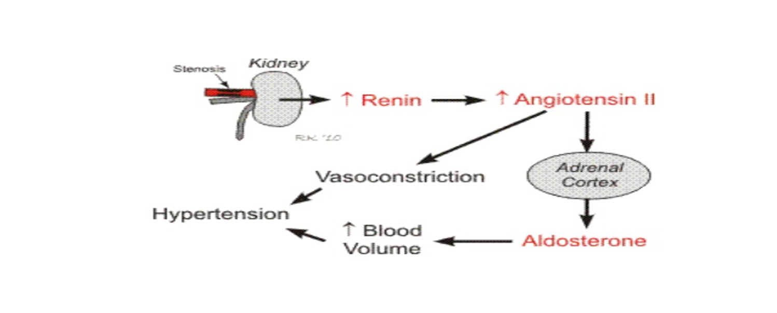

Slide 30
The various methods of inducing reno vascular hypertension are as follows:
I. Gold blatt method: Gold blatt et al (1934) reported that in rabbits and rats,
a U-shaped silver ribbon is used to constrict the renal arteries.
Rats weighing from 120 to 200 g are anaesthetized with hexo barbitone sodium (40 mg/kg body weight) and a silver clip of 0.2 mm internal diameter is placed on the left renal artery close to the aorta.
The renal artery in rats can also be ligated with 4-0 silk suture. Constriction of renal artery should be more than 50%.
The animal is considered hypertensive if systolic BP is more than 160 mm Hg for two consecutive days after 4 weeks of ligation.

Slide 32
Two kidney one clip (2K1C) hypertension
The renal artery is constricted on only one side with the other artery (or kidney) left untouched.
This results in a sustained increase in BP due to increased plasma renin activity (PRA), which in turn increases circulating angiotensin-II, a potent vasoconstrictor
However, there is no salt and water retention because of the other normal kidney being intact.
Thus, the resultant hypertension at this stage is renin-angiotensin dependent.
After about 6 weeks, the increased angiotensin-II releases aldosterone from adrenal cortex leading to a gradual retention of salt and water. Retention of salt and water leads to decreased renin production and returns normal.

Slide 33
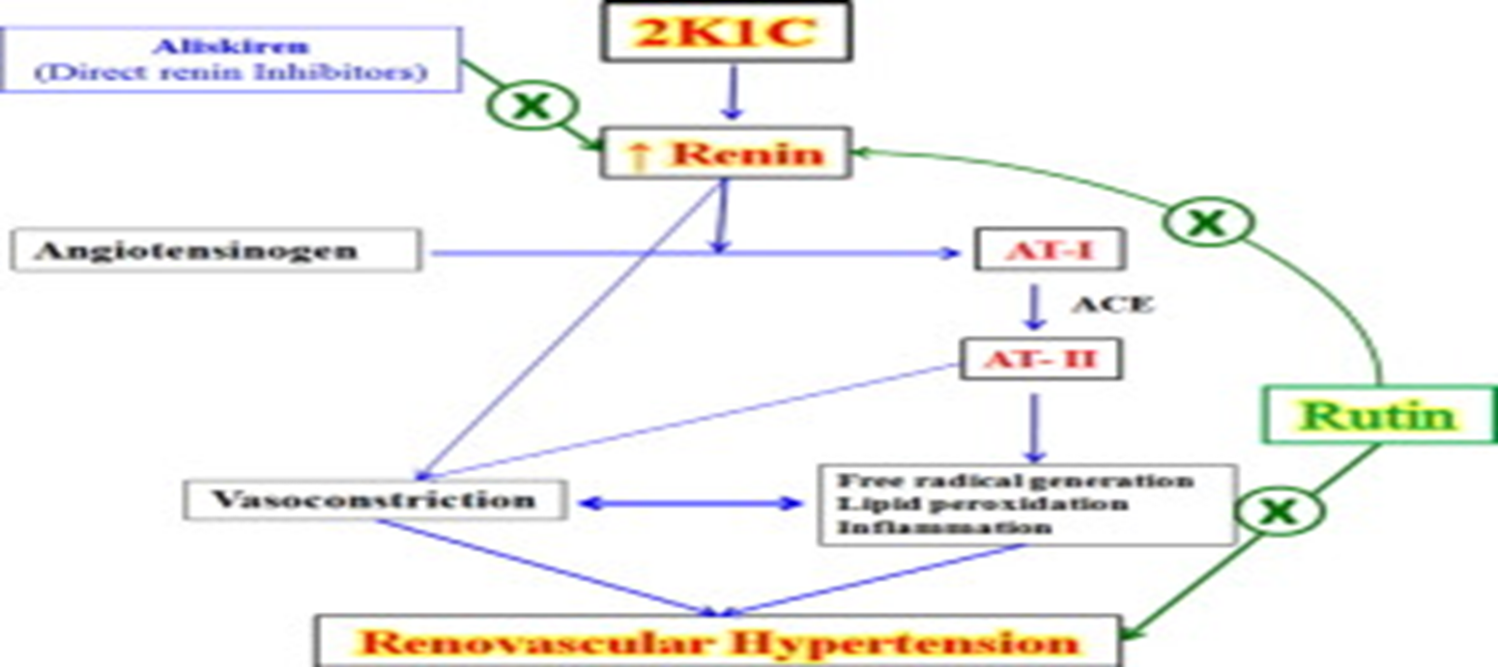

Slide 34
One kidney one clip (1K1C) hypertension
Constriction of renal artery is done on one side and the contralateral kidney is removed.
There is an increase in BP within a few hours. Since there is no other kidney, there is no pressure diuresis and natriuresis, so there is rapid salt and water retention.
Plasma renin activity is usually normal.
Hypertension soon becomes volume dependent

Slide 36
Two kidney two clip (2K2C) hypertension
Constriction of aorta or both renal arteries is done.
There is a patchy ischaemic kidney tissue, which secretes renin leading to increased BP.
The remaining kidney tissue retains salt and water. Indeed, one of the most common causes of renal hypertension in human beings is such a patchy ischaemic kidney disease.

Slide 38
2:Dietry hypertension
Increased salt intake
Chronic ingestion of excess salt produces hypertension in rats, which
mimics human hypertension morphologically. High salt intake hypertension has been produced in rats, rabbits and chicks by replacing drinking water with 1-2% sodium chloride for 9-12 months. High salt intake along with unilateral nephrectomy produces accelerated hypertension within 3-4 weeks in dogs. Accelerated renal hypertension in rats is produced by

Slide 39
3:Endocrine hypertension:
Mineralocorticoid induced hypertension: Selye et al was the first to demonstrate that deoxy corticosterone acetate (DOCA) produces hypertension in rats.
There is increased DOCA-induced reabsorption of salt and water leading to increased blood volume and hence increased BP.
There is also increased secretion of vasopressin leading to water retention and vasoconstriction.
In addition, altered activity of RAAS leads to increased sympathetic activity.
Rats, especially female and young, are prone to DOCA-salt induced hypertension.
This type of hypertension can also be produced in dogs and pigs.
Other mineralocorticoids (e.g. aldosterone) and glucocorticoids can also produce this type of hypertension

Slide 40
4:Neurogenic hypertension
Stimulation of baroreceptors causes inhibition of vasomotor center leading to vasodilatation, bradycardia and decrease in BP. Sectioning of the baroreceptor nerves leads to persistent rise in BP in dogs, cats and rabbits.
5:Psychogenic hypertension:
Borderline hypertensive rats (BHR) are useful for psychogenic hypertension. BHRs that were exposed to daily sessions of either short (20 min) or long (120 min) duration air-jet stimulation developed hypertension within 2 weeks in comparison to home cage controls. Animals exposed to 120 min stress sessions had significantly higher systolic BP relative to the 20 minute group.

Slide 41
Psychogenic hypertension:
Other types of stress have been applied, such as
emotional stimuli
psychosocial stress
immobilization
stress
electric stimuli, but in all cases the results were similar.
As stress plays an important part in development of human hypertension, this model is very frequently used to study the pathophysiology of hypertension.

Slide 42
6:Genetic hypertension
In 1963, Okamoto and Aoki introduced a new model of experimental hypertension that required no physiological, pharmacological or surgical intervention. The so called ‘spontaneous hypertensive rat (SHR)’ was developed by meticulous genetic inbreeding that uniformly resulted in 100% of the progeny having naturally occurring hypertension
In SHRs, BP gradually increases until it is maintained at a markedly elevated level after approximately 12 weeks of age. In unrestrained male SHRs, mean arterial pressure is approximately 190- 200 mm Hg as compared to 115-130 mm Hg in normal rats. During the early stable stages and developmental phase of hypertension, elevated BP is maintained in large part by enhanced central sympathetic outflow.

Slide 43
Genetic Rats models of hypertension
A number of rat genetic models of hypertension have been used in genetic, (patho)physiological, and pharmacological studies. Rat strains exhibiting genetic hypertension include: the SHR, DSS rat, the fawn-hooded hypertensive (FHH) rat, the Milan hypertensive strain, the Lyon hypertensive rat, the Sabra hypertensive rat, the genetically hypertensive rat, and the inherited stress-induced arterial hypertension rat model. Of these, the most commonly studied is the SHR. The most distinct advantage of the rat genetic models of hypertension is the similarities of the BP/hypertension phenotypes to those observed in patients and the genetic basis of disease development that occurs in these animals

Slide 44
Other Models…….
Obesity-related hypertension: Wistar fatty rats show persistent hyperinsulinemia and hypertension after 16 weeks of age and may be a good model to elucidate the relationship between hyperinsulinemia and hypertension.
. Hypertension induced by cholino mimetic agents: Physostigmine (10-80 µg/kg, i.v.), cholinesterase inhibitor, and oxotremorine (20-40 µg/kg, i.v.), a direct muscarinic cholinergic agonist, cause a dose-dependent increase in BP. The cholinomimetic-induced hypertension has been shown to be elicited through activation of central cholinergic mechanism and mediated peripherally through sympathetic nervous system. Pretreatment with methyl scopolamine (1 mg/kg) 5-10 minutes before giving oxotremorine prevents initial hypotension in this model.

Slide 45
Angiotensin-II induced hypertension: Subcutaneous infusion of angiotensin-II (0.7 mg/kg/day) using mini pump elicits hypertension in 4-8 weeks.
Hypertension induced by cadmium: Hypertension is produced by the chronic administration of CdCI (1 mg/kg/day, i.p. for 2 wk). CdCl-induced hypertension might be due to the fact that the metal ion might mimic Ca2+ ion as a partial agonist and produce a direct contractile effect on vascular smooth muscle.
Chronic nitric oxide inhibition-induced hypertension: SHRs when given a nonselective nitric oxide synthase inhibitor, Nwnitro-L-arginine methyl ester (L-NAME), for 4 weeks develop time and dose-dependent hypertension.
Soriguer et al. [51] conducted a study on cooking oils, reporting that repeatedly oxidized frying oil is an independent risk factor for hypertension. Heated oil diet promotes oxidative stress, resulting in NO sequestration and inactivation. Furthermore, heated oil causes a significant increase in ACE activity and a reduction in heme oxygenase content. The thermal oxidation of vegetable oils promotes the generation of free radicals and may contribute to the pathogenesis of hypertension in rats

Slide 46
Measurement of BP in animal models:
In acute experiments, the animals are usually anesthetized and BP is measured for the duration of the experiment by exposing an accessible artery and inserting a cannula connected to a mercury manometer or a pressure transducer. Frequent repetition of the surgical arterial exposure under anaesthesia is undesirable. Anaesthesia is used only when immobilization of the animal is required to measure BP.
Anaesthesia makes determination of BP easier and more accurate but the use of anaesthesia introduces an additional variable. Anaesthetic agents have been reported to alter BP and cardiovascular reflexes.
BP can be recorded in unanaesthetised state.

Slide 47
Comparable forms of experimental and clinical hypertension. Experimental Hypertension Clinical Hypertension
Spontaneous hypertension Renal artery stenosis hypertension Overdosage of glucocorticoids Overdosage of mineralocorticoids Overdosage of salt Obesity related hypertension Uterine ischaemia Reduced renal mass | Essential hypertension Renal artery stenosis Cushing syndrome Primary aldosteronism Chronic high salt intake Obese hypertension Preeclampsia Renal diseases

Slide 51
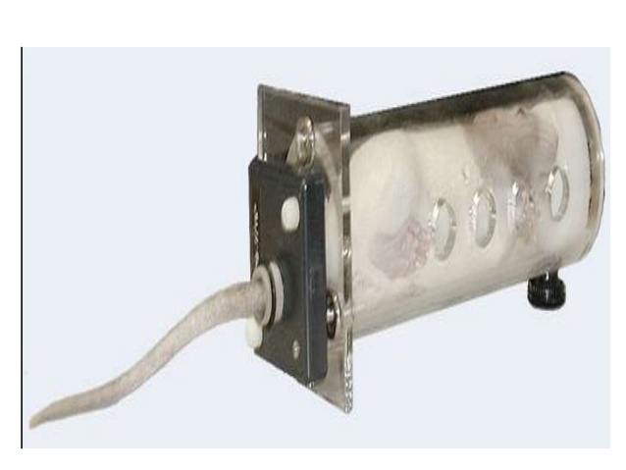
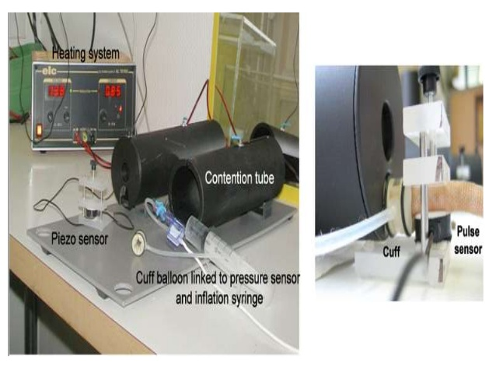

Slide 53
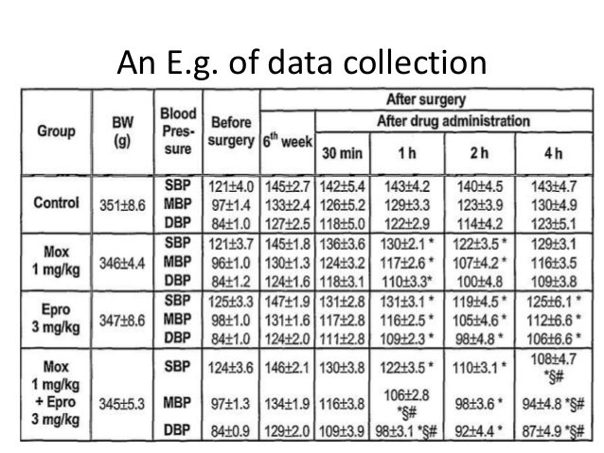

Slide 54
ANTI HYPERTYENSIVE DRUGS:
Diuretics - thiazide diuretics - loop diuretics - potassium-sparing diuretics
Vasodilators - alpha-adrenoceptor antagonists (alpha-blockers) - angiotensin converting enzyme inhibitors (ACE inhibitors) - angiotensin receptor blockers (ARBs) - calcium-channel blockers - direct acting arterial dilators - ganglionic blockers - nitrodilators - potassium-channel openers - renin inhibitors
Cardioinhibitory drugs - beta-blockers - calcium-channel blockers
Centrally acting sympatholytics

Slide 55
REFERENCES:
Hatton, D. C., DeMerritt, J., Coste, S. C., & McCarron, D. A. (1993). Stress-induced hypertension in the borderline hypertensive rat: stimulus duration. Physiology & behavior, 53(4), 635-641.
Suwanich, A., Wyss, J. M., & Roysommuti, S. (2013). Taurine supplementation in spontaneously hypertensive rats: Advantages and limitations for human applications. World journal of cardiology, 5(11), 404.
Sweet, C. S., & Columbo, J. M. (1979). Cardiovascular properties of antihypertensive drugs in a model of severe renal hypertension. Journal of Pharmacological Methods, 2(3), 223-239
Doggrell, S. A., & Brown, L. (1998). Rat models of hypertension, cardiac hypertrophy and failure. Cardiovascular research, 39(1), 89-105.
Singh, V. K., Thrall, K. D., & Hauer-Jensen, M. (2016). Minipigs as models in drug discovery.

Slide 56
Lerman, L. O., Chade, A. R., Sica, V., & Napoli, C. (2005). Animal models of hypertension: an overview. Journal of Laboratory and Clinical Medicine, 146(3), 160-173
Wright, J. M., Musini, V. M., & Gill, R. (2018). First‐line drugs for hypertension. Cochrane Database of systematic reviews, (4).
Sun, Z. J., & Zhang, Z. E. (2005). Historic perspectives and recent advances in major animal models of hypertension. Acta Pharmacologica Sinica, 26(3), 295-301.
Vorobioff, J. U. L. I. O., Bredfeldt, J. E., & Groszmann, R. J. (1983). Hyperdynamic circulation in portal-hypertensive rat model: a primary factor for maintenance of chronic portal hypertension. American Journal of Physiology-Gastrointestinal and Liver Physiology, 244(1), G52-G57.
Vorobioff, J. U. L. I. O., Bredfeldt, J. E., & Groszmann, R. J. (1983). Hyperdynamic circulation in portal-hypertensive rat model: a primary factor for maintenance of chronic portal hypertension. American Journal of Physiology-Gastrointestinal and Liver Physiology, 244(1), G52-G57.

Slide 57
Badyal, D. K., Lata, H., & Dadhich, A. P. (2003). Animal models of hypertension and effect of drugs. Indian Journal of pharmacology, 35(6), 349-362.
Lerman, L. O., Kurtz, T. W., Touyz, R. M., Ellison, D. H., Chade, A. R., Crowley, S. D., ... & Reckelhoff, J. F. (2019). Animal models of hypertension: a scientific statement from the American Heart Association. Hypertension, 73(6), e87-e120.
Tobian, L. (1991). Salt and hypertension. Lessons from animal models that relate to human hypertension. Hypertension, 17(1_supplement), I52.
Dai, S., & McNeill, J. H. (1995). Fructose-induced hypertension in rats is concentration-and duration-dependent. Journal of pharmacological and toxicological methods, 33(2), 101-107.
GOMEZ-SANCHEZ, E. P. (1986). Intracerebroventricular infusion of aldosterone induces hypertension in rats. Endocrinology, 118(2), 819-823.

