Slide 1
Mobile Computing

Slide 2
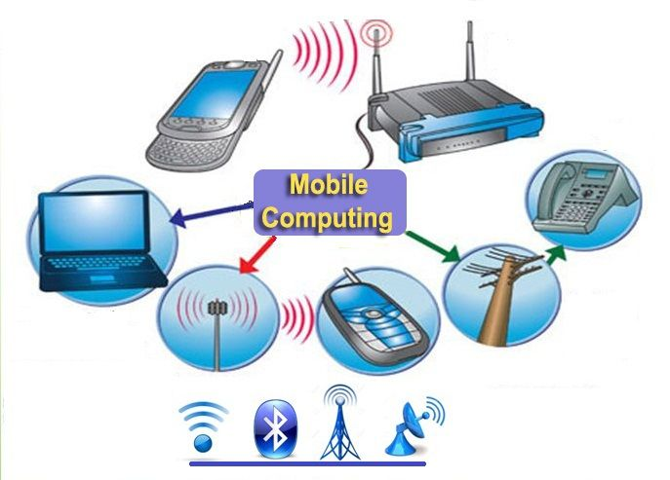
What is Mobile Computing:
Definition – Mobile Computing System mean Wireless communication and its applications are generic technology that refers to numerous devices that are supportable to access transmitted data like voice, video, and text any time and any where over the wireless network infrastructure and in which to include mobile communication, mobile hardware, and mobile software and this react as human-computer interaction. Cause of these has improved the quality of our lives.

Slide 3
Features of Mobile Computing
Easy to handle and carry these small devices.
Data can be transferred easily between users.
Collect simulated data to current zone or your time.
Arbitrary network, easily connect to other environment and transmit data.
Having fast processor speed.
Good battery life.
Huge memory capacity.
Bar code scanner
Windows Operating System
Camera
Global positioning system.
Durability

Slide 4
Mobile Computing Applications
There are different types of real life applications which are used in the Mobile computing, such as:
Traffic:
During traveling in traffic if we require to know road situation, latest news and when if feel more stress in driving then can play music and other important broadcast data are received through digital audio broadcasting(DAB). If we forget the road then we can know our exact location with the help of global positioning system (GPS).In case if got accident then can to inform police and ambulance via an emergency call to the service provider, which help to improve organization and save time & money.
Emergencies Situation
To play a vital role in the medical sector can hire an ambulance with great quality wireless connection and help of this can carry significant information about injured persons. The useful step can prepare for a particular accident and doctor can be consulted for diagnosis. Only Wireless networks work of communication in nature disaster 2 such as earthquakes, tsunami, flood, and fire. In worst conditions only decentralized, wireless ad-hoc networks survive. Means that can handle Emergencies situation by mobile computing easily.

Slide 5
Use in Business
As per business point of view CEO help of this computing system can represent the presentation at the front of their clients while can access hot news of the market. Help of video conference could be discuss at the topic without hindrance any time. Another side if traveling salesman wants to access the company database as per requirement then can be retrieved data on his wireless device and maintain the consistency company’s database. Cause of these every employee are updated up to date.
Credit Card Verification
Credit card verification using this computing most secure. In respect of Sale terminals(POS) when customer buy items in malls and other small shops when and pay bill in the form of swap credit card for transactions then need to establish network in between POS terminal and bank central computer then over protected cellular network verify the credential information of card fastly, if match it then proceed further otherwise denied get boost up speed of transaction process and relieve the burden at the POS network.

Slide 6
Replacement of Fixed Networks
Wired network has been replaced in wireless network e.g. trade shows, remote sensors and historical buildings. in wired networks, weather forecasting, earthquake detection and to get environmental data are impossible. This is possible only in adapting the replacement of fixed networks in this computing.
Infotainment
Wireless networks are capable to deliver the latest information at any suitable regions and can download knowledge about concert at morning through wireless network that concert is conducting in any region as well as Another growing field of wireless network applications lies in entertainment and games to enable, e.g., ad-hoc gaming networks as soon as people meet to play together. So Infotainment by wireless computing is more easy.

Slide 7
Mobile Computing Services
Software as a service is best platform with the help of rendering the many utilities and applications on the internet world in the form of services.
Cloud Computing help to optimize your resources and scale up while control your cost.
Suggest the best mobile hardware and software for your using utilities and applications.
In arbitrary wireless network service help to connect freely network, and with the help of this concept, you can access data anywhere without time and place limitation.
Mobile terminal phases are
Provide the current and appropriate O/S and other software.
Examine the loading time of particular software.
Setup the wireless networks such as WAN and LAN

Slide 8
Mobile Computing Security:
Two types attacks are existed in the Mobile Computing security:-
Passive attack – In this attack intruder only monitor the transmitted data over the network.
Active attack – In which intruder gives some modification in the original data.
Concern Security is:
Encrypted data
Outsource detection
Lack of data capacity
Terminal tracer
Set up timeout system
Use reliable sources such as Google Play and Amazon App

