Slide 1
Screening the Sacrum, Sacroiliac, and Pelvis
Dr Mustafa Qamar

Slide 2
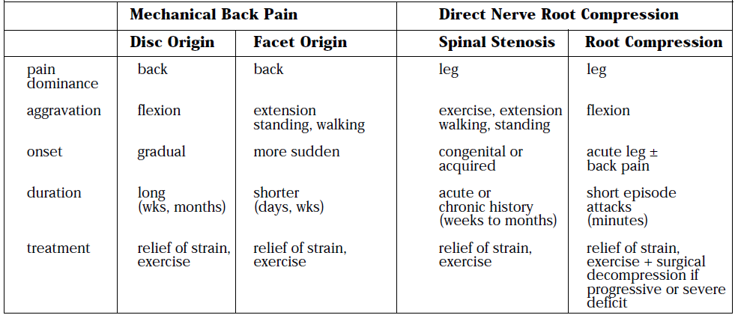
THE SACRUM AND SACROILIAC JOINT
Evaluating the sacroiliac (SI) joint can be difficult in that no single physical examination finding can predict a disorder of the SI joint.
Pain originating from the SI joint can mimic pain referred from lumbar disc herniation, spinal stenosis, facet joint dysfunction, or even a disorder of the hip.

Slide 3
The most common clinical presentation of sacroiliac pain is associated with a memorable physical event that initiated the pain, such as a misstep off a curb, a fall on the hip or buttocks, lifting of a heavy object in a twisted position, or childbirth.
A history of previous spine surgery is very common in clients with SI intra-articular pain.

Slide 4
The most typical systemic diseases that refer pain to the sacrum and sacroiliac joint include:
Endocarditis,
Prostate cancer or other neoplasm,
Gynecologic disorders,
Rheumatic diseases (e.G., Spondyloarthropathies such as ankylosing spondylitis, reiter's syndrome, or psoriatic arthritis),
Paget's disease.
Disorders of the large intestine and colon, such as:
Ulcerative colitis,
Crohn's disease (regional enteritis),
Carcinoma of the colon,
Irritable bowel syndrome,
can refer pain to the sacrum when the rectum is stimulated.

Slide 5
Clinical Presentation
Insidious onset or unknown cause is always a red flag.
Sacral pain in the absence of a history of trauma or overuse is a clue to the presentation of systemic backache.
Low back or sacral pain radiating around the flank suggests the renal or urologic system.
Low back or sacral pain radiating to the buttock or legs may be vascular.
Questions about the effects of activity on symptoms and history of cardiovascular or peripheral vascular diseases are important.
Pain elicited by pressing on the sacrum with the client in a prone position suggests sacroiliitis (inflammation of the sacroiliac joint) or mechanical derangement.

Slide 6
SI JOINT PAIN PATTERN
Whether from a mechanical or a systemic origin, the patient usually experiences pain over the posterior SI joint and buttock, with or without lower extremity pain.
Pain may be unilateral or bilateral and can be referred to a wide referral zone, including the lumbar spine, abdomen, groin, foot, and ankle.
A wide range of SI joint-referred pain patterns occur because innervation is highly variable and complex, or because pain may be somatically referred.
Adjacent structures, such as the piriformis muscle, sciatic nerve, and L5 nerve root, may be affected by intrinsic joint disease and can become active nociceptors.
SI pain can mimic discogenic disease with radicular pain down the leg to the foot.
People who report midline lumbar pain when they rise from a sitting position are likely to have discogenic pain.

Slide 7
Clients with unilateral pain below the level of the L5 spinous process and pain when they rise from sitting are likely to have a painful SI joint.
Pain from SI joint syndrome may be aggravated by sitting or lying on the affected side.
Pain gets worse with prolonged driving or riding in a car, weight bearing on the affected side and trunk flexion with the legs straight.
SI pain can also mimic the pain pattern of kidney disease with anterior thigh pain, but with SI dysfunction, no signs and symptoms (e.g., constitutional symptoms, bladder dysfunction) are associated

Slide 8
Screening for Infectious/Inflammatory Causes of Sacroiliac Pain
Usually, the infection is unilateral and is caused by Pseudomonas aeruginosa, Staphylococcus aureus, Cryptococcus organisms, or Mycobacterium tuberculosis.
Risk factors for joint infection include trauma, endocarditis, intravenous drug use, and immunosuppression.
Inflammation of the sacroiliac joint may result from metabolic, traumatic, or rheumatic causes.
Sacroiliitis is present in all individuals with ankylosing spondylitis

Slide 9
Rheumatic Diseases as a Cause of Sacral or SI Pain
The most common systemic causes of sacral pain are non-infected, inflammatory erosive rheumatic diseases that target the SI, including:
ankylosing spondylitis,
Reiter's syndrome,
psoriatic arthritis,
arthritis associated with inflammatory bowel disease (IBD) such as regional enteritis (Crohn's disease).
Reiter's syndrome often presents as a triad of symptoms, including arthritis, conjunctivitis, and urethritis. These three symptoms in the presence of sacral pain raise a red flag.
Crohn's disease may be accompanied by skin rash and joint pain. This enteric condition is well known for its arthritic component, which is present in up to 25% of all cases.

Slide 10
Screening for Spondylogenic Causes of Sacroiliac Pain
Metabolic bone disease (MBD) such as osteoporosis, Paget's disease, and osteodystrophy can result in loss of bone mineral density and deformity or fracture of the sacrum.
Metabolic Bone Disease
Mild to moderate MBD may occur with no visible signs. Advanced cases of MBD include constipation, anorexia, fractured bones, and deformity.

Slide 11
OSTEOPOROSIS
Osteoporosis can cause insufficiency fractures of the sacrum. The therapist must assess for risk factors
PAGET'S DISEASE
Paget's disease as a cause of lumbar, sacral, sacroiliac (SI), or pelvic pain occurs most commonly in men over 70 years of age (although it can occur earlier and in women).
It is the second most common metabolic bone disease after osteoporosis.
Characterized by slowly progressive enlargement and deformity of multiple bones, it is associated with unexplained acceleration of bone deposition and resorption.
The bones become weak, spongy, and deformed.
Redness and warmth may be noted over involved areas, and the most common symptom is bone pain

Slide 12
Fracture
Three types of fractures affect the sacrum:
traumatic
insufficiency
pathologic
Trauma resulting in fracture occurs most often with lateral compression injuries seen in motor vehicle accidents or vertical shear injuries resulting from a fall from height onto the lower limbs.
Insufficiency fractures of the sacrum result from a normal stress acting on bone with deficient elastic resistance.
Reduced bone integrity is most often associated with postmenopausal or corticosteroid-induced osteoporosis and radiation therapy

Slide 13
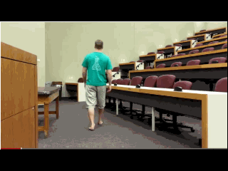
Pathologic fracture describes fractures that occur as a result of bone weakened by neoplasm or other disease conditions (e.g., osteomyelitis)
The client may report or demonstrate localized pain, tenderness with palpation, antalgic gait, and leg length discrepancy.

Slide 14
With all sacral fractures; hip, low back, sacral, groin, or buttock pain may occur, especially with multiple stress fractures of the pelvic and sacral bones.
Symptoms may mimic other conditions such as disc disease, recurrence of a local tumor, or metastatic disease

Slide 15
Screening for Tumors as a Cause of Sacral/Sacroiliac Pain
Benign neoplasms include osteochondroma, giant cell tumor, and osteoid osteoma.
The more common primary malignant lesions directly affecting the sacrum include chordoma, osteosarcoma, and myeloma
Coccygodynia
Most cases of coccygodynia or coccydynia (pain in the region of the coccyx) seen by the physical therapist occur as a result of trauma such as a fall directly on the tailbone or events associated with child birth.
Symptoms include localized pain in the tailbone that is usually aggravated by direct pressure such as that caused by sitting, passing gas, or having a bowel movement.
Moving from sitting to standing may also reproduce or aggravate painful symptoms.

Slide 16
THE PELVIS
The most common primary causes of pelvic pain seen in a physical therapy practice are musculoskeletal, neuromuscular, gynecologic, infectious, vascular, cancer, and gastrointestinal.
Infectious disease is the most common systemic cause of pelvic pain.
Chronic pelvic pain is most commonly associated with endometriosis, adhesions, IBS, and interstitial cystitis
Clinical Presentation
Pelvic pain may be:
Visceral pain, caused by stimulation of autonomic nerves (T11 to S3);
Somatic pain, caused by stimulation of sensory nerve endings in the pudendal nerves (S2, S3);
Peritoneal pain (pressure from inflammation, infection, or obstruction of the lining of the pelvic cavity).

Slide 17
Usually, pelvic disease appears as acute illness with
sudden onset of severe pain accompanied by
Nausea
Vomiting
Fever
Abdominal pain
Mild to moderate back or pelvic pain that gets worse as the day progresses may be associated with gynecologic disorders.

Slide 18
Screening for Neuromuscular and Musculoskeletal Causes of Pelvic Pain
Neurologic disorders can cause pelvic pain and dysfunction.
One of the most common musculoskeletal sources of pelvic pain is the trigger point.
Muscles most likely to refer pain to the pelvic area include the abdominals, quadratus lumborum, and iliopsoas.
Typical aggravating and relieving factors for pain from a neuromuscular or musculoskeletal source include the following:
Aggravated by exercise, weight bearing
Aggravated by trunk/lumbar rotation
Relieved by rest or stretching
Pain or altered movement pattern produced by trunk and lumbar rotation
Eliminated by trigger point therapy

Slide 19
Anterior Pelvic Pain
Anterior pelvic pain occurs most often as a result of any disorder that affects the hip joint, including:
Inflammatory arthritis
Pregnancy with separation of the symphysis pubis
Local injury to the insertion of the rectus abdominis, rectus femoris, or adductor muscle
Femoral neuralgia
Psoas abscess
Posterior Pelvic Pain
Posterior pelvic pain originating in the lumbosacral, sacroiliac, coccydynial, and sacrococcygeal regions usually appears as localized pain in the lower lumbar spine and over the sacrum, often radiating over the sacroiliac ligaments.
Pain radiating from the sacroiliac joint can commonly be felt in both the buttock and the posterior thigh and is often aggravated by rotation of the lumbar spine on the pelvis.

Slide 20
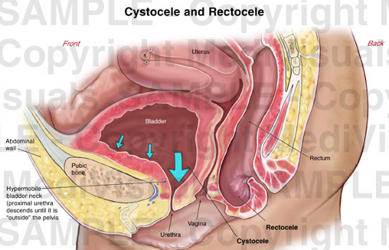
Screening for Gynecological Causes of Pelvic Pain
Gynecological causes of pelvic pain are most often produced by congenital anomaly, inflammatory processes, neoplasia, or trauma.
Pelvic pain may be associated with pregnancy, endometriosis, and altered uterine position
CYSTOCELE AND RECTOCELE
Cystocele is the protrusion or herniation of the urinary bladder against the wall of the vagina.
Rectocele is a protrusion or herniation of the rectum and posterior wall of the vagina into the vagina

Slide 21
Clinical Signs and Symptoms of Cystocele
Urinary frequency and urgency
Difficulty emptying the bladder
Cystitis (bladder infection)
Painful sensation in the perineal area
Urinary stress incontinence

Slide 22
Clinical Signs and Symptoms of Rectocele
Pelvic, perineal pain and difficulty with defecation
Feeling of incomplete rectal emptying
Constipation
Painful intercourse
Aching or pressure after a bowel movement
Screening for Infectious Causes of Pelvic Pain
Infection is the most common cause of systemically induced pelvic pain.
Infection or inflammation within the pelvis from acute appendicitis, diverticulitis, Crohn's disease, osteomyelitis, salpingitis etc. can produce visceral and somatic pelvic pain.
Pelvic inflammatory disease (PID) and sexually transmitted infection are the most common causes of infection in women.

Slide 23
Right-sided abdominal or pelvic inflammatory pain is often associated with appendicitis, whereas left-sided pain is more likely associated with diverticulitis.
Bilateral pain may indicate infection. The pain may be aggravated by increased abdominal pressure (e.g., coughing, walking).
Clinical Signs and Symptoms of Pelvic Inflammatory Disease
Often asymptomatic
Vaginal discharge or bleeding
Burning on urination (dysuria)
Moderate (dull aching) to severe abdominal and/or pelvic pain; back pain is possible
Painful intercourse
Painful menstruation
Constitutional symptoms (fever, chills, nausea, vomiting)

Slide 24
Screening for Vascular Causes of Pelvic Pain
Peripheral Vascular Disease
The iliac arteries may become gradually occluded by atherosclerosis or may be obstructed by an embolus.
The resultant ischemia produces pain in the affected limb but may also give rise to pelvic pain.
The pain is characteristically aggravated by exercise (claudication).
Typically, symptoms develop 5 or 10 minutes after the client has started the activity.

Slide 25
Pelvic Congestion Syndrome
Varicose veins of the ovaries (varicosities) cause the blood in the veins to flow downward rather than up toward the heart.
Clinical Signs and Symptoms of Pelvic Congestion Syndrome (Ovarian varicosities)
Lower abdominal/pelvic pain (intermittent or continuous, described as "dull aching" but can be sharp and severe)
Unilateral or bilateral
Pain that worsens with prolonged standing or at the end of the day
Pain that is worse before or during menses
Pain or "aching" that occurs after intercourse
Presence of varicose veins in the buttocks, thighs, or lower extremities
Low backache is a common feature, made worse by standing

Slide 26
Screening for Cancer as a Cause of Pelvic Pain
A history of cancer with recent surgical removal of tumor tissue followed by back, hip, sacral, or pelvic pain within the next 6 months is a major red flag.
A common clinical presentation of pelvic or abdominal cancer referred to the soma is one of back, sacral, or pelvic pain described as one or more of the following: deep aching, colicky, constant with crescendo waves of pain that come and go, or diffuse pain.
Pain does not localize

Slide 27
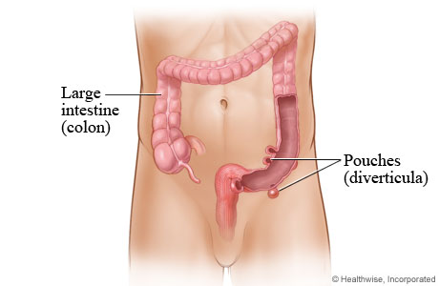
Screening for Gastrointestinal Causes of Pelvic Pain
Gastrointestinal conditions can cause pelvic pain.
The most common causes of pelvic pain referred from the GI system are the following:
Acute appendicitis
Inflammatory bowel disease (IBD; Crohn's disease, ulcerative colitis)
Diverticulitis
Irritable bowel syndrome (IBS)
Notes:
Diverticulitis is a sometimes painful condition that develops when pouches

Slide 28
For all of these conditions, the symptoms as seen or reported in a physical therapy practice are usually the same.
The client may present with one or more of the following:
GI symptoms
Symptoms aggravated by increased abdominal pressure (coughing, straining, lifting, bending)

Slide 29
Iliopsoas abscess (a positive test is indicative of an inflammatory/ infectious process)
Positive McBurney's point
Rebound tenderness or Blumberg's sign
Notes:
The abdominal wall is compressed slowly and then rapidly released. A positive sign is indicated by presence of pain upon removal of pressure on the abdominal wall.

Slide 30
Screening for Urogenital Causes of Pelvic Pain
Infection of the bladder or kidney, kidney stones, renal failure, spasm of the urethral smooth muscle, and tumors in any of the urogenital organs can refer pain to the lower lumbar and pelvic regions, mimicking musculoskeletal dysfunction.
Pelvic floor tension myalgia can develop in response to these conditions and create pelvic pain.
The primary pain pattern may radiate around the flanks to the lower abdominal region, the genitalia, and the anterior/medial thighs.
The therapist needs to ask the client about the presence of painful urination or changes in urination and constitutional symptoms such as fever, chills, sweats, and nausea or vomiting.

