Slide 1
Lecture 10 Nutrition during Pregnancy
By Dr. Umer Farooq

Slide 2
Objectives
To produce, healthy, normal weight infants while minimizing health risks to the mother
To determine appropriate weight gain during pregnancy for normal, under and overweight women
To recognize the additional energy, vitamin and mineral requirements for women during pregnancy
To understand changing nutritional needs during pregnancy

Slide 3
Nutrition prior to Pregnancy
Both a man’s and a woman’s nutrition may affect fertility and possibly the genetic contributions they make to their children, but it is the woman’s nutrition that has the most direct influence on the developing fetus.
Her body provides the environment for the growth and development of a new human being.
Prior to pregnancy, a woman has a unique opportunity to prepare herself physically, mentally, and emotionally for the many changes to come.
The best time to review the nutritional status to make appropriate changes is prior to conception

Slide 4
A very important time of fetal development is during the first several weeks of pregnancy as all of the major fetal body systems are undergoing formation and rapid development.
Many women may not even realize they are pregnant at this time.
Therefore it is prudent to make your lifestyle and nutritional changes several months before conception occurs.
In preparation for a healthy pregnancy, a woman can establish the following habits:

Slide 5
Achieve and maintain a healthy body weight
Both underweight and overweight are associated with
Excess body fat in women disrupts menstrual regularity and ovarian hormone production
Mothers, both underweight and overweight, and their newborns, face increased risks of complications.
Choose an adequate and balanced diet
Malnutrition reduces fertility and impairs the early development of an infant should a woman become pregnant.
Be physically active
A woman who wants to be physically active when she is pregnant needs to become physically active beforehand

Slide 6
Receive regular medical care
Regular health care visits can help ensure a healthy start to pregnancy
Manage chronic conditions
Diseases such as diabetes, HIV/AIDS, PKU, and sexually transmitted diseases can adversely affect a pregnancy and need close medical attention to help ensure a healthy outcome
Avoid harmful influences
Both maternal and paternal ingestion of harmful substances (such as cigarettes, alcohol, drugs, or environmental contaminants) can cause abnormalities, alter genes or their expression, and interfere with fertility

Slide 7
Maternal Weight
Birthweight is the most reliable indicator of an infant’s health
An underweight infant is more likely to have physical and mental defects, become ill, and die than a normal-weight infant
In general, higher birthweights present fewer risks for infants
Two characteristics of the mother’s weight influence an infant’s birthweight:
Her weight prior to conception
Her weight gain during pregnancy

Slide 8
Weight prior to Conception
A woman’s weight prior to conception influences fetal growth
Even with the same weight gain during pregnancy, underweight women tend to have smaller babies than heavier women
Underweight
An underweight woman has a high risk of having a low birth weight infant, especially if she is malnourished or unable to gain sufficient weight during pregnancy
In addition, the rates of preterm births and infant deaths are higher for underweight women
An underweight woman improves her chances of having a healthy infant by gaining sufficient weight prior to conception or by gaining extra pounds during pregnancy
To gain weight and ensure nutrient adequacy, an underweight woman can follow the dietary recommendations for pregnant women

Slide 9
Overweight and Obesity
Obesity can create problems related to pregnancy and childbirth
Obese women have an especially high risk of medical complications such as hypertension, gestational diabetes, and postpartum infections
Compared with other women, obese women are also more likely to have other complications of labor and delivery
Overweight women have the lowest rate of low-birthweight infants. In fact, infants of overweight women are more likely to be born post term and to weigh more than 9 pounds
Large newborns increase the likelihood of a difficult labor and delivery, birth trauma, and cesarean section. Consequently, these infants have a greater risk of poor health and death than infants of normal weight

Slide 10
Of greater concern than infant birthweight is the poor development of infants born to obese mothers
Obesity may double the risk for neural tube defects. Folate’s role has been examined, but a more likely explanation seems to be poor glycemic control
In addition, both overweight and obese women have a greater risk of giving birth to infants with heart defects and other abnormalities
Weight-loss dieting during pregnancy is never advisable. Overweight women should try to achieve a healthy body weight before becoming pregnant, avoid excessive weight gain during pregnancy, and postpone weight loss until after childbirth
Weight loss is best achieved by eating moderate amounts of nutrient-dense foods and exercising to lose body fat

Slide 11
Weight Gain during Pregnancy
All pregnant women must gain weight—fetal growth and maternal health depend on it
Maternal weight gain during pregnancy correlates closely with infant birthweight, which is a strong predictor of the health and subsequent development of the infant
Recommended Weight Gains
Following table presents recommended weight gains for various prepregnancy weights.

Slide 12
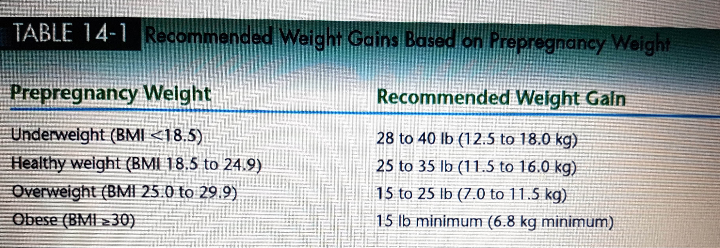
The recommended gain for a woman who begins pregnancy at a healthy weight and is carrying a single fetus is 25 to 35 pounds.
An underweight woman needs to gain between 28 and 40 pounds; and an overweight woman, between 15 and 25 pounds

Slide 13
Some women should strive for gains at the upper end of the target range, notably, adolescents who are still growing themselves whose infants tend to be smaller with the same maternal weight gain
Short women (5 feet 2 inches and under) should strive for gains at the lower end of the target range
Women who are carrying twins should aim for a weight gain of 35 to 45 pounds
If a woman gains more than is recommended early in pregnancy, she should not restrict her energy intake later in order to lose weight
A large weight gain over a short time, however, indicates excessive fluid retention and may be the first sign of the serious medical complication preeclampsia

Slide 14
Weight-Gain Patterns
For the normal-weight woman, weight gain ideally follows a pattern of 3^{1/2} pounds during the first trimester and 1 pound per week thereafter
Health care professionals monitor weight gain using a prenatal weight-gain grid

Slide 16
Components of Weight Gain
Women often express concern about the weight gain that accompanies a healthy pregnancy
They may find comfort by remembering that most of the gain supports the growth and development of the placenta, uterus, blood, and breasts, the increase in blood supply and fluid volume, as well as an optimally healthy 7^{1/2}-pound infant
A small amount goes into maternal fat stores, and even that fat is there for a special purpose—to provide energy for labor and lactation

Slide 17
Weight Loss after Pregnancy
The pregnant woman loses some weight at delivery
In the following weeks, she loses more as her blood volume returns to normal and she sheds accumulated fluids
The typical woman does not, however, return to her prepregnancy weight
In general, the more weight a woman gains beyond the needs of pregnancy, the more she retains
Even with an average weight gain during pregnancy, most women tend to retain a couple of pounds with each pregnancy. When those couple of pounds become 7 or more and BMI increases by a unit or more, complications such as diabetes and hypertension in future pregnancies as well as chronic diseases in later life can increase—even for women who are not overweight

Slide 18
Exercise during Pregnancy
An active, physically fit woman experiencing a normal pregnancy can continue to exercise throughout pregnancy, adjusting the duration and intensity of activity as the pregnancy progresses
Staying active can improve fitness, prevent or manage gestational diabetes, facilitate labor, and reduce stress
Women who exercise during pregnancy report fewer discomforts throughout their pregnancies
Regular exercise develops the strength and endurance a woman needs to carry the extra weight through pregnancy and to labor through an intense delivery
It also maintains the habits that help a woman lose excess weight and get back into shape after the birth

Slide 19
A pregnant woman should participate in “low-impact” activities and avoid sports in which she might fall or be hit by other people or objects. For example, playing singles tennis with one person on each side of the net is safer than a fast moving game of racquetball in which the two competitors can collide
Swimming and water aerobics are particularly beneficial because they allow the body to remain cool and move freely with the water’s support, thus reducing back pain

