Slide 1
ENTO-306
Agricultural pests and their management
Identification of important agricultural pests
Their mode of damages
Control measures
By: Dr. Muhammad Zeeshan Majeed

Slide 2
Major Insect Pests of Summer Vegetable Crops
in Pakistan

Slide 3
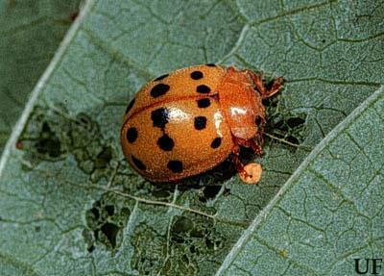
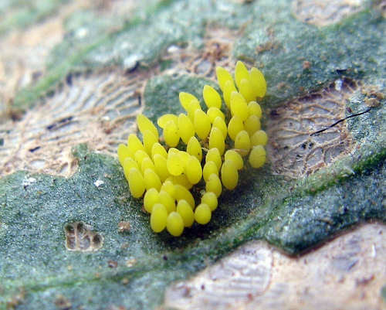
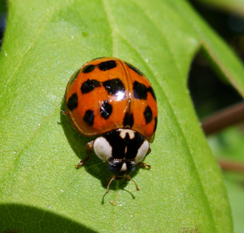
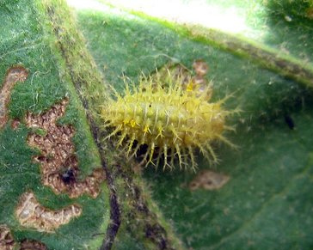
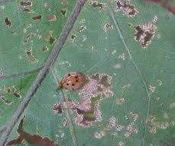
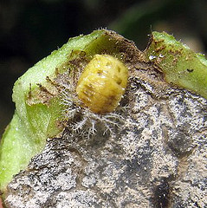
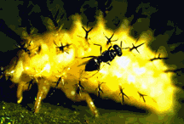
ENTO-306 Agricultural pests and their management 4(3-1)
Hadda beetle (Henosepilachna chrysomelina: Coccinellidae: Coleoptera)
Host plants: All plants of Cucurbitaceae family
A serious pest of these plants
Identification
Adult: Reddish brown forewings with many black prominent spots on dorsal side (6-8 on each forewing)
Eggs: Yellowsih in color laid singly (in clusters of 20-30) on leaf upper sides. (about 300 eggs per adult female)
Larva (grub): Yellowish in color with branched spines.
Life history:
Life cycle: 1.5 to 2 months (male short lived than females)
Adult: 2-3 weeks
Larva: 10 days
Pupa: 4-5 days
No. of generations per annum: 5-7
Overwinters as adult in crop stubbles or in soil structures
Damage:
Active period: March to November (max. damage June/July)
Larval feeding on lower leaf sides making them sieved-like
and ultimately drying and falling of leaves.
Control:
Destruction of crop stubbles.
Biological control by Pediobius foveolatus; P. epilachnae (larval/pupal parasitoid wasp as shown in photo)
Foliar spray of Cypermethrin/ Lambda-cyhalothrin/ Bifenthrin
Notes:
Pediobius chalcid wasp family Eulophidae.
Mexican bean beetle (vegetables and legumes) Epilachna varivestis

Slide 4
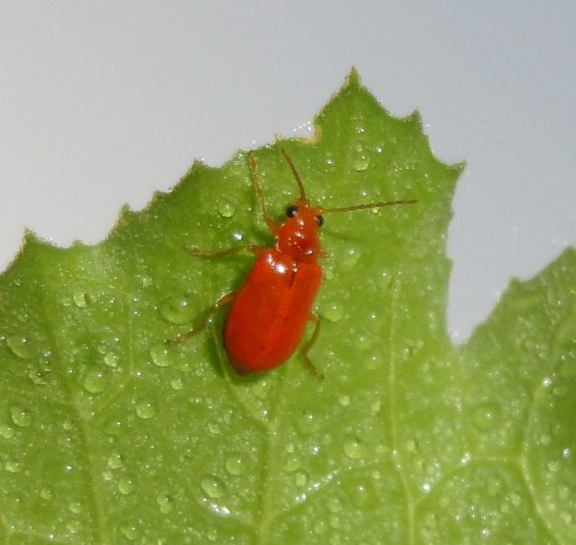
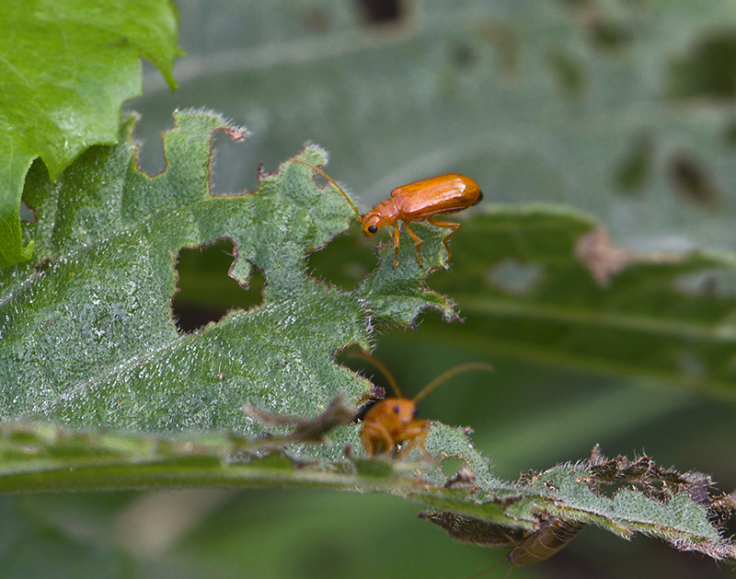
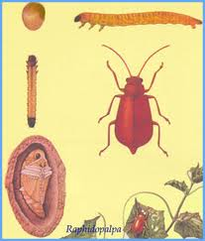
ENTO-306 Agricultural pests and their management 4(3-1)
Red pumpkin beetle (Aulacophora foveicollis: Chrysomelidae: Coleoptera
Host plants: Major pest of pumpkin crop and other cucurbitaceous plants
Identification
Adult: Reddish orange colored body (7 mm long and 2.5 mm broad)
Eggs: Initially yellow, later turns on orange brown (50-300 eggs laid singly or in batches/clusters)
Larva (grub): Creamy white or yellowish
with dark black ends
Pupa: Creamy white
Life history:
Life cycle: About 1.5 to 2.5 months
Adult: 1 month
Larva: 2-3 weeks
Pupation: 1-2 weeks
No. of generations per annum: 5
Damage:
Active period: March to November (max. damage April/May)
Adults and larvae feed on germinating young cucurbit seedlings in spring season.
Grubs attack on roots, stems and fruits as well.
At early stage, severe infestation cause complete crop eradication, so re-sowing becomes necessary.
Control:
Destruction of crop stubbles.
Foliar spray of Cypermethrin/ Lambda-cyhalothrin/ Abamectin

Slide 5
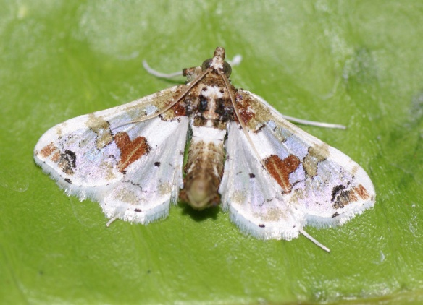
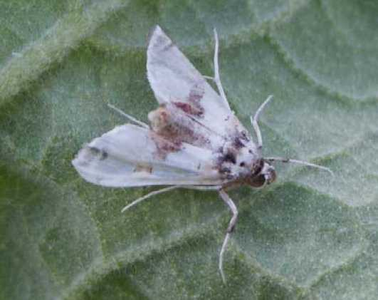
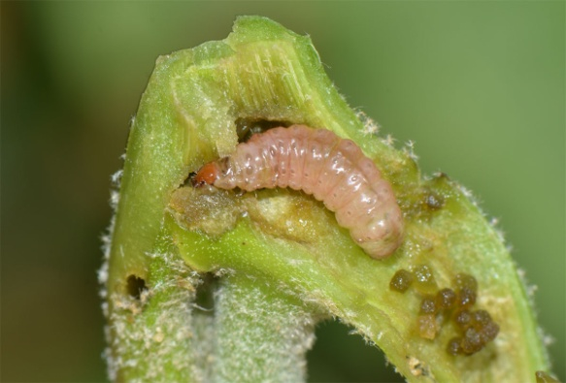
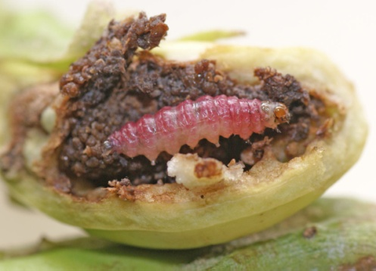
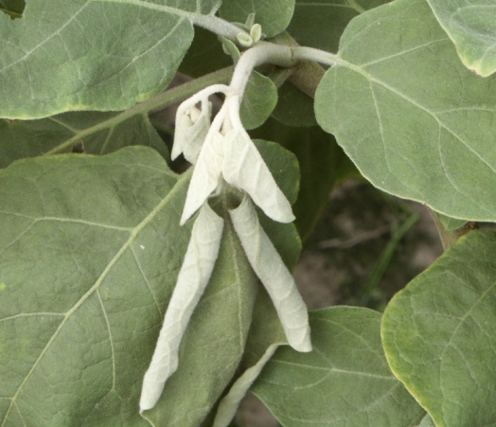
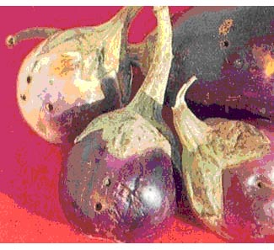
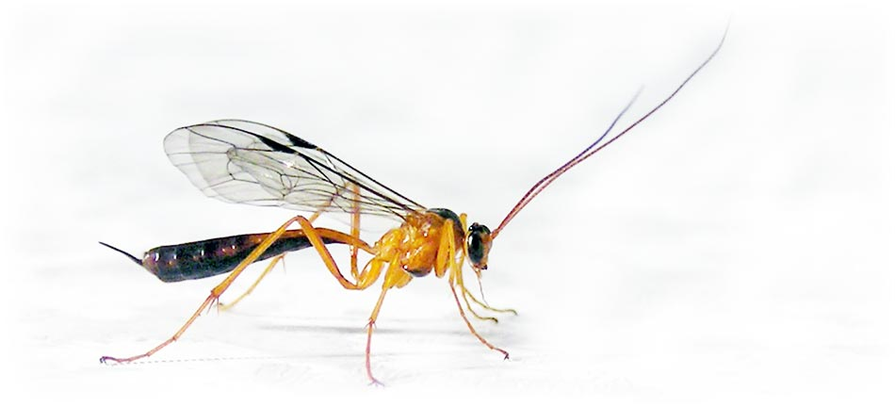
ENTO-306 Agricultural pests and their management 4(3-1)
Brinjal fruit borer (Leucinodes orbonalis: Crambidae: Lepidoptera)
Host plants: Most destructive pest of eggplant crop and of sometimes of okra
Identification
Adult: Milky white forewings with brown irregular spots (22 mm wingspan)
Eggs: Laid singly on leaf, stem, shoot or fruit ventral surface (under-side)
Larvae: Pink in color with brown head capsule (5 instars) 14 mm length
Life history:
Life cycle: 2 months
Adult: 3 weeks
Larvae: 2-3 weeks
No. of generations: many overlapping generations per annum
Damage:
Active period: March to Nov. (maxi. Damage June/July)
Boring of tender shoots and stems (drying of central terminal shoots)
Shedding of flowers and premature fruits
Buds and fruit boring and infestation (entry holes clogged with excreta)
Vectors of brinjal bacterial wilt
Control:
Removal of crop stubbles
Sowing of resistant varieties
Manual removal of infested plants (dead shoot removal)
Biological control (by Ichneumonid wasps: larval parasitoids)
Chemical control (Foliar spray with Cypermethrin, Spinosad etc.)
s

Slide 6
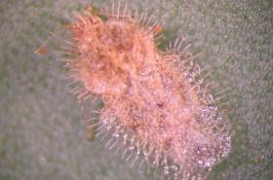
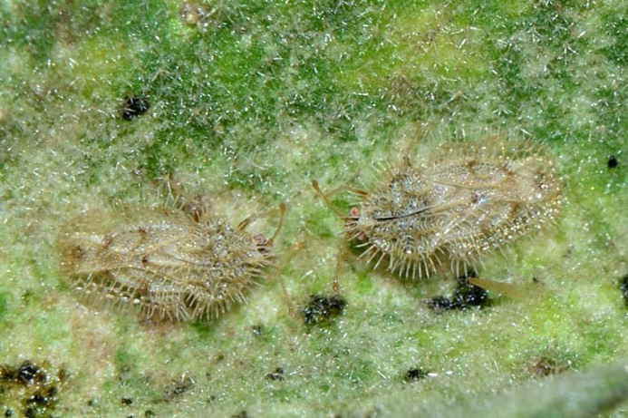
ENTO-306 Agricultural pests and their management 4(3-1)
Insect pests of Vegetable Crops Brinjal lacewing bug (Urentius hystricellus, Tingidae , Hemiptera)
Host plants: Major pest of brinjal crop and other summer vegetable crops
Identification
Adult: shield-shaped green body
Eggs: Yellowish white eggs laid in batches of 30-130 underside of leaves or on tender shoots. 250 eggs in life span.
Larvae/nymph: 1st instart light yellow, 2nd instar black body with orange and yellow spots, 5th instar becomes green
Life history:
Life cycle: 2.5 to 3.5 months
Adult: 3 weeks
Larvae: 1 month
No. of generations: many overlapping generations per annum
Damage:
Active period: March to Nov. (maxi. Damage August/Sept.)
Adults and nymphs suck sap from plant tender shoots/fruits, withering and dyeing of plants occur
Control:
Clean cultivation
Biological control by parasitic Tachinid flies (nymph/adult)
and Trissolcus wasps (egg parasitoid)
Chemical control throgh systemic insecticides (Imidaclopride etc.)
Notes:
Most tachinid flies are larger than a house fly and noticeably more bristly, but they range in size from 2–20mm and across the family there is a tremendous variety of shapes, colors and degree of bristling (Fig. 1). The Tachinidae are a large and variable family of true flies within the insect order Diptera, with more than 8,200 known species and many more to be discovered.

Slide 7
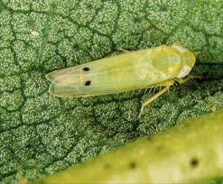
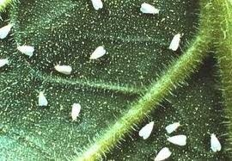
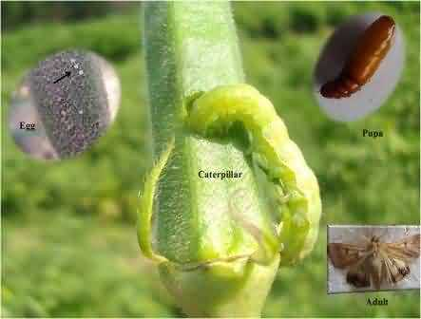
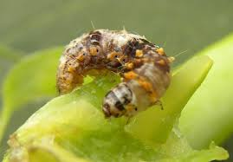
Insect Pests Complex of Okra
Amrasca devastans, Earias vittella, Bemisia tabaci, Helicoverpa armigera, Acrocercops bifasciata, Thrips tabaci, Aphis gossypii, Podagrica, Anomisflava,
Sylepta derogata, Haritalodes derogata, Dysdercus koengii and Nezara viridula
Jassid Amrasca biguttula biguttula (Ishida)
Whitefly Bemisia tabaci (Gennadius)
Pod/Fruit borer Helicoverpa armigera (Hübner)
Shoot &fruit borer Earias vittella (Fabricius)
Major Insect Pests of Okra
(Lohar, 2001; Praveen and Dhandapni 2001; Dabire-Binso et al. 2009; Echezona et al. 2010)
Slide 3 of 48

Slide 8
