Slide 1
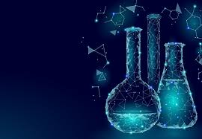
Organic Chemistry
Ayesha Shamim
Pharm. D
M.phil

Slide 2
Reactive Intermediate

Slide 3
Definition
Introduction
Explanation
Key features
Classification

Slide 4
Reactive intermediates
A reactive intermediate is a short-lived, high-energy, highly reactive molecule. When generated in a chemical reaction, it will quickly convert into a more stable molecule.
Notes:
Only in exceptional cases can these compounds be isolated and stored, e.g. low temperatures, matrix isolation. When their existence is indicated, reactive intermediates can help explain how a chemical reaction takes place.

Slide 5
Reactive intermediates in certain cases, they are separated and stored. For example,
Matrix Isolation
Low temperatures
Matrix Isolation is a technique that is used experimentally in physics and chemistry that includes a material that has been trapped within an unreactive material. Host matrix generally comprises of guest particles that are generally embedded. Guest particles can be molecules, atoms and ions. The guest is isolated within the host matrix.

Slide 6
Reactive intermediates occur only in one of the intermediate steps but in the case of other chemical reactions, they take more than one elementary steps. It differs from a simple reaction intermediate or product or reactant only through fast spectrographic methods.
Notes:
Spectroscopy is a study of the interaction between electromagnetic radiation and matter. They are categorized based on the type of radiative energy used in the interaction.

Slide 7
Its existence can be proved with the help of chemical trapping. The chemical trap is nothing but a chemical compound that detects a molecule in certain cases and they are illustrated below:
When the molecule is highly reactive or when it cannot be determined by Spectroscopic means.
When the concentration of the molecule is below the detection limit.
When a molecule is present within the mixture, where elements of a component interfere with its detection.

Slide 8
Common features
Low concentration
Often generated on chemical decomposition of a chemical compound
Often possible to prove the existence of this species by spectroscopic means
Often stabilization by conjugation or resonance
Often difficult to distinguish from a transition state
Notes:
low concentration with respect to reaction substrate and final reaction product
prove existence by means of chemical trapping
cage effects have to be taken into account
It is hard to distinguish from a transition state. It is a state that corresponds to potential energy at a higher level along with a reaction coordinate. It is a type of chemical reaction that comprises a particular configuration along a reaction coordinate.

Slide 9
Classification
CARBOCATION
CARBANION
FREE RADICAL
CARBENE
NITRENE
ARENE/BENZYNE

Slide 12
Nitrenes
A nitrene or imene (R–N) has:
Six-electron
Neutral
Monovalent
Highly reactive intermediates.
Sp2 hybridized
Planar structure
Notes:
The N atom has 4 non-bonded electrons. There are triplet and singlet states, as for carbenes.
They are isoelectronic with carbenes, but have 6 π electrons instead. Similar chemistry is seen, although on the whole they are more reactive.

Slide 13
Features
Nitrene is called as nitrogen analogue of carbene as it has similar properties as that of carbene.
Carbenes are less stable than Nitrene.
Notes:
The greater thermodynamic stability of nitrenes, relative to carbenes, is attributed to the large amount of 2s character in the orbital that is occupied by the lone pair of electrons in nitrenes.
Nitrene is electro-neutral monovalent electron species.
Generation of Nitrene is possible in both triplet and singlet state but mostly the ground state for Nitrene is triplet.

Slide 14
Benzyne
It is non isolable very reactive species with the hexagonal planar ring structure with 6 pi delocalizing and 2 additional pi electrons.
This is a six membered ring containing C-C triple bond this triple bond gives high reactivity to the species.
Notes:
The addition two pi electrons do not affect the aromatic character of ring as it does not interfere with the Huckel number.

Slide 15
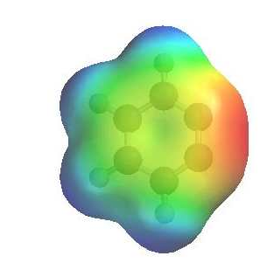
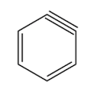
Benzyne
Benzyne is an example of an aryne (-yne = triple bond)
Notes:
This is no ordinary triple bond as the second π interaction results from a weak interaction of sp² hybrid orbitals lying in the plane of the ring. The triple bond is non-linear due to the constraints of the 6-membered ring. Benzyne is strained and highly reactive.Reactivity
The image shows the electrostatic potential for benzyne. The more red an area is, the higher the electron density and the more blue an area is, the lower the electron density. Here we see the triple bond as a region of high electron density (red). As a result of the non-linear triple bond, benzyne is highly reactive. Benzyne is a reactive intermediate, an tends to undergo addition reactions.

