Slide 1
Exposure
To take a perfect picture, we need a balanced exposure.
Not under exposed (dark picture)
Not Over Exposed (over bright picture)

Slide 2
DIFFERENT WAYS TO MAKE A GOOD PHOTOGRAPH
Control exposure
Aperture
Shutter speed
ISO

Slide 3
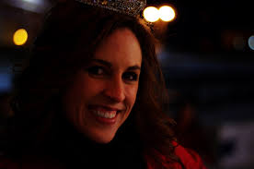
UNDER/OVER EXPOSED

Slide 4
Exposure Triangle

Slide 5
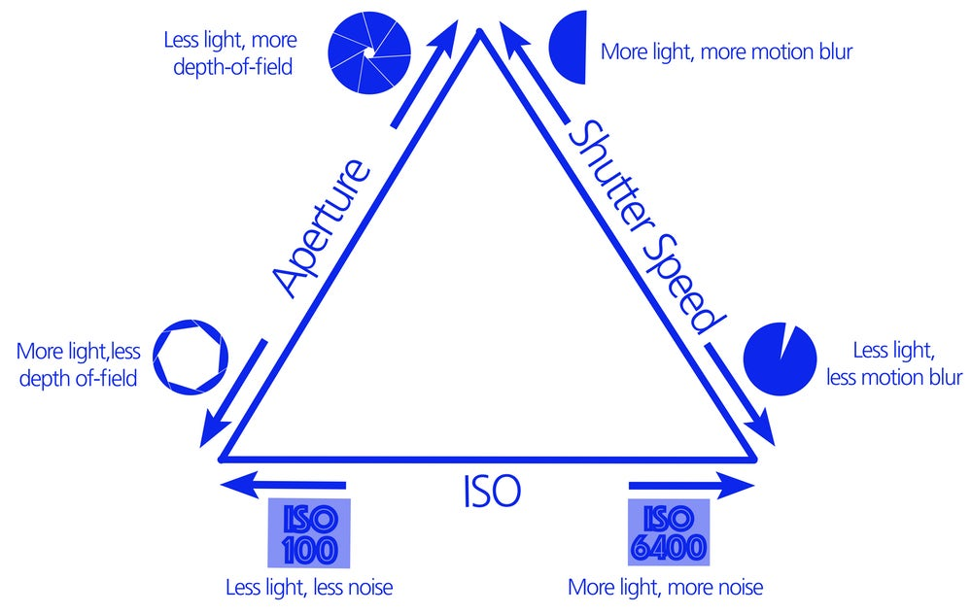
Perfect Exposure
We can adjust the exposure by controling
Shutter, Aperture, ISO & Lighting

Slide 6
EXPOSURE TRIANGLE

