Slide 1
Introduction to Electrotherapy and Physical Agents

Slide 2
What is Electrotherapy
Electrotherapy is the use of electrical energy as a medical treatment.
Electrotherapy includes a range of treatments using electricity to reduce pain, improve circulation, repair tissues, strengthen muscles, and promote bone growth, leading to improvements in physical functioning.

Slide 3
What is Electrotherapy
Electrotherapy is the science of using electrical stimulation to treat injuries and illnesses, such as to improve circulation, reduce pain, strengthen muscles, repair tissues, and promote bone growth, leading to improvements in physical functioning. It is a discipline that is encompassed within the physical rehabilitation and medicine used by many medical practitioners.

Slide 4
What is Electrotherapy
Electrotherapy is a method which usually employs electrical energy mainly to speed the healing process after surgery, to reduce the pain, and to stimulate muscle contractions. Basically, it triggers the release of natural painkillers in the body.

Slide 5
What is Electrotherapy
Electrotherapy provides a wide array of treatments commonly used as a therapeutic means to heal the body. The electrical stimulation provides physiological and chemical refinement in the body, allowing an increased ability to repair damaged tissues that may have been caused by inflammation, skin ulcers or injury, among others. It is primarily the utilisation of an electrical current to stimulate nerves and muscles through the skin in order to ascertain the measure of pain relief.

Slide 6
Some ancient concepts:
In fact, the utilisation of electrotherapy dates back to ancient times and its growing benefits have been used to address:
⦁ Anxiety and Depression ⦁ Chronic Fatigue in General ⦁ Chronic Pain ⦁ Stimulating Bone Growth ⦁ Migraine Headaches ⦁ Fibromyalgia ⦁ Diabetic Nerve Pain ⦁ Wound Healing

Slide 7
Some Benefits
Depending on your medical or musculoskeletal condition, electrotherapy can offer several key benefits:
Reduce Nerve Pain. ...
Promote Healing of Musculoskeletal Injuries. ...
Non-Invasive, Drug-Free Pain Control. ...
Prevent Atrophy. ...
Increase Circulation for Wound Repair. ...
Few, if Any, Side Effects.

Slide 8
Physical Agents in Physicaltherapy
Physical Agents, in physical therapy, may also be referred to as modalities. Often used in conjunction with other manual therapies such as exercises and stretching.

Slide 9
physical agents that we call modalities. These agents are thermal [heat and cold], electrical, sound, light and mechanical.

Slide 10
Physical Agents & Electromodalities

Slide 11
INFRARED RADIATIONS

Slide 12
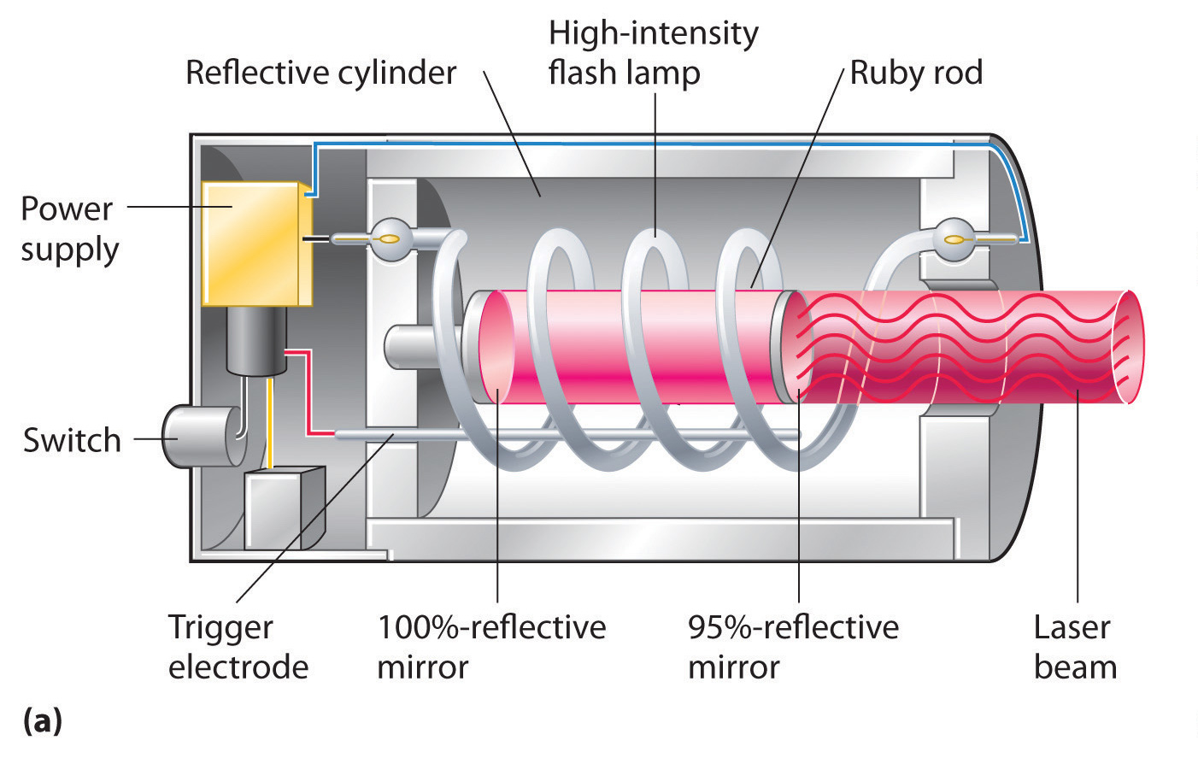
LASER THERAPY

Slide 13
ULTRASOUNDTHERAPY

Slide 14
TRACTION

Slide 16
COMPRESSION THERAPY

Slide 17
INTERMITTENT PNEUMATIC COMPRESSION PUMP

Slide 18
FARADIC STIMULATION

Slide 19
TENS

Slide 20
INTERFERRENTIAL THERAPY

