Slide 1
Ocular Manifestation of Vitamin A Deficiency and its Management
By
Dr. Suhail Mushtaq Boobak
MBBS, DOMS, MCPS, ICO(UK), FCPS, FRCS(UK)
Associate Professor Ophthalmology
Sargodha Medical College, University of Sargodha

Slide 2
Essential for :
1- Maintenance of epithelial surfaces.
2- Immune function.
3- Retinal photoreceptor protein

Slide 3
Symptoms:
1. Night blindness(nyctalopia)
2. Ocular discomfort
3. Loss of vision

Slide 4
Xerophthalmia:
Ocular disease due to inadequate vitamin A intake

Slide 5
Conjuntiva:
Xerosis- dryness of conjuntiva.
Bitot spots- corynaebacterium xerosis

Slide 7
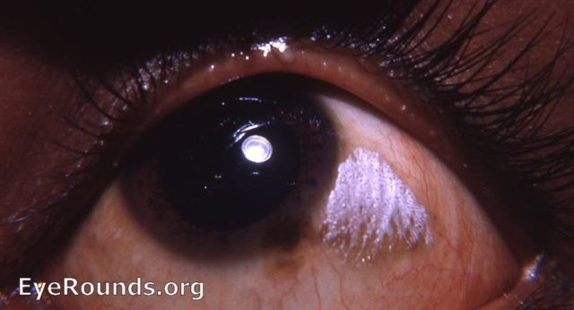

Slide 8
Cornea:
Lusterless appearance
Punctate corneal epithelial erosions
Keratanization leading to:
Keratomalacia Perforation

Slide 9
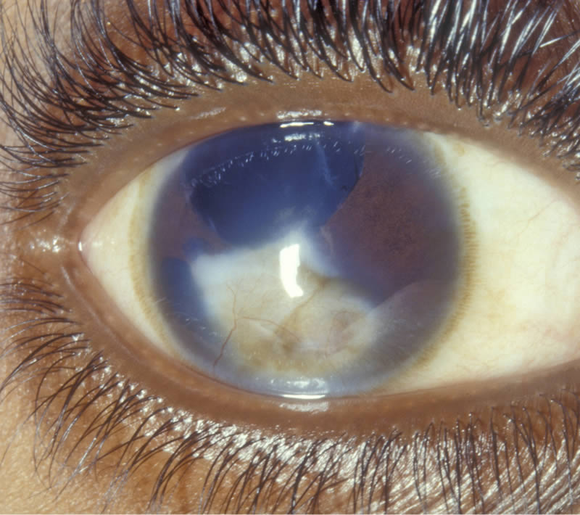

Slide 10
Retinopathy:
Yellow peripheral dots
Decreased electroretinogram
amplitude

Slide 11
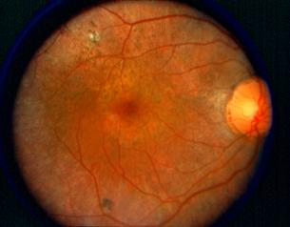
Xerophthalmic fundus

Slide 12
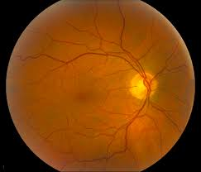

Slide 13
Extraocular:
Hyperkeratosis
Anorexia
Retarded growth

Slide 14
Treatment:
Systemic:
Children < 12 months: 100,000 IU daily for two days and then repeat in 2 weeks.
Adults & children > 12 months: 200,000 IU daily for two days then repeat in 2 weeks.

Slide 15
Ocular:
Intensive ocular lubrication
Corneal surgery.
General measures:
Supplement with zinc & Vitamin A

Slide 16
Prophylaxis:
Infants: 50,000 IU
6 to 12 months: 100,000 IU for 4 to 6 months.
Children> 12 months and adults: 200,000 IU for 4 to 6 months

Slide 17
Thanks

