Slide 1
System & Network Administration (MCSA & RHCSA)
Lecture By Waseem Ahmad
Topic :Yellow Dog UPDATER (yum, RPM)

Slide 2
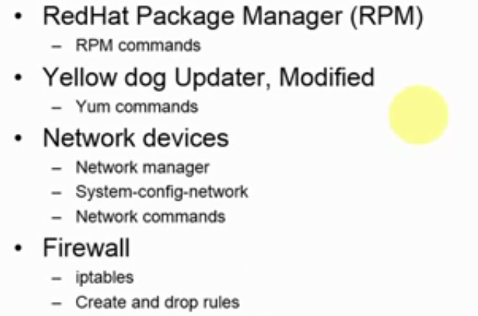
Today Topics

Slide 3
RPM
RPM and SRPM
=>The two types of RPM is available Source Rpm with the source code also .
Naming Convention:
Package name -Version- Release – Artitecture.rpm
No Arh: Architecture means its both for X86 and 64 bit and platform independent package
cd var/lib/rpm for installation of RPM => rpm –ivh packagename

Slide 4
RPM (cont)
If you want to query the database
Rpm -qa | grep vsftpd
For deletion of package
=>Rpm –e package name
If you want to update the package
=> Rpm -Uvh packagname
Check either package have documentation , configuration file ,information
=>rpm –qd cups =>rpm –qc cups =>rpm –qi cups

Slide 5
Yum(Automatic Resolve Package dependencies)
Yum search package-name
Yum info package-name
Yum install package –name
Yum remove package-name
Yum grouplist package-name yum grouplist ”webserver”
Yum groupinstall package-name
Yum search samba
Yum install samba*

Slide 6
Network Manager
IFCONFIG
/etc/sysconfig/network-scripts/
Ifconfig eth0 192.168.1.10 netmask 255.255.255.0
Dhclient eth0

Slide 7
FTP Server VSFTPD
Yum install ftp vsftpd -y
Rpm –ivh vsftpd
------------------------
Vim /etc/vsftpd/vsftpd.conf
Modify banner
ASCI Dowload and uypload enable
Use_localtime=YES
----------------------
Systemctl enable vsftpd
Systemctl start vsftpd
------------------------
Firewall-cmd –-- permanent --add-port=21/tcp-
Firewall-cmd -- permanent --add-service=ftp
----------------------
Firewall-cmd --reload

Slide 8
FTP Server
System-config-firewall& GUI
Setsebool -P ftp_home_dir on
Adduser ftp
Passwd ftp
Login by ftp 192.168.10.100

Slide 9
Iptables
Yum install iptables-services
Systemctl mask firewalld
Systemctl enable iptables
Systemctl stop firewalld
Systemctl start iptables
Vim /etc/sysconfig/iptables
Add line: -A INPUT -m state – NEW –m tcp –p tcp --dport 21 -j ACCEPT
Systemctl restart iptables

Slide 10
Install Filezila
Yum install epel-release
Yum install filezilla

