Slide 1
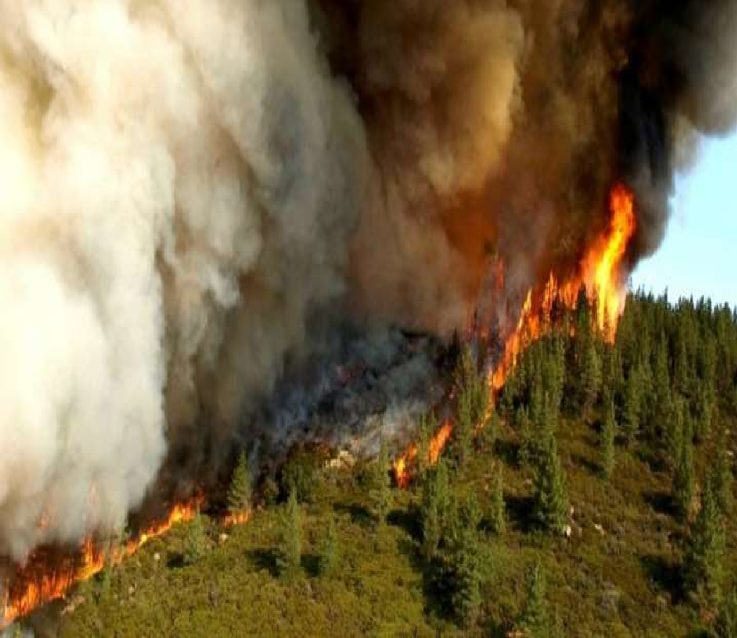
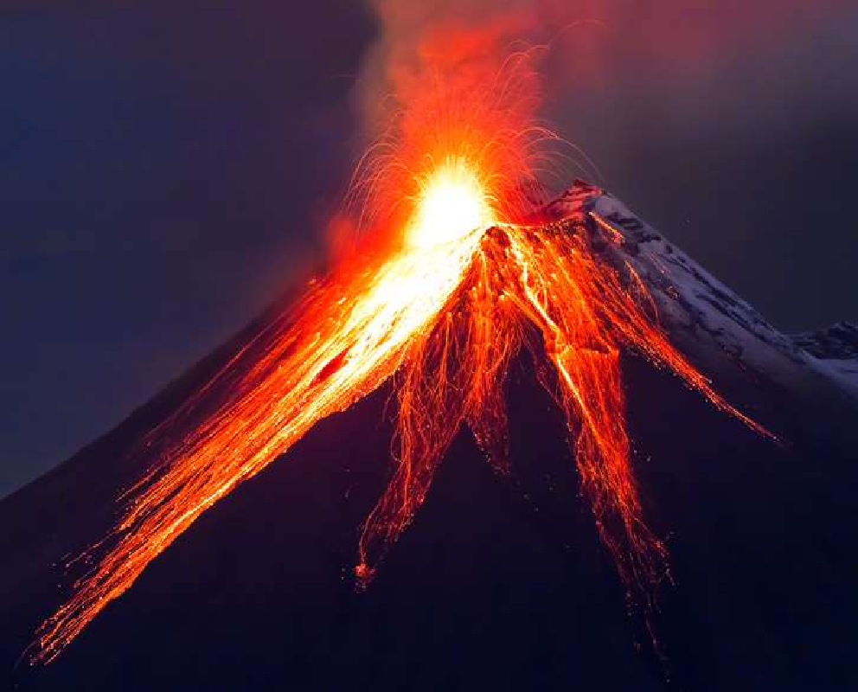
CARBON SEQUESTRATION by Dr. Naila Farooq

Slide 2
INTRODUCTION
CO2 is one of the main greenhouse gases that is causing global warming and forcing climate change.
The continued increased in CO2 concentration in the atmosphere is believed to be accelerated by human activities such as burning of fossil fuels and deforestation.
One of the approaches to reducing CO2 Concentration in the atmosphere is carbon sequestration.

Slide 3
CARBON SEQUESTRATION
Carbon Sequestration is the placement of CO2 into a depository in such way that it remains safely and not released back to the atmosphere.
Sequestration means something that is locked away for safe keeping. the trapping of a chemical in the atmosphere or environment and its isolation in a natural or artificial storage area.

Slide 4
OBJECTIVES
Developing technology to reduce rate of concentration of greenhouse gases in air.
Reducing pollution in air as well as improving natural carbon content in soil.
Improvement of soil structure and restoring degraded soil leading to increase yield in crops.

Slide 5
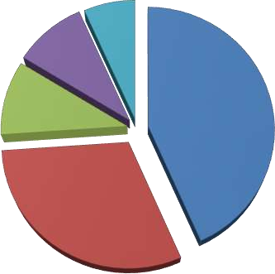
Carbon dioxide emission in top five countries
Japan, 1.26
Russia, 1.78
China, 8.1
China
India, 1.83
The U.S.
CO2
India
Russia
The U.S., 5.7
Japan
Billion metric tons per Annum

Slide 6
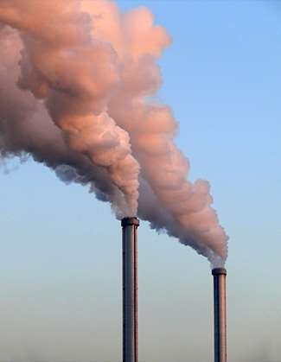
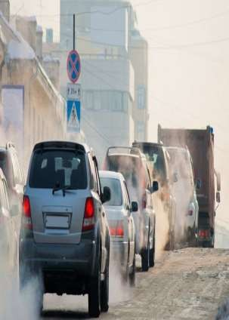
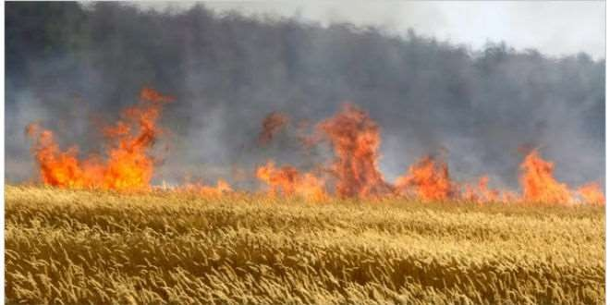
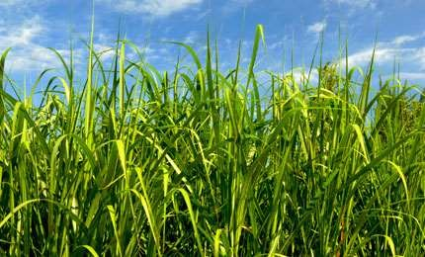
Source of carbon dioxide emission
1. Man made sources Industries Transportation Land use change soil cultivation Biomass burning

Slide 7
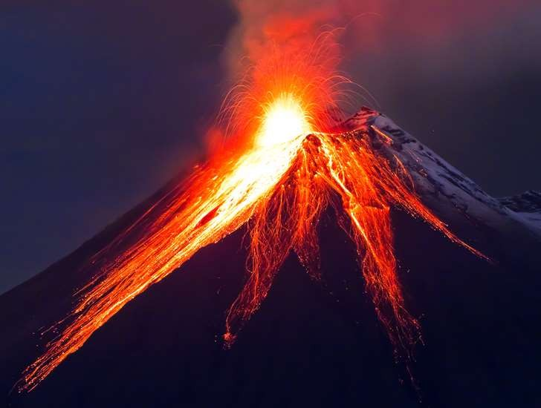
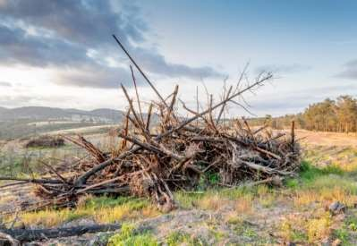
2. Natural sources
Volcanoes
Wild fires
Decomposition
Respiration

Slide 8
Ways that carbon can be sequestered
Geological sequestration : Underground
Ocean Sequestration : Deep in ocean
Terrestrial Sequestration : In plants and soil

Slide 9
1.Geological sequestration
Geologic Storage involves capturing anthropogenic CO₂ before it enters the atmosphere and injecting it into underground formations. Once CO₂ is injected deep underground (typically more than 800 meters) it is trapped in minute pores or spaces in the rock structure. Impermeable cap rocks above the storage zones act as seals to ensure the safe storage of CO₂.

Slide 10
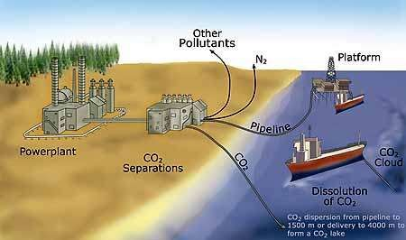
2.Ocean sequestration
Carbon is naturally stored in the ocean via two pumps, solubility and biological and there are analogous man made methods, direct injection and ocean fertilization, respectively.
At the present time, approximately one third of human generated emission are estimated to be entering the ocean.

Slide 11
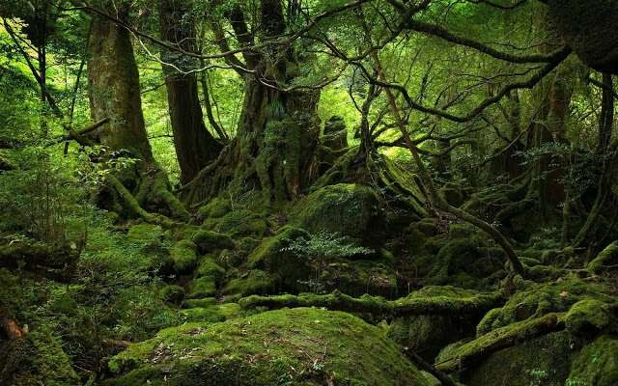
3.Terrestrial Sequestration
The process atmosphere is
through which CO₂ from the absorbed naturally through
photosynthesis & stored as carbon in biomass & soils.

Slide 12
CO₂ Capture Technologies
Pre-combustion
In this process, the fuel is pre treated before combustion.
Post-combustion
This process removes CO₂ from the flue gas after combustion has taken place.
Oxyfuel combustion
In Oxyfuel combustion, oxygen, instead of air, is used for combustion.

Slide 13
CO₂ Separation Technologies
The main CO₂ separation technologies that can be applied to isolate the CO₂ from the fuel gas stream prior to transportation.
1. Absorption
A liquid sorbent is used to separate the CO₂ from the flue gas. The sorbent can be regenerated through a stripping or regenerative process by heating and/or depressurization.

Slide 14
Adsorption
In contrast to absorption processes which use a liquid absorbent, a solid sorbent is used to bind the CO₂ on its surfaces. Large specific surface area, high selectivity and higher generation ability are the main criteria for sorbent selection.
Chemical looping combustion
A metal oxide is used as an oxygen carrier instead of using pure oxygen directly for the combustion as in the case of oxyfuel combustion. During the process the metal oxide is reduced to metal while the fuel is being oxidized to CO₂ and water.

Slide 15
Membrane separation
Membranes can be used to allow only CO₂ to pass through, while excluding other components of the flue gas.
Hydrate-based separation
Hydrate-based CO₂ separation is a new technology by which the exhaust gas containing CO₂ is exposed to water under high pressure forming hydrates. The CO₂ in the exhaust gas is selectively engaged in the cages of hydrate and is separated from other gases.

Slide 16
6. Cryogenic distillation
Cryogenic distillation is a gas separation process using distillation at very low temperature and high pressure, which is similar to other conventional distillation processes except that it is used to separate components of gaseous instead of liquid.

Slide 17
Carbon sources and carbon sinks
Carbon source
A forest is considered to be a carbon source if it releases more carbon than it absorbs.
Anthropogenic activities such as the burning of fossil fuels have released carbon from its long-term geologic storage as coal, petroleum and natural gas and have delivered it to the atmosphere as carbon dioxide gas.

Slide 18
Carbon sink
The main natural carbon sinks are plants, the ocean and soil. Plants grab carbon dioxide from the atmosphere to use in photosynthesis; some of this carbon is transferred to soil as plants die and decompose. The oceans are a major carbon storage system for carbon dioxide. Marine animals also take up the gas for photosynthesis, while some carbon dioxide simply dissolves in the seawater.

Slide 19
What is Carbon Credits
A carbon credit is a a market term or generic term for any tradable certificate or permit representing the right to emit one tonne of carbon dioxide or the mass of another greenhouse gas with a carbon dioxide equivalent to one tonne of carbon dioxide.

Slide 20
The Role of Trees & forest in Reducing
Atmospheric Carbon.
Trees it’s the Carbon Storage Experts. One half the dry weight of wood is carbon. Trees take in CO₂ from the air in the process called photosynthesis.
The tree effectively breaks down the CO₂, stores the carbon in all parts of the tree, and releases the oxygen back into the atmosphere. Fast growing trees are, in fact, the most efficient way to sequester atmospheric carbon.

Slide 21
As forests grow, they store carbon in woody tissues and soil organic matter. The net rate of carbon uptake is greatest when forests are young, and slows with time. Old forests can sequester carbon for a long time but provide essentially no net uptake.
The main strategies for using forests for carbon sequestration
Active forest management
Avoided deforestation
Forest preservation
Afforestation

Slide 22
Benefits of Soil Sequestration of Carbon
Improved soil structure
Better water use and storage
Less erosion
Increased soil fertility
Improved biodiversity
Healthier ecology
Improved agricultural performance.

Slide 23
Challenges in soil carbon sequestration
Deforestation
Residue burning
Conventional tillage
Imbalanced use of fertilizers
Reduced inputs of organic matter

Slide 24
Conclusions
Greenhouse gas concentration in the atmosphere are increasing and the threat of global climate change requires our attention.
Soil carbon sequestration is an effective tool to sequester atmosphere CO2 with better practical application than other approaches.
Soil carbon sequestration provide vast opportunity to sequester carbon in the soil.

Slide 25
A diversity of agricultural management practices can be employed to sequester more carbon in plants and soil:
Crop management.
Nutrient management.
Residue management and conservation tillage.
Agro-forestry.
Soil carbon sequestration using innovate soil and crop management practices is needed to augment soil carbon storage.
Combination of different agricultural management practices can enhance soil carbon sequestration.

