Slide 2
Cytoplasmic Inclusions
The contents of the cell between the plasma membrane and nuclear envelope are known as cytoplasm. It is a gel-like clear substance that contains living and non-living materials such as water, enzymes, salts, organelles, and various organic molecules. Among them, organelles form the living inclusions, and non-living substances form cytoplasmic inclusions.
The cytoplasmic inclusions or non-living cell contents may be classified into the following three main groups:
1. Reserved Products
2. Secretory Products
3. Excretory Products

Slide 3
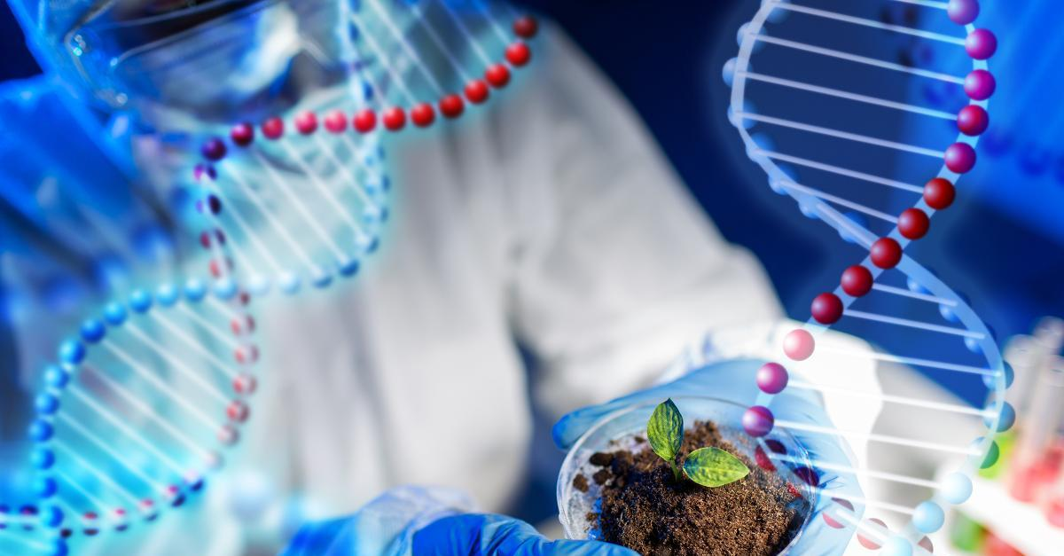
CARBOHYDRATES
Carbohydrates are neutral organic compounds that are made up of carbon(C), hydrogen (H), and oxygen (O) ions.
Carbohydrates are classified into three types, namely monosaccharide, which contains one molecule of sugar, oligosaccharide, which contains 2-10 molecules of sugars and polysaccharide, which contains more than ten molecules of sugars.

Slide 4
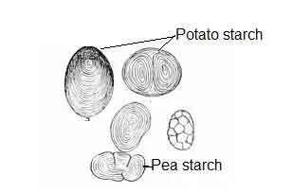
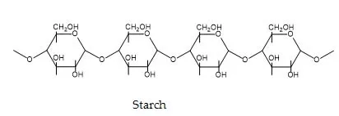
ALLOGENEIC PRIMARY CELLS
Starch (C₆H₁₀O₅)_{n}: In the cytoplasm, starch remains scattered in the form of particles. These particles are called starch grains. They may be round, oval (potato), polygonal(maize) or spherical(pea) in shape.
Glycogen (C₆H₁₀O₅)_{n}: It is a multi-branched polysaccharide that is mainly found in the liver and muscle cells of the animal body. Hence, it is also known as animal starch. Generally, it is present in the cytoplasm in between mitochondria and endoplasmic reticulum in the form of particles.

Slide 5
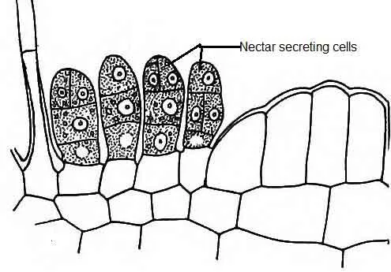
SECRETORY PRODUCTS
Nectar: It is secreted by a special type of glands, called nectaries, present in many flowers. It attracts the insects for pollination.
Coloring materials: These are produced by the plant cell. The coloring materials include chloroplasts, chromoplasts, and anthocyanins, etc. These are essentials in the process of photosynthesis. They also provide coloration to various organs of the plant.

Slide 6
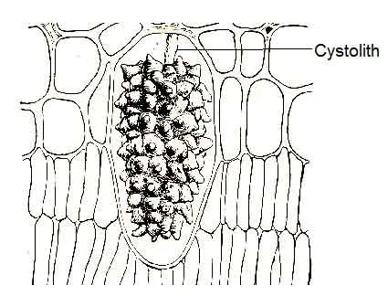
EXCRETORY PRODUCTS
Mineral crystals
​The common forms of crystal secreted by plant cells are made up of silica, calcium carbonate, and calcium oxalate. Calcium oxalate is the most common and is widely distributed among the various plants.
(i) Cystolith: It is an outgrowth of the epidermal cell wall; Calcium carbonate occurs as a large mass of small crystals in many plants leaves. The whole crystalline mass looks like a bunch of grapes suspended from a stalk from the upper epidermis. It is known as cystolith. Cystoliths are found in certain plant families, such as Acanthaceae, Urticaceae, Cannabaceae, Moraceae (Ficus elastica), etc.

Slide 7
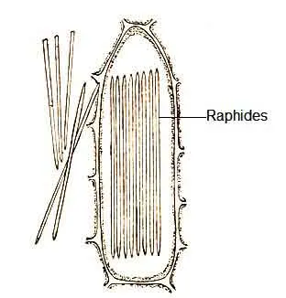
RAPHIDES
Mainly calcium oxalate occurs as aggregates of crystals in the form of raphides. The bag-like specialized cells where these are formed are known as idioblasts. These may be seen singly or in a bundle. The crystals are needle-like structures. They are commonly seen in water hyacinth (Eichhornia crassipes), Colocasia (Araceae), leaves of Bougainvillea (Nyctaginaceae), and in many other plants.

Slide 8
TANNINS AND ESSENTIALS
Tannins
​These are a group of complex compounds; it commonly occurs in single isolated cells. These are abundant in the bark caves and many unripe fruits. Tea leaves contain about 15% tannins.
Essentials oils
​These are present in oil glands, which are found in the leaves of sacred basil or tulsi (Ocimum tenuiflorum), lemon, petals of the rose, etc. The common essential oils are sandalwood oil, rose oil, and clove oil.

Slide 9
RESINS AND GUMS
Resins
Resins are yellowish solids, insoluble in water, but soluble in alcohol. They are found in the stems of conifers and sal trees ( Shorea robusta).
Gums
It is an amorphous colloid and consists largely of decomposition products of cellulose or other carbohydrates of the cell wall. They occur in mixtures with resins and complex carbohydrates. Common examples are camphor(Cinnamomum camphora), goggul(Commiphora wightii), gum Arabic(Acacia species), gum tragocanth ( Astragalus), etc.

Slide 10
LATEX AND ALKALOIDS
It is generally milky, viscous colloidal substances, found in latex cells and latex vessels. It is often found in Indian rubber plant (Ficus elastica), para rubber tree (Hevea brasiliensis) and calotropis (milkweeds: Apocynaceae). It is also found in opium poppy (Papaver somniferum).
These are complex nitrogenous substances and are present in the seeds and roots of some plants. These are intensely bitter, and some of them are poisonous. The caffeine of coffee and tea, nicotine of tobacco, quinine of cinchona(Rubiaceae), morphine of opium poppy, and strychnine of Strychnine tree (Strychnos nux-vomica) are the best examples of alkaloids.

Slide 11
SOME FUNCTIONS OF CYTOPLASMIC INCLUSIONS
These substances aid the organism in defense.
It does maintenance of the cellular structure.
It helps to store various materials.
Some inclusions such as hormones, enzymes, etc. influence the metabolism, growth, and development of animal and plant bodies.
Inclusions like nectar attract the insects for pollination.
Tannins of plants play a role in protection from predation and might help in regulating plant growth.
The resin of plants protects the plant from pathogens and insects.

Slide 12
CONCLUDING REMARKS
The cytoplasm is a gel-like, highly viscous substance that is composed of three types of structure, including the cytoplasmic matrix, the cytoplasmic organelles, and the cytoplasmic inclusions. They are enclosed within the cell membrane, and they contain about 85% water, 10-15% proteins, 2-4% lipids, inorganic salts, nucleic acids, and carbohydrates in a small amount. Most of the metabolic activities occur within the cytoplasm. During metabolic activities, some non-living substances such as nutrients, pigments, hormones, enzymes, etc. are produced. These products form the cytoplasmic inclusions and perform various functions.

