Slide 1
ATP AS AN ENERGY CARRIER
Reactions or processes that have a large positive G, such as moving ions against a concentration gradient across a cell membrane, are made possible by coupling the endergonic movement of ions with a second spontaneous process with a large negative ΔG, such as the hydrolysis of adenosine triphosphate (ATP).

Slide 2
Mechanical model of energy coupling
A gear with an attached weight spontaneously turns in the direction that achieves the lowest energy state, in this case the weight seeks its lowest position.

Slide 3
The reverse motion is energetically unfavored and does not occur spontaneously.
The energetically favored movement of one gear can be used to turn a second gear in a direction that it would not move spontaneously.

Slide 4
Reactions are coupled through common intermediates
The simplest example of energy coupling in biologic reactions occurs when the energy-requiring and the energy-yielding reactions share a common intermediate.

Slide 5
Reactions are coupled through common intermediates
Two chemical reactions have a common intermediate when they occur sequentially so that the product of the first reaction is a substrate for the second.
For example, given the reactions
D is the common intermediate and can serve as a carrier of chemical energy between the two reactions.

Slide 6
Example
Very often, two or more biochemical reactions are coupled.
This allows an energetically favoured reaction to allow energetically less favoured reaction to occur.
For example:
The overall reaction is exergonic and a favoured reaction.

Slide 7
Many coupled reactions use ATP to generate a common intermediate.
These reactions may involve ATP cleavage – that is, the transfer of a phosphate group from ATP to another molecule.
Other reactions lead to ATP synthesis by transfer of phosphate from an energy-rich intermediate to ADP, forming ATP.

Slide 8
Energy carried by ATP
ATP consists of a molecule of adenosine (adenine + ribose) to which three phosphate groups are attached.
It is the compound that stores most of the chemical energy

Slide 9
Energy released by ATP
If one phosphate is removed, adenosine diphosphate (ADP) is produced.
If two phosphates are removed, adenosine monophosphate (AMP) results.
The standard free energy of hydrolysis of ATP, ΔG°, is approximately -7300 for each of the two terminal phosphate groups.
Because of this large, negative ΔG°, ATP is called a high-energy phosphate compound.

Slide 10
Although both the reactions release the same amount of energy, they are not interchangeable as the enzymes that catalyze these reactions are specific for the reaction.

Slide 11
In most of the enzymatic reactions the ATP binds to Mg²⁺. Hence, most reactions involving ATP show Mg²⁺ as the cofactor.
The products of hydrolysis of ATP can be used for coupling other chemical reactions
ADP or AMP produced can bind to enzymes and help in the regulation of these enzymes and
ATP does not itself get hydrolyzed but can be hydrolyzed enzymatically.

Slide 12
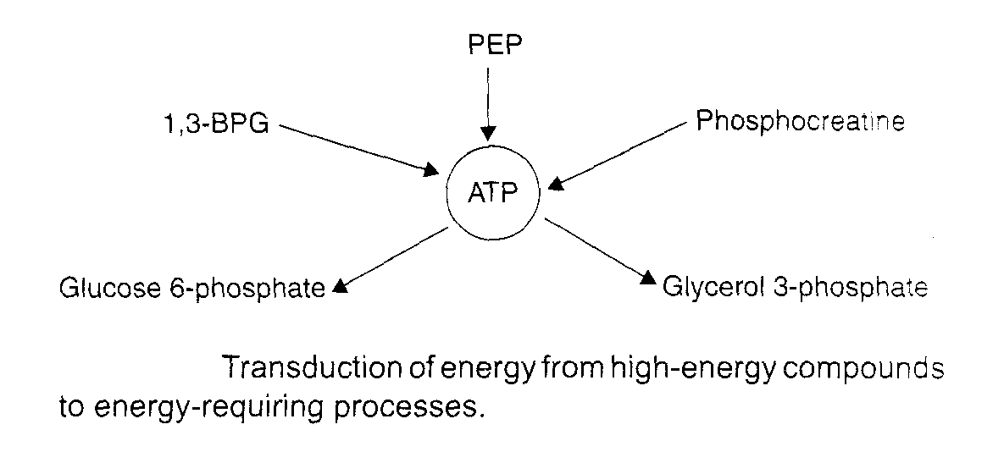
High energy compounds
A compound that on hydrolysis undergoes a large decrease in free energy under standard conditions is called a high-energy compound.

Slide 13
High Energy compounds
There are a number of compounds that not only contain phosphate but have a higher negative free energy of hydrolysis than ATP.
These compounds are
Phosphoenolpyruvate (PEP)
Phosphocreatine and
1,3-bisphosphoglycerate (BPG)
These are called high-energy compounds.
Some compounds are called low energy phosphates such as
glucose 6-phosphate
glycerol 3-phosphate
AMP
ATP occupies a middle position on the scale

Slide 14
Sources of ATP
There are three major sources of ATP production.
Oxidative Phosphorylation in ETC is main process of ATP production.
Glycolysis
Tricarboxylic acid cycle.
Energy produced in II and III called substrate level phosphorylation.

Slide 15
ELECTRON TRANSPORT CHAIN
Energy-rich molecules, such as glucose, are metabolized by a series of oxidation reactions ultimately yielding CO₂ and water

Slide 16
Energy transfer by other nucleotide phosphates
Other nucleotides triphosphates participate in the transfer of high energy phosphates.
UTP GTP the CTP from their diphosphate.
ATP+UDP nucleoside → ADP+UTP
Di-PO₄ kinase
ATP+UMP nucleoside → ADP+UDP
Mono PO₄ kinase
ATP → AMP + ppi

Slide 17
.
G
Kj/mol kcal/mol
Phosphoenolpyruvate −61.9 −14.8
Carbamoyl phosphate −51.4 −12.3
1,3-Bisphosphoglycerate −49.3 −11.8
(to 3-phosphoglycerate)
Creatine phosphate −43.1 −10.3
ATP →ADP + Pi −30.5 −7.3
ADP →AMP + Pi −27.6 −6.6
Pyrophosphate −27.6 −6.6
Glucose 1-phosphate −20.9 −5.0
Fructose 6-phosphate −15.9 −3.8
AMP −14.2 −3.4
Glucose 6-phosphate −13.8 −3.3
Glycerol 3-phosphate −9.2 −2.2
1 calorie = 4.184 joules

Slide 18
PHOSPHAGENS
Phosphagens are compounds that act as storage form of energy e.g. creatine phosphate in skeletal muscle, heart, brain and the spermatozoa.
Phosphagens permit to maintain ATP level in muscle when ATP is rapidly being utilized as some of energy for muscle contraction.
In skeletal and heart muscle creatine phosphate shuttle is responsible for transport of ATP from mitochondria to cytosol.
In heart it provides immediate protection against infarction.

Slide 19
.

Slide 20
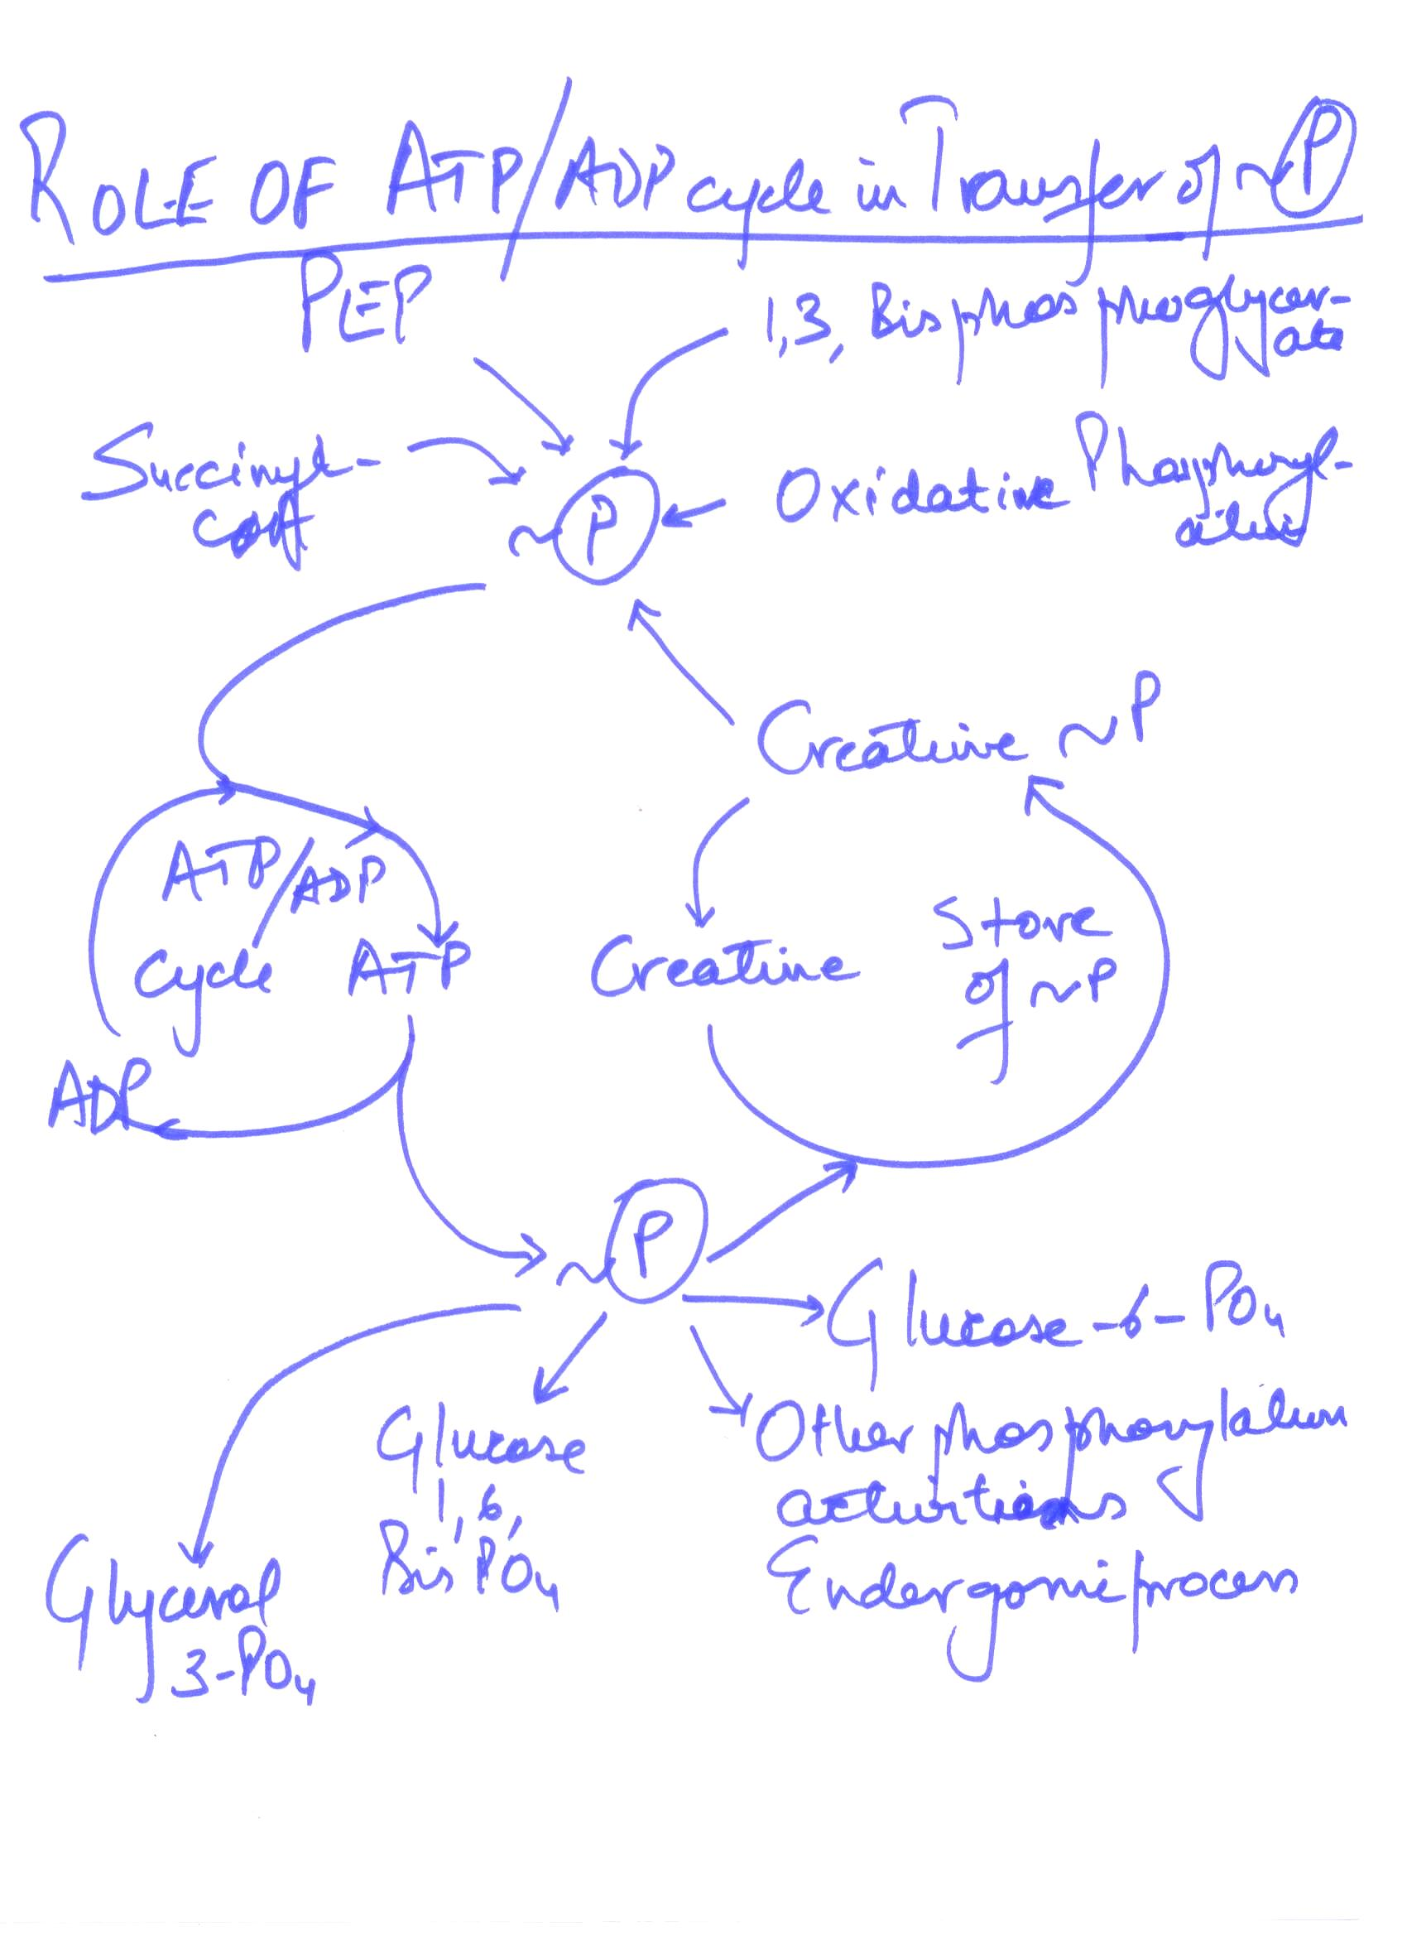

Slide 21
ELECTRON TRANSPORT CHAIN
Energy-rich molecules, such as glucose, are metabolized by a series of oxidation reactions ultimately yielding CO₂ and water

Slide 22
Substrate-level phosphorylation
When a substrate undergoes oxidation in the presence of inorganic phosphate, redistribution of energy occurs within the molecule in such a way that a high-energy phosphate bond is formed.
The phosphorylation thus brought about is called substrate-level phosphorylation (SLP).
Thus, SLP occurs without the involvement of ETC and molecular oxygen.

Slide 23
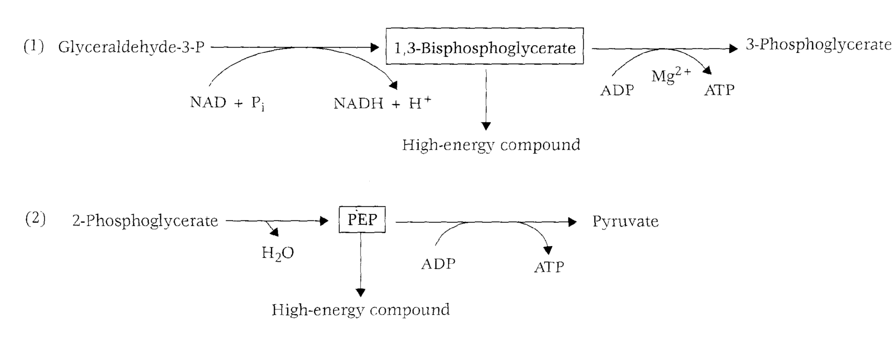
Examples of SLP are as follows:
These reactions are part of glycolysis.

Slide 24
