Slide 1
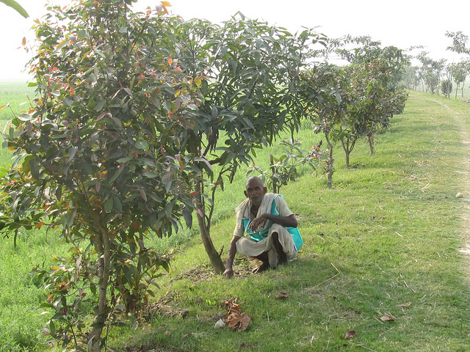
SOCIAL AND COMMUNITY FORESTRY
CODE : 2509
Social forestry is the forestry
by the people and for
the people

Slide 2
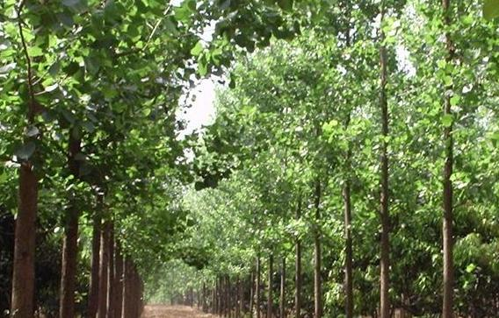
SOCIAL FORESTRY
The term was coined by J.C. Westoby
It was first recognized as an important component of forestry for meeting rural needs in the interim report of the National Commission on Agriculture (NCA, 1976)

Slide 3
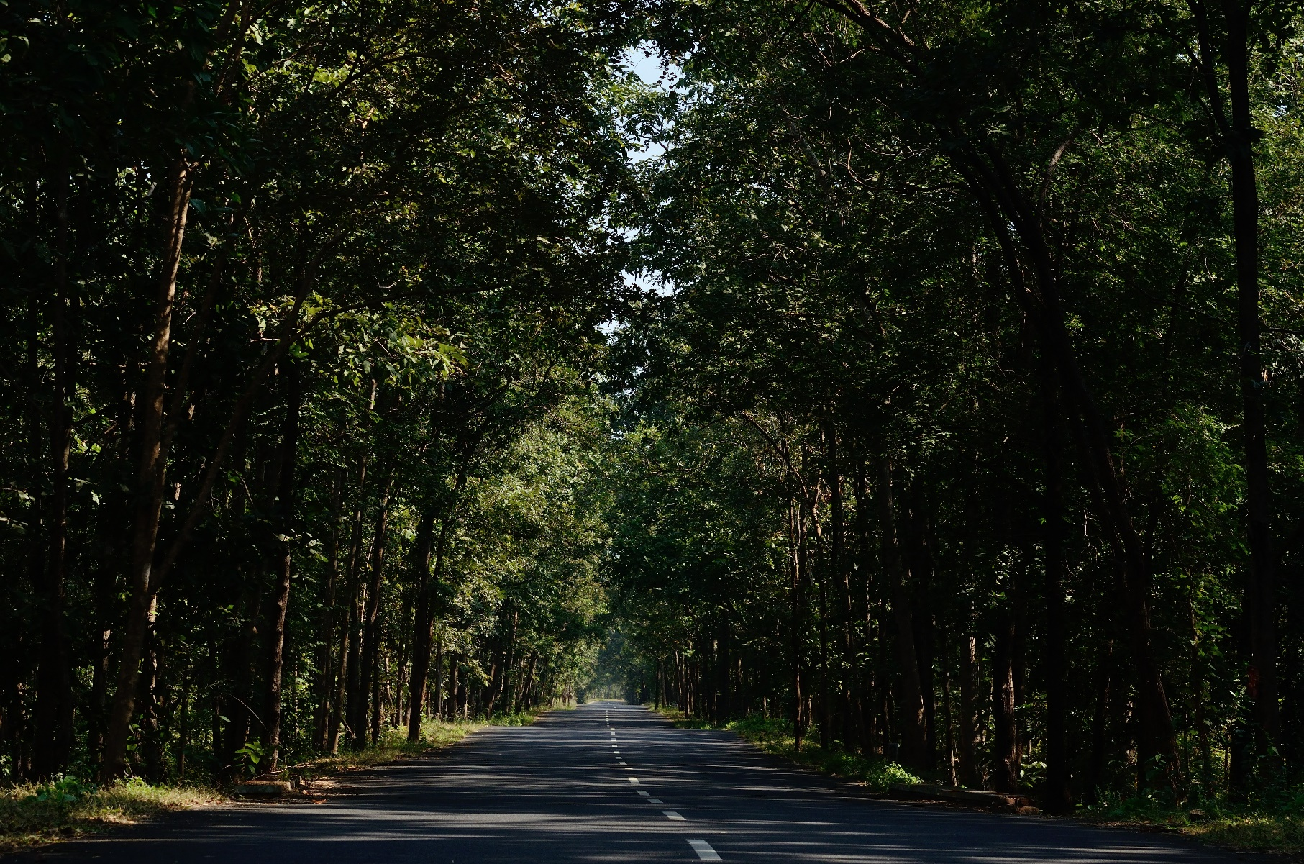
Social Forestry near Mothugudem of Khammam district in Andhra Pradesh, India

Slide 4
DEFINITIONS
Social forestry means the management and protection of forests and afforestation of barren and deforested lands with the purpose of helping in environmental, social and rural development. (National Commission on Agriculture; Govt. of India)
Social forestry is the involvement of different sectors of the society in planning, management and protection of forests. (Sudanese Social Forestry Society)
Social forestry is the forestry outside the conventional forests and deals with poor people to produce goods such as fuel, fodder etc. to meet the needs of local community particularly underprivileged section. (Shah; 1985)

Slide 5
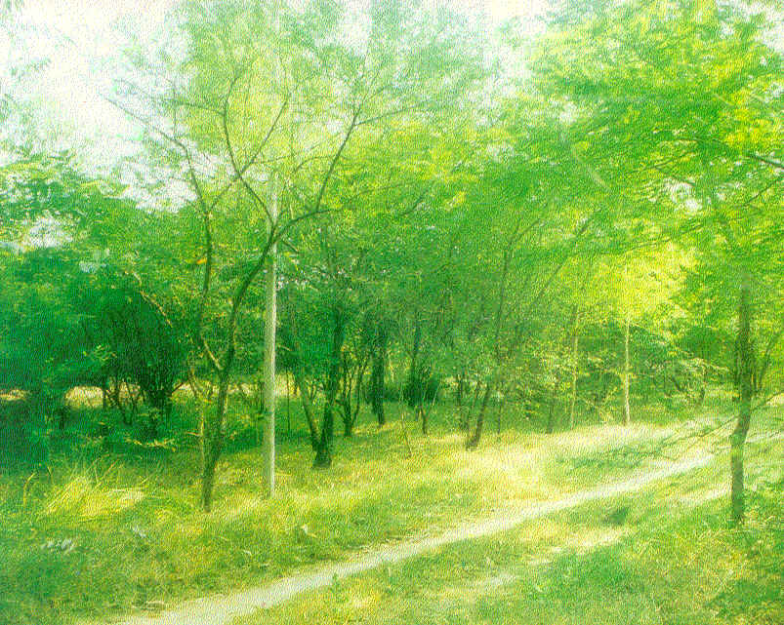
DEFINITIONS
Social Forestry is the production of tree based
commodities at village level is often embedded in complex
resource and social systems influenced primarily
by human factors. (Arnold; 1989)
Social Forestry a forestry which aims at ensuring
economical, ecological and social benefits to the people,
particularly to the rural masses and those living below poverty line, specially by
involving the beneficiaries right from the planning stage to the harvesting stage.

Slide 6
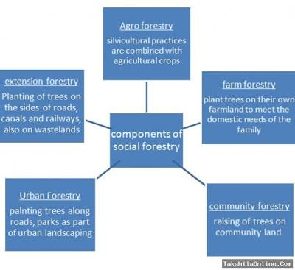
BRANCHES OF SOCIAL FORESTRY
Farm Forestry
Community Forestry
Extension Forestry
Agroforestry

Slide 7
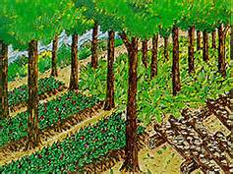
Farm Forestry
A term used in Australia
Farm Forestry is defined as
establishment and/or
management of trees or
forests on agricultural
landscapes for commercial,
aesthetic and/or
environmental reasons

Slide 8
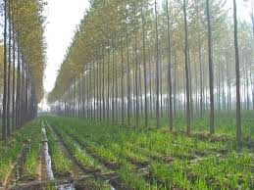
DEFINITIONS
Farm forestry is the practice of forestry on farms in the form of raising rows of tree on bunds or boundaries of field and individual trees in private agriculture land as well as creation of wind breaks, which are protective vegetal screens created round a farm or an orchard by raising one or two lines of trees fairly close with shrubs in between

Slide 9
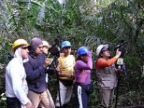
Community Forestry
Worldwide phenomenon
Began in developing countries
Practiced by communities where
livelihood depends upon access to
healthy, productive public forest land

Slide 10
DEFINITIONS
Initially defined by FAO as:
“Any situation which intimately involves local people in a forestry activity. It embraces a spectrum of situations ranging from woodlots in areas which are short of wood and other forest products for local needs, through the growing of trees at the farm level to provide cash crops and the processing of forest products at the household, artisan or small industry level to generate income, to the activities of forest dwelling communities”.
Community forestry is an evolving branch of forestry whereby the local community plays a significant role in forest management and land use decision making by themselves in the facilitating support of government as well as change agents

Slide 11
Extension Forestry
Extension forestry is the practice of forestry in areas devoid of tree growth and other vegetation and situated in places away from the conventional forest areas with the object of increasing the area under tree growth
Extension Forestry is a mission to enable farmers to make informed decisions concerning the management, enhancement, and enjoyment of their forest and other natural resources through sound, research-based information and education.

Slide 12
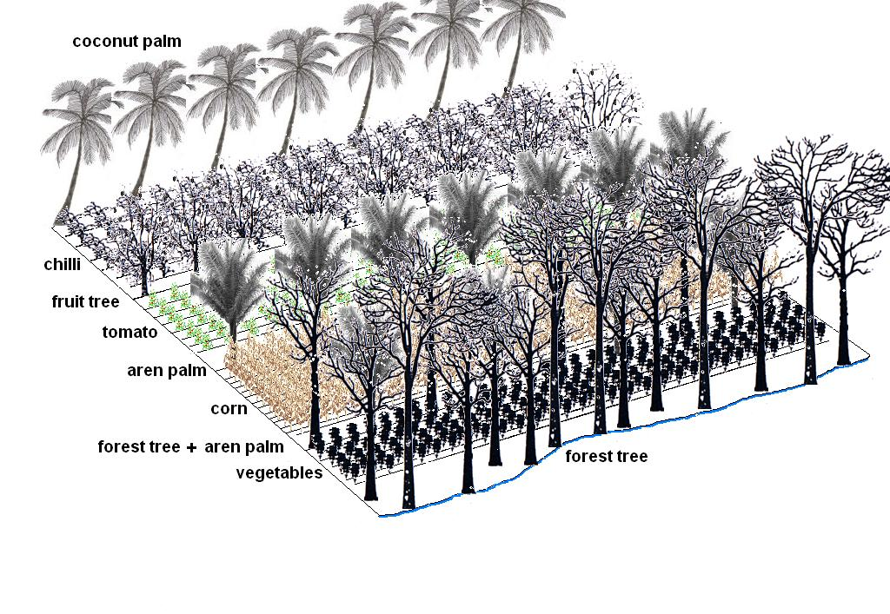
Agroforestry
Recognized by the scientist
through the creation of ICRAF
in 1774

Slide 13
DEFINITIONS
A collective name for land use systems and practices in which woody perennials are deliberately integrated with crops and/or animals on the same land management unit. (ICRAF)
Agroforestry should be considered as a dynamic, ecologically based, natural resource management system that, through the integration of trees in farm and rangeland, diversifies and sustain smallholder production for increased social, economic and environmental benefits. (Leakey; 1996)

Slide 14
DEFINITIONS
Agroforestry are diverse technical practices that have following in common:
There are at least two different plants in biological interaction
One of these two plants is perennial
One of these two plants is forage, a food crop or a tree crop
(Somariba E. 1992)

Slide 15
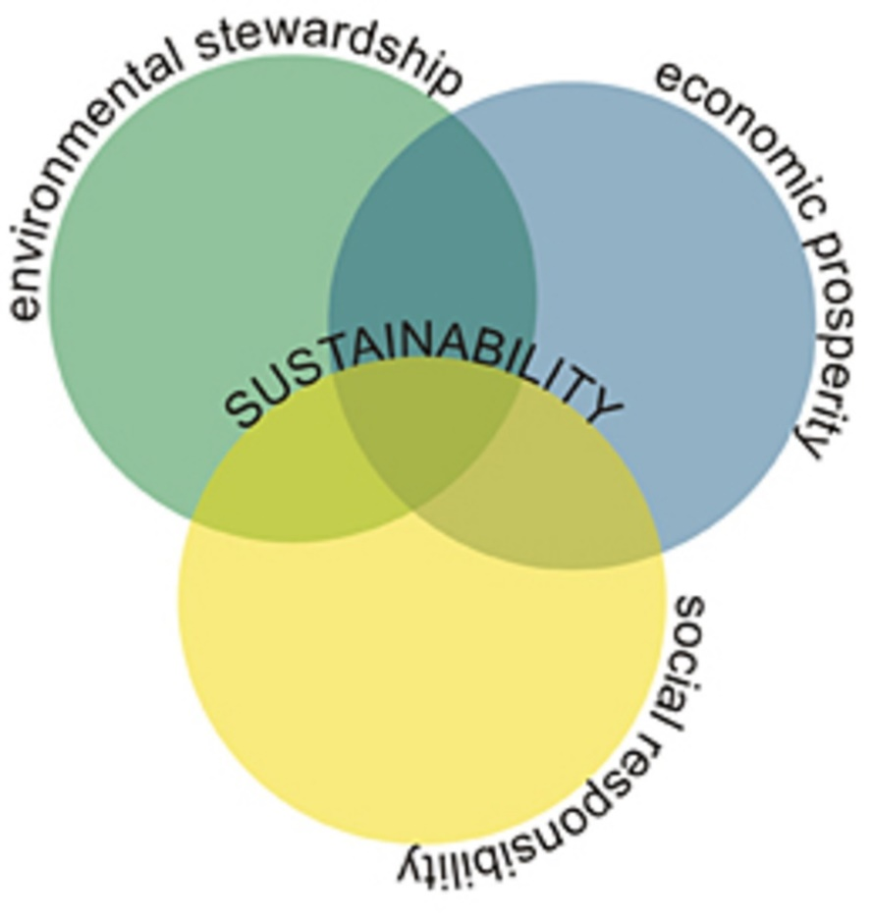
AIMS OF SOCIAL FORESTRY
Three major aims of Social Forestry stated
by FAO (1978):
Provision of fuel and other goods
Provision of food and the environment stability
Generation of income and employment

Slide 16
SCOPE OF SOCIAL FORESTRY
People’s participation in, and decentralization and devolution of forest management
focus on integrated resource management
Generates interest in alternate approaches to the existing forest management
Impacts the functioning and performance of forestry institutions
Emerges staff skills in local people

Slide 17
The History of Social Forestry in Pakistan
Govt. successfully launched many developmental social forestry projects in 1975 (Punjab Forest Department 2005)
The history of plantations in Pakistan (1860s) is linked with the need for more fuel wood
Accelerated growth experiments on hybrid Poplar, Eucalyptus camaldulensis and E. tereticornis to establish the comparative merit of the two genera (1972)
The superior traits of Eucalyptus made it the predominant planting species of Malakand Agency and other parts of the country

Slide 18
HISTORY OF SOCIAL FORESTRY IN PAKISTAN
CRITICAL REVIEW
1970s to 1980
Establishment of plantations
Did not address holistic natural forest management.
EARLY NINETIES
Focus changed to “social forestry”
In recent years, shifted to institutional strengthening and reforms, both policy and structure
Unfortunately, the overall investment in forest related projects has been drastically reduced and bi-lateral arrangements have almost dried up (EC and UNDP 2002).

Slide 19
Overview of donor funded forestry related initiatives in Pakistan (1975 to 2006) Source: EC and UNDP 2002
NO. | DONOR | PERIOD | INVESTMENT (million $) | FOCUS
1. | USAID | 1982-1995 | 50 | Plantation/Farm Forestry
2. | WFP | 1975-2001 | 150 | Watershed Management
3. | UNHCR | 1987-1995 | 40 | Plantation/Income Generation
4. | FAO | 1985-1998 | 15 | Watershed Management
5. | GTZ | 1981-2000 | 25 | Forest Management /Joint Forest Management
6. | SDC | 1981-2005 | 20 | Integrated Development/ Resource Inventory
7. | ADB | 1996-2004 | 14 | Institutional Strengthening
8. | RNE | 1987-2000 | 12 | Social Forestry/Institutional Strengthening
9. | EC | 1997-2005 | 30 | Integrated NRM/Rural Development
10. | UNDP/GEF | 2002-2006 | 19 | Conservation and Ecosystem Management

Slide 20
HISTORICAL INITIATIVES TAKEN IN SOCIAL FORESTRY IN PAKISTAN
Siran Forest Development Project (GTZ)
Malakand Social Forestry Project (Dutch)
Kalam Integrated Development Project (SDC)
Master Plan for Forest Sector Development (MPFD)
Integrated Rural Development Project (IRDP)
Joint Forest Management
Project on Environmental Rehabilitation in NWFP and Punjab (ERNP)
Social Forestry Project in Amlookdara
Promotion of Social Forestry and Rain Water Conservation Technology
IUCN-Pakistan's Korangi Ecosystem Project
Social Forestry Approach Adopted for Mangroves Forests

Slide 21
Siran Forest Development Project (GTZ)
Initiated by German aid agency GTZ (1992)
For natural resource management on self-help promotion in NWFP
Participation of local communities along with Forest Departments
Encouraged the federal government to modify the Forest Act of 1927, known as Hazara Protected Forest Rules, 1996.
This modification mandated the formation of:
Joint Forest Management Committees (JFM)
Operational guidelines
Production-sharing agreement with the Provincial government (Ali 2007)

Slide 22
Malakand Social Forestry Project (Dutch)
Worked with rural women to enhance productive capacity
Capacity-building via integrated training on the use of new and appropriate technology transfer
Women were able to participate in the training sessions on social forestry (Dohmen 1992, LEAD 2004)

Slide 23
Kalam Integrated Development Project (SDC)
Started in 1981
Swiss assistance
Pioneer social forestry program
A key part of the project was the formation of community-based organizations thus helping communities to organize themselves for collective action (LEAD 2004)

Slide 24
Master Plan for Forest Sector Development (MPFD)
Published in 1992
25 years plan
Proposed strategies to manage forests and farmlands by encouraging farmers to plant trees
Plan has set the objective of planting 3.95 million acres by the year 2018
164,525 acres (4%) was afforested during 1992-1996 (Khan et al. 1997)
On April 18, 1993 in Islamabad, Donors meeting (International Round Table) was held
The meeting was attended by several donors like ADB, FAO, IUCN, ODA, WFP, UNDP, USAID, The World Bank etc.

Slide 25
Integrated Rural Development Project (IRDP)
Initiated in 1994
Integrated Rural Development Project (IRDP) in Mardan re-planted over 900 acres of land (Ali 1999)
Provision of local residents with seedlings for the plantation program
Provided training to local residents on the management of nurseries and technical assistance
Residents are now growing their own nurseries to continue the program
Quite successful
Number of grass-root development initiatives underway in the Peshawar and Swat Valleys

Slide 26
Joint Forest Management
Introduced in 1996
Concept of community participation
Devolution/decentralization plan added an additional dimension to the forest reform process
Successful efforts of private sector and NGOs:
Restore natural resources
Improving social capital

Slide 27
Project on Environmental Rehabilitation in NWFP and Punjab (ERNP)
In 1997, initiated by European Union (EU)
Contain lessons related to forest management
Mobilization of communities in the project area to participate actively
(EC and UNDP 2002)
plantation of trees
Orchards
nursery plants

Slide 28
Social Forestry Project in Amlookdara
Village of Amlookdara implemented a management plan to rehabilitate the natural environment
Plan routes for water needs and feeding stalls
Limit the Grazing
Conducting workshops and meetings
Implementation of a natural resource management plan
(Kingdom of the Netherlands and the NWFP Forest Department, 1997)
The experts believe that if local residents continue to apply the plan's strategy, the initiative will be sustainable (LEAD 2004)

Slide 29
Promotion of Social Forestry and Rain Water Conservation Technology
Launched by “Society for Up-gradation of Knowledge, Health and Infrastructure” - SUKHI (Non-government Organization)
Period of 2 years (2006_2008)
Works on poverty alleviation
SUKHI entered into partnership with CASMA (Communities Association for Sustainable Development of Murree Areas)
creating the awareness against brutal cutting and burning of forests
promoting social forestry

Slide 30
IUCN-Pakistan's Korangi Ecosystem Project
The first phase was set up in 1987
Attempt to gather information about the ecosystem of Indus delta (Karachi coast)
The second phase started in 1991
Funded by NORAD (Norwegian Agency for Development Co-operation)
Developing a coastal management plan
Sustainable use of the mangroves (Karachi coast)
Mangroves replanting and their management
IUCN worked with the Sindh forests department for replanting blank areas with mangrove species (especially Rhizophora mucronata)
Shelter belts
Linear plantation
Block plantations (IUCN 1994, IUCN 1995, Vistro 2000)

Slide 31
SCOPE OF SOCIAL FORESTRY IN PAKISTAN
75% of the total geographical area of the country is uncultivated (Hafeez 1998)
mountainous areas
Deserts
Plains without irrigation
Ravine tracts
Uncommanded areas in the irrigated plains
Saline, sodic and waterlogged lands
All have a great potential for raising trees of suitable species for fuel, fodder, fiber, food etc. (Khan 2001).

Slide 32
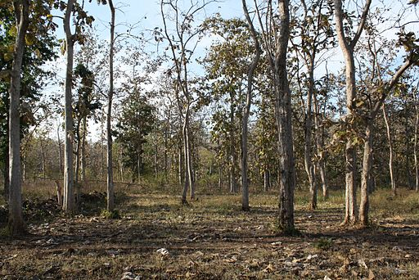
Potential of Social Forestry on Wastelands and Degraded Areas
Best for wood production
Improve the ability of watersheds to
produce a sustained supply of water
Improves the soil conditions
Bringing back degraded and deforested lands can help stabilize the climate while sustainably supporting global and local economies, say experts

Slide 33
The Most Suitable Areas for Social Forestry in Pakistan(Source: Khan (2001)
NO. | LAND TYPES | DESCRIPTION
1. | Guzara forests (subsistence) | Ownership is vested in local people, either as individual property or joint property
2. | Communal forests (Sub-category of the Guzara forest) | Entire village owns the forest (Joint Forest Management techniques)
3. | Shamlats | Piece of lands owned by the state but managed and used by all the villagers for the collective purposes of the community
4. | Village pastures | If these lands are managed on proper scientific lines they can contribute to wood production.
5. | Public waste lands | Lands lying without vegetation and can be used for energy plantations along with crops.
6. | Linear plantations | Linear plantations present on large areas for wood fuel production
7. | Farm forest areas | Linear or compact plantings of trees on private farm lands, owned individually or jointly by local; subject to forest department authority.
8. | Canal side land strips | -
9. | Road/Railway land strips | -
10. | Auqaf lands | Large auqaf (government) lands are available for growing trees

Slide 34
GENERAL ROLES OF SOCIAL FORESTRY
Social Forestry In Sustaining Food Security
Physical Access To Food
Social forestry for Nutrition
Social Forestry in agricultural production
Supplying Food In Time Of Famine
Role Of Social Forestry In Economic Solvency
Role of Social Forestry in Household Needs
Communal Benefits
Role in Environmental Benefits

Slide 35
Social Forestry In Sustaining Food Security

Slide 36
Physical Access To Food

Slide 37
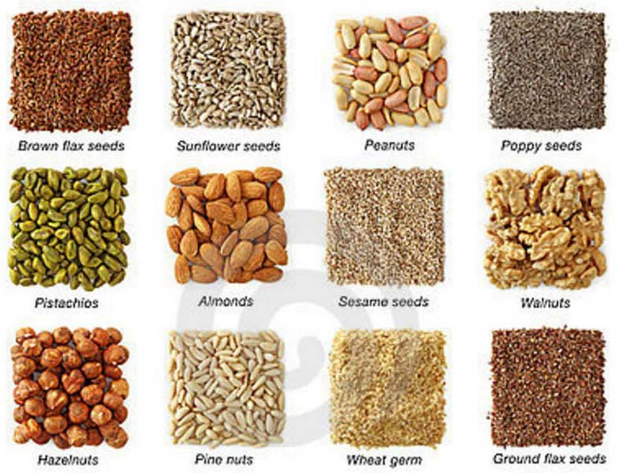
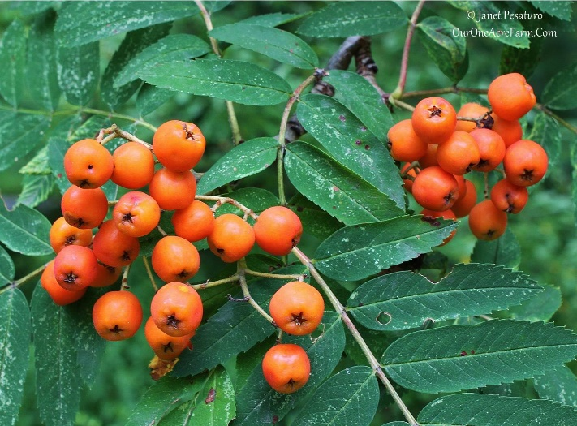
Social forestry for Nutrition
Vitamin A in oil seeds
Edible leaves or yellow fruits
Used as curative rather
than preventive medicines

Slide 38
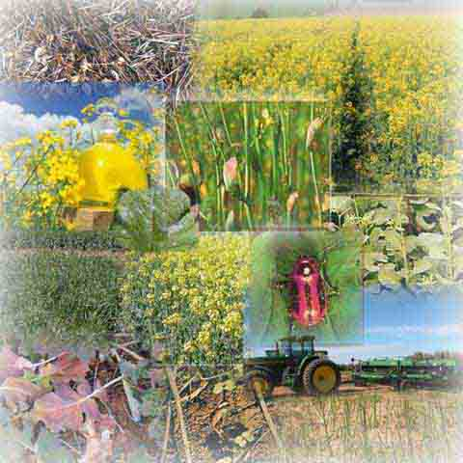
Social Forestry in agricultural production
Provide a direct source of
regularly utilized foods
Supply essential nutrients and
medicines
Provide a store house of genetic
resources
Support fuel wood for cooking,
preserving and processing foods

Slide 39
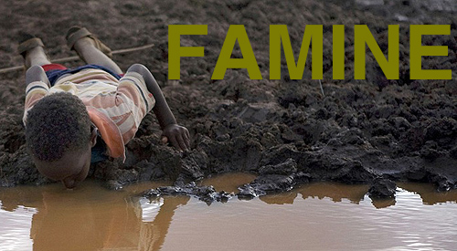
Supplying Food In Time Of Famine
Dry fruits sometimes contain nutrients
Trees or shrubs or different parts of the same plant may be eaten during famines
Trees store their energy supply in their roots

Slide 40
Role Of Social Forestry In Economic Solvency
Source of plants and animals
Fruit-bearing trees may be grown as cash crop
Under conditions of scarce land, capital or labour

Slide 41
Communal Benefits
Large growing trees can come in conflict with utilities, views, and structures, beyond the bounds of the owner’s property.
Trees can enhance and function on one property without infringing on the rights and privileges of neighbors
City trees often serve several architectural and engineering functions

Slide 42
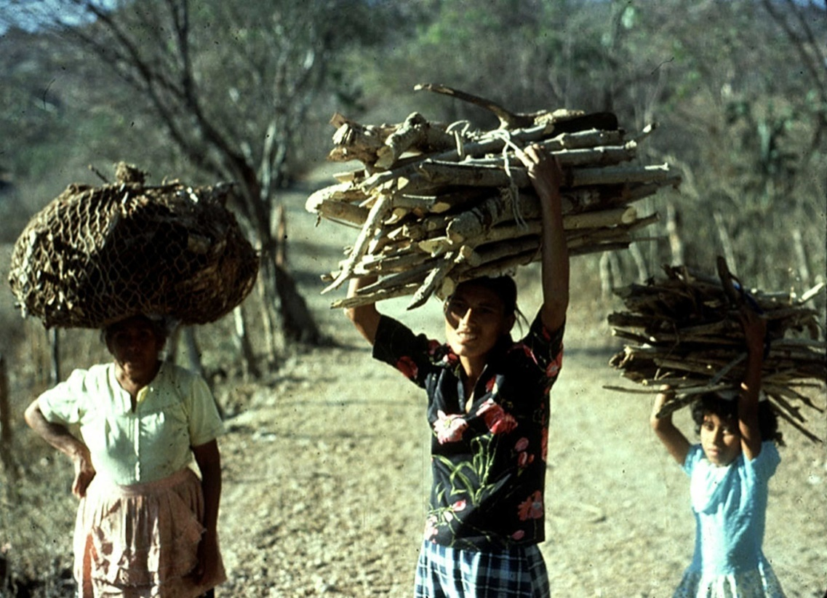
Role of Social Forestry in Household Needs
Rural households using wood fuels respond in several ways to wood scarcity or inflation
Households may continue to consume
the same amount of wood by spending
a larger fraction of their income
A rise in the price of wood also
may cause households to substitute
other fuels for wood

Slide 43
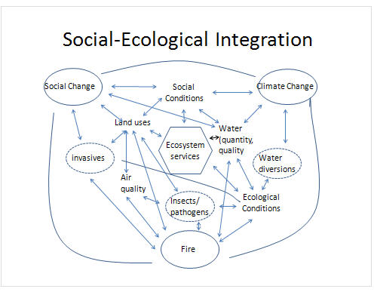
Biodiversity Conservation
Trees planted on degraded
forestland and in marginal
areas are also conserving soil,
water and biodiversity.
With the introduction of
co-management in protected areas,
the non-consumptive benefits
Reduce poverty and conserve
biodiversity

Slide 44
Role Environmental Benefits
The larger the tree, the greater the cooling effect
Moderate heat-island effect caused by pavement and buildings in commercial areas
Affecting wind speed and direction
The more compact the foliage on the tree or group of trees,. Air quality is improved through the use of trees, shrubs, and turf
Leaves filter the air we breathe by removing dust and other particulates

Slide 45
Role Of Social Forestry In Society
The social functions of forests are often more difficult to measure and can vary considerably among countries, depending on
Development
Traditions
For example, in developed, the benefits of forests for recreation or maintenance of a rural way of life may be most important

Slide 46
Social Forestry To Prevent Natural Disaster
Construction material like bamboos, small timber and fuel wood
Provision of temporary settlement of affected people in the degraded/open forest area
Provision of employment to the affected people in the forestry activities
Immediate food supply under 'World Food Program’

Slide 47
Conclusion
Social forestry has increasingly become the tool to establish multipurpose plantations and to maximize returns from social forestry as a land use
Social Forest communities are the most marginalized and vulnerable to climate change and their capacity to adapt depends not merely on limited benefits or livelihood options but on secure access to resources

