Slide 1
Concept of Addition and Subtraction BS Education-V Teaching Mathematics (EDU-511)
Department of Education University of Sargodha

Slide 2
Concept of Addition and Subtraction
Areeba Zulfiqar (BEUD18M030)
Teaching of Mathematics (EDU-511)
BS Education (semester 5)
Department of Education
University of Sargodha , 40100 Sargodha , Pakistan
October 2020

Slide 3
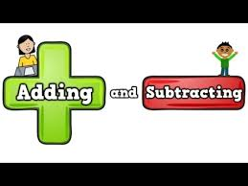
Concept of Addition and Subtraction
Addition :
Addition is the "putting together" of two
groups of objects.
Finding how many in all.
Subtraction :
Subtraction tells "how many are left“.
Or how many are left.
In math, to subtract means to take away
from a group or a number of things.

Slide 6
Importance of Addition:
No matter what your age, but addition is and will always be a part of your life.
Shopping. (Going shopping means that you are going to spend some money, we need to use addition to get right amount)
Ordering. (no of stock we need)
Computers & Calculators.
Also in math we put two numbers together to find out that how many are they all ?
2+2 = 4
Arithmetic. (adding something to our daily routine)
In literature and daily living. ( no of books )
Building a family.
Birthdays and events.

Slide 7
Properties of addition :
There are three properties of addition:
Commutative property of addition:
Changing the order of things or numbers does not change the sum.
Associative property of addition:
Changing the grouping does not change the sum.
Identity property of addition:
The sum of 0 and any number is that number.
* 2+0 or 0+2 is equal to 2.

Slide 8
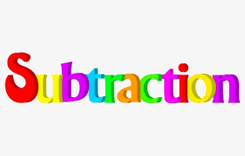
Importance of Subtraction
Subtraction is an important tool we use to help us find out what is left ,
when taking one number away from another.
For example :
If Lauren has Rs.23 and spends Rs.12 on a new shirt, we can use subtraction to find out how much money Lauren has left.
So , here are some reasons that why is subtraction important in our lives.
Career choices.
Teamwork. ( take players off the field )
.

Slide 9
Continue :
Balance.
Brain storming. ( foundation of ideas )
Dentist and teeth. ( subtraction of extra tooth )
Knowledge.
Gardening.( subtraction of plants )

Slide 10
Properties :

Slide 11
Examples:
Addition | Subtraction

Slide 12
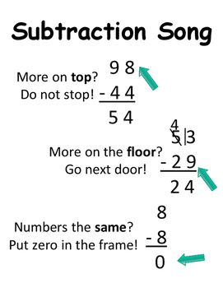
Borrow in subtraction:
Borrowing is a two-step process:
Subtract 1 from the top number in the column directly to the left.
Cross out the number you're borrowing from, subtract 1, and write the answer above the number you crossed out.

