Slide 2
LECTURE CONTENT
Introduction of fats and oils
Classification
Functionality in foods
Fat content in foods
Health benefits

Slide 3
INTRODUCTION
Fats and oils are a wide group of compounds
Generally soluble in organic solvents
Insoluble in water
Chemically they are
Triglycerides
Triesters of glycerol and fatty acids
Solid or liquid
Subset of lipids

Slide 5
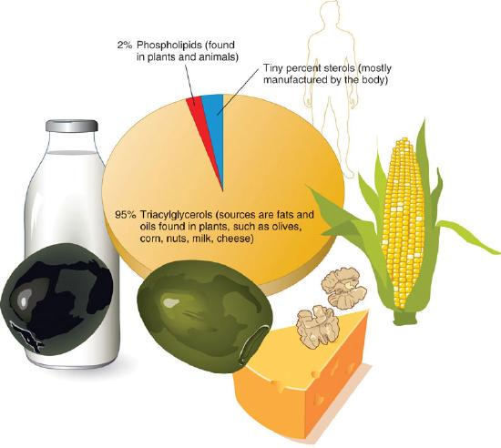
TYPES OF LIPIDS
The three main types of lipids are
Triacylglycerols (also called triglycerides)
Phospholipids
and sterols

Slide 6
TYPES OF LIPIDS
1.Triacylglycerols (also known as triglycerides) make up more than 95 percent of lipids in the diet and are commonly found in fried foods, vegetable oil, butter, whole milk, cheese, cream cheese, and some meats
2. Phospholipids make up only about 2 percent of dietary lipids. They are water-soluble and are found in both plants and animals. Phospholipids are crucial for building the protective barrier, or membrane, around body’s cells. In fact, phospholipids are synthesized in the body to form cell and organelle membranes

Slide 7
TYPES OF LIPIDS
3.Sterols are the least common type of lipid. Cholesterol is perhaps the best well-known sterol. Though cholesterol has a notorious reputation, the body gets only a small amount of its cholesterol through food—the body produces most of it. Cholesterol is an important component of the cell membrane and is required for the synthesis of sex hormones, vitamin D, and bile salts

Slide 8
TYPES OF LIPIDS

Slide 9
CLASSIFICATION
Classified on following parameters
Saturated/Unsaturated
Volatile/Non-volatile
Chain length
Sources
Visible/Invisible
Melting point

Slide 10
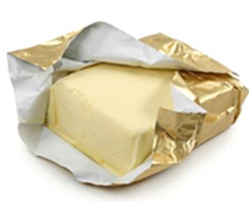
CLASSIFICATION ON BASIS OF SATURATION
Saturated fatty acids
No double bond
Solid at room temperature
This fat is mainly found in foods such as fat on meat, chicken skin, full fat dairy products, butter etc
Saturated fat can raise body cholesterol
Examples
Palmitic acid (16C)
Stearic acid (18C)
Lignoceric acid (24C)
)

Slide 11
CLASSIFICATION ON BASIS OF SATURATION
Unsaturated fatty acids
This is the liquid form of fat at room temperature. It is mostly in oils from plants. Eating unsaturated fat is better than saturated fat as it helps in maintaining your cholesterol levels
Monounsaturated fatty acids
One double bond (CnH2n-1COOH)
Examples
Palmitoleic acid (C16:1∆9)

Slide 12
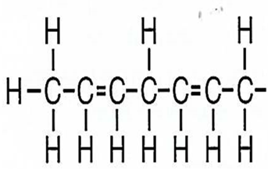
CLASSIFICATION ON BASIS OF SATURATION
Polyunsaturated fatty acids
Known as essential fatty acids
Two or more double bonds
Examples
Linoleic acid (C18)
Linolenic acid (C18)
Arachidonic acid (C20)
Predominantly in sunflower

Slide 13
CLASSIFICATION..
Unsaturated fatty acids
Monounsaturated fatty acids
Polyunsaturated fatty acids

Slide 14
CLASSIFICATION ON BASIS OF SATURATION
Omega-3 fatty acids
Omega−3 fatty acids, also called Omega-3 oils, ω−3 fatty acids or n−3 fatty acids, are polyunsaturated fatty acids characterized by the presence of a double bond three atoms away from the terminal methyl group in their chemical structure

Slide 15
CLASSIFICATION ON BASIS OF SATURATION
Omega-6 fatty acids
They are (also referred to as ω-6 fatty acids or n-6 fatty acids) are a family of polyunsaturated fatty acids that have in common a final carbon-carbon double bond in the n-6 position, that is, the sixth bond, counting from the methyl end

Slide 17
CLASSIFICATION ON BASIS OF VOLATILITY
Volatile fatty acids
Liquid at room temperature
Contain 2-6 carbon atoms
Non-volatile fatty acids
Solid at room temperature
Contain 7-10 carbon atoms

Slide 18
CLASSIFICATION ON BASIS OF CHAIN LENGTH
Chain length
Short chain Fatty acids
Contain 2-10 carbon atoms
May be volatile/non-volatile or solid/liquid
Long chain fatty acids
More than 10 carbon atoms
Non-volatile

Slide 19
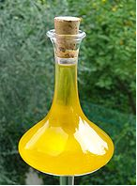
CLASSIFICATION ON BASIS OF SOURCES
SOURCES
Plant origin (seeds/fruits)
It includes
Cotton seed, rapeseed and mustard, sunflower, canola, soybeans, safflower, maize, palm, olive
Animal origin (land/marine)
It includes
Cattle, sheep, fish ( fish oil)

Slide 20
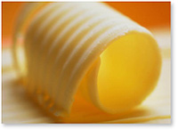
CLASSIFICATION ON BASIS OF PRESENCE
Visible fat
Visible fats are those added to the diet in food
That is easily seen
Examples: Butter on a baked potato, layer of fat around a meat chop, etc

Slide 21
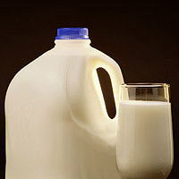
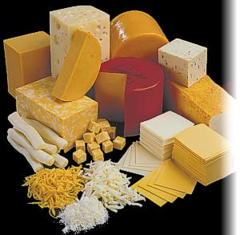
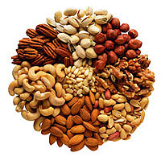
CLASSIFICATION ON BASIS OF PRESENCE
Invisible fat
Invisible fats are those that are naturally occurring in foods
Can not be detected by eye
Examples:whole milk, some cheese, egg yolks, nuts, avocados, etc

Slide 22
CLASSIFICATION ON BASIS OF MELTING POINT
Melting Point
Fats
Solid/semisolid at room temperature
Usually animal origin(margarine)
Oils
Liquid at room temperature
Usually plant origin (sunflower oil)

Slide 23
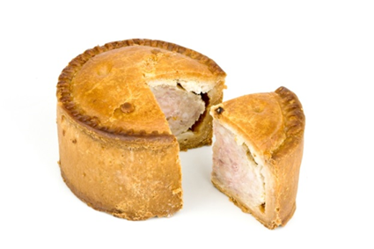
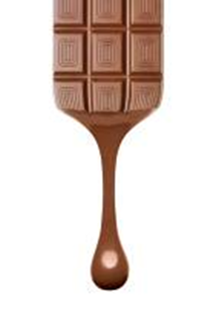
FUNCTIONALITY IN FOODS
Fats are required in food products for one or more
of the following possessions
Tenderness
Texture
Flavour
Shortening
Glaze
Aeration

Slide 24
FAT CONTENT OF SOME SELECTED FOODS
Food | Fat (g/100g) | Food | Fat(g/100g)
Ghee,buffalo | 99.5 | Goat meat | 11.2
Beef | 18.6 | Soyabean oil | 99.9
Butter | 80.6 | peanut | 44.1
Almond | 55.0 | Chicken meat | 17.6
Milk,cow | 3.9 | Eggs,hen,raw | 11.2
Wheat flour | 1.2 | Fish,Shanghara | 3.4
Lentil,cooked | 1.4 | Chickpea,cook | 3.8

Slide 25
Importance of fat to the body
It provides with warmth and acts like an insulator trapping heat in our bodies.
It supplies body with the most of our energy. By supplying energy, fats save proteins from being used for energy and allow them to perform their more important role of building and repairing tissues
It provides a source of fat soluble vitamins A-D-E-K into the body and help in the absorption of these vitamins in the intestines.
Fat surrounds and protects certain vital organs like the kidneys, glands and others.
It is part of the structure of cells and tissues (cell membrane) especially in our brains

Slide 26
HEALTH BENEFITS
In general
More palatable and storable
High energy value
Supply with essential fatty acids
Transport fat soluble vitamins
Constituent of nervous system
Constituent of cell membrane

Slide 27
HEALTH BENEFITS..
Deposit fat serves as
Energy store
Cushion for organs
Insulator against heat loss
Lipoproteins-important cell constituents
Cholesterol synthesises
Adrenal cortical hormone
Vitamin-D

