Slide 1
Philosophy of Naturalism

Slide 2
Naturalism

Slide 3
Introduction to Naturalism
Naturalism is a philosophy with the belief that nature alone represents the entire reality.
There is nothing beyond behind, or other than nature. According to this philosophy, human life is the part of the scheme of nature.
This philosophy gives emphasis to matter, the physical world.
It does not believe in spirituality and supernaturalism.

Slide 4
Conti…
Proponents of naturalism believes that it is a self-sufficient entity. According to them
Nature is the ultimate reality
Natural world is the real world
Nature alone consists of the answer to all philosophical problems.
Back to nature is the phrase to watch with naturalism philosophy.
Naturalism believes that nature and reality are identical and there is no reality without nature.

Slide 5
Definition of Naturalism
Thomas and Lamg “ Naturalism is opposed to idealism. It subordinates mind to matter and holds that ultimate reality in material not spiritual”
Rusk’s views “Naturalism is a philosophical position adopted by those who approach philosophy from a purely scientific point of view.”
Hocking “Naturalism is metaphysics which considers nature as the whole of reality. It excludes what is supernatural or the other world”.

Slide 6
Protagonist of Naturalism
JJ Rousseau – champion of naturalism
Others –
Aristotle
Comte
Bacon
Darwin
Huxley
Spencer
Epicurus
Tagore etc.

Slide 9
Main Characteristics of Naturalism
Nature alone is the entire reality. Naturalism denies the existence of anything beyond nature. It says no to the supernatural phenomena.
Naturalism has no belief in spiritual values. Values can be subjective and relative. They can be created according to situations, needs, and conditions of life.
They believe scientific knowledge to be of highest worth.

Slide 10
Main Characteristics of Naturalism Conti…
Here society is only an artificial structure. Individuals alone are real.
It does not have faith in the existence of the soul, God, and the spiritual world.
It believes only in the existence of the material world, matter, and nature.
Here senses are considered the natural gateway to knowledge. Knowledge can be comprehended through senses.

Slide 11
Forms of Naturalism
Physical Naturalism:
Studies the external nature
It explains human activities and experiences in terms of material objects and natural laws.
Lays more stress on external phenomenon then conscious human beings.
Nature has a complete hold on the life of human beings.
Mechanical Naturalism
regards man as machines

Slide 12
Forms of Naturalism Conti…
believes in behavioristic psychology
believes man as well as mind is matter
science is only a dependable form of matter.
Biological naturalism
Based on the notion of evolution.
Darwin believed in the “survival of the fittest” in the evolution.
Believes that life is ever-changing dynamic and always developing.
our survival depends on adjustments.

Slide 13
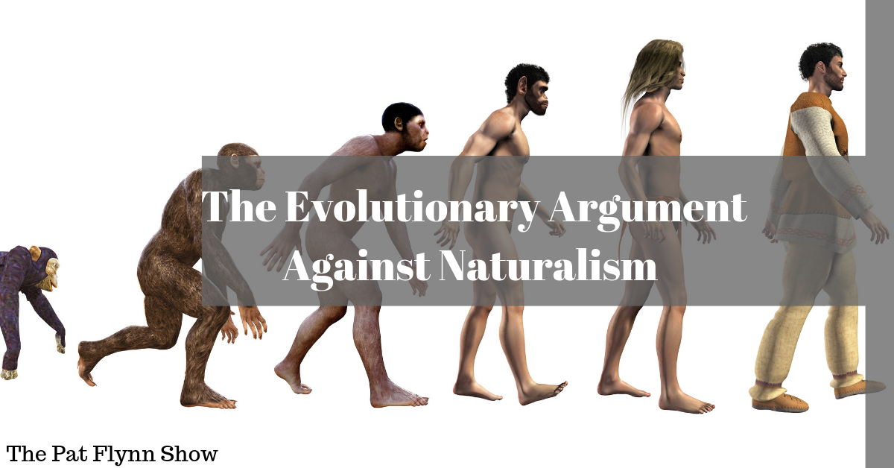
Forms of Naturalism Conti…
three principles according to biological naturalism are
Adaptation of environment
Struggle for existence
Survival of the fittest

Slide 15
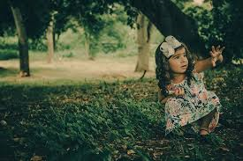
Naturalism in Education
Naturalism has a great impact on theory as well as the practice of education.
In systems of educations with naturalistic philosophy, there is no place for classrooms, textbooks, time-table, formal exams, etc.
It stands against the present system of teaching.
The ‘chalk and talk’ method has no scope.
The teacher has no significant role to play.

Slide 16
Naturalism in Education
Naturalism in education stands for the doctrine of “follow nature” in education.
It stands for complete freedom to be given to the child in learning. He is to be left alone, absolutely free.
Its watchword is “Back to Nature” as expounded by Rousseau.
The whole of the child’s learning will come from his own experiences and their natural consequences. His whole education will be according to the natural laws of human development.

Slide 17
Naturalism and Aims of Education
Under the naturalistic school of philosophy the aim of education is self-expression. Some naturalists consider man as a machine and they opine that the aim of education is to make the human machine as perfect and efficient as possible.
According to Spencer, self-preservation and self-satisfaction constitute the highest good in life and, hence, the primitive instincts and natural impulses should be used in such a way that this highest good can be achieved.

Slide 18
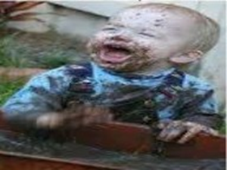
Naturalism and Aims of Education
3. According to the Darwinian school of naturalists, the aim of education should be to “equip the individual for struggle for existence and thus to ensure his survival.” The individual must be “in harmony with and well-adapted to his surroundings.”
4. Rousseau’s statement of naturalistic aim of education is the most comprehensive and lucid. Education, he holds, should aim at the development of the child in conformity with his nature.

Slide 19
Naturalism and Curriculum
The naturalistic aims of education are reflected in its curriculum.
The naturalists strongly advocate inclusion of natural sciences — such as physics, chemistry, zoology, botany — in the curriculum.
As regards language and mathematics they opine that only such knowledge of these subjects should be acquired as is essential for scientific studies.
They also want that the pupil should not be plunged into poetry and literature.

Slide 20
Naturalism and Curriculum
Naturalism advocates the inclusion of subjects in the curriculum that promotes self-preservation.
There is no place for moral religious and spiritual education.

Slide 21
Naturalism and Methods of Teaching
In methods of teaching, naturalism is a revolt against the old, traditional and bookish system of education.
Attaches no importance to formal schools and textbooks
It encourages learning by doing.
“Give your pupils no verbal lesson, they should be taught by their experiences alone” is what Rousseau said.
They are advocates of the play-way method of teaching. The Montessori method is one such method of teaching. Teaching should be a joyous, creative, and spontaneous activity.

Slide 22
Naturalism and the Teacher
Teacher plays the role of the observer.
Teacher as a facilitator.
He is only to help the child in the discovery of truth.
He should not make an artificial effort to educate the child.
Teacher’s role should be that of a stage setter.
Nature is the supreme teacher.
Teacher as a guide.

Slide 23
Naturalism and Discipline
For harmonious development of the child, he should be given freedom to plan his own activities. But this freedom means individual freedom and not social freedom.
Naturalists have no faith in discipline based on external force. They condemn corporal punishment as it represses the impulses and instincts of the children.

Slide 25
Naturalism and School
The school environment should be completely free, flexible and without any rigidity.
It should be helpful for the free and natural development of the child.
It should be situated in the lap of nature, far away from cities.
There should not be any fixed time table and ready dozes of knowledge.
There should be no provision for punishment.
School develops the feeling of self learning and self-discipline.
It does not want to burden the child with examination.

Slide 26
Naturalism and women Education
According to Rousseau, “ a woman should be the center of the family, a housewife, and a mother. She should strive to please her husband, concern herself more than he with having a good reputation, and be satisfied with a simple religion of the emotions.”

Slide 27
Merits of Naturalism
It gives the child a very important place in the educational process. It treats a child as child and not as an adult. The child is good and pure at the terms of birth.
It considers nature as the best teacher in whose company the child learns better. Society is full of evils.
It considers individual interests, aptitude, inclination, needs and capacities while structuring the curriculum.
It prepares and encourages the child to engage in experimentation, discoveries and inventions.
It motivates the child to acquire more knowledge in the natural environment.

Slide 28
Demerits of Naturalism
Nature centered study makes the child become unsocial with no feeling of social service
Naturalism ignores the spiritual world and considers the material world only
Naturalism lays stress on solutions for only the present needs and problems of an individual and neglects his future needs and problems. It has failed to prepare the child for the future life
Naturalism advocates unrestricted freedom for the child to develop himself naturally. This is undesirable and harmful to the child

Slide 29
Demerits of Naturalism
It minimizes the role of the teacher in the educative process. A teacher is an observer, a sympathetic guide and helper in structuring experiences for the child
Naturalistic education practices are hard to follow in urban areas. This is because schools in urban areas are crowded, noisy, and are located in densely populated localities.

Slide 30
Conclusion
The contribution of naturalism is significant in the progressive modern educational thought and practice. All the modern method of teaching technique owe their origin to this school of philosophy.
It aims to make teaching real, interesting, and meaningful. It also does good to society by rejecting superstitions.

