Slide 1
Marketing
ADVERTISING-II

Slide 2
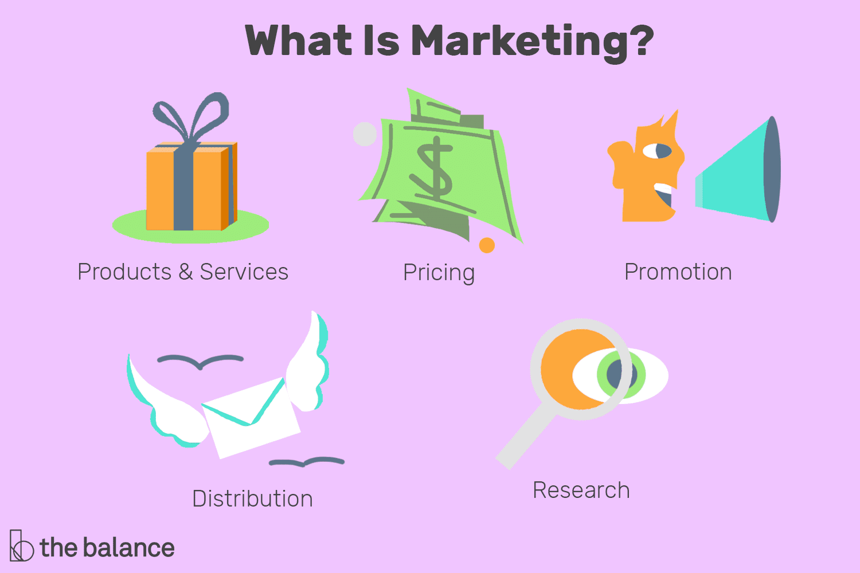
Marketing
Marketing refers to activities a company undertakes to promote the buying or selling of a product or service. Marketing includes advertising, selling, and delivering products to consumers or other businesses.

Slide 3
Marketing
Marketing is the process of interesting potential customers and clients in your products and/or services. The key word in this marketing definition is "process"; marketing involves researching, promoting, selling, and distributing your products or services.

Slide 4
Marketing Concepts
There are five alternative concepts under which organizations design and carry out their marketing strategies.
5 Marketing Concepts are;
Production Concept,
Product Concept,
Selling Concept,
Marketing Concept,
Societal Marketing Concept.

Slide 5
Marketing Concepts

Slide 6
Production concept
The idea of production concept – “Consumers will favor products that are available and highly affordable

Slide 7
Product concept
The product concept holds that the consumers will favor products that offer the most in quality, performance and innovative features.

Slide 8
Selling Concept
The selling concept holds the idea- “consumers will not buy enough of the firm’s products unless it undertakes a large-scale selling and promotion effort”.

Slide 9
Marketing Concepts
The marketing concept holds- “achieving organizational goals depends on knowing the needs and wants of target markets and delivering the desired satisfactions better than competitors do”

Slide 10
Difference between Selling Concepts and Marketing Concepts

Slide 11
Societal Marketing Concepts
The societal marketing concept holds “marketing strategy should deliver value to customers in a way that maintains or improves both the consumer’s and society’s well-being”.

Slide 12
Conclusion
Companies don’t follow a single marketing concept rigidly. They usually use a mix of marketing concepts or change it depending on the market situation, competition and sales numbers.

