Slide 1
Evidence-based Physiotherapy

Slide 2
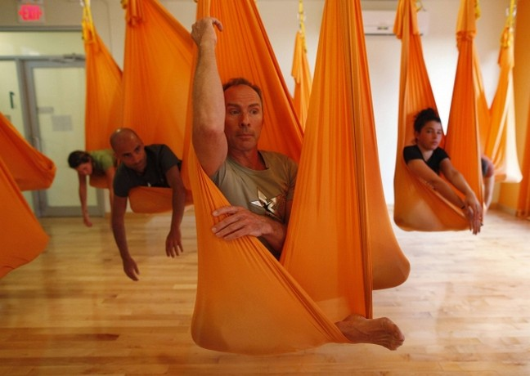
what I want from health research when I am a patient
Reliable Evidence

Slide 3
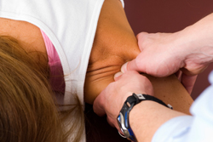
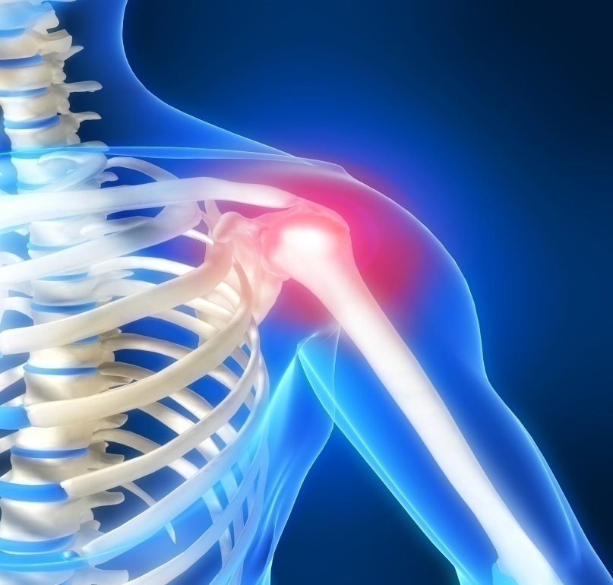
Clinical case:
Painful Shoulder injury:
Nothing seemed to be helping……..
SS > Cyriax Friction =
Notes:
Professional responsibility of doing more good than harm > EBP

Slide 4
DRAMATIC EFFECTS ??
Dramatic Effects
You never predict dramatic effects . they are rare
Good=========Harm
More good / harm>
needs Research

Slide 5
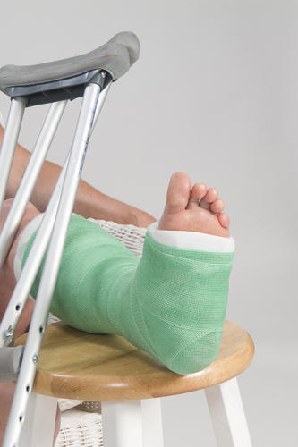
# fibula
1st advice subsiding swelling
Then cast for 6 weeks
2nd opinion using supportive bandage and Wt bearing till ankle hurts and so on.
How to judge b/w two clinical approach ???
>>Randomized clinical trials
Notes:
A clinical trial in which the participants are assigned randomly (by chance alone) to different treatments. randomized trials were for
people who were uncertain whether or not they were right, and he was certain that he was right!

Slide 6
Evidence based Physiotherapy
Physiotherapy informed by relevant,
high quality clinical research.

Slide 7
Research alone does not make
good or bad decisions – people do.
When patients, health professionals
and policy makers make health care decisions,
they bring to their decisions a range of
Values
Preferences
Experiences
Knowledge

Slide 8
High Quality Clinical Research:

Slide 9
High Quality Clinical Research:
High quality clinical research is that which is carried out in a way that allows us to trust the results (it has a low risk of bias) and is relevant to our questions
research on Pts conducted in clinical settings.
It is empirical(based on Exp & Observation rather theory)
Low risk of bias & relevant
research that impact decisions.
Notes:
BIAS : “systematic deviation from truth”
Clinical Research is conducted on patients in clinical setting.

Slide 10
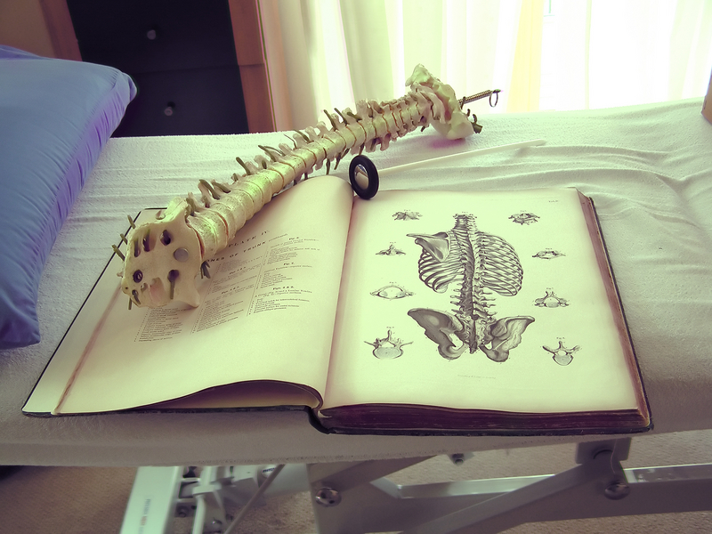
When High Quality Clinical Research does not Exist ????

Slide 11
Where high quality clinical research does not exist Then
Expert/trusted colleagues
Practice generated knowledge
Patient preference
Low quality research

Slide 12
Patient Preferences
Traditional clinical model: decisions were made by clinicians
Patient centered approach
In contemporary models of clinical decision making
Communication e Pt.
Risks & benefits of alternative Rx.

Slide 13
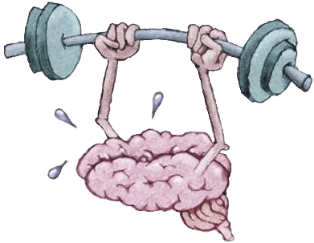
Practice Knowledge
Knowledge arising from professional practice and experience.
Professional knowledge is not evidence
But it helps in professional judgment
Notes:
Rapid & fluent response to a situation

Slide 14
Clinical Decision making
Case of CP’
Cost effectiveness

Slide 15
Requires clinical reasoning to analyze, synthesize, interpret and communicate relevant information from and to the patient in a dynamic and interactive way

Slide 16
Other factors.
Cultural Norms,values
Norms: Actual or standardized behavior as a real conduct. Socially approved ways of behaving
values: are supposed to be the guidelines of the society. It tells what to do and how to do in different situations

Slide 17
Additional factors
Culture
Work site/environment
Resources
Availability of resources pose problems in clinical decision making.
Effectiveness of intervention ~~~ financial issue
Expertise of PT.

Slide 18
”If you listen carefully to the patient they will tell you the diagnosis” (Quotation of Sir William Osler 1849–1919).
This statement still holds true and emphasizes the great importance of taking a good history.

Slide 20
Evidence ??
Values , Preference ,Experience ,Knowledge

Slide 21
High quality clinical research
Professional/practice knowledge
Titchen & Ersser (2001) comment that practice
knowledge ‘underpins the practitioner’s rapid and fluent response to a situation’.
Patient preferences

